Slide 1
Eigen library
Doug Young Suh
Oct. 25, 2019

Slide 2





Eigen library ←
Open sources optimized for matrix operations
Used by TensorFlow, OpenCV(computer vision)
Applications
(Machine Learning / Deep Learning)
Tensor Flow, OpenCV
Eigen library
Kernel(CPU, GPU, ASIC)

Slide 3
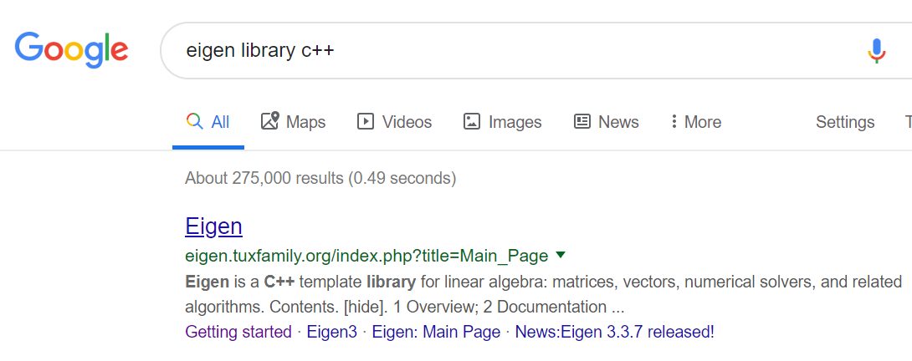

Download

Slide 4
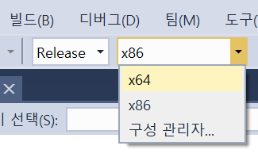

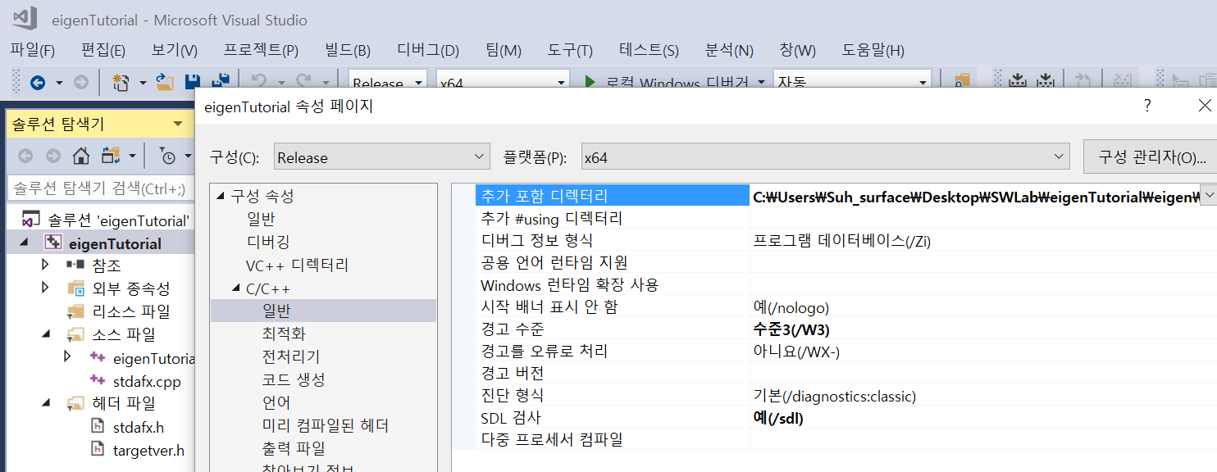
Include in Visual C++
Zip을 압축 풀기한 folder를 copy하고 folder 이름을 바꾼다.
Project 이름에서 오른쪽 button click → 속성(property) → C/C++
Backslash

Slide 5
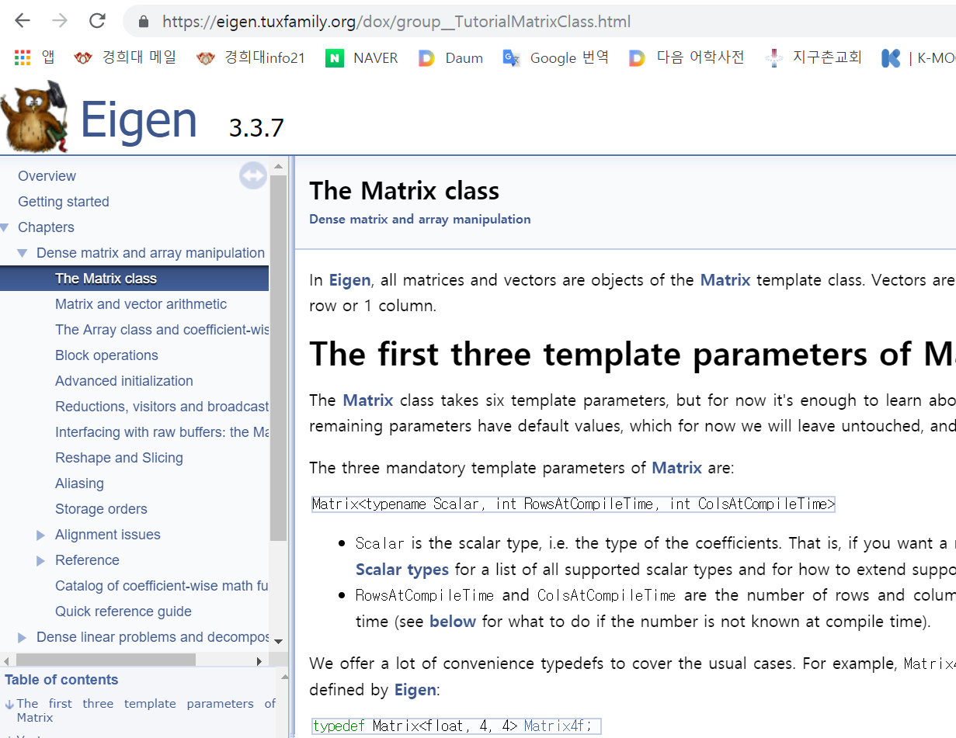
Tutorials

Slide 6
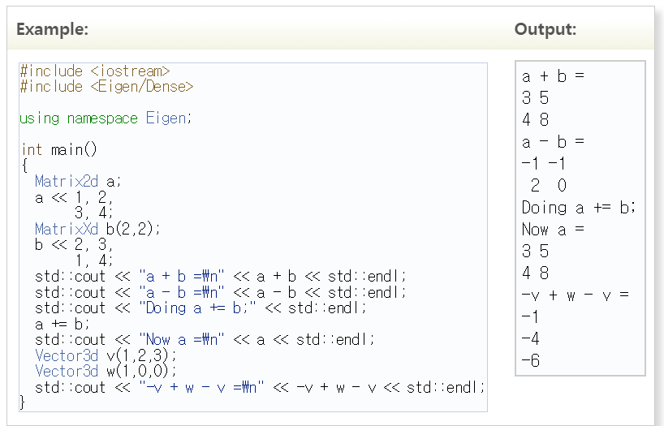
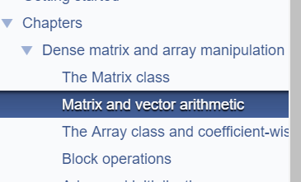
Examples

Slide 7
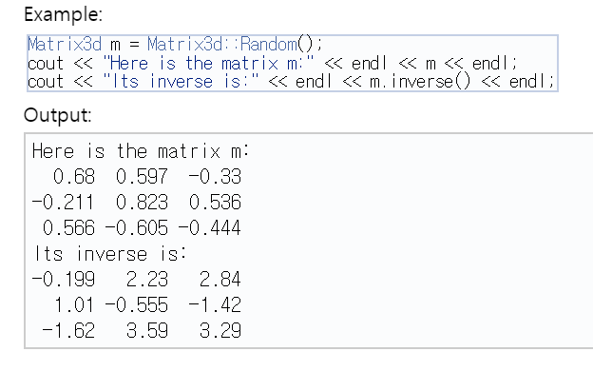
Inverse

Slide 8
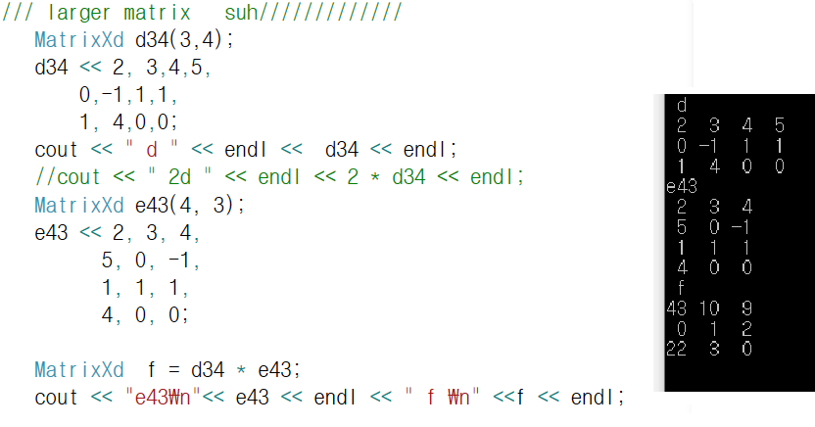
Matrix multiplication

Slide 9
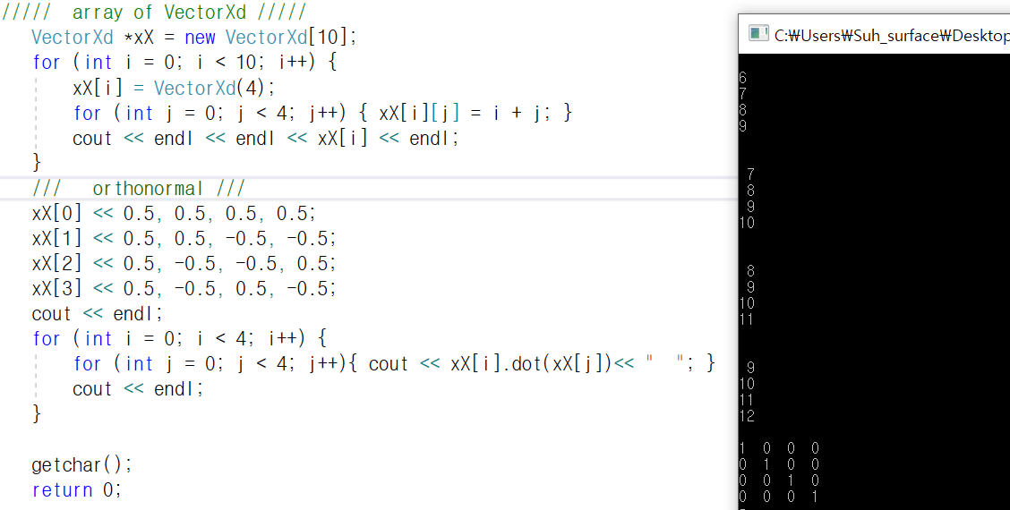
Vector array and inner product(dot( ))
Array of 10 vectors
Decide dimension
Set element values
Orthonormal vectors
Inner product

Slide 10
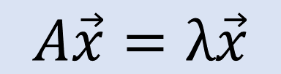
EigenValue/EigenVector
$$A\vec{x}=λ\vec{x}$$
MatrixXcf A = MatrixXcf::Random(4,4);
cout << "Here is a random 4x4 matrix, A:" << endl << A << endl << endl;
ComplexEigenSolver<MatrixXcf> ces;
ces.compute(A);
cout << "The eigenvalues of A are:" << endl << ces.eigenvalues() << endl;
cout << "The matrix of eigenvectors, V, is:" << endl << ces.eigenvectors() << endl << endl;
complex<float> lambda = ces.eigenvalues()[0];
cout << "Consider the first eigenvalue, lambda = " << lambda << endl;
VectorXcf v = ces.eigenvectors().col(0);
cout << "If v is the corresponding eigenvector, then lambda * v = " << endl << lambda * v << endl;
cout << "... and A * v = " << endl << A * v << endl << endl;
cout << "Finally, V * D * V^(-1) = " << endl
<< ces.eigenvectors() * ces.eigenvalues().asDiagonal() * ces.eigenvectors().inverse() << endl;

Slide 11
EigenValue/EigenVector
Here is a random 4x4 matrix,
A: (-0.211,0.68) (0.108,-0.444) (0.435,0.271) (-0.198,-0.687)
(0.597,0.566) (0.258,-0.0452) (0.214,-0.717) (-0.782,-0.74)
(-0.605,0.823) (0.0268,-0.27) (-0.514,-0.967) (-0.563,0.998)
(0.536,-0.33) (0.832,0.904) (0.608,-0.726) (0.678,0.0259)
The eigenvalues of A are: (0.137,0.505) (-0.758,1.22) (1.52,-0.402) (-0.691,-1.63)
The matrix of eigenvectors, V, is:
(-0.246,-0.106) (0.418,0.263) (0.0417,-0.296) (-0.122,0.271)
(-0.205,-0.629) (0.466,-0.457) (0.244,-0.456) (0.247,0.23)
(-0.432,-0.0359) (-0.0651,-0.0146) (-0.191,0.334) (0.859,-0.0877)
(-0.301,0.46) (-0.41,-0.397) (0.623,0.328) (-0.116,0.195)
Consider the first eigenvalue, lambda = (0.137,0.505)
If v is the corresponding eigenvector, then
lambda * v = (0.0197,-0.139) (0.29,-0.19) (-0.0412,-0.223) (-0.274,-0.0891) ...
and A * v = (0.0197,-0.139) (0.29,-0.19) (-0.0412,-0.223) (-0.274,-0.0891)
Finally, V * D * V^(-1) = (-0.211,0.68) (0.108,-0.444) (0.435,0.271) (-0.198,-0.687)
(0.597,0.566) (0.258,-0.0452) (0.214,-0.717) (-0.782,-0.74)
(-0.605,0.823) (0.0268,-0.27) (-0.514,-0.967) (-0.563,0.998)
(0.536,-0.33) (0.832,0.904) (0.608,-0.726) (0.678,0.0259)

