Slide 1
QPSK channel and GitHub
Doug Young Suh
2019. 4. 25

Slide 2
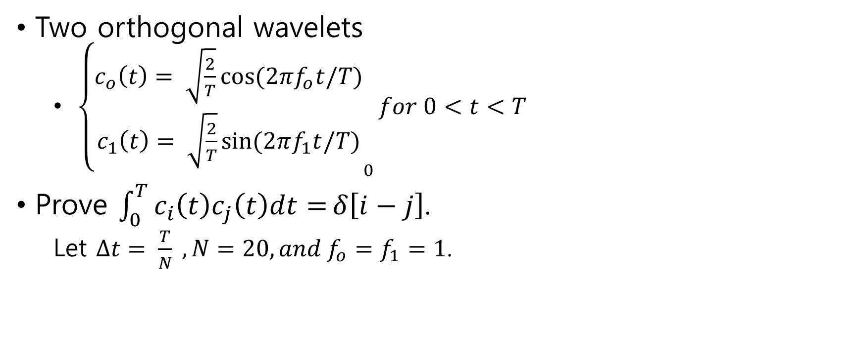
Orthogonal wavelets
Two orthogonal wavelets
${\left\{\begin{matrix}c_{o}\left(t\right)= \sqrt{\frac{2}{T}}cos⁡(2πf_{o}t/T) \\ c_{1}\left(t\right)= \sqrt{\frac{2}{T}}sin⁡(2πf_{1}t/T)\end{matrix}\right.}_{0}for 0<t<T$
Prove $\int_{0}^{T}{c_{i}\left(t\right)c_{j}\left(t\right)dt=}δ\left[i−j\right]$.
Let $∆t= \frac{T}{N} , N=20, and f_{o}=f_{1}=1$.

Slide 3
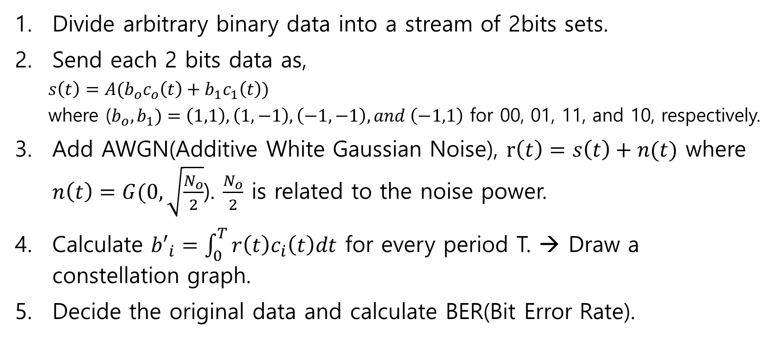
QPSK
Divide arbitrary binary data into a stream of 2bits sets.
Send each 2 bits data as,
${s\left(t\right)=A(b}_{o}c_{o}\left(t\right)+b_{1}c_{1}\left(t\right))$
where ($b_{o},b_{1})=\left(1,1\right), \left(1,−1\right), \left(−1, −1\right), and \left(−1,1\right)$ for 00, 01, 11, and 10, respectively.
Add AWGN(Additive White Gaussian Noise), $r\left(t\right)=s\left(t\right)+n(t)$ where $n\left(t\right)=G(0,\sqrt{\frac{N_{o}}{2}}$). $\frac{N_{o}}{2}$ is related to the noise power.
Calculate ${b′}_{i}=\int_{0}^{T}{r\left(t\right)c_{i}\left(t\right)dt}$ for every period T. → Draw a constellation graph.
Decide the original data and calculate BER(Bit Error Rate).

Slide 4



Git-hub
Platform for co-work
Engineer 1: sender simulation
Engineer 2: channel simulation
Engineer 3: receiver simulation
Engineer 4: evaluate the simulation, SNR/BER graph
arbitrary
binary
data
$$s\left(t\right)$$
$$r\left(t\right)$$
decoded
binary
data
sender
channel
receiver
A
$$N_{o}$$
evaluate

Slide 5
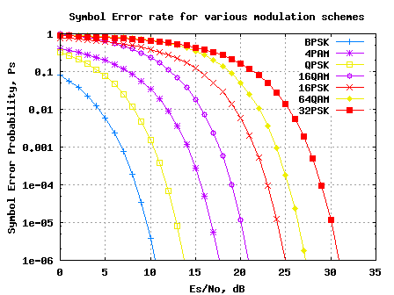
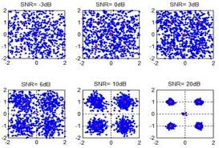
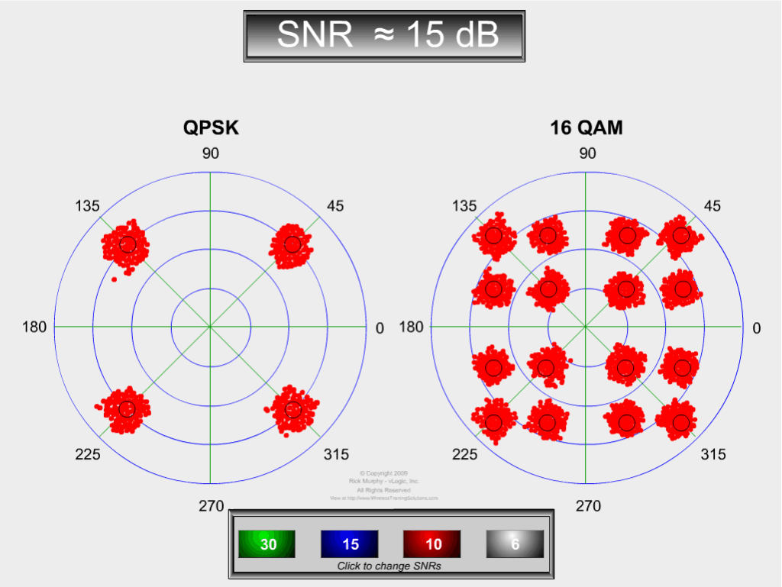
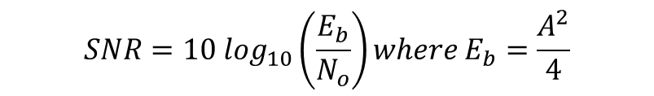
References
$$SNR=10 \log_{10}\left(\frac{E_{b}}{N_{o}}\right)where E_{b}=\frac{A^{2}}{4}$$

Slide 6
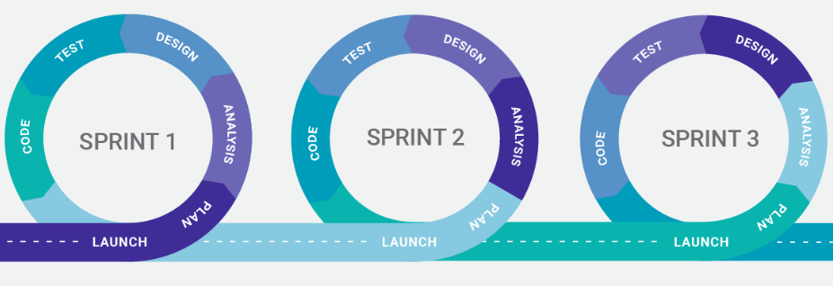
Agile programming
To develop a SW as a team project. (team = scrum)
A project is composed of multiple sprints.
At every sprint, the team provides an executable result.

Slide 7
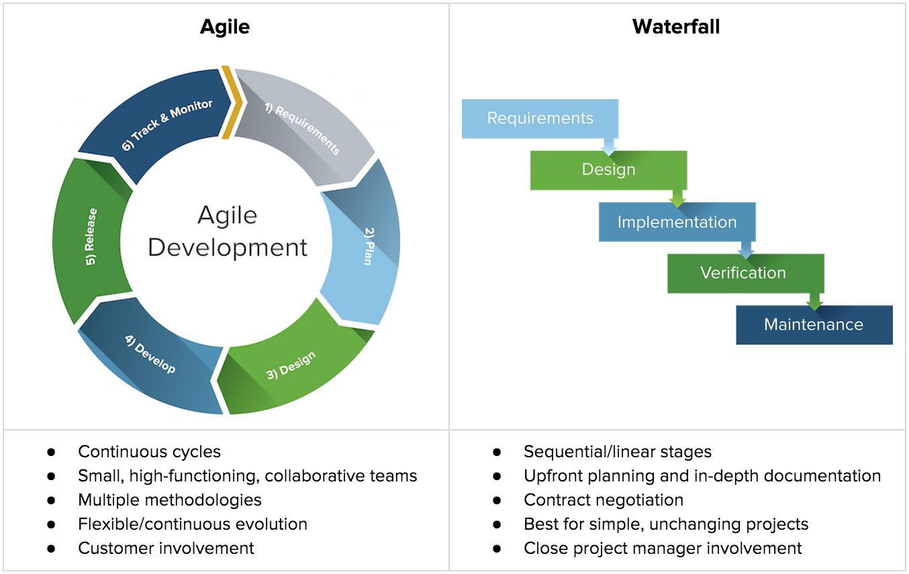

Slide 8


Slide 9
Sprint 1
공유하는 데이터들이 제대로 교환되는지 확인
Sender : Data[i] = 10, s[i] = 1.
Channel : r[i] = s[i] + 1
Receiver : DecodedData[i] = sum of r[ ]
Evaluate : Check Data[ ] and DecodedData[ ]

Slide 10
Sprint 2
Sender
Make 2 basis vectors c0t[20] and c1t[20].
Depending on data, s[ ] = a c0t[ ] + b c1t[ ].
myMatrix.cpp : scalamult( ), matrixadd( )
Channel
r[ ] = s[ ] + n, where n = Gaussian random variable
Receiver
a’ = r[ ] • c0t[ ] b’ = r[ ] • c1t[ ]
myMatrix.cpp : dot( ) for inner-product
(a’, b’) → decide DecodedData[ ]
Evaluator
Compare Data[ ] of the sender with DecodedData[ ] of the receiver → BER
BER(Bit Error Ratio)

Slide 11
Sprint 3
Constant E_{b} with varying N_{o} → BER vs. E_{b}/N_{o}.

Slide 12
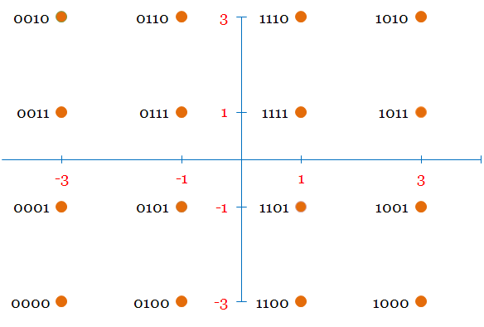
Assignment
Implement 16 QAM.

