Slide 1
Machine Learning
Doug Young Suh
Last update 2019. 5. 19

Slide 2
Machine Learning (ML)
Child?
Height x[1]
Problem solving x[2]
Child or adult?
Height x[1]
Problem solving x[2]
Child?
x[1]
x[1]
w1c
∑
True or
false
w1
Child?
∑
True or
false
w1a
w2
Adult?
w2c
∑
True or
false
x[2]
w2a
x[2]
Perceptron
Multi-class

Slide 3
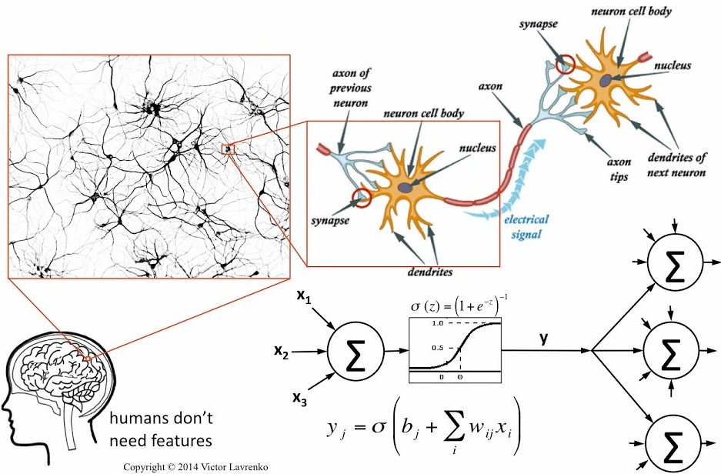
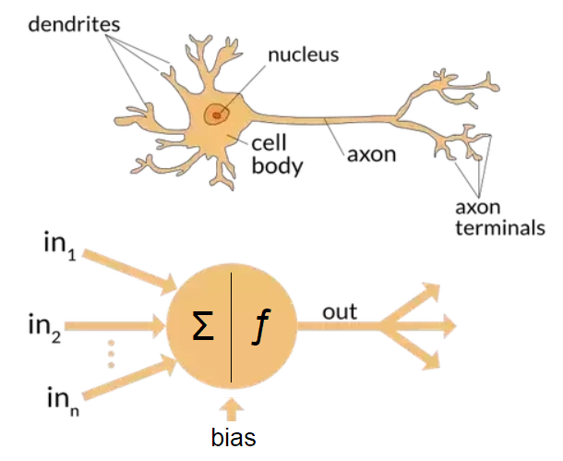
Multi-layer NN
Input layer
hidden layer
output layer
Z₁
X₁
...
Y₁
...
...
...
y_{k} ∈[ 0,1]
X_{D}
Z_{M}
Y_{K}
nIn = 2
W⁽¹⁾_{MD}
W⁽²⁾_{KM}
nOut = 2

Slide 4
Machine learning
Learning (to make decision according to input)
Supervised learning
Un-supervised learning
Reinforcement learning(≈un-supervised learning)
Techniques
Support vector machine (SVM) – linear classification
Hidden Markov Model (HMM) - unsupervised
Neural networks – supervised and un-supervised
Logistic regression - supervised

Slide 5
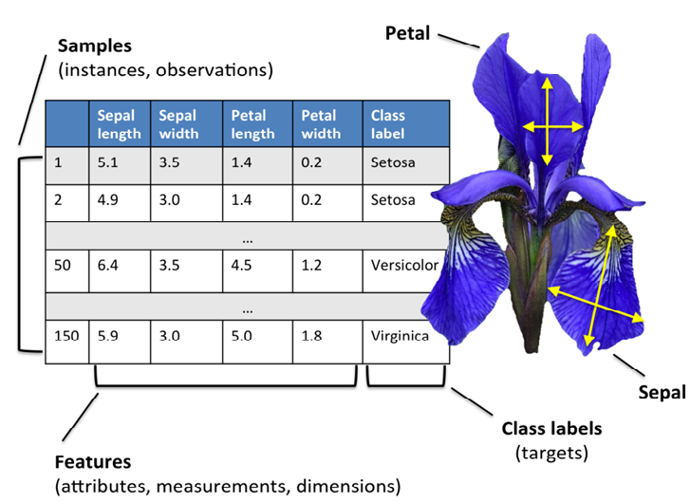
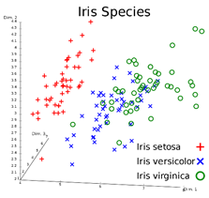
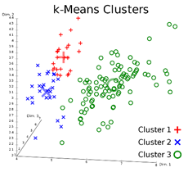
Ex) Iris data
If labels not exist, un-supervised
https://riptutorial.com/machine-learning/example/22618/implementing-a-perceptron-model-in-cplusplus

Slide 6
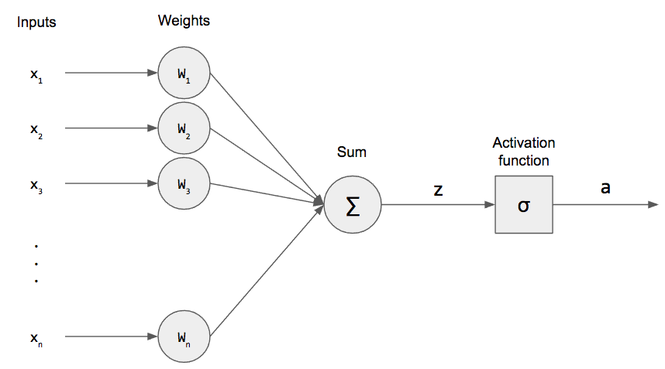
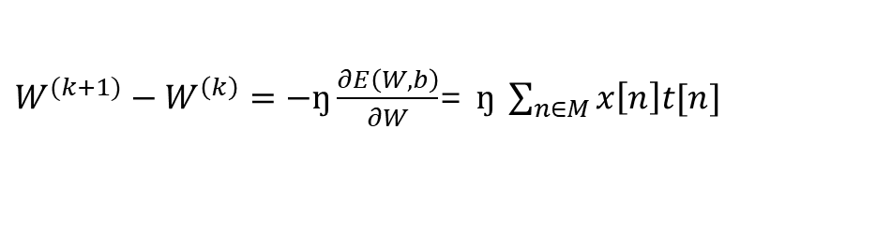

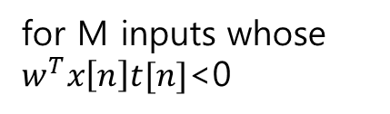
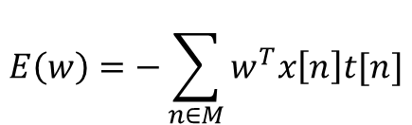
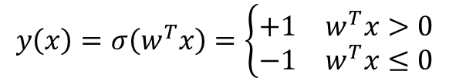

Perceptron (Single layer neural network) (1)
Training for setting w-values
with input x[n,k], t[n] for n∈[1,train_N], k ∈[1,nIn] ($the answer t\left[n\right]=\{−1,1\})$
$$y\left(x\right)=σ\left(w^{T}x\right)=\left\{\begin{matrix}+1 & w^{T}x>0 \\ −1 & w^{T}x≤0\end{matrix}\right.$$
y
Error function
$$E\left(w\right)=−\sum_{n∈M}{w^{T}x\left[n\right]t[n]}$$
train
for M inputs whose $w^{T}x\left[n\right]t[n]$<0
$ŋ$: learning rate
Gradient descent to minimize $E\left(w\right)$
$W^{(k+1)}−W^{\left(k\right)}=−ŋ\frac{∂E\left(W,b\right)}{∂W}$= $ŋ \sum_{n∈M}{x\left[n\right]t[n]}$

Slide 7



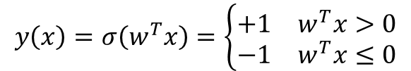
Perceptron (Single layer NN) (2)
Testing(checking if t[n] = y[n])
with input x[n,k], t[n], and output y[2]
$$y\left(x\right)=σ\left(w^{T}x\right)=\left\{\begin{matrix}+1 & w^{T}x>0 \\ −1 & w^{T}x≤0\end{matrix}\right.$$
 | y=1 | y=-1
t=1 | TP(true positive) | FN(false negative)
t=-1 | FP(false positive) | TN(true negative)
y
$$accuracy= \frac{TP+TN}{TP+TN+FP+FN}$$
$$precision= \frac{TP}{TP+FP}$$
$$recall= \frac{TP}{TP+FN}$$
all
y=1
t=1

Slide 8
Logistic Regression (1)
Supervised
Multi-class: 3 classes
Single layer for linear model
Shuffle → training → predict → evaluate
Input1: train_N data set with known class
Input2: test_N data set with known class
Output
Accuracy
Precision
Recall

Slide 9

Logistic Regression (2)
nOut = 3
nIn = 2
W₀₀
y₀ ∈[ 0,1]
W₀₁
Supervised
Multi-class: 3 classes
Single layer for linear model
Shuffle → training → predict → evaluate
Input1: train_N data set with known class
Input2: test_N data set with known class
Output
Accuracy
Precision
Recall
X₀
T₁₀₀ or
T₀₁₀ or
T₀₀₁
W₁₀
W₁₁
y₁ ∈[ 0,1]
X₁
W₂₀
W₂₁
y₂ ∈[ 0,1]
train
$$W^{(k+1)}−W^{\left(k\right)}=ŋxt t∈\{0,1\}$$

Slide 10
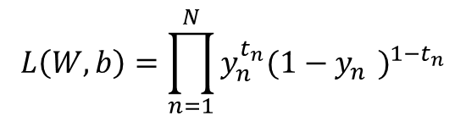
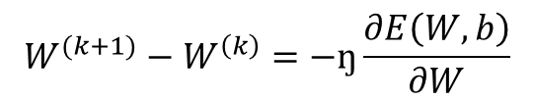

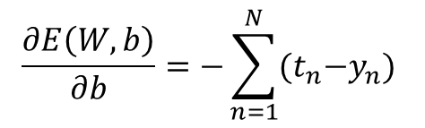
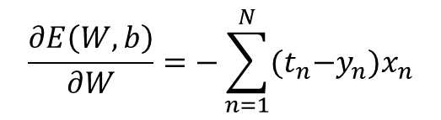
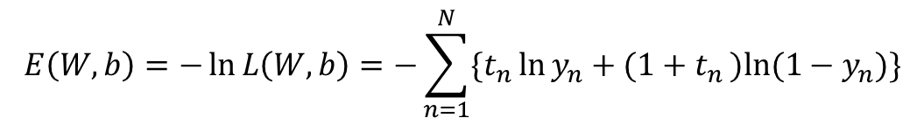
Logistic Regression (3)
Posterior probability
$p\left(C=1 | x\right)=y\left(x\right)=σ\left(W^{T}x+b\right) where σ\left(x\right)=\frac{1}{1+e^{−x}}$
$p\left(C=0 | x\right)=1−y\left(x\right)$
Then for $t∈\{0,1\}$, $p\left(C=t | x\right)={y(x)}^{t}{(1−y\left(x\right))}^{1−t}$
Likelihood function
Log-likelihood function
$$\frac{∂E\left(W,b\right)}{∂W}=−\sum_{n=1}^{N}{(t_{n}{−y}_{n})x_{n}}$$
$$L\left(W,b\right)=\prod_{n=1}^{N}{y_{n}^{t_{n}}{{(1−y}_{n}^{})}^{{1−t}_{n}}}$$
$$\frac{∂E\left(W,b\right)}{∂b}=−\sum_{n=1}^{N}{(t_{n}{−y}_{n}) }$$
$$E\left(W,b\right)=−\ln{L\left(W,b\right)}=−\sum_{n=1}^{N}{\{t_{n}\ln{y_{n}}+(1+t_{n})ln{(1−y_{n})}\}}$$
$$W^{(k+1)}−W^{\left(k\right)}=−ŋ\frac{∂E\left(W,b\right)}{∂W}$$

Slide 11
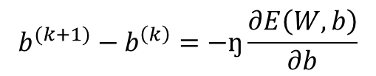

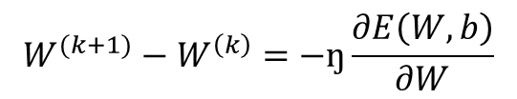

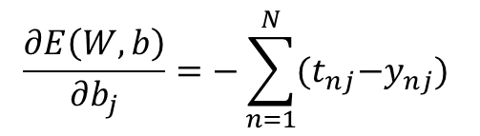
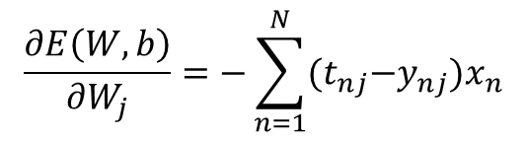
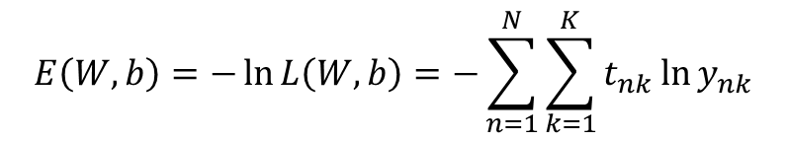
Multi-class Logistic Regression
Posterior probability
$p\left(C=k | x\right)=y_{k}\left(x\right)=\frac{exp⁡(W_{k}^{T}x+b_{k})}{\sum_{j=1}^{N}{exp⁡(W_{j}^{T}x+b_{j})}}$
Likelihood function
Log-likelihood function
$$\frac{∂E\left(W,b\right)}{∂W_{j}}=−\sum_{n=1}^{N}{(t_{nj}{−y}_{nj})x_{n}}$$
$$L\left(W,b\right)=\prod_{n=1}^{N}{\prod_{k=1}^{K}{y_{nk}^{t_{nk}}}}$$
$$\frac{∂E\left(W,b\right)}{∂b_{j}}=−\sum_{n=1}^{N}{(t_{nj}{−y}_{nj}) }$$
$$W^{(k+1)}−W^{\left(k\right)}=−ŋ\frac{∂E\left(W,b\right)}{∂W}$$
$$E\left(W,b\right)=−\ln{L\left(W,b\right)}=−\sum_{n=1}^{N}{\sum_{k=1}^{K}{t_{nk}\ln{y_{nk}}}}$$
$$b^{(k+1)}−b^{\left(k\right)}=−ŋ\frac{∂E\left(W,b\right)}{∂b}$$

Slide 12
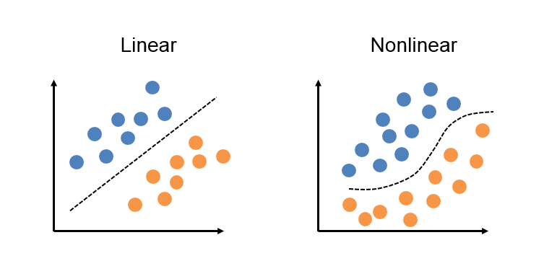
Linear and non-linear classification

Slide 13
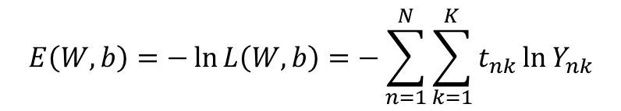
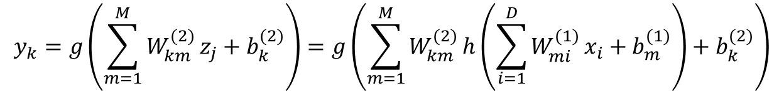
Multi-layer Perceptron(neural networks)(1)
Non-linear classification ex) XOR
신세대
Input layer
hidden layer
output layer
Z₁
X₁
...
Y₁
구세대
...
...
y_{k} ∈[ 0,1]
...
X_{D}
Z_{M}
Y_{K}
$$E\left(W,b\right)=−\ln{L\left(W,b\right)}=−\sum_{n=1}^{N}{\sum_{k=1}^{K}{t_{nk}\ln{Y_{nk}}}}$$
nIn = 2
nOut = 2
W⁽¹⁾_{MD}
W⁽²⁾_{KM}
$$y_{k}=g\left(\sum_{m=1}^{M}{W_{km}^{(2)}}z_{j}+b_{k}^{(2)}\right)=g\left(\sum_{m=1}^{M}{W_{km}^{(2)}}h\left(\sum_{i=1}^{D}{W_{mi}^{(1)}}x_{i}+b_{m}^{(1)}\right)+b_{k}^{(2)}\right)$$

Slide 14
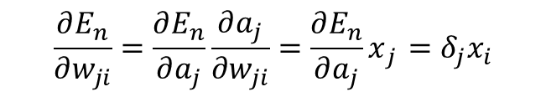
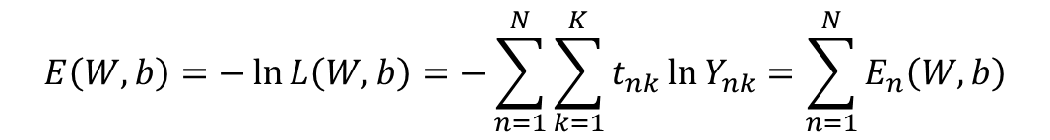
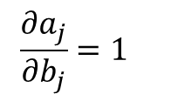
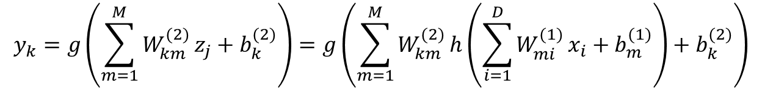
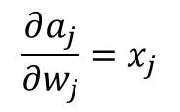

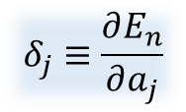
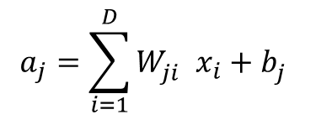
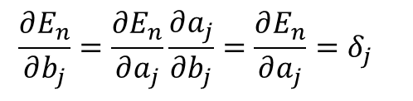
Multi-layer Perceptron(2)
Non-linear classification ex) XOR
$$E\left(W,b\right)=−\ln{L\left(W,b\right)}=−\sum_{n=1}^{N}{\sum_{k=1}^{K}{t_{nk}\ln{Y_{nk}}}}=\sum_{n=1}^{N}{E_{n}\left(W,b\right)}$$
$$y_{k}=g\left(\sum_{m=1}^{M}{W_{km}^{(2)}}z_{j}+b_{k}^{(2)}\right)=g\left(\sum_{m=1}^{M}{W_{km}^{(2)}}h\left(\sum_{i=1}^{D}{W_{mi}^{(1)}}x_{i}+b_{m}^{(1)}\right)+b_{k}^{(2)}\right)$$
$$a_{j}=\sum_{i=1}^{D}{W_{ji}^{}}x_{i}+b_{j}^{}$$
$$\frac{∂E_{n}}{∂w_{ji}}{=\frac{∂E_{n}}{∂a_{j}}\frac{∂a_{j}}{∂w_{ji}}=\frac{∂E_{n}}{∂a_{j}}x}_{j }=δ_{j}x_{i}$$
$$\frac{∂a_{j}}{∂w_{j}}{=x}_{j}$$
$$\frac{∂a_{j}}{∂b_{j}}{=1}_{}$$
$$\frac{∂E_{n}}{∂b_{j}}{=\frac{∂E_{n}}{∂a_{j}}\frac{∂a_{j}}{∂b_{j}}=\frac{∂E_{n}}{∂a_{j}}=δ_{j}}_{}$$
$$z_{j}=h(a_{j})$$
$$δ_{j}≡\frac{∂E_{n}}{∂a_{j}}$$

Slide 15


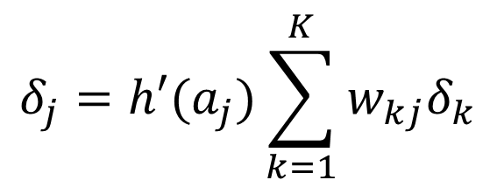
Multi-layer Perceptron(3): back propagation
$$δ_{k}= y_{k}{−t}_{k}$$
$$δ_{j}=\frac{∂E_{n}}{∂a_{j}}=\sum_{k=1}^{K}{\frac{∂E_{n}}{∂a_{k}}\frac{∂a_{k}}{∂a_{j}}}$$
$$δ_{j}=h′(a_{j})\sum_{k=1}^{K}{w_{kj}δ_{k}}$$

Slide 16
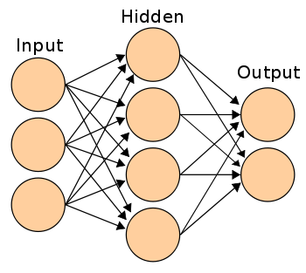
MLP implementation
nIn = 2, nHidden = 3, nOut = 2
HiddenLayer W⁽¹⁾
LogisticLayer W⁽²⁾
(1)H.forward( )
(2)L.train()
Input
X
Hidden
Z
Output
Y
Input
(3)H.backward( )
Training

Slide 17
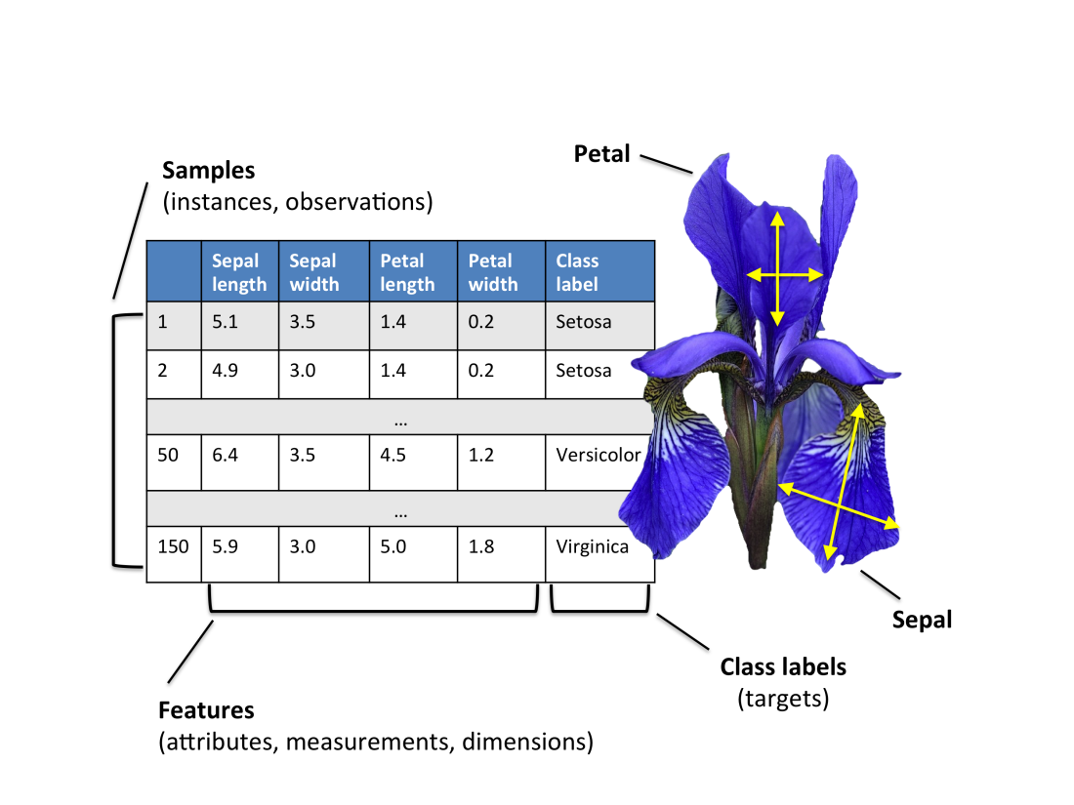
Iris data

Slide 18
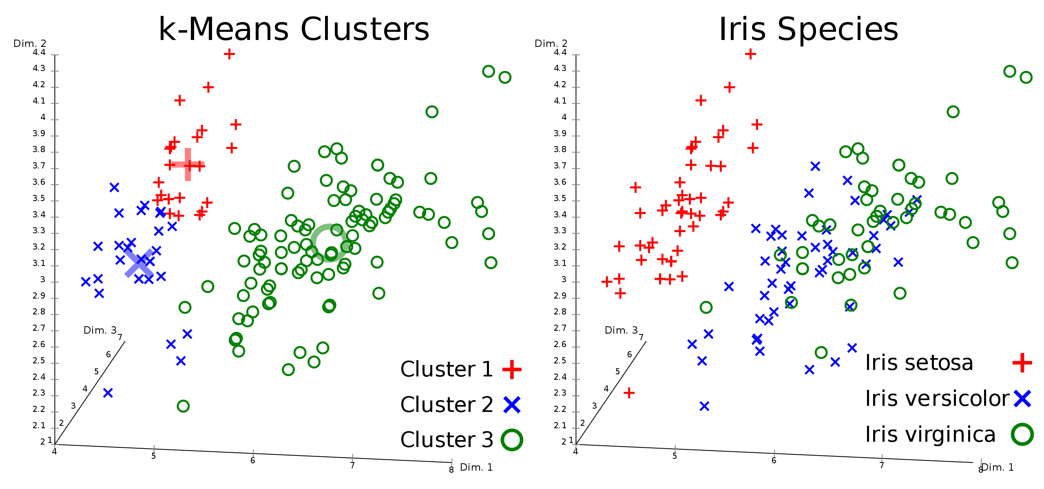
Iris data

Slide 19
ML in C++ (translation from Java to C++)
Doug Young Suh
Last update 2019. 5. 19
 | Single NN | Multi-class | Multi-layer
given | O | O | X
Iris data | 66% | O | X

Slide 20
Machine learning in C++ or Phyton?
Machine learning and data science in general is a huge interdisciplinary area, so different people might have very different opinions. R or Python is more preferred in data analytics or data mining, while C++ is fundamental in deep learning and computer vision. This question is about whether to learn machine learning, and my answer is about that only. If the question is about what language to use in building ML applications, there’s no clear winner, because applications differ vastly. If one is trying to build a robot for example, he/she is basically stuck in ROS/C++/CMake/Linux ecosystem; if the project is to predict sales trends for a company, one might even consider Tableau for convenience.
We can do a lot more than using canned libraries in Matlab or Python, in fact, in both languages you can implement a linear SVM or logistic regression without using any library, which is perfect for educational purposes. ML to its core is a set of vector or matrix operations, which is a perfect fit for Matlab and Numpy. If I were to learn ML in C++, I would certainly use Eigen for faster vector operations, the resulting code would be quite similar to Matlab/Numpy code, so why not just use Matlab instead?

Slide 21
Machine learning in Python
Wrapper in
Python or Matlab
TensorFlow in C++
The fact that Python is slow is very much exaggerated. Beginners like to argue about which language is faster etc., I did the same thing as well, but you are not writing TensorFlow, you are just trying to implement a simple gradient descent by yourself, the scale of your problem is still far away from reaching the bottleneck of language runtime speed.
It’s true that TensorFlow is implemented in C++, as well as many other large scale learning frameworks (e.g. caffe, vowpal wabbit, libsvm) and to best of my knowledge, all optimization routines. However, you’ll notice that most of them have a Python or Matlab wrappers. This means that even if you build everything in Python, under the hood you are still running C++ code, so there really is no performance difference.
Remember that your main purpose is to learn about ML, not to practice programming. It would cost you a lot of time to understand the mathematical concepts in ML alone, coupling that with a language that’s more difficult to deal with will slow you down a lot. And I have to warn you that debugging C++ code for ML algorithms is very difficult. Your brain cycle is much more valuable than CPU cycle, your time is much more expensive than CPU time.

Slide 22
Assignment 1 (given)
Translate the Java code for ‘perceptron’ to C++ code.
https://github.com/PacktPublishing/Java-Deep-Learning-Essentials/blob/master/Chapter%202/DLWJ.Perceptrons/SingleLayerNeuralNetworks/Perceptrons.java
https://github.com/PacktPublishing/Java-Deep-Learning-Essentials/blob/master/Chapter%202/DLWJ.Perceptrons/util/ActivationFunction.java
https://github.com/PacktPublishing/Java-Deep-Learning-Essentials/blob/master/Chapter%202/DLWJ.Perceptrons/util/GaussianDistribution.java
Hint
Perceptrons.java → perceptron_main.cpp, perceptron.cpp, perceptron.h
Activation.java → activation.cpp, activation.h
GaussDistribution.java → #include <random>
For iris data, iris_perceptron_main.cpp instead of perceptron_main.cpp

Slide 23
Assignment 2
Translate the Java code for ‘logistic regression’ to C++ code.
https://github.com/PacktPublishing/Java-Deep-Learning-Essentials/blob/master/Chapter%202/DLWJ.LogisticRegression/SingleLayerNeuralNetworks/LogisticRegression.java
Hint
LogisticRegression.java → Iris_LR_main.cpp(given), LogisticRegression.cpp, LogisticRegression.h
Import Activation.java → activation.cpp, activation.h (given)
No import of Gaussian distribution → #include <random>

Slide 24
Java → C++ (1)
double[][] xx = new double[N][M];
…..
xx[3] = vectorxx(M);
…..
double[ ] vectorxx(int NN){
double[ ] x = new double[NN]
for(int i=0;i<NN;i++) x[i] = (double)i;
return x;
}
double **xx = new double*[N];
for(int i=0;i<N;i++) xx[i] = new double[M];
…..
vectorxx(M,xx[3]);
…..
void vectorxx(int NN, double *x){
for(int i=0;i<NN;i++) x[i] = (double)i;
}

Slide 25
Java → C++ (2)
double[][] xx = new double[N][M];
…..
xx[3] = vectorxx(M);
…..
double[ ] vectorxx(int NN){
double[ ] x = new double[NN]
for(int i=0;i<NN;i++) x[i] = (double)i;
return x;
}
double **xx = new double*[N];
…..
xx[3] = vectorxx(M);
…..
delete xx[3];
…..
double * vectorxx(int NN){
double *xx = new double[NN];
for(int i=0;i<NN;i++) x[i] = (double)i;
return xx;
}

Slide 26
Java → C++ (3)
“abc.h”
class abc{
int nx, ny;
int add(int i, int j);
};
“abc.cpp”
#include “abc.h”
int abc::add(int i, int j){
return i+j;
}
“xxx.cpp”
#include “abc.h”
abc myabc;
…
“abc.java”
class abc{
int nx, ny;
int add(int i, int j){
return i+j;
}
};
“xxx.java”
…
abc myabc;
…

Slide 27
Java → C++ (4)
System.out.println("--------------------");
train_X = new double[][]{
{ 0., 0. }, { 0., 1. }, { 1., 0. }, { 1., 1. } };
cout << “---------------------\n”;
double data[4][2] = {0., 0, 0, 1, 1, 0, 1., 1.};

Slide 28
Function pointer
int test1(int i) { return i*1; }
int test2(int i) { return i*2; }
int test3(int i) { return i*3; }
…
int(*xx)(int);
xx = test3;
cout << (*xx)(10) << "\n";
-------------
30

