Slide 1
Integration and differentiation
2019. 9. 16
Doug Young Suh

Slide 2
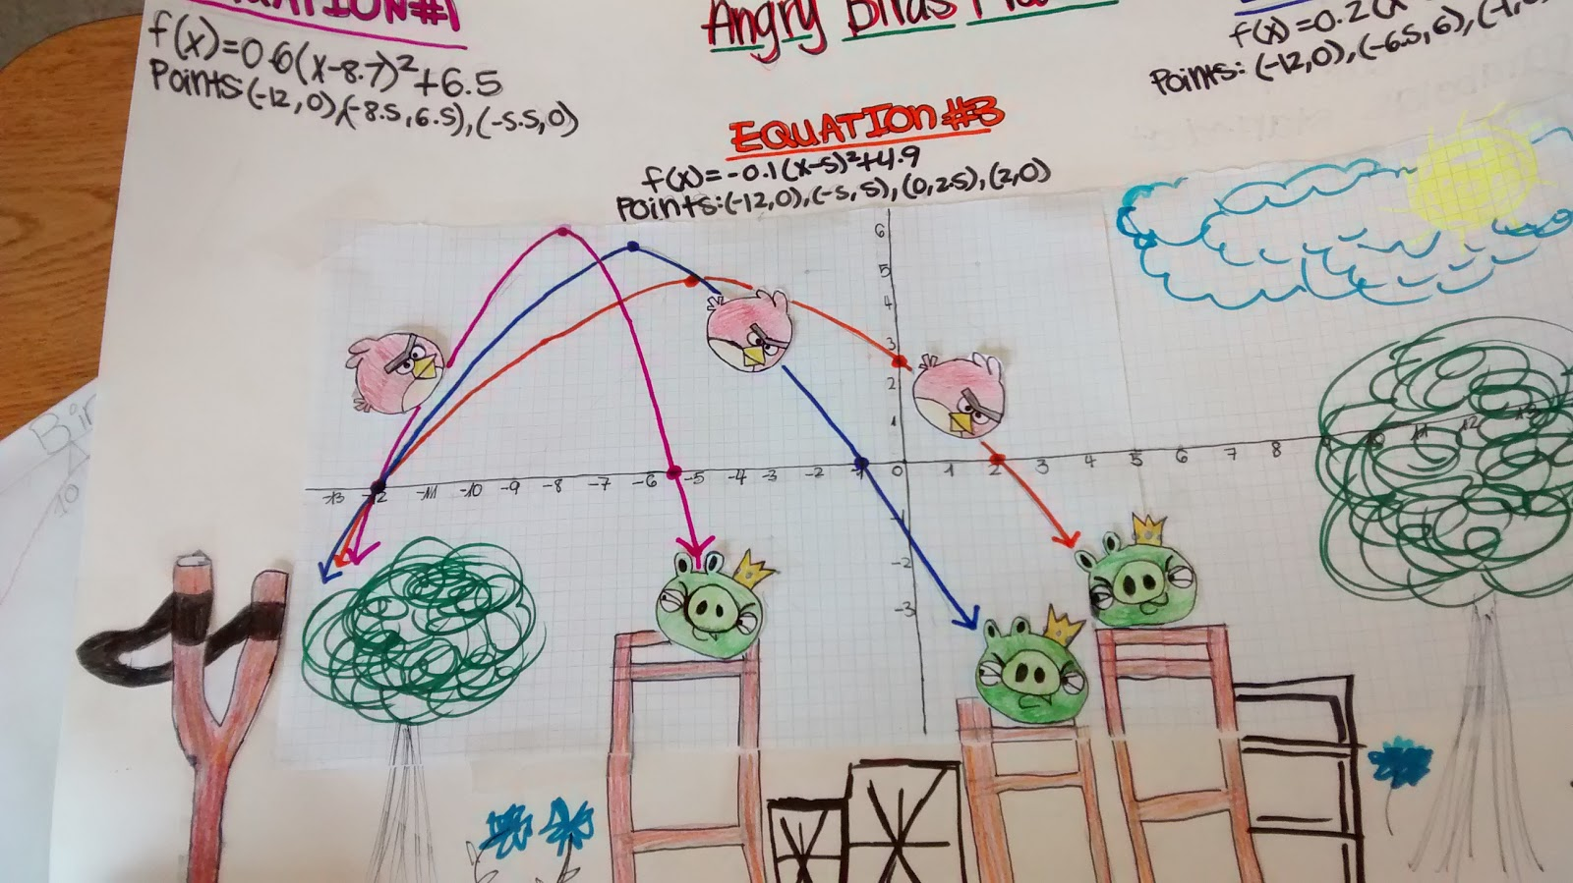

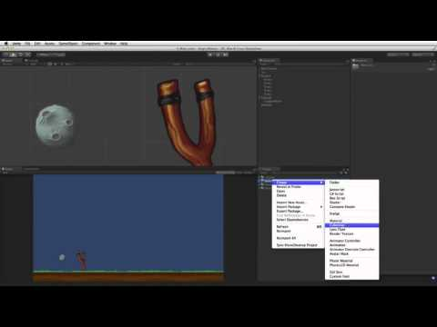
포물선 (parabola)

Slide 3





Fire!!
$${v_{y}=v}_{o}sinθ$$
$${\vec{v}}_{o}$$
$$θ$$
$${v_{x}=v}_{o}cosθ$$

Slide 4




수직방향 등가속도 운동
거리 = 0
초기 속도 = $v_{o}sinθ$
가속도 9.8m/sec²
꼭대기 도달 시간
${\text{9.8}t}_{top}=v_{o}sinθ$
$$v_{o}sinθ$$
속도
$$t_{top}$$
$${2t}_{top}$$
시간

Slide 5



수평방향 등속도 운동
초기 속도 = $v_{o}cosθ$
간 거리
${\text{2}t}_{top}v_{o}cosθ$
$$v_{o}cosθ$$
속도
거리
$${2t}_{top}$$
시간

Slide 6




How to hit?
$$v_{o}? θ?$$
?
(0,0)
(X,0)

Slide 7
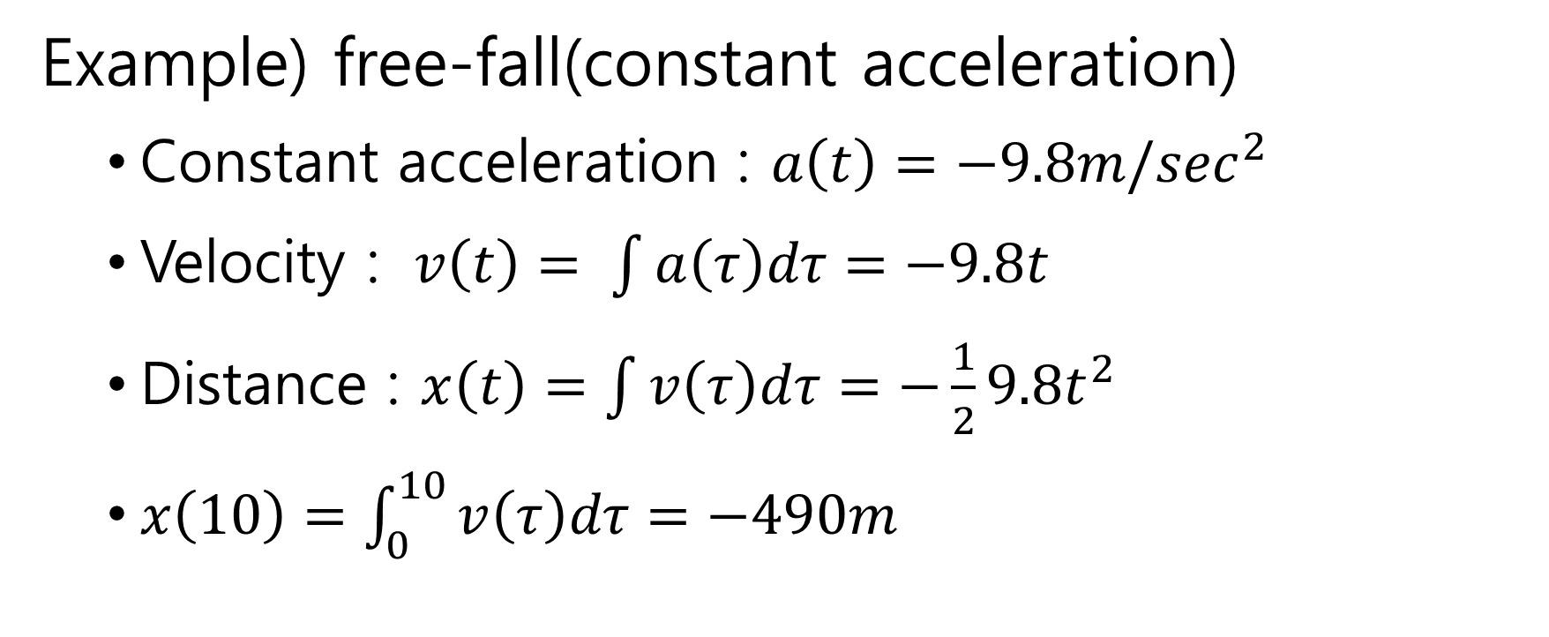
Integration in the continuous time
Example) free-fall(constant acceleration)
Constant acceleration : $a\left(t\right)={−9.8m/sec}^{2}$
Velocity : $v\left(t\right)= \int{a\left(τ\right)dτ=−9.8t}$
Distance : $x\left(t\right)=\int{v\left(τ\right)dτ=−\frac{1}{2}9.8t^{2}}$
$x\left(10\right)=\int_{0}^{10}{v\left(τ\right)dτ}=−490m$

Slide 8





Integration → Summation
$\tilde{x}\left(10\right)=\sum_{n=1}^{N}{−9.8(n∆t)}∆t$ where $N∆t=10$
$$t$$
$$t$$
$$v(t)$$
$$v(t)$$

Slide 9
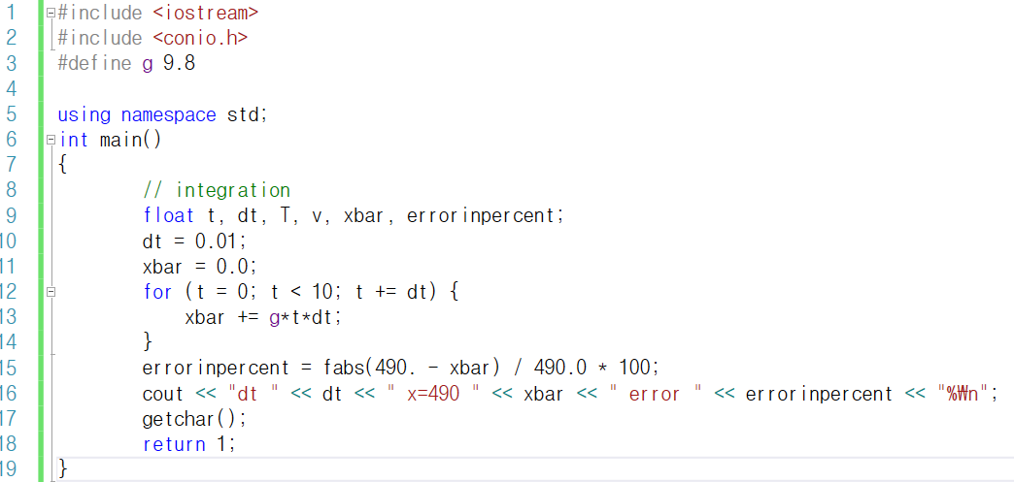

Slide 10
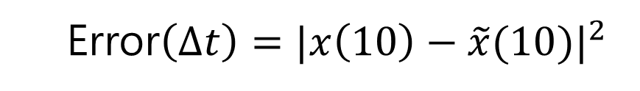



Error
Error$\left(∆t\right)=|x\left(10\right)−\tilde{x}(10)|^{2}$
Size of $∆t$
Approximation of $v(t)$
$\sum_{n=1}^{N}{v(n∆t)}∆t$ vs. $\sum_{n=1}^{N}{v(n−\frac{∆t}{2})}∆t$
$$v(t)$$
$$v(t)$$

Slide 11
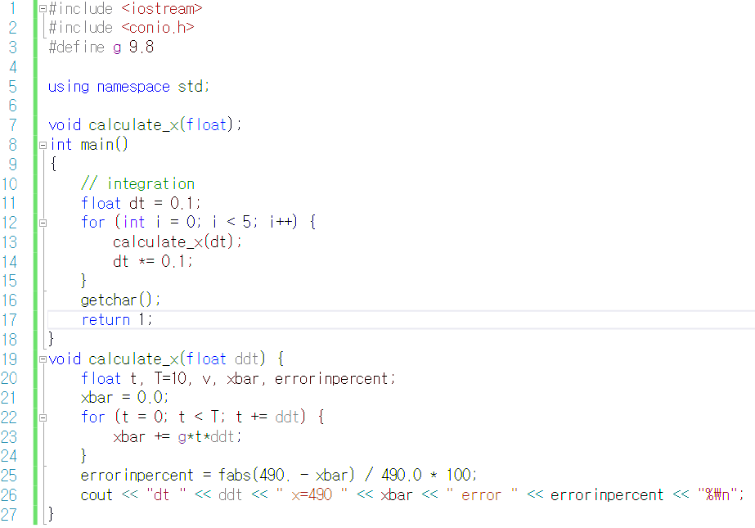
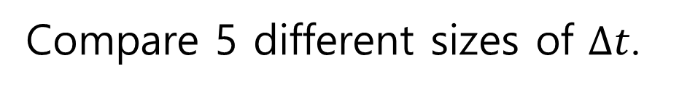
Compare 5 different sizes of $∆t$.

Slide 12
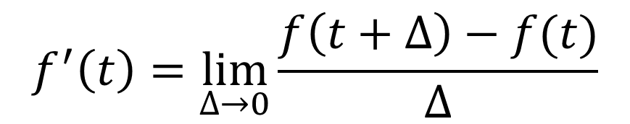
Differentiation
Definition of differentiation
$$f^{′}\left(t\right)=\lim_{∆→0}{\frac{f\left(t+∆\right)−f(t)}{∆}}$$

Slide 13
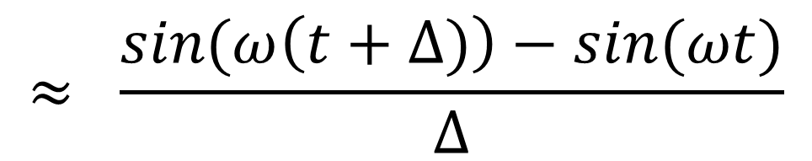
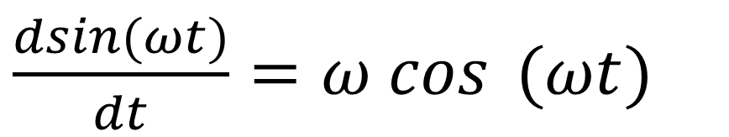
Differentiation(미분) → difference(차분)
$\frac{dsin(ωt)}{dt}=ω cos$ $(ωt)$
$$≈ \frac{sin(ω\left(t+∆)\right)−sin(ωt)}{∆}$$

Slide 14
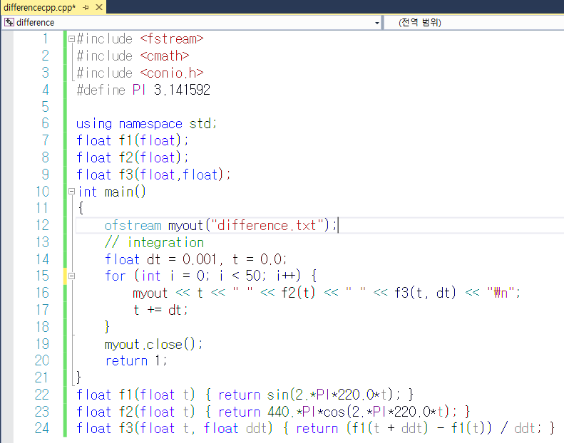

Slide 15
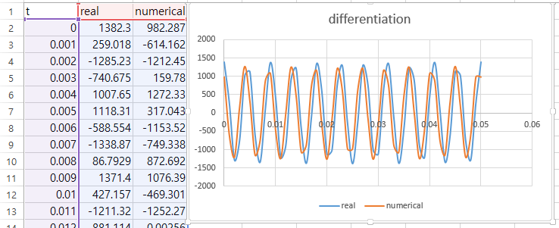
Results

Slide 16
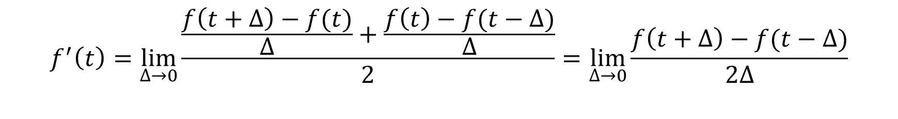
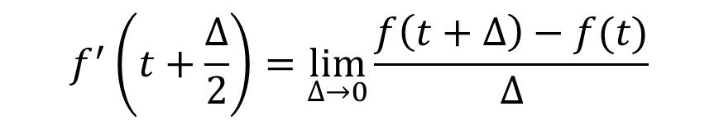
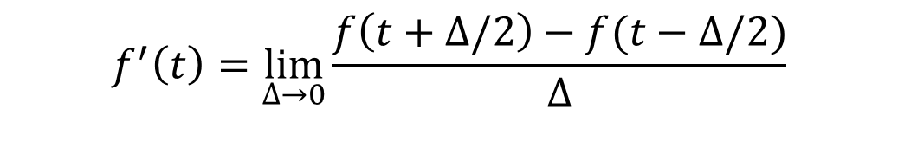
Why shifted?
$$f^{′}\left(t+\frac{∆}{2}\right)=\lim_{∆→0}{\frac{f\left(t+∆\right)−f(t)}{∆}}$$
(1)
(2)
(3)
$$f^{′}\left(t\right)=\lim_{∆→0}{\frac{\frac{f\left(t+∆\right)−f(t)}{∆}+\frac{f\left(t\right)−f(t−∆)}{∆}}{2}}=\lim_{∆→0}{\frac{f\left(t+∆\right)−f(t−∆)}{2∆}}$$
$$f^{′}\left(t\right)=\lim_{∆→0}{\frac{f\left(t+∆/2\right)−f(t−∆/2)}{∆}}$$

Slide 17
Performance
Performance = (benefit) / (cost)
Performance in this problem
(accuracy) / (computation time)

Slide 18
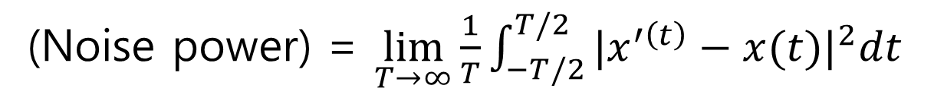
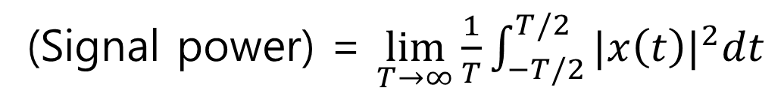
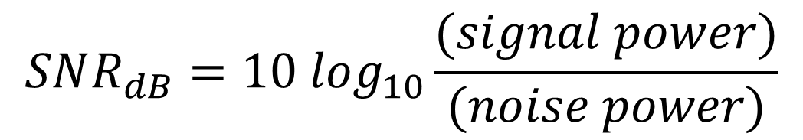
Accuracy in SNR(Signal-to-Noise Ratio)
Ratio in power
(Signal power) = $\lim_{T→∞}{\frac{1}{T}\int_{−T/2}^{T/2}{{|x\left(t\right)|}^{2}dt}}$
(Noise power) = $\lim_{T→∞}{\frac{1}{T}\int_{−T/2}^{T/2}{{|x^{′\left(t\right)}−x(t)|}^{2}dt}}$
$$SNR_{dB}=10 \log_{10}\frac{(signal power)}{(noise power)}$$

Slide 19
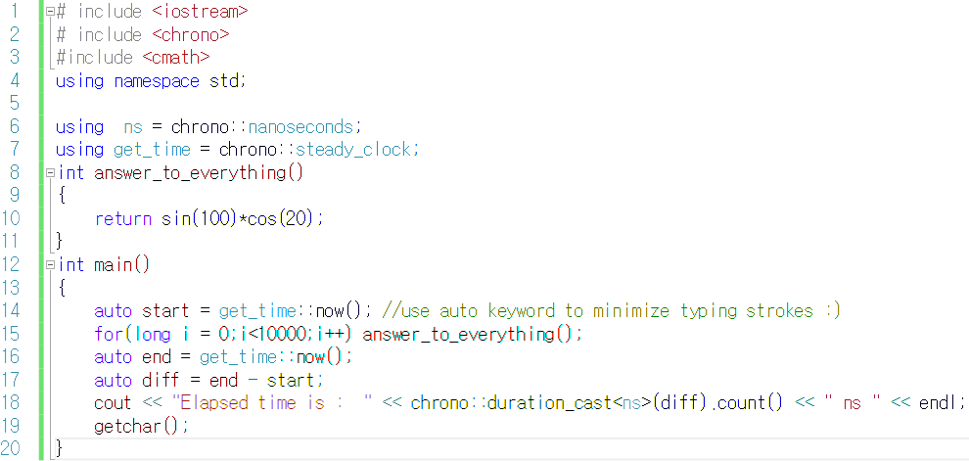
Computation time

Slide 20
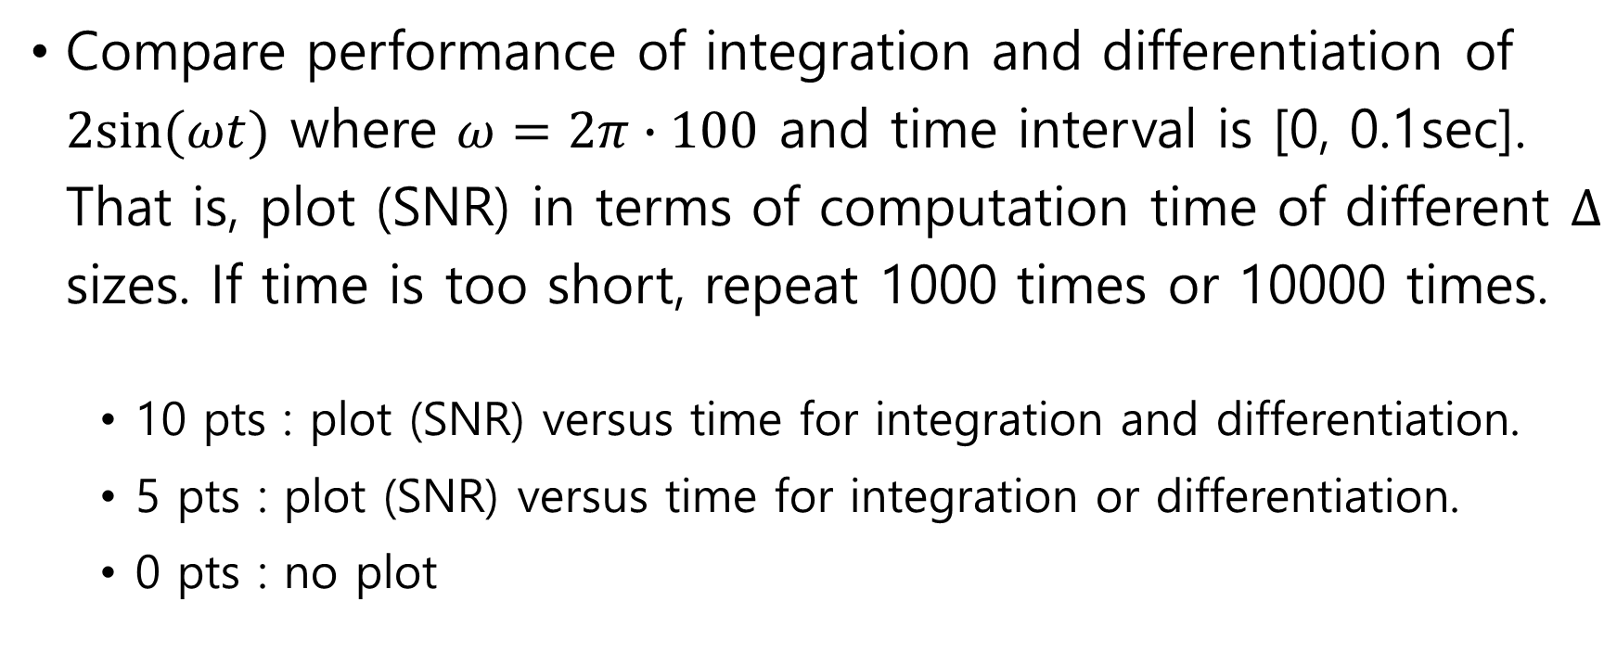
Assignment
Compare performance of integration and differentiation of $2sin⁡(ωt)$ where $ω=2π∙100$ and time interval is [0, 0.1sec]. That is, plot (SNR) in terms of computation time of different $∆$ sizes. If time is too short, repeat 1000 times or 10000 times.
10 pts : plot (SNR) versus time for integration and differentiation.
5 pts : plot (SNR) versus time for integration or differentiation.
0 pts : no plot

