Slide 1
Text file, cmath
2019. 3. 6
Doug Young Suh

Slide 2
Contents
Write/read text file
Math functions
Integration/differentiation
Sampling theory

Slide 3
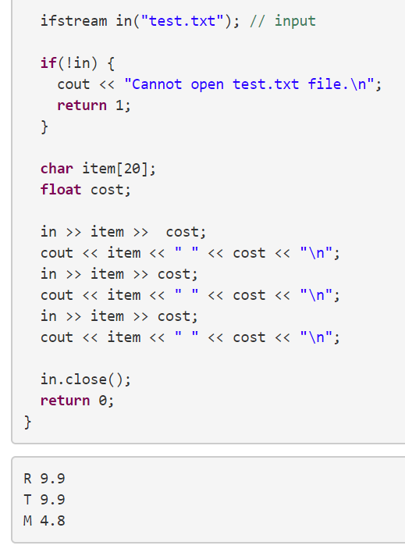
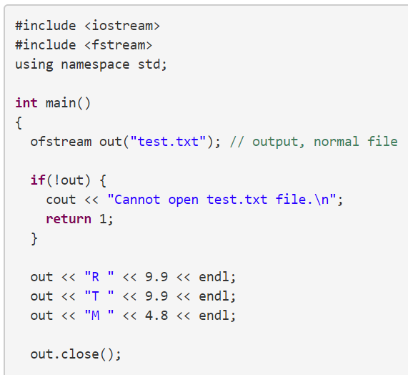
Text file IO

Slide 4

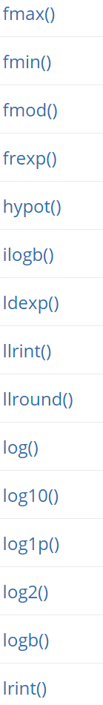
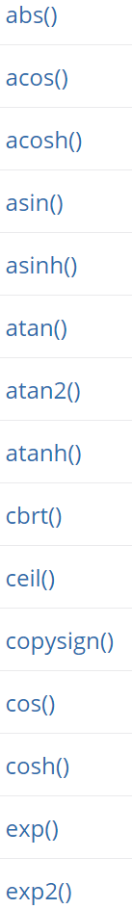
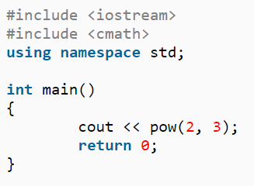
Math functions
http://www.cplusplus.com/reference/cmath/
Calculate 2³

Slide 5

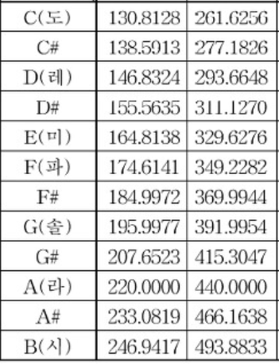

Sine graph
Sampling of 220Hz sine wave at fs = 8kHz
$f\left(t\right)=3sin⁡(2π∙220∙t)$

Slide 6
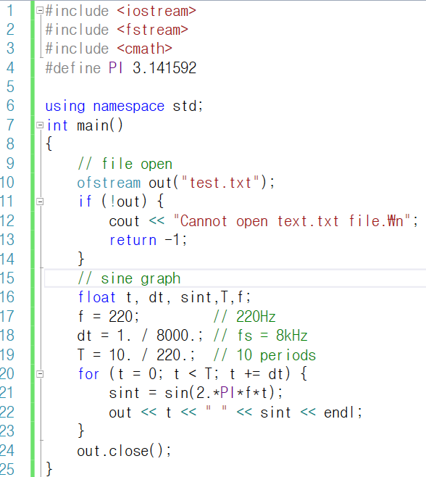

Slide 7
Aliasing?
Sampling of 220Hz sine wave at fs = 150Hz

Slide 8
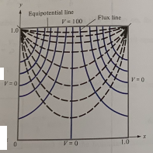
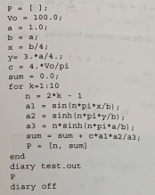



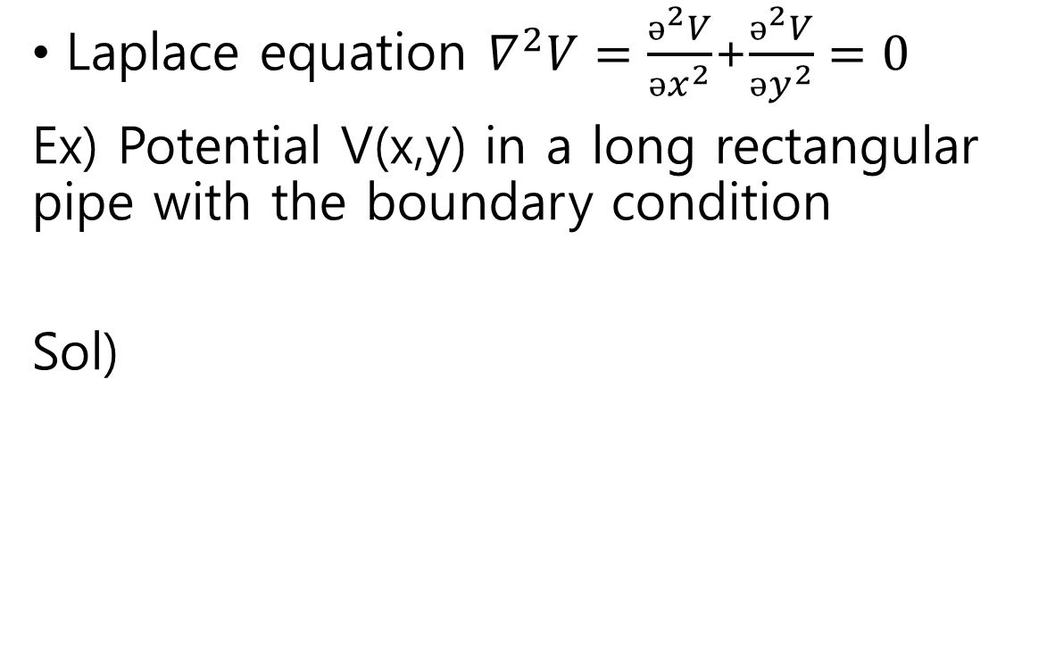



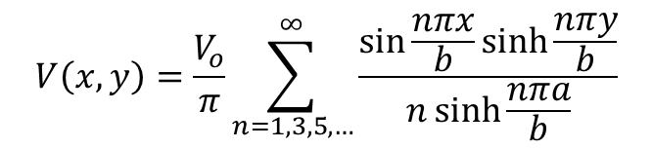
Laplace equation Ex) Boundary Value Problem
Laplace equation $∇^{2}V=\frac{ǝ^{2}V}{ǝx^{2}}$+$\frac{ǝ^{2}V}{ǝy^{2}}=0$
Ex) Potential V(x,y) in a long rectangular pipe with the boundary condition
Sol)
$$y$$
$$V\text{(}\text{x}\text{,}\text{y}\text{)=}V_{o}$$
$$a$$
$V\text{(}\text{x}\text{,}\text{y}\text{)=}$0
$$2a$$
$$x$$
$$V\left(x,y\right)=\frac{V_{o}}{π}\sum_{n=1,3,5,…}^{∞}{\frac{\sin{\frac{nπx}{b}}\sinh{\frac{nπy}{b}}}{n\sinh{\frac{nπa}{b}}}}$$
V(a/2,3a/4)
Excel 3D surface: https://www.youtube.com/watch?v=jUoo_7KQfO0

Slide 9
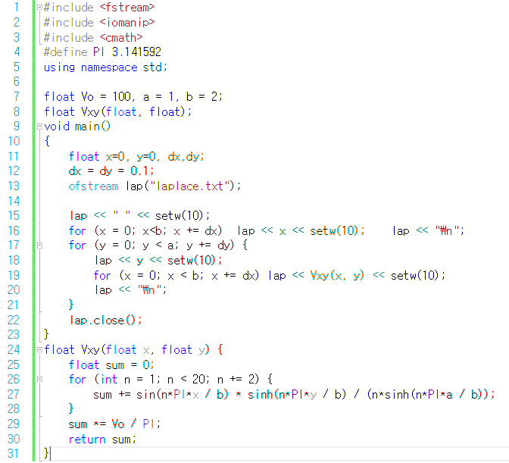
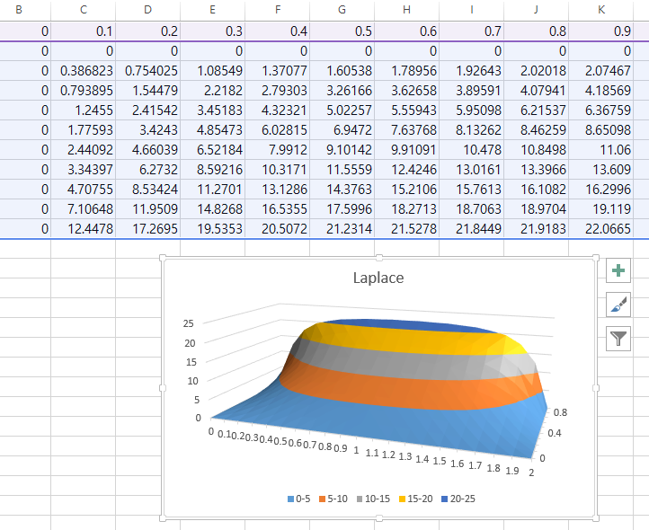

Slide 10
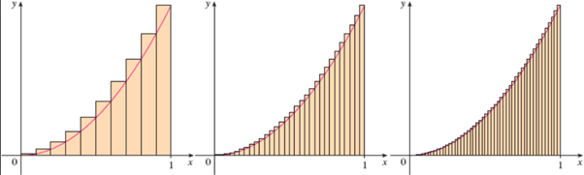

Integration
Example) free-fall(constant acceleration)
$a\left(t\right)=9.8m/\sec^{2}, v\left(t\right)= \int{a\left(τ\right)dτ=9.8t, x\left(t\right)=\int{v\left(τ\right)dτ=\frac{1}{2}9.8t^{2}}}$
$x\left(10\right)=\int_{0}^{10}{v\left(τ\right)dτ}=490m≈\tilde{x}\left(10\right)=\sum_{n=1}^{N}{9.8(n∆t)}∆t$
where $N∆t=10$
Error$\left(∆t\right)=|x\left(10\right)−\tilde{x}(10)|^{2}$
x(t)
x(t)
x(t)
t
t
t

Slide 11
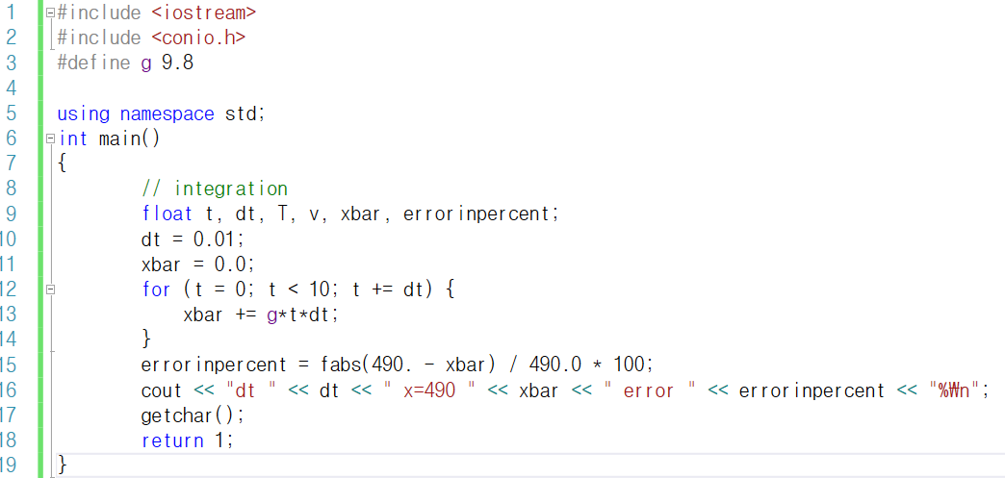

Slide 12
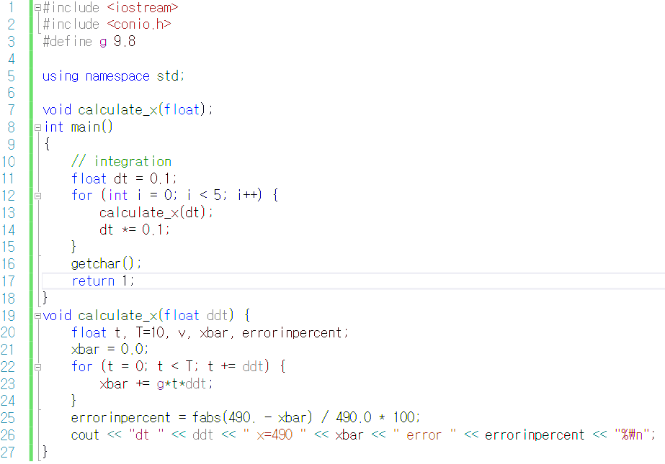

Slide 13
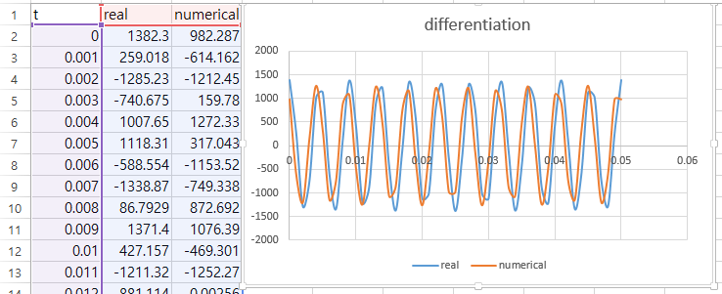
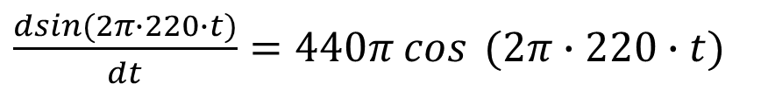

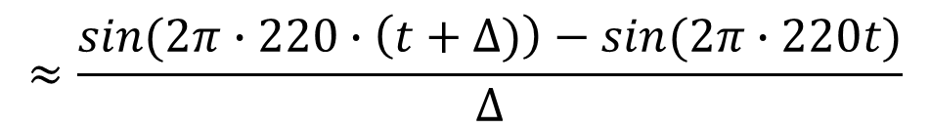
Differentiation
$$f^{′}\left(t\right)=\lim_{∆→0}{\frac{f\left(t+∆\right)−f(t)}{∆}}$$
Compare two equations at different Δ.
$\frac{dsin(2π∙220∙t)}{dt}=440π cos$ $(2π∙220∙t)$
$$≈\frac{sin(2π∙220∙\left(t+∆)\right)−sin(2π∙220t)}{∆}$$

Slide 14
