Slide 1
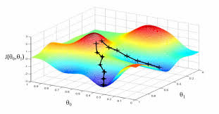
Optimization “Gradient Descend”
Oct. 6, 2019
Doug Young Suh

Slide 2
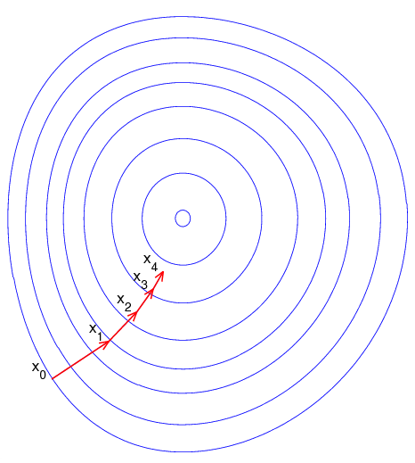

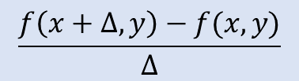
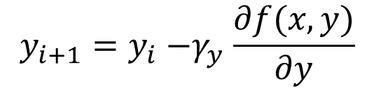
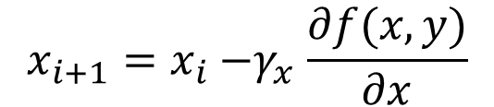
Gradient Descent(경사하강법)
$x_{i+1}=x_{i}{−γ}_{i}∇f(x_{i})$
Local optimum, but not global optimum
Depending in $x_{o}$.
2 dimensional problem
$$\frac{f\left(x+∆,y\right)−f(x,y)}{∆}$$
$$x_{i+1}=x_{i}{−γ}_{x}\frac{∂f(x,y)}{∂x}$$
$$y_{i+1}=y_{i}{−γ}_{y}\frac{∂f(x,y)}{∂y}$$

Slide 3
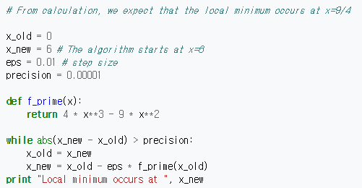

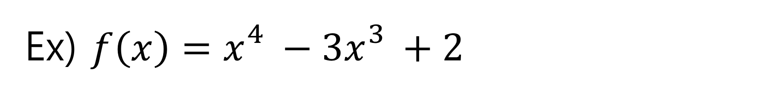
Ex) $f\left(x\right)=x_{}^{4}−{3x}_{}^{3}+2$
Sol) $f′\left(x\right)={4x}_{}^{3}−{9x}_{}^{2}$

Slide 4
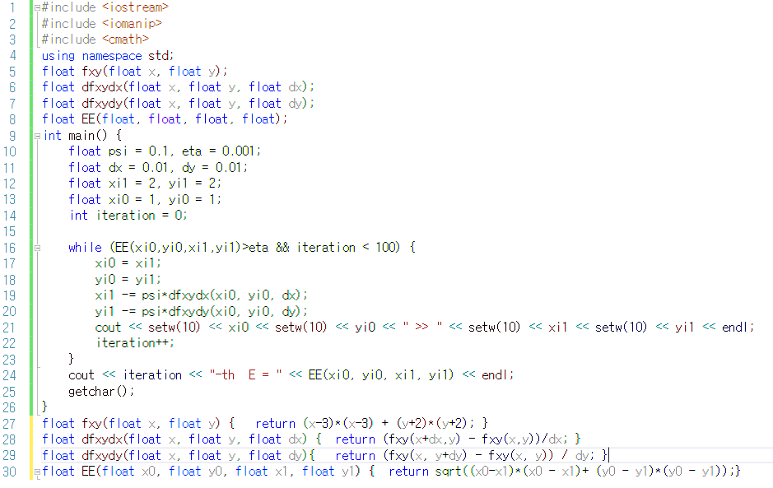
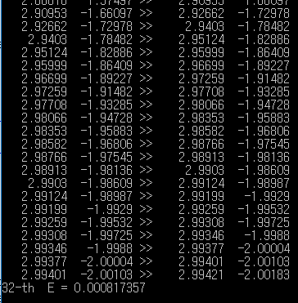
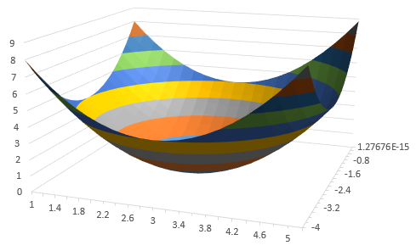



$$f\left(x,y\right)={(x−3)}^{2}+{(y+2)}^{2}$$
$$\frac{∂f(x,y)}{∂x}$$
$$\frac{∂f(x,y)}{∂y}$$
What happens if psi = 1??

Slide 5
Discussion
psi : step size
What happens if psi = 1 in the previous page.
eta : precision(accuracy)
(dx, dy) : accuracy of differentiation

Slide 6
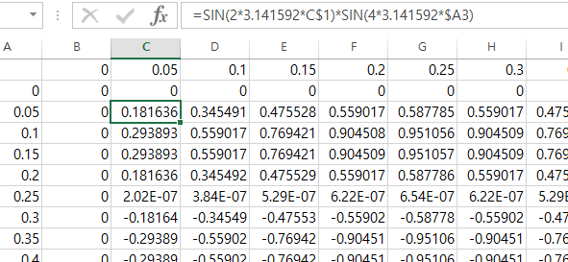

Assignment 1
In the region of $0<x,y<1,$find local minima and maxima of $f\left(x,y\right)=sin⁡(2πf_{0}x)$ $sin⁡(2πf_{1}y)$ where $f_{0}=1 and f_{1}=2.$
constant

Slide 7
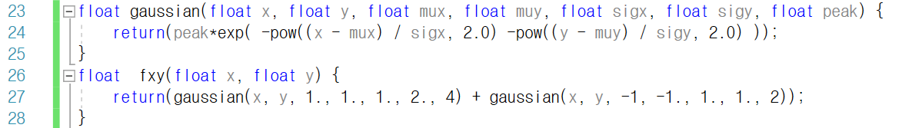
Assignment 2: 2 Peaks
The function fxy( ) has 2 peaks at (1, 1) and (-1, -1).
Show that the local minimums dependent of starting point.
Discuss quantitative analysis of cost/benefit(accuracy vs. number of iterations) with respect to eta, and psi.
Hint) Range of (x, y): -3 < (x, y) < 3
Let dx = dy = 0.001.

Slide 8
