Slide 1
Matrix Inverse
2019. 3. 8
Doug Young Suh

Slide 2
Contents
Gauss Jordan
LSM(curve fitting)

Slide 3




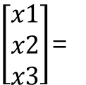






Solve equation
Ax = b
Swapping rows
Scalar multi. to a row Ex) (2)X2
Subtract a row Ex) (2)’=(1)X2-(2)
Original equation
$$\left[\begin{matrix}2 & −3 & 4 \\ 1 & 0 & 3 \\ −2 & 2 & 1\end{matrix}\right]$$
$\left[\begin{matrix}x1 \\ x2 \\ x3\end{matrix}\right]$=
$$\left[\begin{matrix}−1 \\ 5 \\ 3\end{matrix}\right]$$
$\left[\begin{matrix}2 & 3 \\ 4 & 5\end{matrix}\right]\left[\begin{matrix}x \\ y\end{matrix}\right]$=$\left[\begin{matrix}1 \\ 3\end{matrix}\right]$
$\left[\begin{matrix}4 & 5 \\ 2 & 3\end{matrix}\right]\left[\begin{matrix}x \\ y\end{matrix}\right]$=$\left[\begin{matrix}3 \\ 1\end{matrix}\right]$
$\left[\begin{matrix}4 & 5 \\ 4 & 6\end{matrix}\right]\left[\begin{matrix}x \\ y\end{matrix}\right]$=$\left[\begin{matrix}3 \\ 2\end{matrix}\right]$
$$\begin{matrix}4x+5y=3 ∙∙∙(1) \\ −y=1 ∙∙∙(2)\end{matrix}$$
$\left[\begin{matrix}4 & 5 \\ 0 & −1\end{matrix}\right]\left[\begin{matrix}x \\ y\end{matrix}\right]$=$\left[\begin{matrix}3 \\ 1\end{matrix}\right]$

Slide 4






Gauss Jordan
A
x
b
I
$\left[\begin{matrix}4 & 5 \\ 2 & 3\end{matrix}\right]\left[\begin{matrix}x \\ y\end{matrix}\right]$=$\left[\begin{matrix}3 \\ 1\end{matrix}\right] \left[\begin{matrix}1 & 0 \\ 0 & 1\end{matrix}\right]$
A가 I가 되도록 operation하면,
b가 solution이 된다.
I가 A⁻¹이 된다.
$\left[\begin{matrix}4 & 5 \\ 4 & 6\end{matrix}\right]\left[\begin{matrix}x \\ y\end{matrix}\right]$=$\left[\begin{matrix}3 \\ 2\end{matrix}\right] \left[\begin{matrix}1 & 0 \\ 0 & 2\end{matrix}\right]$
$\left[\begin{matrix}4 & 5 \\ 0 & −1\end{matrix}\right]\left[\begin{matrix}x \\ y\end{matrix}\right]$=$\left[\begin{matrix}3 \\ 1\end{matrix}\right] \left[\begin{matrix}1 & 0 \\ 1 & −2\end{matrix}\right]$
$\left[\begin{matrix}4 & 5 \\ 0 & 1\end{matrix}\right]\left[\begin{matrix}x \\ y\end{matrix}\right]$=$\left[\begin{matrix}3 \\ −1\end{matrix}\right] \left[\begin{matrix}1 & 0 \\ −1 & 2\end{matrix}\right]$
$\left[\begin{matrix}4 & 0 \\ 0 & 1\end{matrix}\right]\left[\begin{matrix}x \\ y\end{matrix}\right]$=$\left[\begin{matrix}8 \\ −1\end{matrix}\right] \left[\begin{matrix}6 & −10 \\ −1 & 2\end{matrix}\right]$
I
x
A⁻¹
$\left[\begin{matrix}1 & 0 \\ 0 & 1\end{matrix}\right]\left[\begin{matrix}x \\ y\end{matrix}\right]$=$\left[\begin{matrix}2 \\ −1\end{matrix}\right] \left[\begin{matrix}3/2 & −5/2 \\ −1 & 2\end{matrix}\right]$

Slide 5
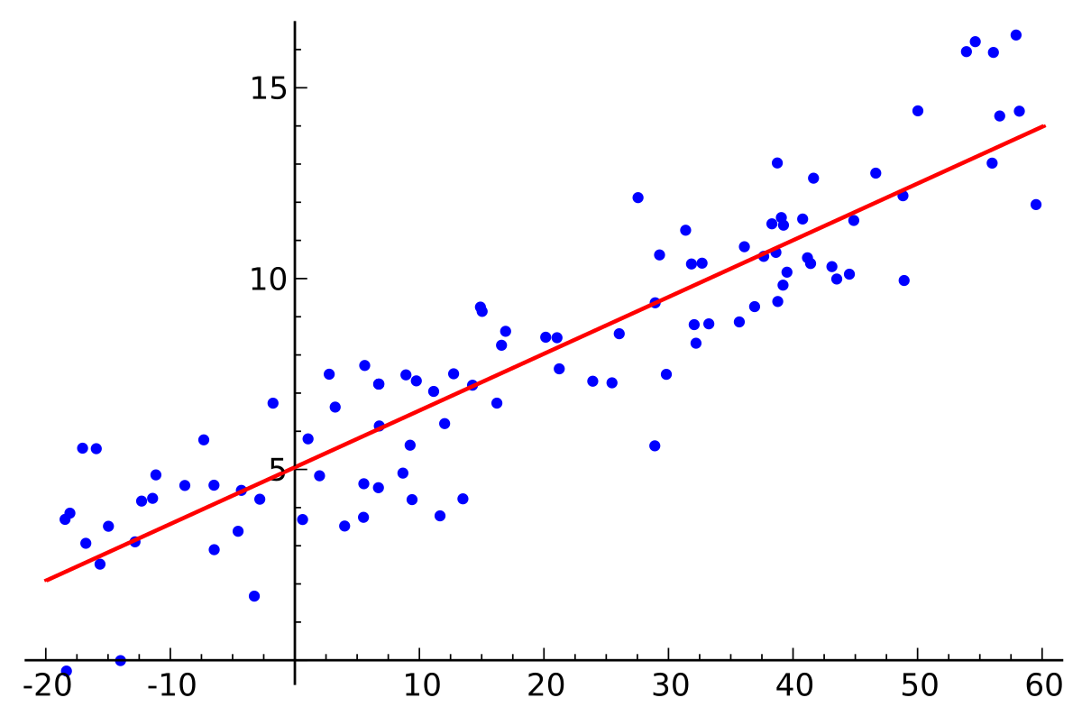
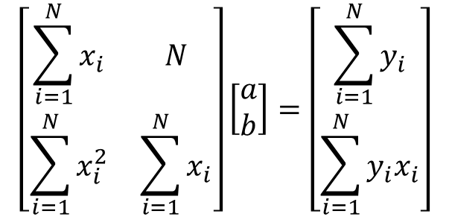
LSM(Least Square Method)
set of (x, y) data → Estimate a and b of y = ax + b
$$\left[\begin{matrix}\sum_{i=1}^{N}{x_{i}} & N \\ \sum_{i=1}^{N}{x_{i}^{2}} & \sum_{i=1}^{N}{x_{i}}\end{matrix}\right]\left[\begin{matrix}a \\ b\end{matrix}\right]=\left[\begin{matrix}\sum_{i=1}^{N}{y_{i}} \\ \sum_{i=1}^{N}{{y_{i}x}_{i}}\end{matrix}\right]$$
A
x =
B

Slide 6
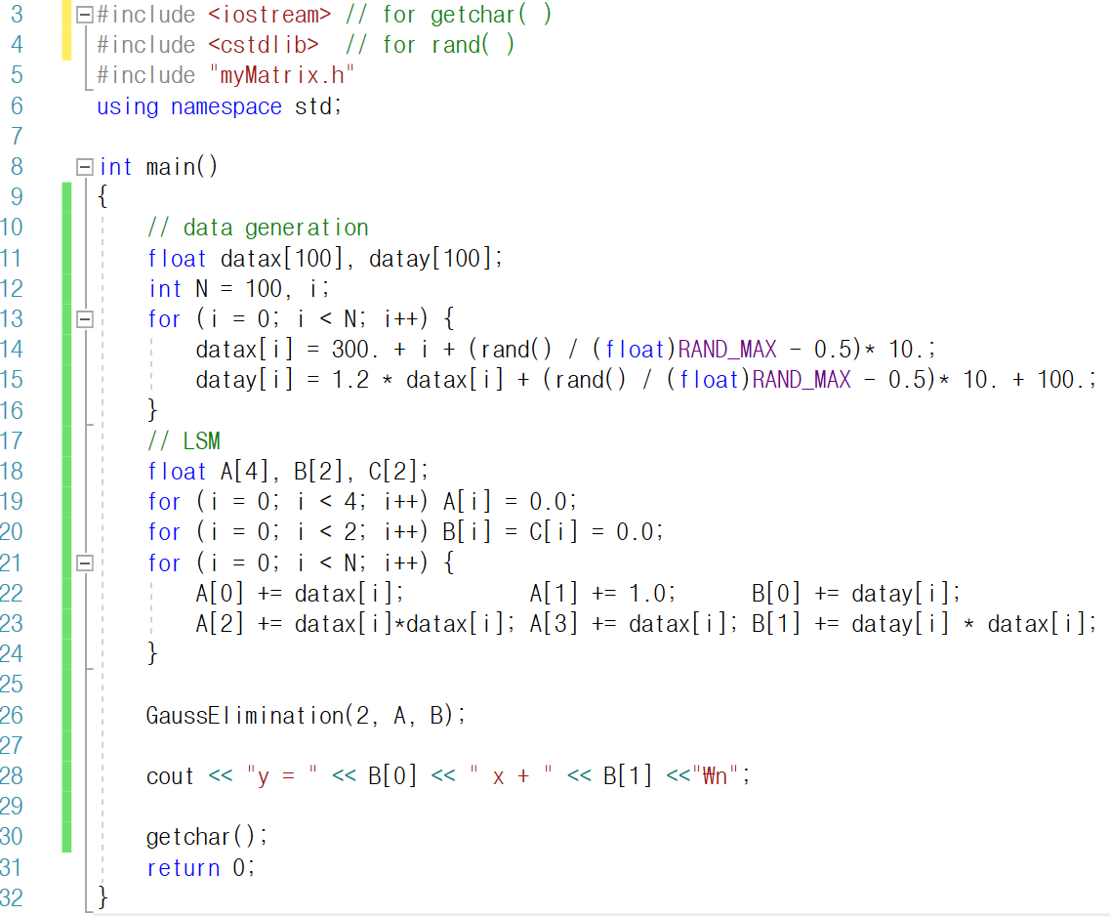

Slide 7
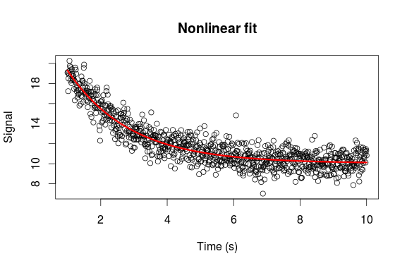

Assignment: LSM-extended
$y=a_{0}{+a}_{1}x{+ a}_{2}x^{2}$
data2.txt N x1 y1 x1 y2 … xN yN
$y=be^{ax}$ → $\log{y}=logb+a x$
datae.txt N x1 y1 x1 y2 … xN yN

