Slide 1
khu_sensor
Filter Design
김진상 교수님
Life Science Technology Inc.
2015103977 김건학
2015103999 김윤형
2015104027 박정진
2015104069 유현민

Slide 2
Dependencies
Python 2.7
Python library (Subprocess, Chips, Numpy, Matplotlib)
g++ Compiler
Icarus Verilog Compiler

Slide 3
Python(Subprocess)
Verilog compile
C++(signal)
Generate Signal
Vivado HLS (Xilinx)
Convert C to Verilog
file_reader.v
Stimulus
lpf.cpp
iir_lpf.v
iir_lpf.cpp
lpf.v
file_writer.v
Output_CPP
Output_Verilog
Python(Matplotlib)
Compare Data
Graph, Text

Slide 4

IIR Low Pass Filter Filter Coefficient
Acoef[0] = 0.013369783003445533
Acoef[1] = 0.026739566006891067
Acoef[2] = 0.013369783003445533
Acoef[3] = 0
Acoef[4] = 0
Acoef[5] = 0
Bcoef[0] = 1.000000000000000000
Bcoef[1] = -1.6474599810769766
Bcoef[2] = 0.70089678118840248
Bcoef[3] = 0
Bcoef[4] = 0
Bcoef[5] = 0

Slide 5
IIR Low Pass Filter Filter Diagram
Acoef[1]
X[1]
Acoef[0]
o_Y_Data
X[0]
c
X[2]
-Bcoef[1]
Y[1]
-Bcoef[2]
Y[2]

Slide 6
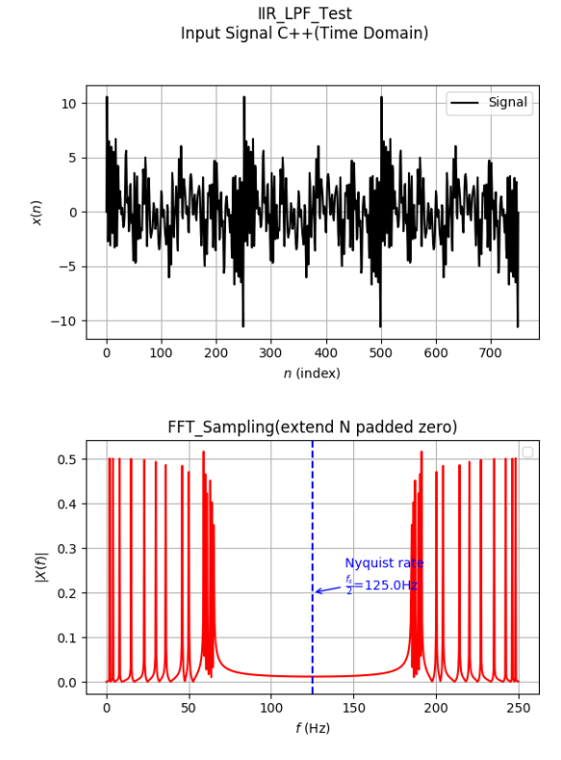
IIR Low Pass Filter Filter Input

Slide 7
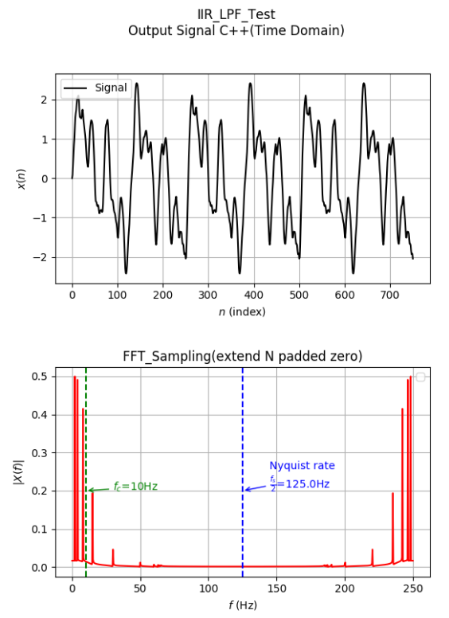

IIR Low Pass Filter Simulation : C++ vs Verilog (Graph)

Slide 8
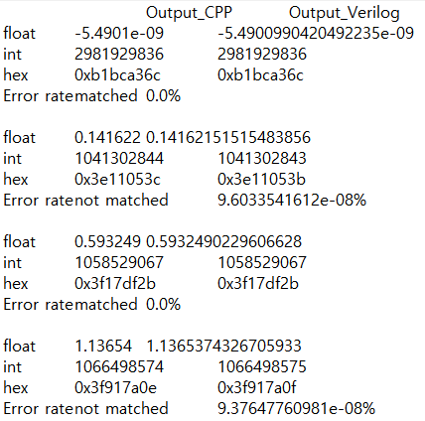
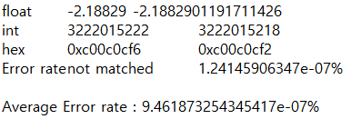
IIR Low Pass Filter Simulation : C++ vs Verilog (Text)

Slide 9
IIR Notch Filter Filter Coefficient
Acoef[0] = 0.9005830143056166
Acoef[1] = -0.22683676727047436
Acoef[2] = 1.815449808720442
Acoef[3] = -0.22683676727047436
Acoef[4] = 0.9005830143056166
Acoef[5] = 0
Bcoef[0] = 1.00000000000000000000
Bcoef[1] = 0.23849243624947844
Bcoef[2] = 1.80168874042915350
Bcoef[3] = -0.21430582988195795
Bcoef[4] = 0.8079495913332013
Bcoef[5] = 0

Slide 10
IIR Notch Filter Filter Diagram
Acoef[0]
X[0]
32h’3f80….0
(10진수 1)
X[4]
Acoef[1]
X[1]
X[3]
Acoef[2]
X[2]
32h’0
o_Y_Data
-Bcoef[1]
Y[1]
-Bcoef[2]
Y[2]
-Bcoef[3]
Y[3]
-Bcoef[4]
Y[4]

Slide 11
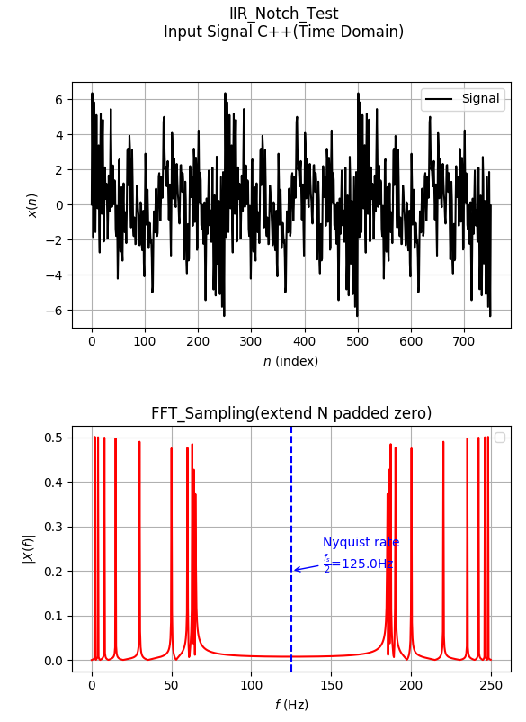
IIR Notch Filter Test Input

Slide 12
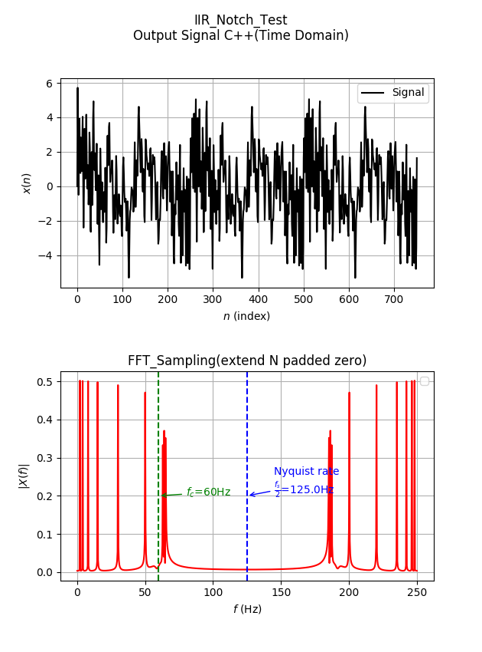

IIR Notch Filter Simulation : C++ vs Verilog (Graph)

Slide 13
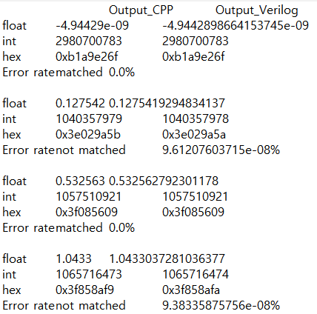
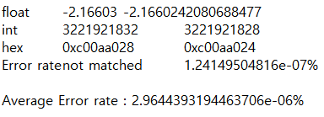
IIR Notch Filter Simulation : C++ vs Verilog (Text)

Slide 14

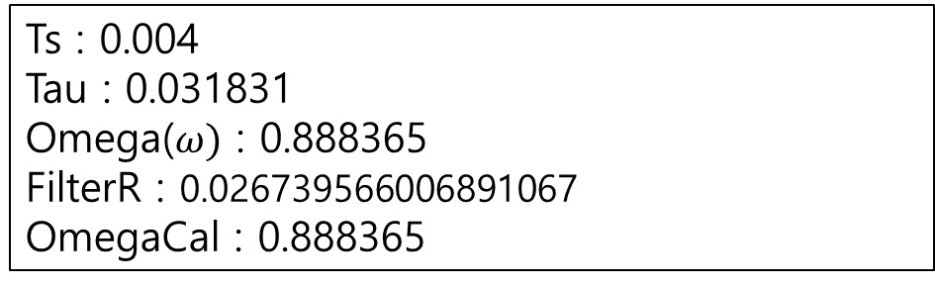
IIR High Pass Filter Filter Coefficient
Ts : 0.004
Tau : 0.031831
Omega($ω)$ : 0.888365
FilterR : 0.026739566006891067
OmegaCal : 0.888365

Slide 15


IIR High Pass Filter Filter Diagram
X[0]
-X[1]
$$ω$$
o_Y_Data
y[1]
$$ω$$
y[0]

Slide 16
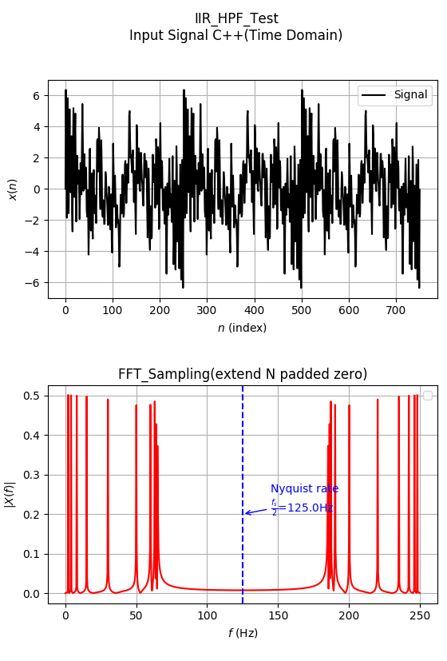
IIR High Pass Filter Filter Input

Slide 17
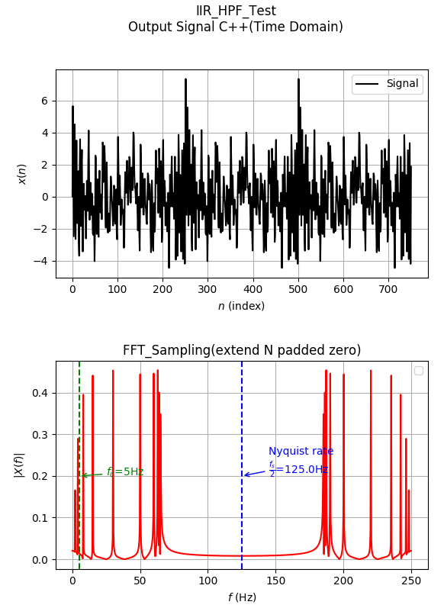
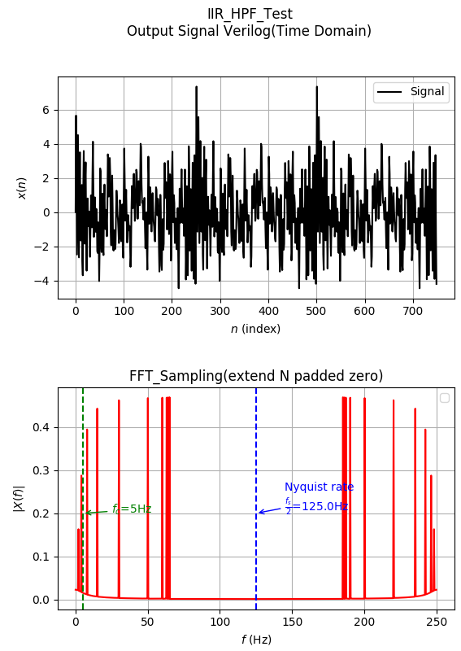
IIR High Pass Filter Simulation : C++ vs Verilog (Graph)

Slide 18
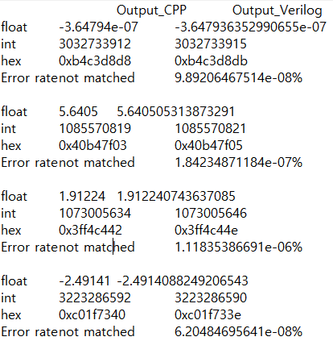
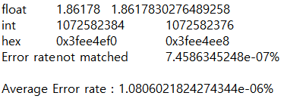
IIR High Pass Filter Simulation : C++ vs Verilog (Text)

Slide 19
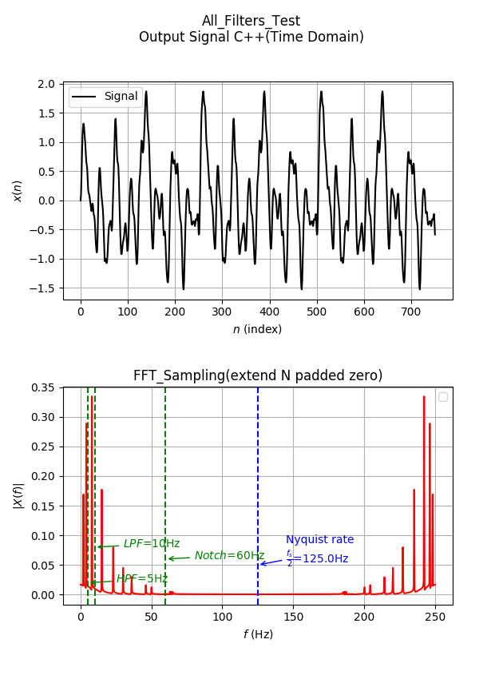
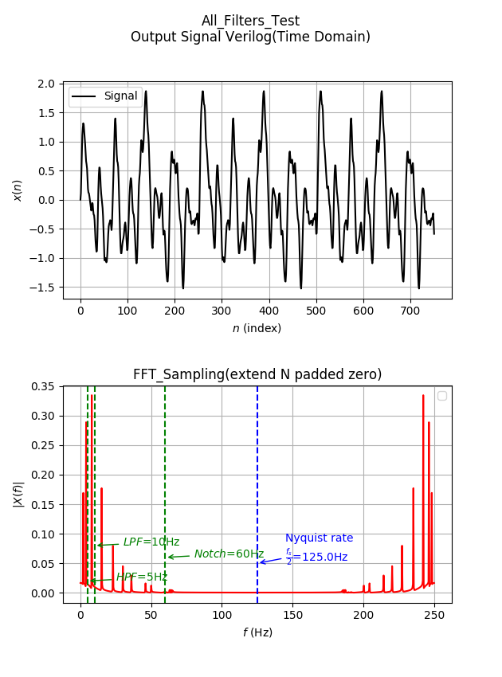
Passed All Filters

Slide 20
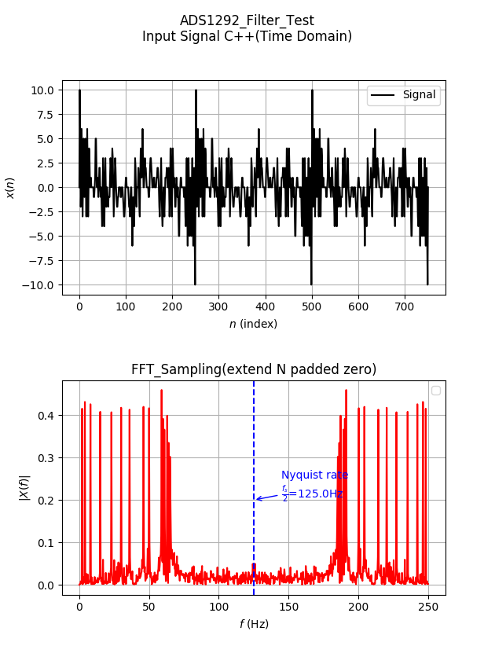
Round-Off Noise int to float, float to int
Integer Input
( = ADS1292 24bit )

Slide 21
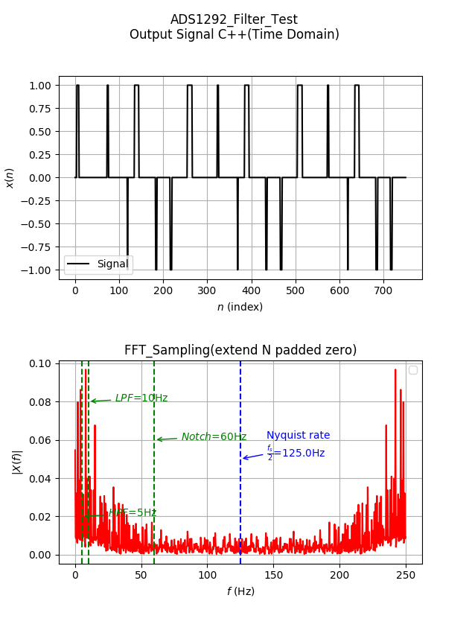

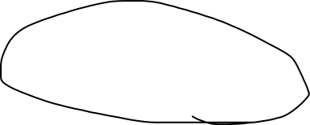
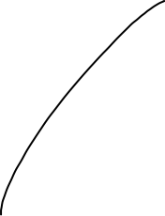
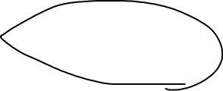
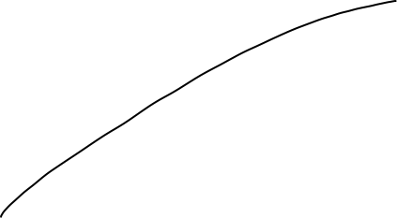
Round-Off Noise int to float, float to int
Round-Off Noise occurred!

Slide 22
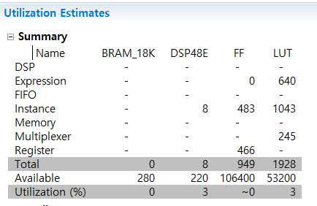
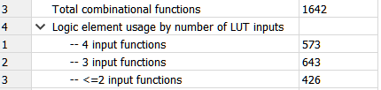
Synthesis (LPF) Vivado HLS (Xilinx) vs direct coded Verilog
Vivado HLS(Xilinx)
Total LUT : 1928
Total Cycle : 26
2. Direct coded Verilog code (iir_lpf.v)
Total LUT : 1642
Total Cycle : 16 ~ 40
using less of LUT!

Slide 23
Synthesis (LPF) Vivado HLS (Xilinx) vs direct coded Verilog
Vivado HLS(Xilinx)
Total LUT : 1928 (X Handshaking)
Total Cycle : 26
2. Direct coded Verilog code (iir_lpf.v)
Total LUT : 1642 (O Handshaking)
Total Cycle : 16 ~ 40
using less of LUT!

