Slide 1
khu_sensor
Filter Design
김진상 교수님
Life Science Technology Inc.
2015103977 김건학
2015103999 김윤형
2015104027 박정진
2015104069 유현민

Slide 2

IIR Low Pass Filter Filter Coefficient
a0 = 0.013369783003445533
a1 = 0.026739566006891067
a2 = 0.013369783003445533
b0 = 1.000000000000000000
b1 = -1.6474599810769766
b2 = 0.70089678118840248

Slide 3
IIR Low Pass Filter Filter Diagram
Acoef[1]
X[1]
Acoef[0]
o_Y_Data
X[0]
c
X[2]
-Bcoef[1]
Y[1]
-Bcoef[2]
Y[2]

Slide 4
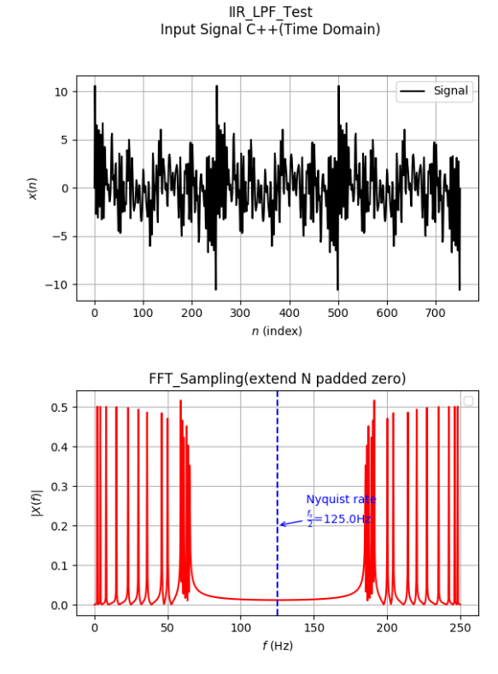
IIR Low Pass Filter Filter Input

Slide 5
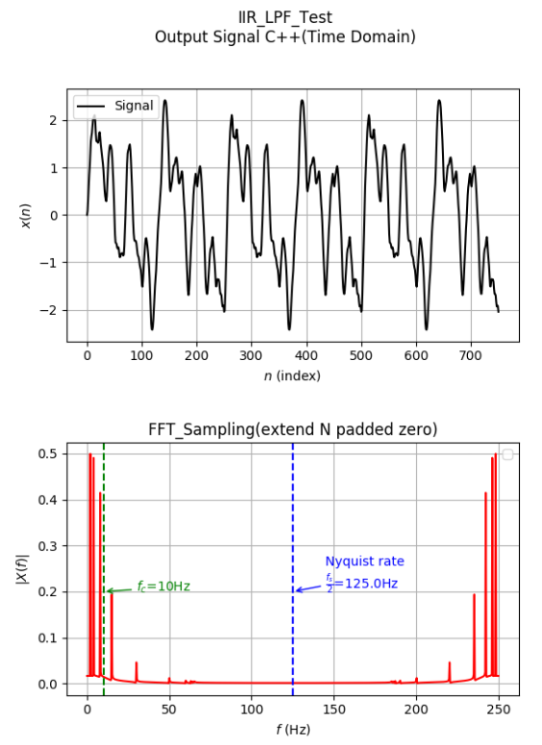

IIR Low Pass Filter Simulation : C++ vs Verilog (Graph)

Slide 6
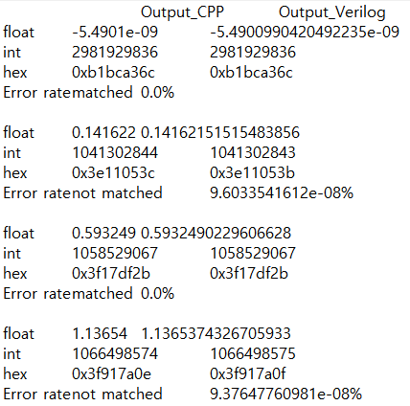
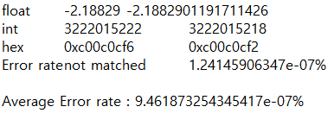
IIR Low Pass Filter Simulation : C++ vs Verilog (Text)

Slide 7
IIR Notch Filter Filter Coefficient
a0 = 0.9005830143056166
a1 = -0.22683676727047436
a2 = 1.815449808720442
a3 = -0.22683676727047436
a4 = 0.9005830143056166
b0 = 1.00000000000000000000
b1 = 0.23849243624947844
b2 = 1.80168874042915350
b3 = -0.21430582988195795
b4 = 0.8079495913332013

Slide 8
IIR Notch Filter Filter Diagram
Acoef[0]
X[0]
32h’3f80….0
(10진수 1)
X[4]
Acoef[1]
X[1]
X[3]
Acoef[2]
X[2]
32h’0
o_Y_Data
-Bcoef[1]
Y[1]
-Bcoef[2]
Y[2]
-Bcoef[3]
Y[3]
-Bcoef[4]
Y[4]

Slide 9
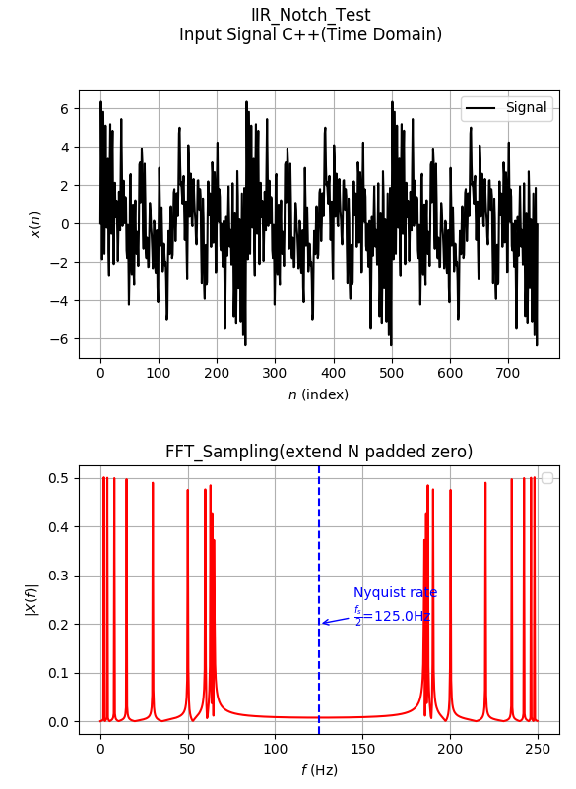
IIR Notch Filter Test Input

Slide 10
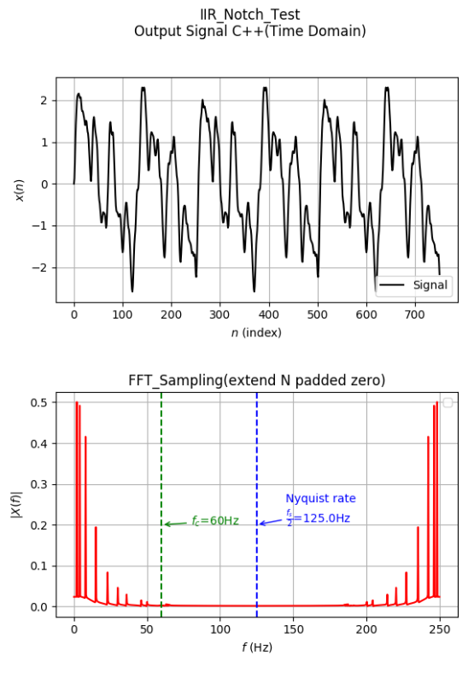
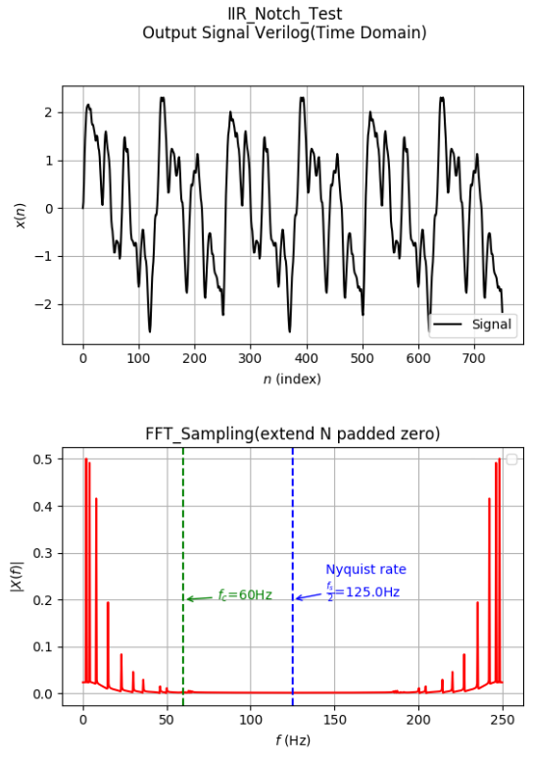
IIR Notch Filter Simulation : C++ vs Verilog (Graph)

Slide 11
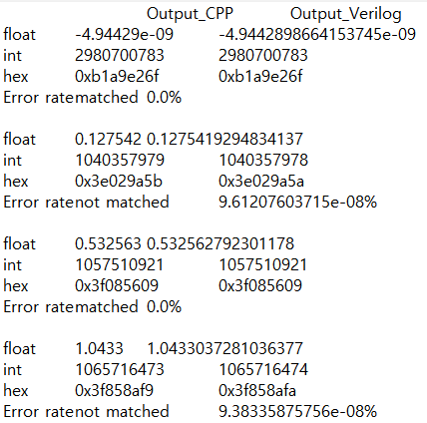
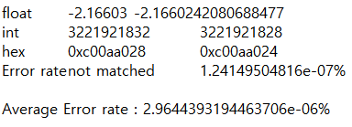
IIR Notch Filter Simulation : C++ vs Verilog (Text)

Slide 12

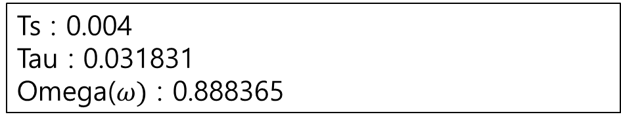
IIR High Pass Filter Filter Coefficient
Ts : 0.004
Tau : 0.031831
Omega($ω)$ : 0.888365

Slide 13


IIR High Pass Filter Filter Diagram
X[0]
-X[1]
$$ω$$
o_Y_Data
y[1]
$$ω$$

Slide 14
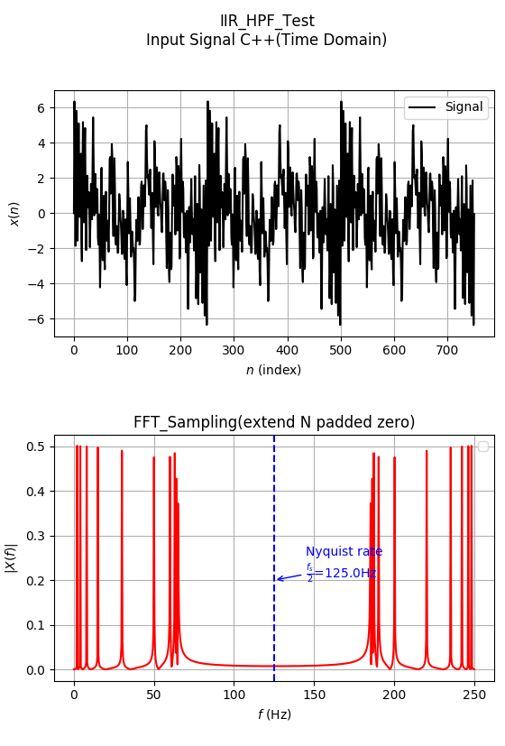
IIR High Pass Filter Filter Input

Slide 15
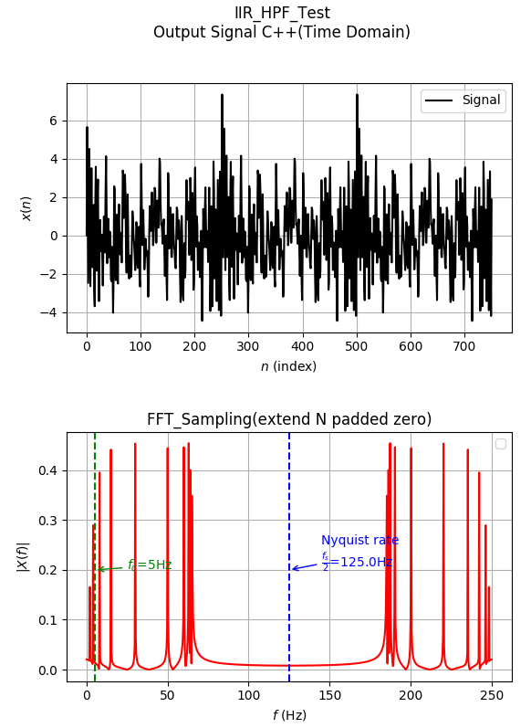
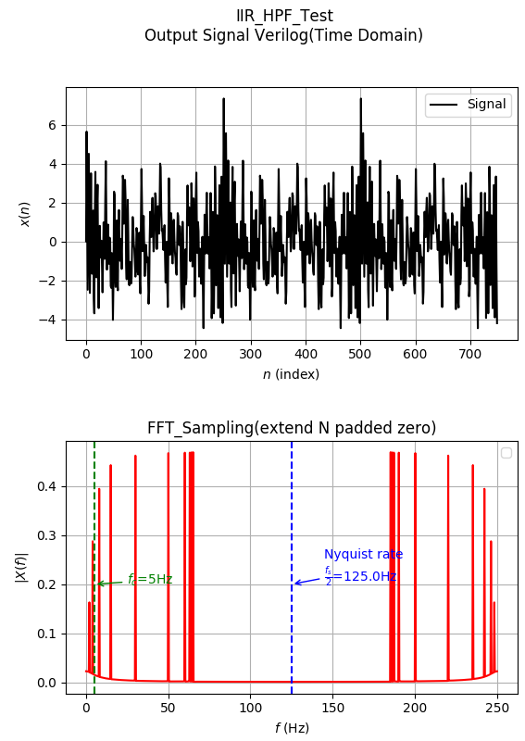
IIR High Pass Filter Simulation : C++ vs Verilog (Graph)

Slide 16
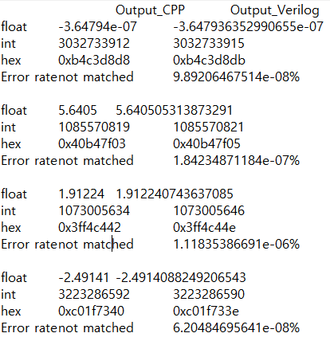
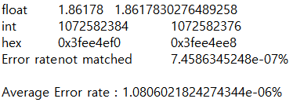
IIR High Pass Filter Simulation : C++ vs Verilog (Text)

Slide 17
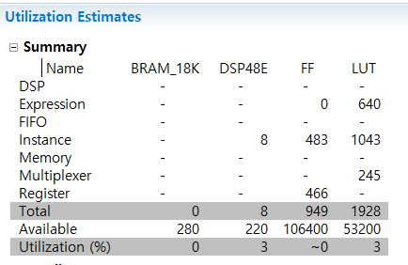
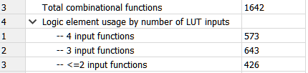
Synthesize with Xilinx hls convert C code to Verilog vs direct coded Verilog
1. Using Xilinx hls Verilog code
Total LUT : 1928
2. Direct coded Verilog code (iir_lpf.v)
Total LUT : 1642
using less of LUT!

