Slide 1
khu_sensor_top
mpr121_controller
MPR121
i2c_master
sensor core
uart_controller
PC
uart_tx
ads1292_controller
uart_rx
ads1292_filter
ADS1292
spi_master
IIR_Filter

Slide 2
sensor_core state | i_ADS1292_CONTROL | Next ads1292_controller state
ST_ADS_RUN | CB_RDATAC (r_rdatac_mode <= 1’b1) | ST_RDATAC_INIT
ST_ADS_STOP | CB_SDATAC (r_sdatac_mode <= 1’b1) | ST_SDATAC_INIT
ST_ADS_WREG_INIT | CB_WREG (r_wreg_mode <= 1’b1) | ST_WREG_INIT
ST_ADS_WREG_CONFIRM | CB_IDLE (r_idle_mode <= 1’b1) | ST_IDLE
ST_ADS_RREG_INIT | CB_RREG (r_rreg_mode <= 1’b1) | ST_RREG_INIT
ST_ADS_RREG_CONFIRM | CB_IDLE (r_idle_mode <= 1’b1) | ST_IDLE

Slide 3

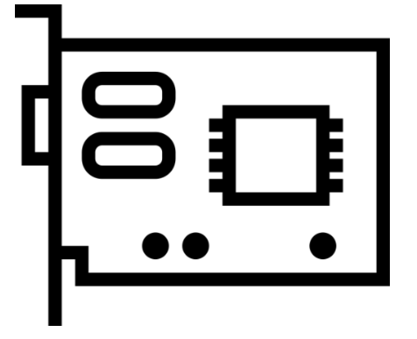


MPR121
FPGA
PC
Reg_Address
{0x6D, Reg_Address}(2byte)
Reg_Data
{0x6D, Reg_Address, Reg_Data}(3byte)
1. {0x5E, 0x8F}(write)
0x52
Run
2. 0x00(read)
3. 0x00 Data(ELE 7 ~ 0)
Run 버튼 클릭 후
Stop 버튼 클릭 전 까지
2 ~ 7 번 Loop
4. 0x01(read)
5. 0x01 Data(OVCF - - ELE 11 ~ 8)
6. {0xBB, 4’b0, 0x01 Data[3:0], 0x00 Data}(3byte)
{0x5E, 0x00}(write)
0x53
Stop

Slide 4
MPR
FPGA
PC
Reg_Address
{0x6D, Reg_Address}(2byte)
Reg_Data
{0x6D, Reg_Address, Reg_Data}(3byte)
1. {0x5E, 0x8F}(write)
0x52
Run
2. 0x00(read)
3. 0x00 Data(ELE 7 ~ 0)
4. 0x01(read)
Run 버튼 클릭 후
Stop 버튼 클릭 전 까지
2 ~ 7 번 Loop
5. 0x01 Data(OVCF - - ELE 11 ~ 8)
6. {0xBB, 4’b0, 0x01 Data[3:0], 0x00 Data}(3byte)
{0x5E, 0x00}(write)
0x53
Stop

Slide 5

ADS
FPGA
PC
Reg_Address
{0x61, Reg_Address}(2byte)
Reg_Data
{0x61, Reg_Address, Reg_Data}(3byte)
1. 0x10(write)(RDATAC)
0x52
Run
DRDY
Pulse
(250Hz)
2. {0xC0, CH1(3byte), CH2(3byte)}(9byte)
3. {0xAA, CH2(3byte)}(4byte)
Run 버튼 클릭 후
Stop 버튼 클릭 전 까지
2 ~ 4 번 Loop
0x11(write)(SDATAC)
0x53
Stop

