Slide 1
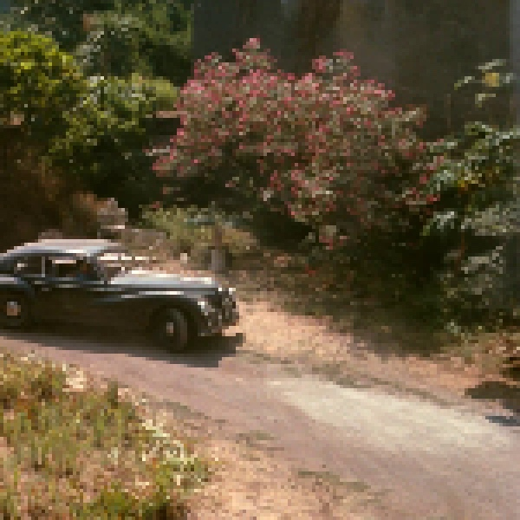

Traditional(Bicubic)
Proposed

Slide 2
BM3D
Proposed
Ground-Truth

