Slide 1
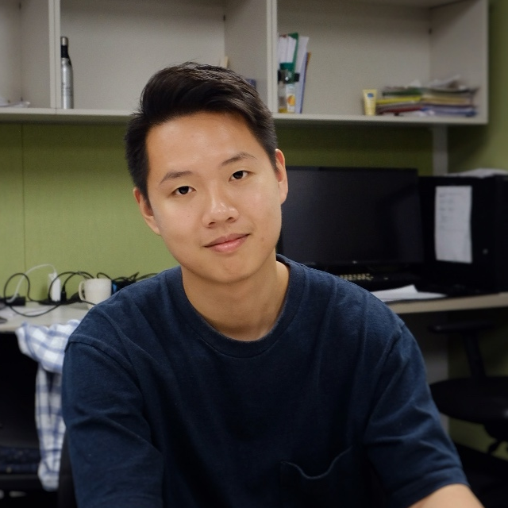

Slide 2



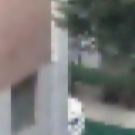
Bicubic noise-free
Bicubic noised
Proposed noise-free
Proposed noised

