Slide 1
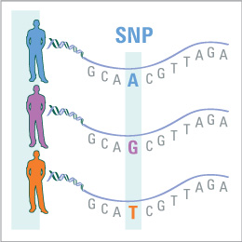
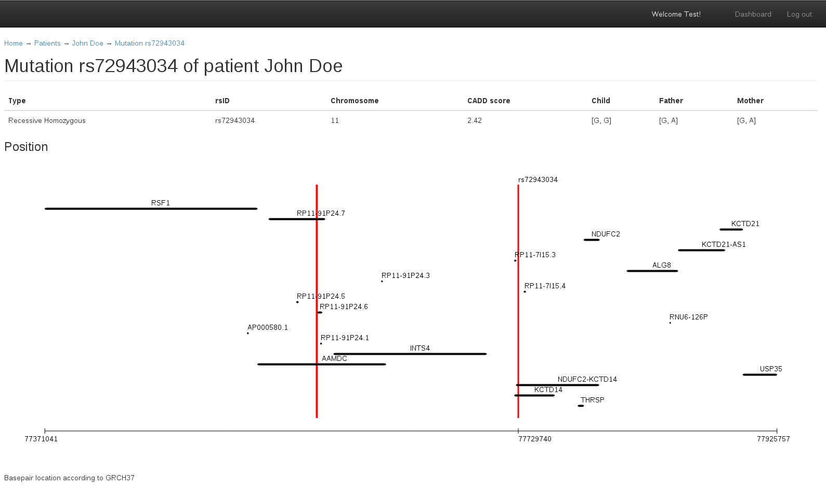
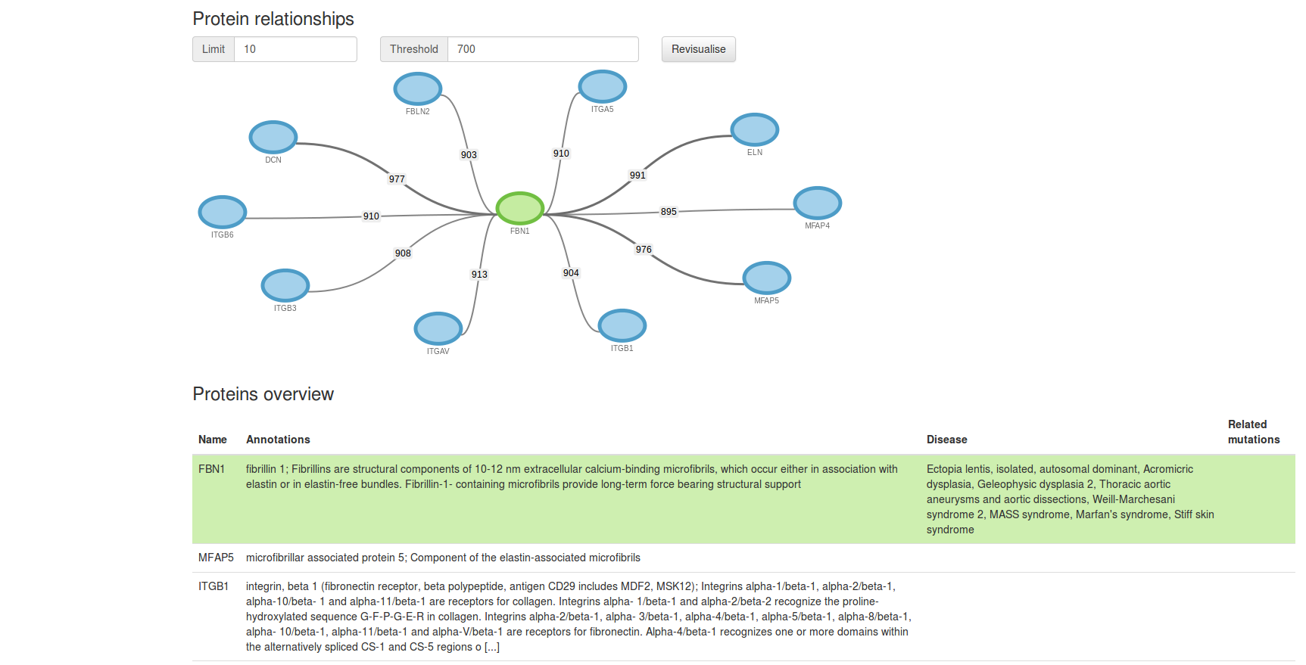
GEVATT
Jasper Denkers – Mathijs Hoogland – Robbert van Staveren – Ruben Bes – Willem Jan Glerum
The problem
In our world a lot of people suffer from diseases, these can be caused by genetic mutations. GEVATT (GEnetic Variations Analyzer Through Triodata) is a webapplication which tries to find those mutations to help doctors cure diseases. Our focus is on triodata from the patient and his parents.
Tons of data
A human has about 3,000,000,000 base-pairs and around 3,000,000 small mutations. This application finds the most relevant mutations and visualizes each of them.
Furthermore we retrieve information from databases which contain all information about genes, proteins and mutations. These databases add up to more than 3TB of data!
Visualizations
The focus of our application is visualizing mutations. This helps doctors to easily identify the mutation(s) that could cause the disease of the patient.
Delft University of Technology – Contextproject – Programming Life – Group 2

