Slide 1
2026-10-27
SiteWhy

Slide 2
Data center moratoria and the
site-selection bottleneck
Site selectors and developers triage US
greenfield sites before spending on legal
review and interconnection queues.
321
Moratoria or restrictions
Sep 2026, Electric Choice
Listing tools (Acres.com, Cherre
DataCenter Intel, LightBox, Transect,
C&W Athena) list rules and scores but
do not reason about whether a rule
applies to a site.
32
States with limits
Sep 2026, Electric Choice
SiteWhy answers the harder question:
which rules apply to this site at this
MW, with the quote, the threshold math,
and the flips that would change
the verdict.
NY Executive Order 62
Statewide moratorium
Jul 2026
Table 1. Moratorium counts, Electric Choice, September 2026; New York Executive
Order 62, July 2026
Source: README problem statement; judging evidence impact.md

Slide 3

Verdicts with the rule, the math and the flip
Verdict: go, conditional or
no-go for a US address plus
IT load, with the verified
rule text, the applicability
math, and what would change
the answer.
Track: The Agent That Can Explain Why: every verdict traces to a quote plus arithmetic, never to a completion alone.
Scope: federal Title V, a 1,291-entry moratorium dataset, Texas and ERCOT state and grid rules, verified county ordinances for Washington County MD and Pima County AZ.
A screening tool, not
legal advice.
Figure 1. SiteWhy brand visual: site, grid and rule layers over the US | Source: branding/sitewhy-team.png
Source: README; samples/*.json

Slide 4
Agent workflow from address to verdict
1
2
3
4
5
Plan
Investigate
Verify
Decide
Trace
the planner drafts investigation tasks per layer on Nemotron Ultra · Input: address, MW, jurisdiction match · Output: per-layer tasks for federal, state and county investigators
layer investigators gather candidate rules with quoted text · Lightning extraction; the county loop uses Markovian chunked reasoning · Output: candidate rules with quotes and source locators
deterministic quote check plus Lightning verify_support, retry at most twice · Unverifiable claims become needs_confirmation, never fatal verdicts · Output: verified, not_found or unsupported per claim
applicability in Python, draft verdict, critic re-investigates objections · Adjudicator and critic run on Nemotron Ultra · Output: verdict with the why-chain and the flips table
every message is a typed event in the shared World Model log; one run at a time with a 5-minute cooperative deadline · The log streams to the UI lanes with the model and receipt per request · Output: model_trace, markovian_runs and events in every sample
Source: README architecture; app/orchestrator.py; app/llm.py

Slide 5
Technical stack
Layer | Choice
App | FastAPI and uvicorn; SAMPLE_MODE serves the recorded showcase reports
Data | Zetaris SITEWHY tables; DuckDB serves the same SQL when unreachable
AI provider | Meterless Nightshift for every model call, with a per-request receipt
Models | Nemotron Lightning 30B for extraction and verification; Nemotron Ultra 550B for planning and critique
Engines | World Model provenance log; Markovian county reasoning loop
Table 2. Stack as shipped, October 2026
One run at a time; a run past its 5-minute deadline returns a
partial needs_confirmation report instead of hanging.
No local GPU needed; Python 3.12 with uv.
Source: README; app/llm.py STEP_MODELS; app/data.py

Slide 6
Zetaris and Meterless integration
Moratorium rows | Legislation rows | Traced model calls
1,291 | 440 | 30
Zetaris SITEWHY tables, Sep 2026 | Zetaris SITEWHY tables, Sep 2026 | model_trace across 5 samples
Table 3. Zetaris seed tables and recorded model usage, October 2026
Nightshift is the primary AI provider; model and compute
receipt per request appear in the UI agent lanes.
Markovian: bounded-context chunked county investigation,
conformance-tested; current single-chunk sources save 0 tokens.
World Model: a shared provenance-stamped rule graph with a
per-run JSONL audit log.
Cursor: <to confirm>
Source: README sponsor tech; samples/*.json model_trace

Slide 7
Deterministic checks
between model calls
Rule-listing tools
SiteWhy
List rules and scores for an area
Models propose candidate rules; Python decides applies yes or no
Leave the applicability question to the reader
Each claim carries the verbatim quote, source URL and as-of date
Keep no record of which model said what
Computed flips show what would change the verdict; the
critic re-investigates
Models propose, deterministic code disposes, so every verdict traces to a quote plus arithmetic.
Source: README; judging evidence why.md and tech.md

Slide 8
Evaluation and honest limits
Ground truth sites | Seeded critic faults | Recorded samples | Test suite
3 / 3 | 3 / 3 | 5 | 153 passed
Washington MD, Abilene TX, Tucson AZ | fatal-pima, title-v, washington-exemption | 4 at 300 MW plus Abilene at 50 MW | pytest, 27 Oct 2026
Table 4. data/eval/results.json; samples/*.json; pytest run 2026-10-27
Markovian saved 0 tokens on current sources; the engine and its accounting are implemented
and tested.
Seed rules are curated with runtime-verified quotes; autonomous rule discovery is roadmap.
Coverage is modelled for Texas and ERCOT plus two counties; other states get a federal-only report
with an explicit scope note.
Source: data/eval/results.json; README limitations

Slide 9
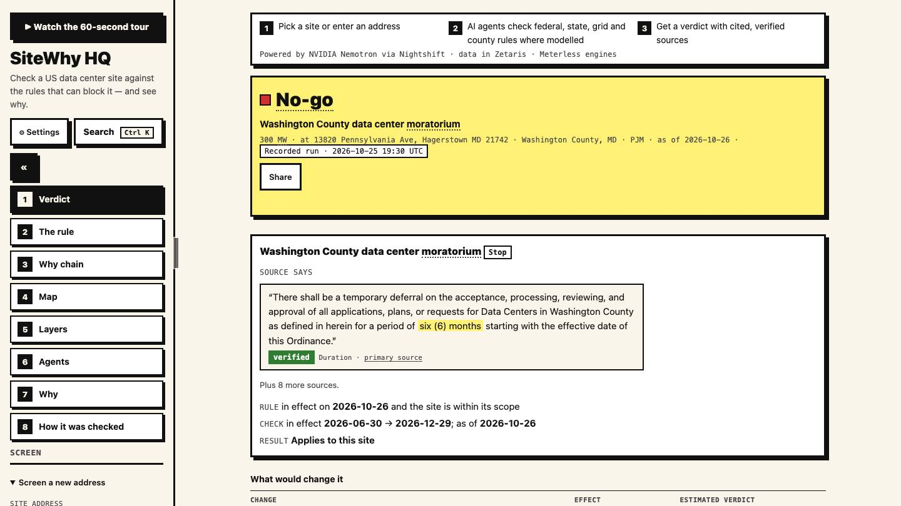
A no-go with its verified rule
Finding: Washington County
MD unincorporated at 300 MW
is no-go under county
moratorium ORD-2026-12.
Evidence: verbatim quote
with a verified badge,
duration and primary source,
then the in-effect check and
applies-to-site result.
Badge: showcase reports
carry a Recorded run mark
with the UTC date; live runs
carry none.
Figure 2. Recorded no-go report: county moratorium with verified quote and applicability math | Source:
app screenshot, 27 Oct 2026, 1440x810
Source: samples/md-washington-county-unincorporated.json

Slide 10
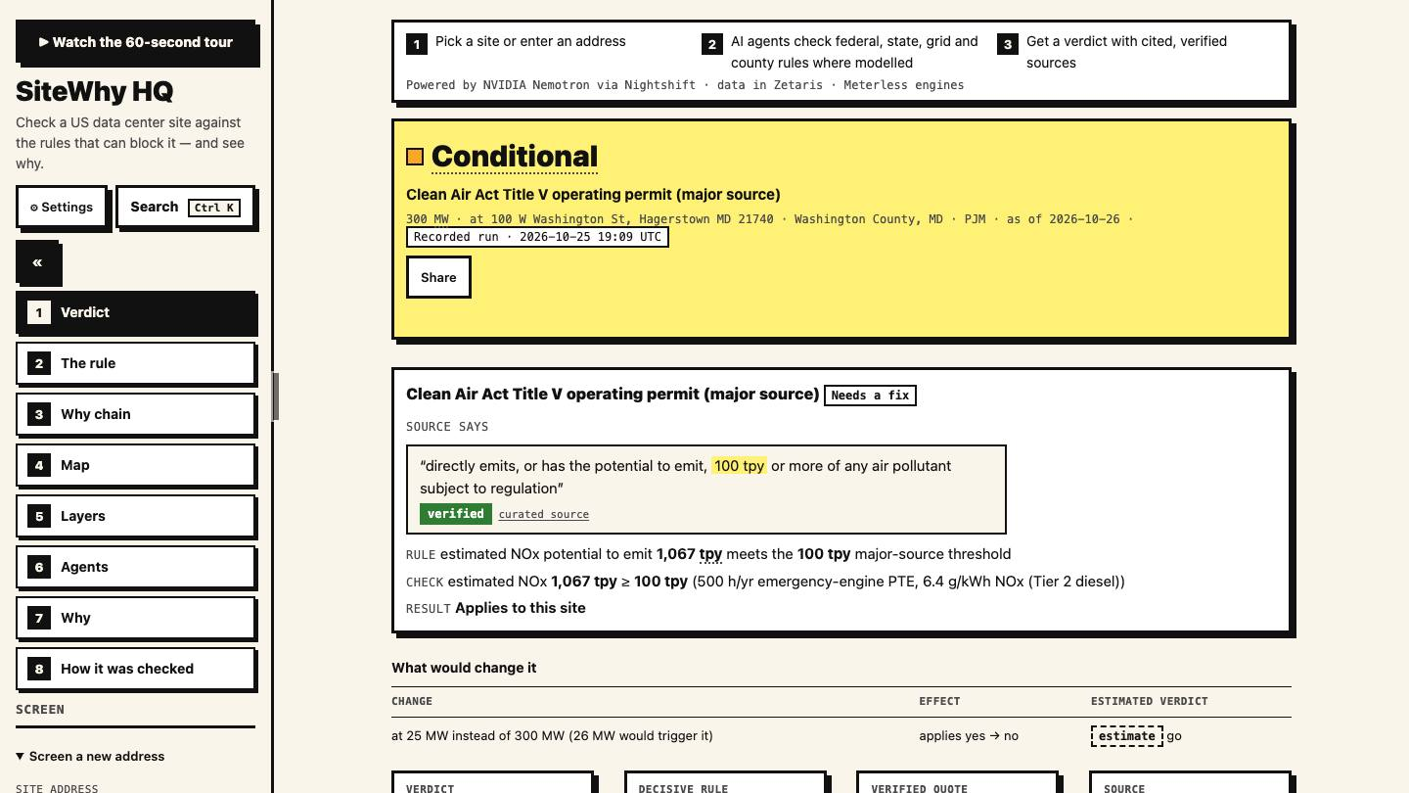
Incorporated city versus unincorporated county
Flip: the Hagerstown city
site is conditional because
the county ordinance does
not cover the city.
Math: the flips table shows that at 25 MW instead of 300 MW the Title V finding changes yes to no, with estimate badges on computed lines.
The scope flip is the headline
the demo leads with.
Figure 3. Recorded conditional report: the same county gives a different answer inside city limits |
Source: app screenshot, 27 Oct 2026, 1440x810
Source: samples/md-hagerstown-city.json

Slide 11
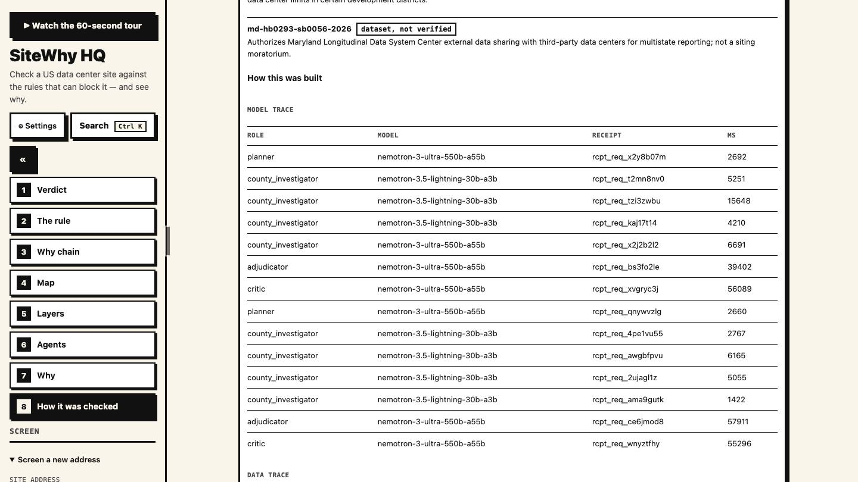
Every model call on the record
Trace: each row names the
agent role, the Nemotron
model, the compute receipt
and the latency.
Roles: Lightning handles
extraction and verification;
Ultra handles planning,
synthesis and critique.
30 traced calls across
5 samples: 18 Ultra and
12 Lightning.
Figure 4. Model trace: role, Nemotron model, compute receipt and latency per call | Source: app
screenshot, 27 Oct 2026, 1440x810
Source: samples/*.json model_trace; README evaluation

Slide 12
Recorded samples and verdicts
Sample | Input | Verdict
md-washington-county-unincorporated | 13820 Pennsylvania Ave, Hagerstown MD 21742, 300 MW | no-go
md-hagerstown-city | 100 W Washington St, Hagerstown MD 21740, 300 MW | conditional
tx-abilene-ercot | 555 Walnut St, Abilene TX 79601, 300 MW | conditional
tx-abilene-ercot-50mw | Same Abilene address, 50 MW | conditional
az-tucson-pima | 255 W Alameda St, Tucson AZ 85701, 300 MW | conditional
Table 5. samples/*.json, recorded 25 Oct 2026
Four sites at 300 MW plus a 50 MW contrast at the same address;
verdicts match the data/eval ground truth on the
3 checked sites.
Each sample carries model_trace with the model per request,
plus markovian_runs and events.
Source: samples/*.json

Slide 13
Planned enhancements and current scope
Enhancement | Why it matters
Agent rule discovery | Replace curated seed rules with runtime-verified discovery
More states and ISO rules | Extend beyond Texas and ERCOT plus two counties
Quote-to-value alignment check | Verify the numbers, not just quote presence
Multi-chunk Markovian demo | Show token savings on larger sources
Dockerfile judge path | One-command sample-mode run for judges
Table 6. Roadmap as of 27 Oct 2026; none of this changes the recorded verdicts above
Current scope stays honest: no accuracy claims beyond the
measured 3/3 ground truth and 3/3 seeded faults.
Pre-window datasets and the Meterless specs are declared as
pre-existing third-party material.
Source: plans/m4-submission.md; README limitations

Slide 14
The track
and the team
Track: The Agent That Can Explain Why. Solo team SiteWhy. Every verdict traces to a
quote plus arithmetic.

