Slide 1
Team 33
National Democratic institute

Slide 2
You want to test the game?
Register here :
Notes:
SMS Based Game
- to reach the majority of the humans
- based on questions to evaluate your skills

Slide 3
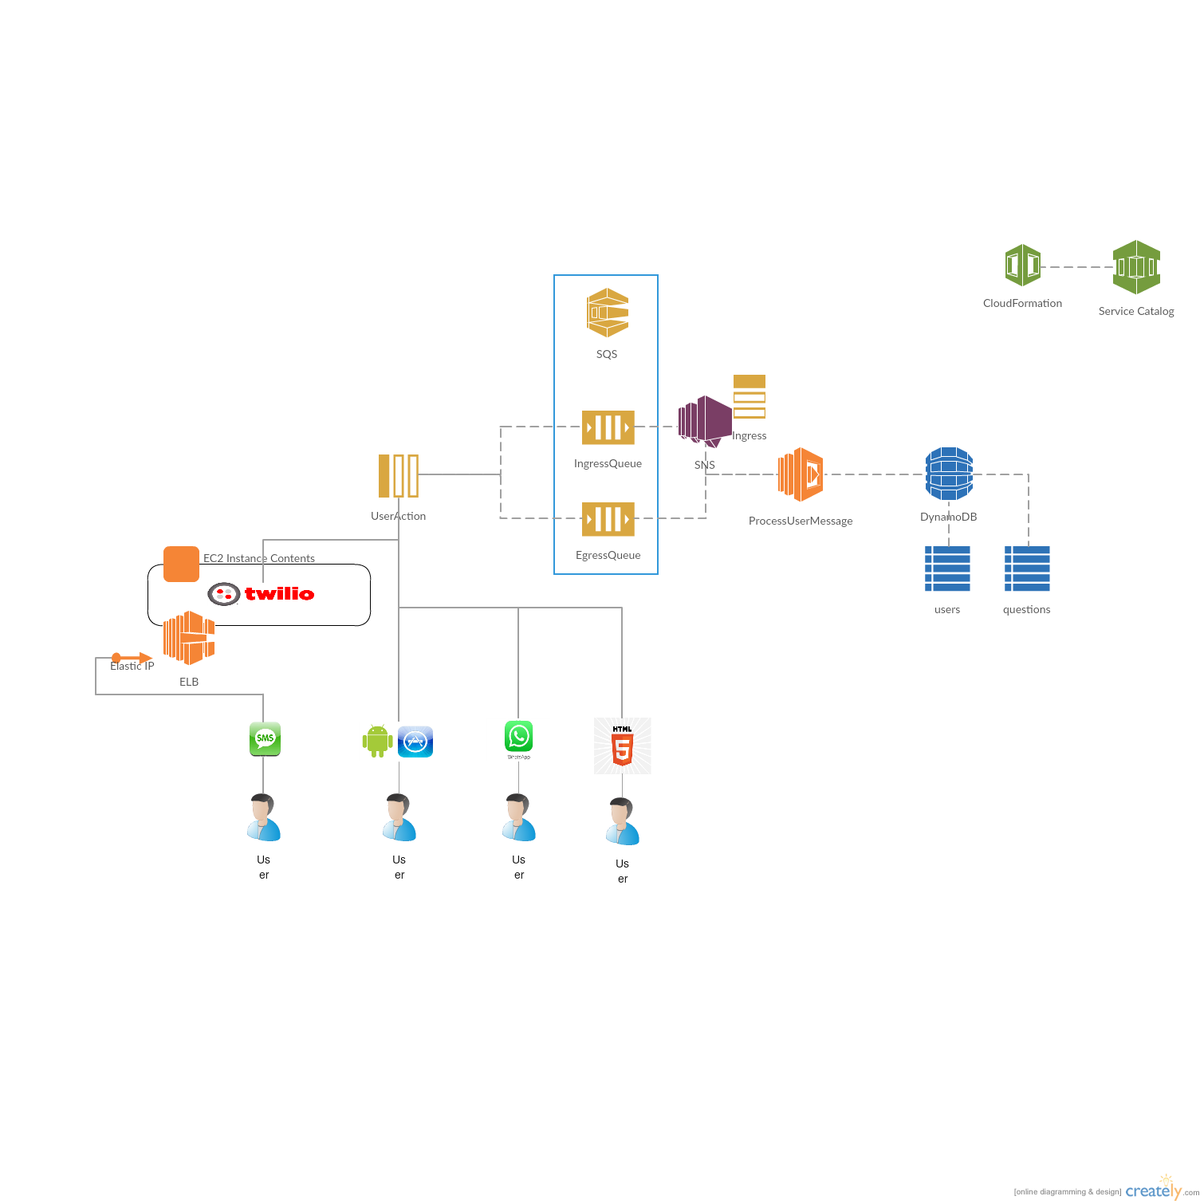

Slide 4
Future evolutions
Add themes and score
You can compete with your friends and measure your progress
Web application for administration purpose
Edit your game online
Client application in html5
With pictures & videos
Social network: ask your friends!

