Slide 1
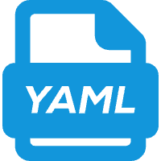
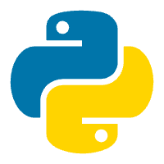
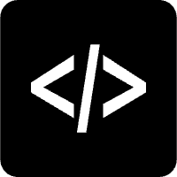





EasyOPD: A Three-Layer Framework for OPD Integration OPD
1
User Layer
Minimal user-side invocation
1
User
YAML Configs
gkd.yaml, simct.yaml, ...
Python / CLI
EasyOPD.from_hparams(...)
Examples
reproducible scripts
Choose method, config, and script.
2
EasyOPD Layer
Method-local OPD extensions
2
EasyOPD
Registry
method registration
Config
unified hyperparameters
Methods
Released OPD methods
Localize method-specific supervision.
Utils
shared tools
Metrics
training statistics
GKD
SDPO
SimCT
SOD
...
3
verl
🔗 Minimal hooks
loss
rollout
reward
alignment
teacher sidecar
Execute distributed training.
3
verl Execution Substrate
Reuse verl for rollout, optimization, and distributed execution
Select released methods
through YAML configurations!
Trainer
Rollout Engine
Reward Manager
Distributed Workers
Model Forward / Logit Processor
Parallel Execution
PPO / Distillation
Generation & Rollout
Reward Computation
Scalable execution
Efficient scaling
EasyOPD separates user-side invocation, method-level OPD logic, and verl execution.

