Slide 1
Chicago Crime Data Project
Liam O’Farrell
GA
08/12/15

Slide 2
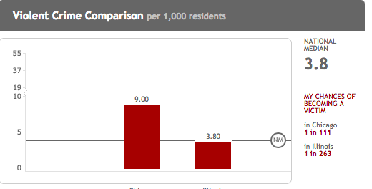
Background

Slide 3
Data
Open source Chicago crime data
Used data from 2010-2015
Shape: (1041356, 24)
Includes year, month, time of day, location, district, latitude and longitude, date, type of crime, and whether or not an arrest was made

Slide 4
Closest Distance
for i in xrange(len(crime_lat)):
initial_dist = 1000 for j in xrange(len(station_lat)):
dist = haversine(crime_lat[i], crime_long[i],station_lat[j], station_long[j])
if dist<initial_dist:
initial_dist = dist
nearest_pt.append(initial_dist)

Slide 5
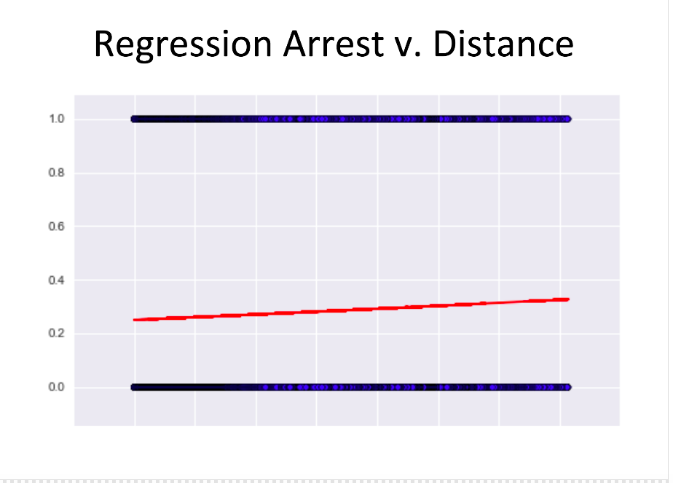
Previous Work

Slide 6
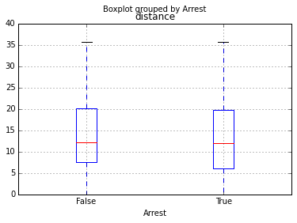

Slide 7
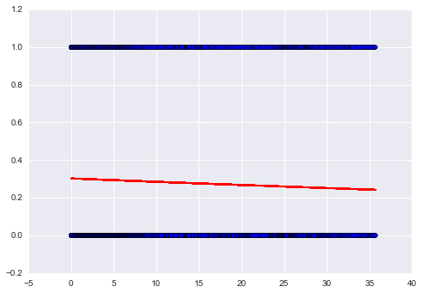
Updated Logistic Regression
*******NEW LOG GRAPH********

Slide 8
Pivot
Arrest or no arrest is a classificaiton problem
Not necessarily the best indicator
Analyze affect on total number of reported crimes
Becomes a regression problem

Slide 9
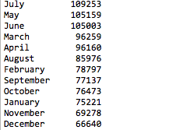
Data Exploration
Crime increases in summer months
Could be attributed to heat or schools getting out of school

Slide 10
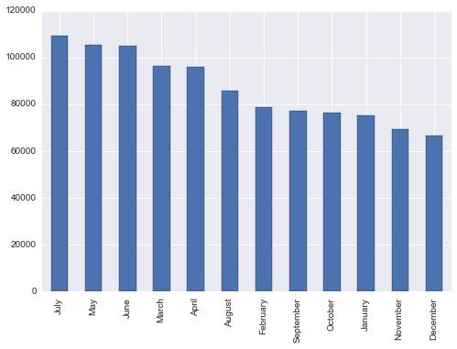

Slide 11
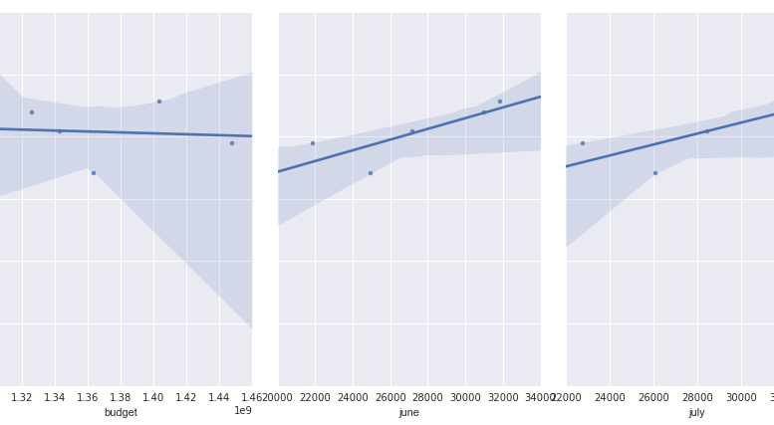
Linear Regression

Slide 12
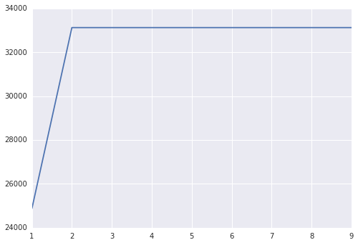

Slide 13
Next Steps
Extend Linear model further back
Incorporate more data
Explore other regression modeling techniques
Decision Trees
Random Forests
Ensembling

Slide 14
Questions?

