Slide 1
Victorious VBA
Day 6
The Data Bootcamp |
Saturday, January 19, 2019

Slide 2
Refresher

Slide 3
Refresher
Explain to a baby:
What is a for-loop?

Slide 4
Refresher
for-loop? Write once Use multiple times

Slide 5
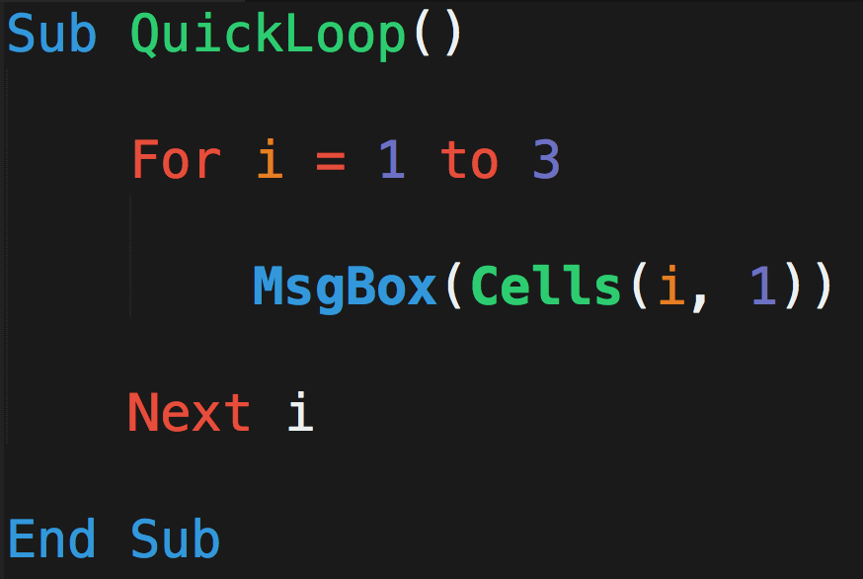
What Will This Code Do?
A
B
C
Michael | Luis | Ruchi
Evan | Mariah | Ricky
Jamie | Ron | Jeff
John | Lakshmi | Baskaran
1
2
3
4

Slide 6
What Will This Code Do?
A
B
C
Michael | Luis | Ruchi
Evan | Mariah | Ricky
Jamie | Ron | Jeff
John | Lakshmi | Baskaran
i = 1
1
2
3
When i = 1…
4

Slide 7
What Will This Code Do?
A
B
C
Michael | Luis | Ruchi
Evan | Mariah | Ricky
Jamie | Ron | Jeff
John | Lakshmi | Baskaran
1
i = 2
2
3
When i = 2…
4

Slide 8
What Will This Code Do?
A
B
C
Michael | Luis | Ruchi
Evan | Mariah | Ricky
Jamie | Ron | Jeff
John | Lakshmi | Baskaran
1
2
i = 3
3
When i = 3…
4

Slide 9
What Will This Code Do?
A
B
C
Michael | Luis | Ruchi
Evan | Mariah | Ricky
Jamie | Ron | Jeff
John | Lakshmi | Baskaran
1
2
i = 3
3
Nope….
Not going to i =4
4

Slide 10
Refresher
Explain to a baby:
What is a nested for-loop?

Slide 11
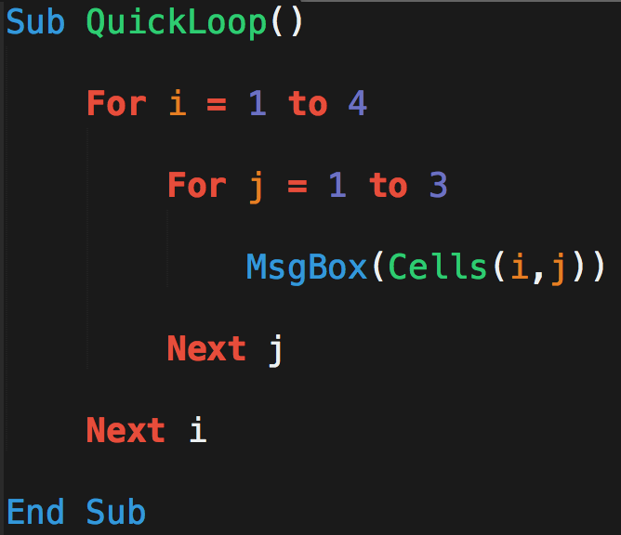
What Will This Code Do?
A
B
C
Michael | Luis | Ruchi
Evan | Mariah | Ricky
Jamie | Ron | Jeff
John | Lakshmi | Baskaran
1
2
3
4

Slide 12
What Will This Code Do?
A
B
C
i = 1
Michael | Luis | Ruchi
Evan | Mariah | Ricky
Jamie | Ron | Jeff
John | Lakshmi | Baskaran
j = 1
1
2
3
When…
i = 1
j = 1
4

Slide 13
What Will This Code Do?
A
B
C
Michael | Luis | Ruchi
Evan | Mariah | Ricky
Jamie | Ron | Jeff
John | Lakshmi | Baskaran
i = 1
j = 2
1
2
3
When…
i = 1
j = 2
4

Slide 14
What Will This Code Do?
A
B
C
Michael | Luis | Ruchi
Evan | Mariah | Ricky
Jamie | Ron | Jeff
John | Lakshmi | Baskaran
i = 1
j = 3
1
2
3
When…
i = 1
j = 3
4

Slide 15
What Will This Code Do?
A
B
C
Michael | Luis | Ruchi
Evan | Mariah | Ricky
Jamie | Ron | Jeff
John | Lakshmi | Baskaran
1
i = 2
j = 1
2
3
When…
i = 2
j = 1
4

Slide 16
What Will This Code Do?
A
B
C
Michael | Luis | Ruchi
Evan | Mariah | Ricky
Jamie | Ron | Jeff
John | Lakshmi | Baskaran
1
i = 2
j = 2
2
3
When…
i = 2
j = 2
4

Slide 17
What Will This Code Do?
A
B
C
Michael | Luis | Ruchi
Evan | Mariah | Ricky
Jamie | Ron | Jeff
John | Lakshmi | Baskaran
1
i = 2
j = 3
2
3
When…
i = 2
j = 3
4

Slide 18
What Will This Code Do?
A
B
C
Michael | Luis | Ruchi
Evan | Mariah | Ricky
Jamie | Ron | Jeff
John | Lakshmi | Baskaran
1
2
i = 3
j = 1
3
This continues…
4

Slide 19
VBA Formatting
.Font.ColorIndex = color Code
.Interior.ColorIndex = color Code Example: Range("C1").Font.ColorIndex = 5
Range("C2:C5").Interior.ColorIndex = 5 color guides: http://dmcritchie.mvps.org/excel/colors.htm

Slide 20
Looking to the Next Cell
<> look at value of the next cell
Example: If [NextCells].Value <> [CurrentCells].Value Then
….

Slide 21
Last non Empty Row or Column
Range.End() / Cells.End
The Range.End / Cells.End method is very similar to pressing the Ctrl+Arrow Key
Example: 'Find the last non-blank cell in column A(1)
lastRow = Cells(Rows.Count, 1).End(xlUp).Row
'Find the last non-blank cell in row 1
lastCol = Cells(1, Columns.Count).End(xlToLeft).Column

Slide 22
For Each Loop
For Each [item] in [list]
Example: For Each sheet in Worksheets
….
Next sheet

Slide 23
Questions / Discussion
Notes:
It’s important to keep in mind why you joined this class. Let’s talk about your goals.

