Slide 1




Data Analysis
and
Machine Learning Basics
Alex Razim, University of Nova Gorica, Slovenia
VISTULA workshop
Warsaw, Sep 22, 2026

Slide 2
Lecture outline
Part 0: Why are you here?
Part I: What is Machine Learning
‘Behaviour from the data’ principle
Optimization problem. Loss and cost functions
Gradient descent and backpropagation
SLP and MLP
Shallow and deep NNs
ML interpretability problem
ML types: supervised/un-/semi-/self-supervised
Classification, regression, clusterization, prediction
Part III: Interrogating the black box
Train/validation/test sets. Cross-validation
Bias-variance tradeoff
Overfitting
Precision-recall, F1 score
Confusion matrix, ROC, AUC
Typical failure modes

Slide 3
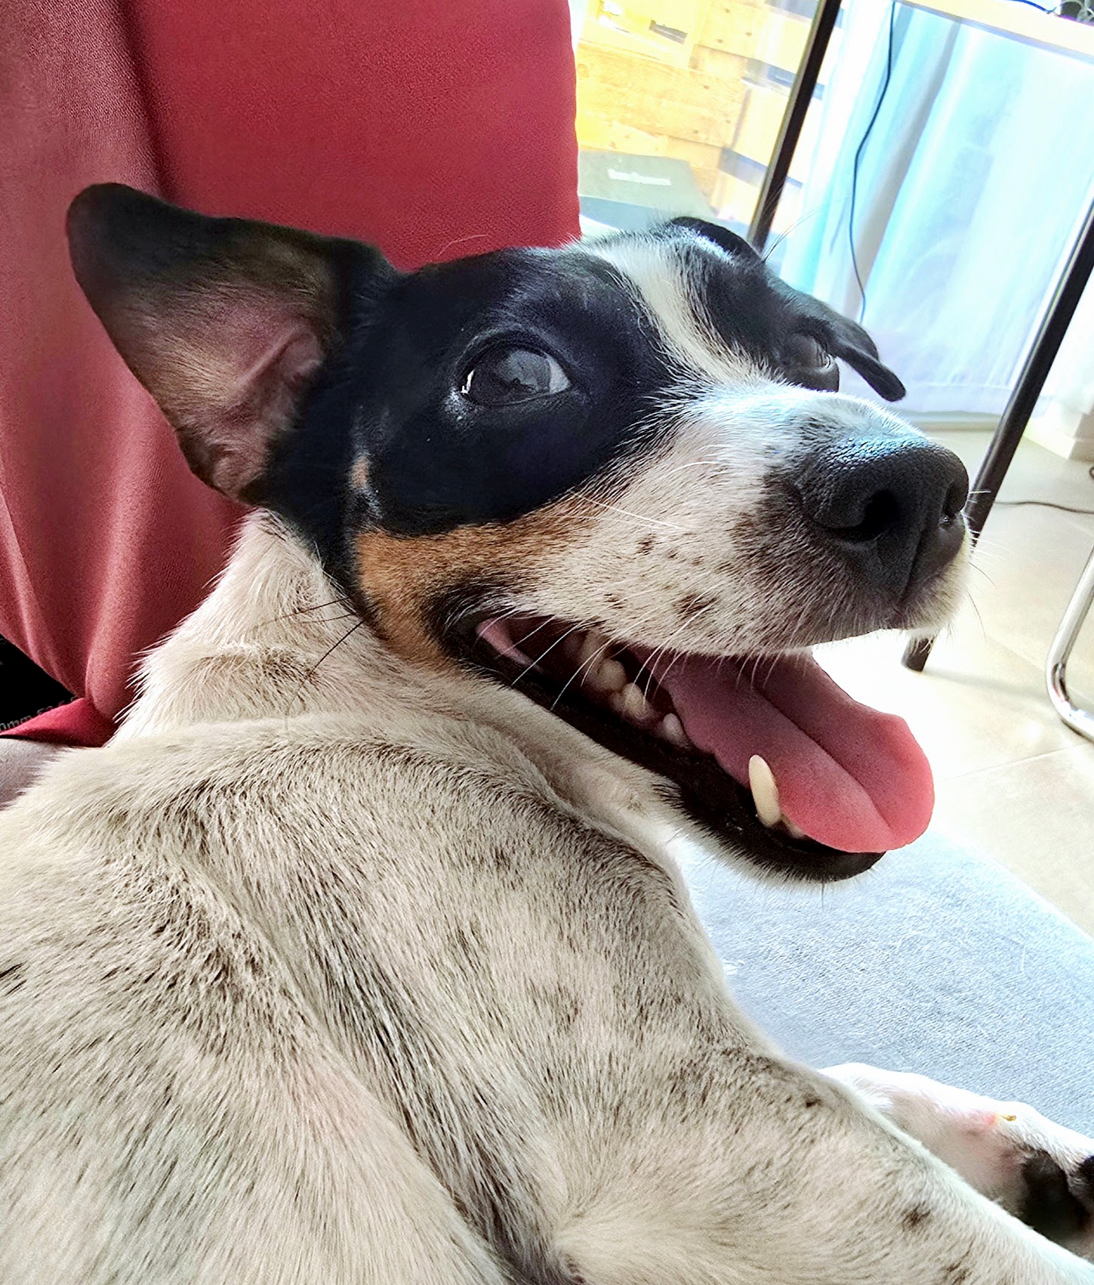
Alex Razim, astroinformatician = astronomy + ML + Data science
Boring biography stuff
I’m from Ukraine
BSc & MSc: Processing Moon images
PhD: Photometric redshifts (aka ‘distances to many-many galaxies, but with dubious accuracy’) with ML.
  Defended during Covid!
  Survived Naples!
First postdoc (Zagreb, Croatia): developed a catalogue of synthetic LSST magnitudes, organized a bunch of Python workshops for astronomers.
Second postdoc: SMASH fellow in the University of Nova Gorica, Slovenia
The dog to look at while I babble
Science: rare variability search
TL;RL: we need efficient novelty detection methods for PB-scale astronomica datasets. I look for these methods.
Example:
Take large astro-survey
Extract features using community-developed packages
Feed to a bunch of UML algorithms
See if we can find previous accidental discoveries semi-automatically

Slide 4
Part 0: Who are you people,
and why are you here?

Slide 5
SPEC.md
What is your topic?
What question your work tries to answer?
How often do you write code?
How often do you generate code?
Which coding languages?
Did you use ML before?
Does your group uses ML?
What should happen during this workshop for you to feel
that you spent your time well?

Slide 6
Part 1: What is Machine Learning

Slide 7
ML as advanced calculus
Machine learning – algorithms that learn from data and can perform tasks for which they were not explicitly programmed.
But what do we mean by ‘learning’?..

Slide 8
ML as advanced calculus
Machine learning – algorithms that learn from data and can perform tasks for which they were not explicitly programmed.
But what do we mean by ‘learning’?..
ML method is a method whose capabilities improve as it sees more data (D. Hogg) ->

Slide 9
ML as advanced calculus
Machine learning – algorithms that learn from data and can perform tasks for which they were not explicitly programmed.
But what do we mean by ‘learning’?..
ML method is a method whose capabilities improve as it sees more data (D. Hogg) ->
Learning is the ability to perform the task better when presented with more (relevant) data.

Slide 10
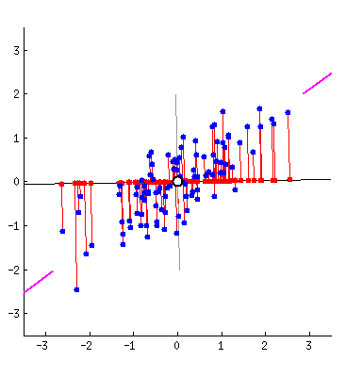
ML as advanced calculus
Machine learning – algorithms that learn from data and can perform tasks for which they were not explicitly programmed.
But what do we mean by ‘learning’?..
ML method is a method whose capabilities improve as it sees more data (D. Hogg) ->
Learning is the ability to perform the task better when presented with more (relevant) data.
From the practical point of view,
learning = optimization = minimizing (or maximizing) certain target value.

Slide 11
Minimizing what?
…sorry, terminology detour first.

Slide 12
Minimizing what?
…sorry, terminology detour first.
Data point (sometimes called ‘sample’) - a set of observed values (‘features’) describing an object or an event (in practice: rows in the table).
Label (or ‘target’) - the property of the data points that we try to learn, e.g. a classification (‘elliptical or spiral’, ‘a star or a quasar’) or a numerical value of interest (e.g. a sersic index or a redshift). In practice: the columns.
Prediction - the label that the trained model assigns to the data point.

Slide 13
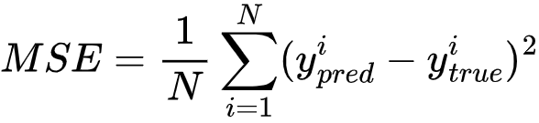
(coming back) So, minimizing what?
Loss function – how we calculate an error for a single prediction. E.g.:
square_loss = (y_{pred} - y_{true})²
Cost function - loss function, averaged across the whole sample. E.g.:
Mean Squared Error, aka
How MSE would behave if you have extreme outliers?..

Slide 14
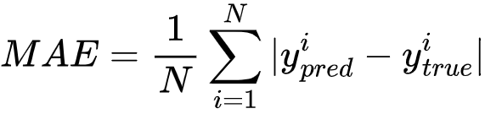
Minimizing what?
Loss function – how we calculate an error for a single prediction. E.g.:
square_loss = (y_{pred} - y_{true})²
Cost function - loss function, averaged across the whole sample. E.g.:
Mean Squared Error, aka
How MSE would behave if you have extreme outliers?..
MSE penalizes extreme outliers strongly. An alternative - Median Absolute Error (MAD):

Slide 15
Minimizing what?
Loss function – how we calculate an error for a single prediction. E.g.:
square_loss = (y_{pred} - y_{true})²
Cost function - loss function, averaged across the whole sample. E.g.:
Mean Squared Error, aka
How MSE would behave if you have extreme outliers?..
MSE penalizes extreme outliers strongly. An alternative - Median Absolute Error (MAD):
There is no universal cost (or loss) function. You have to choose one depending on your task (or sometimes design one)

Slide 16
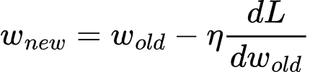
Gradient descent
We want to minimize the value of the loss function L ->
we have to move in the direction of negative gradient ->
change inputs of L to move it in the direction of negative gradient ->
gradient descent
where L is the loss function, and - learning rate

Slide 17

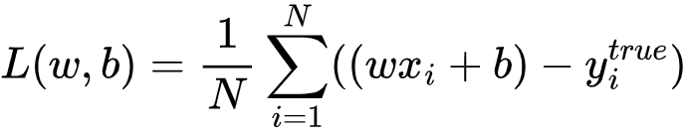
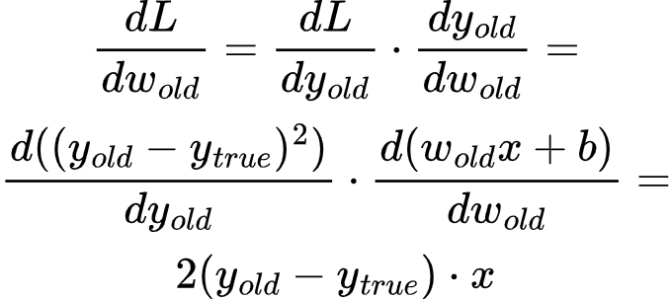
Linear regression example
x - our data - is fixed, y^true - our labels - are fixed. We can change only w and b
For w,
(pay attention, we have to do the same for b as well)

Slide 18
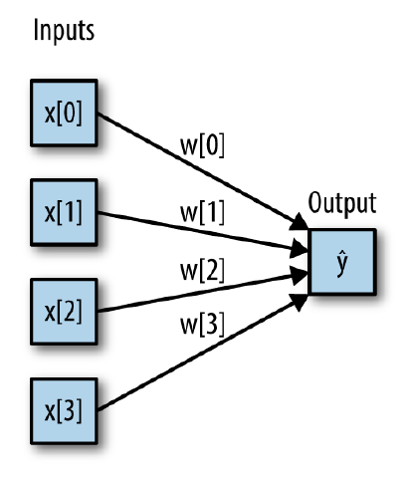
How to approximate anything
Single feature -> many features:

Slide 19
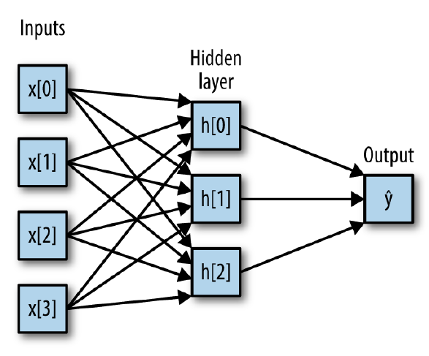
How to approximate anything
Single feature -> many features:
Add layers

Slide 20
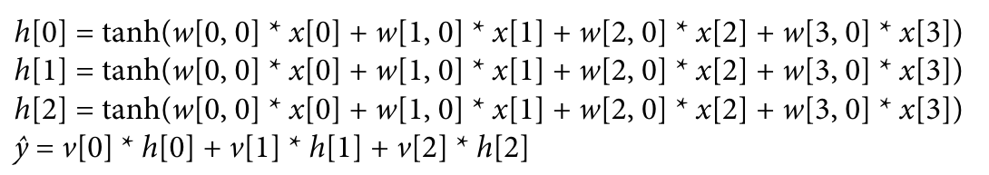
How to approximate anything
Single feature -> many features:
Add layers
Add an activation function (because without one you always produce
only straight lines)

Slide 21
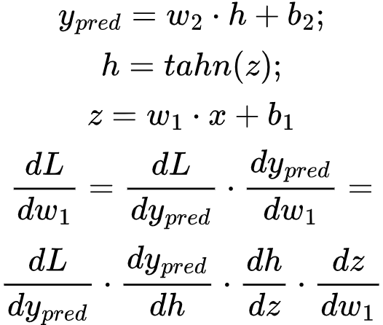
But how do we update all the weights?..
Que backpropagation:

Slide 22
But how do we update all the weights?..
Que backpropagation:
x
backpropagated derivative
local derivative for the neuron

Slide 23
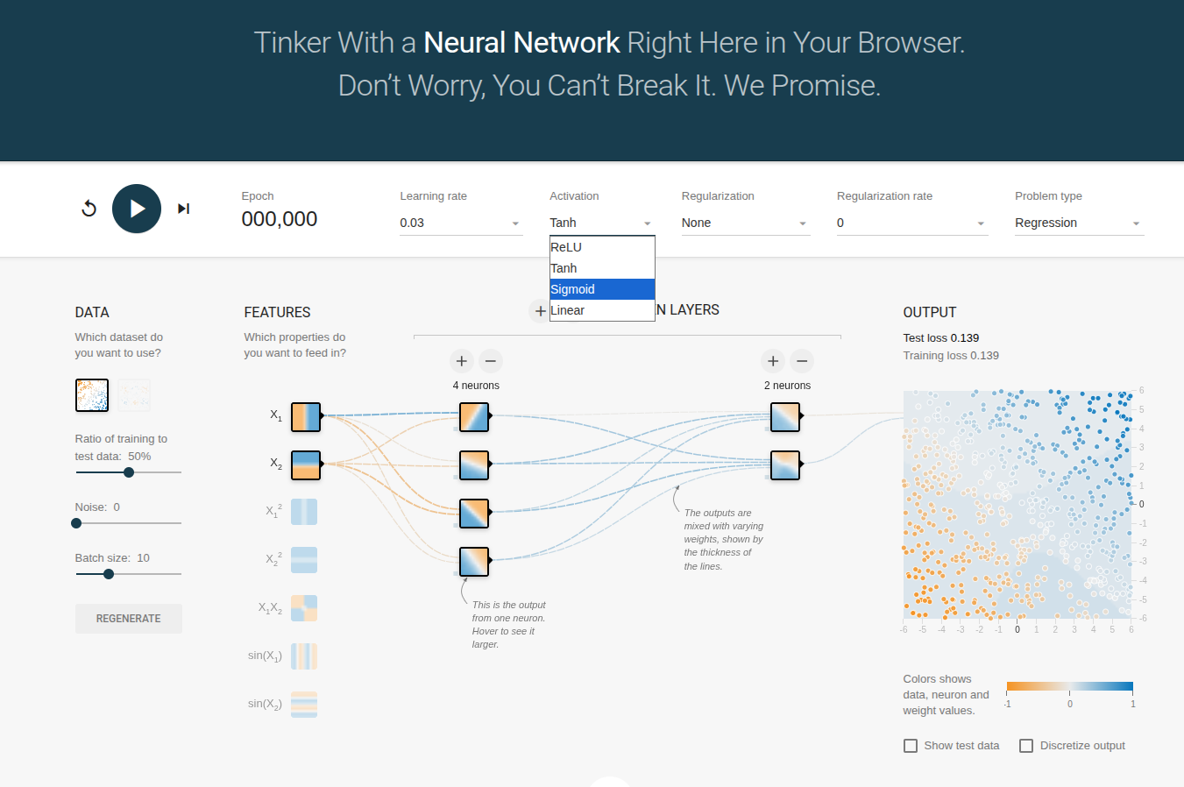
Playtime
https://playground.tensorflow.org/

Slide 24
Part 2: ML Zoo

Slide 25
ML taxonomy
Supervised
Reinforcement
Unsupervised
Self-supervised
Learn from labelled data
Learn via reward and punishment
Find patterns and structures in unlabelled data
Create labels from the data itself
Clustering
Computer
vision
Classification
Robotics
Dimensionality
reduction
World models
Regression
LLMs
Outlier
detection
Gaming

Slide 26
ML taxonomy
Supervised
Reinforcement
Unsupervised
Self-supervised
Learn from labelled data
Learn via reward and punishment
Find patterns and structures in unlabelled data
Create labels from the data itself
Clustering
Computer
vision
Classification
Robotics
Dimensionality
reduction
World models
Regression
LLMs
Outlier
detection
Gaming

Slide 27
ML taxonomy
Supervised
Reinforcement
Unsupervised
Self-supervised
Learn from labelled data
Learn via reward and punishment
Find patterns and structures in unlabelled data
Create labels from the data itself
Clustering
Computer
vision
Classification
Robotics
Dimensionality
reduction
World models
Regression
LLMs
Outlier
detection
Gaming

Slide 28
ML taxonomy
Supervised
Reinforcement
Unsupervised
Self-supervised
Learn from labelled data
Learn via reward and punishment
Find patterns and structures in unlabelled data
Create labels from the data itself
Clustering
Computer
vision
Classification
Robotics
Dimensionality
reduction
World models
Regression
LLMs
Outlier
detection
Gaming

Slide 29
ML taxonomy
Supervised
Reinforcement
Unsupervised
Self-supervised
Learn from labelled data
Learn via reward and punishment
Find patterns and structures in unlabelled data
Create labels from the data itself
Clustering
Computer
vision
Classification
Robotics
Dimensionality
reduction
World models
Regression
LLMs
Outlier
detection
Gaming

Slide 30
ML taxonomy
Supervised
Reinforcement
Unsupervised
Self-supervised
Learn from labelled data
Learn via reward and punishment
Find patterns and structures in unlabelled data
Create labels from the data itself
Clustering
Computer
vision
Classification
Robotics
Dimensionality
reduction
World models
Regression
LLMs
Outlier
detection
Gaming

Slide 31
ML taxonomy
Supervised
Reinforcement
Unsupervised
Self-supervised
Learn from labelled data
Learn via reward and punishment
Find patterns and structures in unlabelled data
Create labels from the data itself
Clustering
Computer
vision
Classification
Robotics
Dimensionality
reduction
World models
Regression
LLMs
Outlier
detection
Gaming

Slide 32
ML taxonomy
Supervised
Reinforcement
Unsupervised
Self-supervised
Learn from labelled data
Learn via reward and punishment
Find patterns and structures in unlabelled data
Create labels from the data itself
Clustering
Computer
vision
Classification
Robotics
Dimensionality
reduction
World models
Regression
LLMs
Outlier
detection
Gaming

Slide 33
ML taxonomy
Supervised
Reinforcement
Unsupervised
Self-supervised
Learn from labelled data
Learn via reward and punishment
Find patterns and structures in unlabelled data
Create labels from the data itself
Clustering
Computer
vision
Classification
Robotics
Dimensionality
reduction
World models
Regression
LLMs
Outlier
detection
Gaming

Slide 34
Part 3: Interrogating
the Black Box

Slide 35
Exploratory Data Analysis or EDA
Exploratory Data Analysis = systematic inspection of structure, distributions, relationships and anomalies in the dataset.
Purpose: detect errors, form hypotheses, and understand modeling constraints.
Steps:
Dataset shape - size and dimensionality
Missing value analysis
Summary statistics
Feature distributions
2D relationships
Correlation analysis
Target variable inspection
Lots of plots. LOTS.

Slide 36
EDA: Basic stats
‘Five number summary’:
Extrema: min, max
Median
Q1, Q3 (values that split the lowest 25% of data from the highest 75% and vice versa) -> Q3-Q1 aka ‘interquantile range’ is a common ML feature!
Also:
Mean (but median is more robus)
Standard deviation (but quantiles are more robust again)

Slide 37
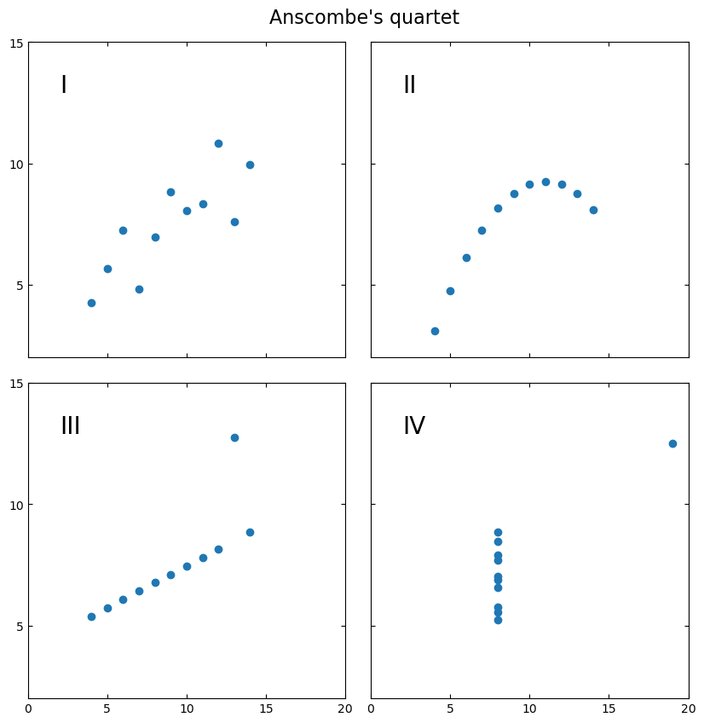
EDA: Lies, damned lies, and statistics
Which statistical indicators you’d use to describe these datasets in a paper?
Notes:
You did four experiments and got four datasets, but the journal in which you want to publish raised publishing fees again and you don’t have space for a plot. You can fit only a small table with some statistical descriptors. Which ones would you choose to illustrate how the outcomes of your experiments differ from one another?

Slide 38
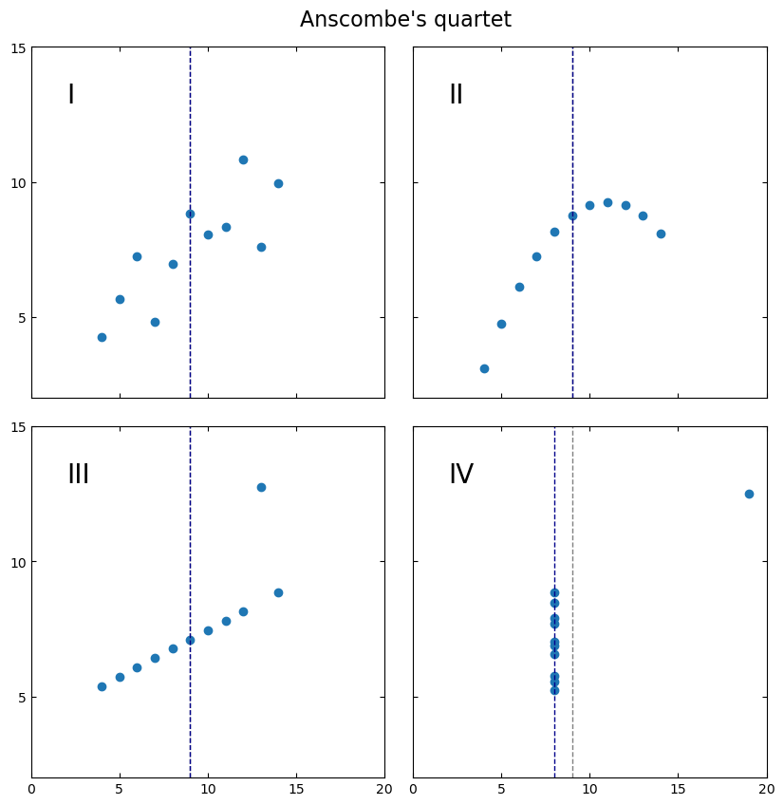
EDA: Lies, damned lies, and statistics
Which statistical indicators you’d use to describe these datasets in a paper?
Notes:
You did four experiments and got four datasets, but the journal in which you want to publish raised publishing fees again and you don’t have space for a plot. You can fit only a small table with some statistical descriptors. Which ones would you choose to illustrate how the outcomes of your experiments differ from one another?

Slide 39
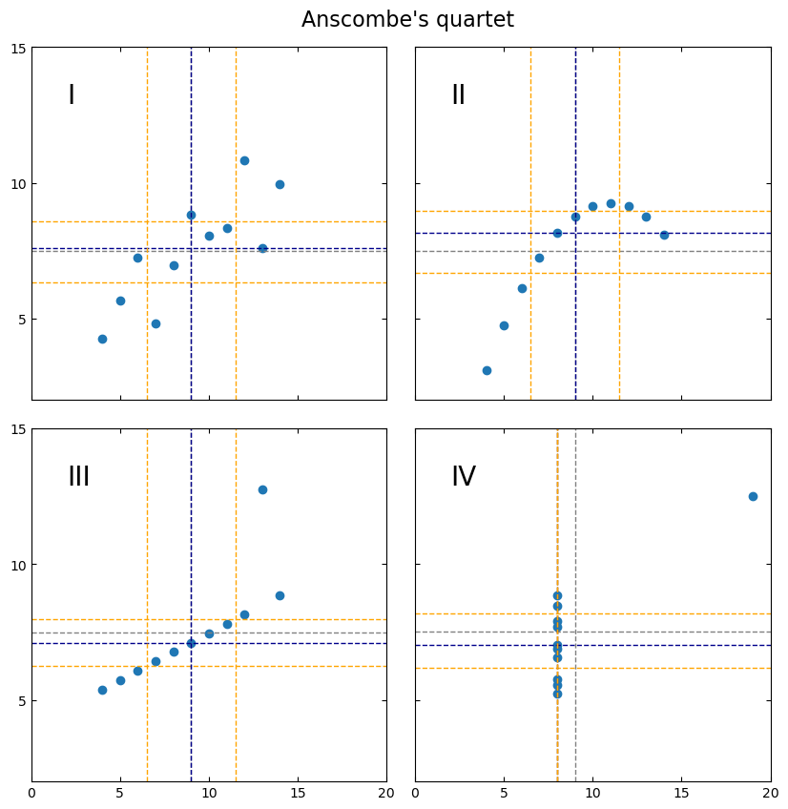
EDA: Lies, damned lies, and statistics
Which statistical indicators you’d use to describe these datasets in a paper?

Slide 40
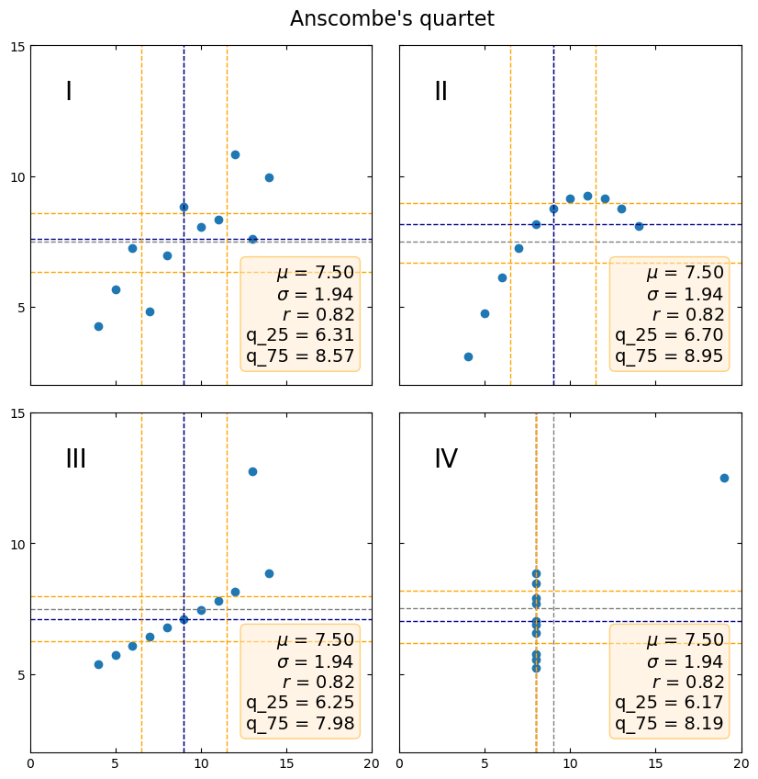
EDA: Lies, damned lies, and statistics
Which statistical indicators you’d use to describe these datasets in a paper?

Slide 41
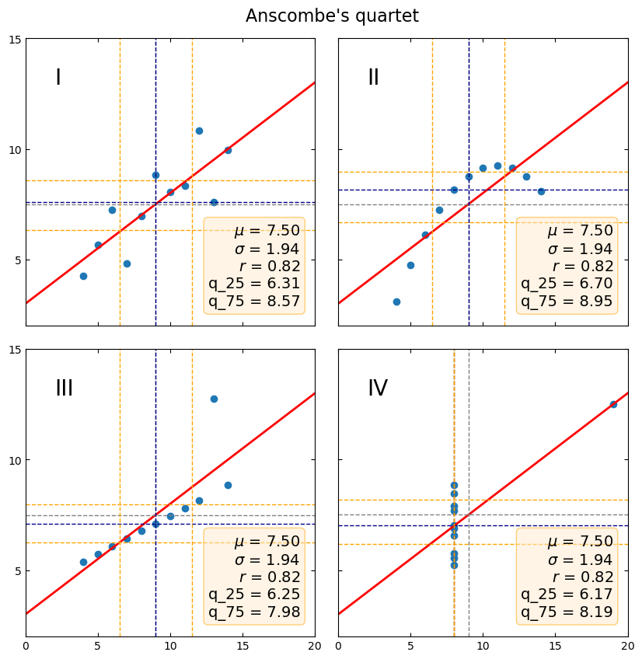
EDA: Lies, damned lies, and statistics
Which statistical indicators you’d use to describe these datasets in a paper?

Slide 42

EDA: Lies, damned lies, and statistics
Which statistical indicators you’d use to describe these datasets in a paper?

Slide 43
EDA: Distributions matter
Things to inspect:
Skewness (affects gradient-based optimization)
Heavy tails (amplify variance)
Multimodality (suggests hidden subpopulations)
Outliers (distort scaling and correlation)
Notes:
We can think of ML as of something that works with matrices, but we can also think about it as about something that works with multidimensional geometry, or a landscape.

Slide 44
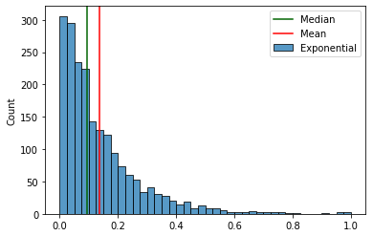
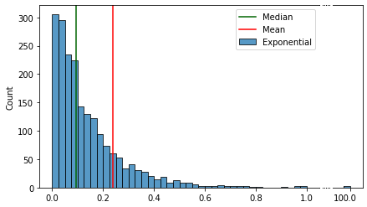
EDA: Exhibit A: ‘Long tail’
https://habr.com/ru/articles/527334/
Notes:
We can think of ML as of something that works with matrices, but we can also think about it as about something that works with multidimensional geometry, or a landscape.

Slide 45
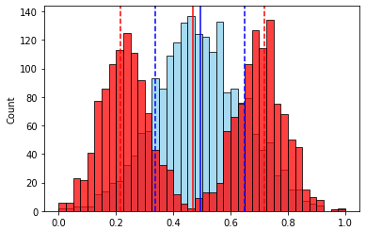
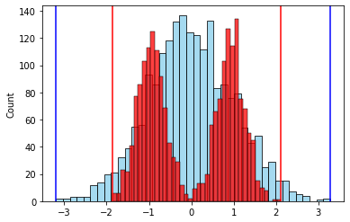
EDA: Exhibit B: Type of distribution and standatization
https://habr.com/ru/articles/527334/
Notes:
We can think of ML as of something that works with matrices, but we can also think about it as about something that works with multidimensional geometry, or a landscape.

Slide 46
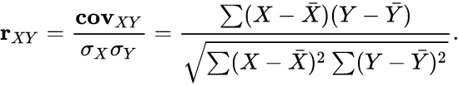
EDA: Correlation analysis
Pearson correlation:
Sensitive to outliers
Misses nonlinear structure
Does not imply causation!
High correlation → possible redundancy → risk of overfitting later, however,
conditional feature importance is a thing.

Slide 47
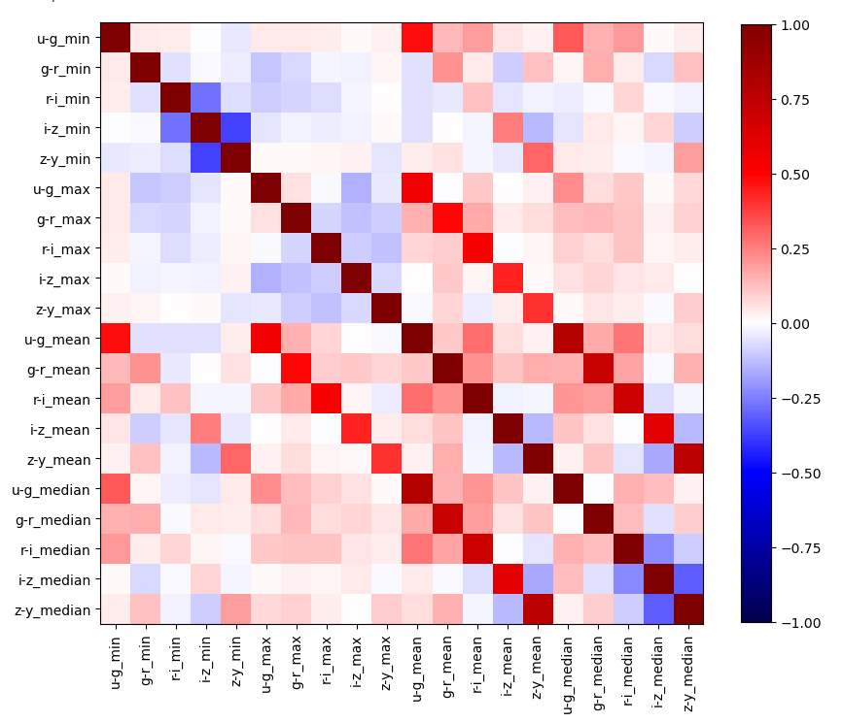
EDA: Correlation analysis

Slide 48
EDA: Label leakage detection
Label leakage – ‘use of information during model training that would not be available at prediction time’.
Examples:
using total number of visits to a doctor when trying to predict illness recurrence risk
using total number of observations when trying to classify rare, super-interesting objects
timestamps, coordinates, hand-written labels on X-ray images…
features extraction or any kind of preprocessing done separately for different
classes of objects (with some parameters changing in the process)))
Leads to artificially high validation performance
If corr matrix shows super-high correlation of one or few features with the label - you’re in trouble (likely)).

Slide 49

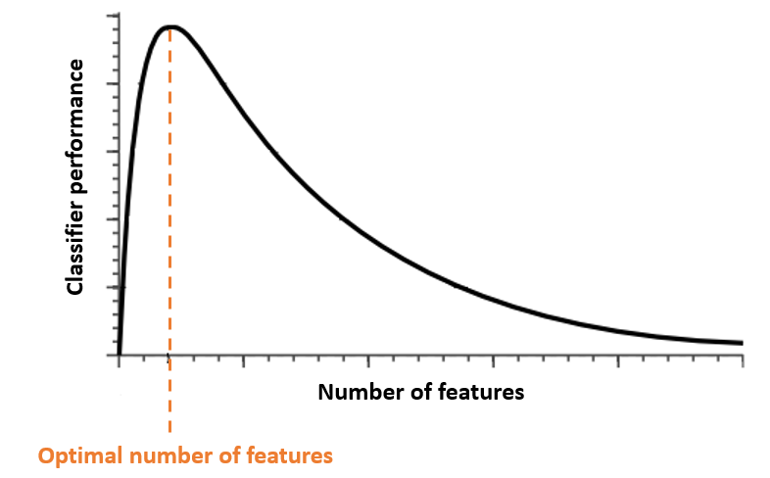
More ≠ better: Curse of Dimensionality
As feature dimension increases:
Distances become similar
Data becomes sparse
Density estimation becomes unreliable
High-dimensional space is mostly empty :/

Slide 50
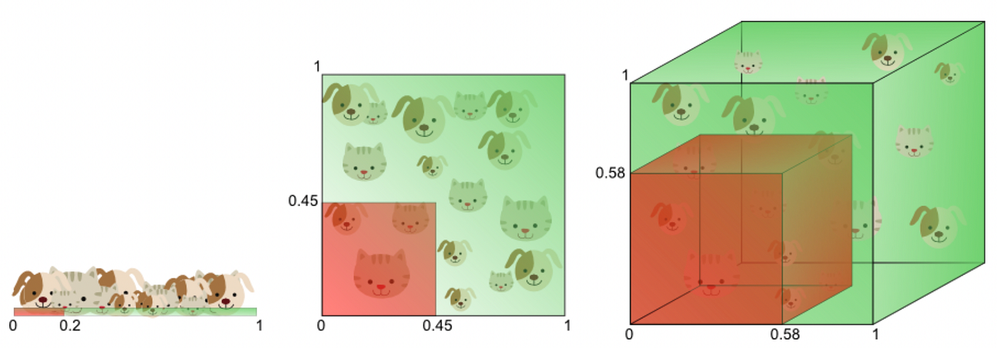
More ≠ better: Curse of Dimensionality

Slide 51
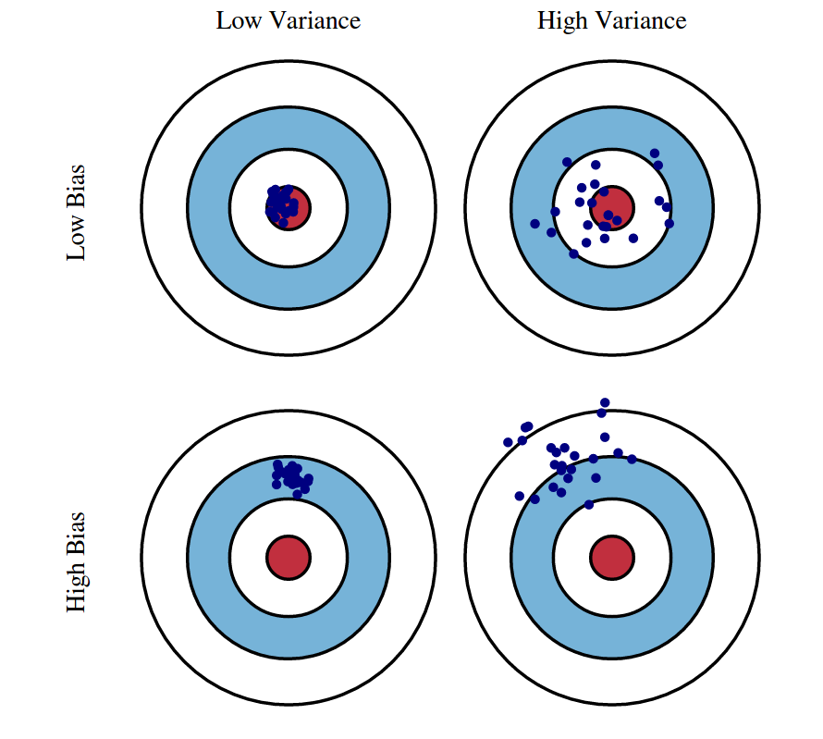
More ≠ better: Bias-Variance Tradeoff
Small dataset + many features -> high variance.
Model complexity increases -> training error decreases. Because the model memorizes everything!
Validation error eventually increases (good performance on train split, but bad on unfamiliar data).
Consequence – overfitting: the model learns noise instead of signal.
Rule of thumbs: num_samples > x*num_features
(x commonly equals 5, but it depends)

Slide 52
Feature selection
Goal: Reduce variance, remove noise, and lower parameter space dimensionality.
Methods:
Correlation filtering: remove highly correlated features
Greedy selection: iterative addition/removal
Tree-based importance: model-based ranking
Permutation importance: measure performance drop when feature shuffled
Selection reduces overfitting risk.

Slide 53
The Holy Trinity: Train / Validation / Test
Classic split of the whole dataset with labels: train/validation/test, 60/20/20%.
Train: Fit parameters (the subset on which you train your models).
Validation: Tune hyperparameters (the subset you use for evaluating the performance while tweaking the knobs).
Test: Final unbiased estimate (the subset which numbers you report in the paper).
Preprocessing must be learned (‘fit’ methods) on training data only, then applied (‘transform’ methods) on everything else.

Slide 54

If you don’t have that much data…
k-fold cross-validation:
Split data into k parts
Train on k−1
Validate on remaining
Average results
Reduces variance of estimate.

Slide 55
Model Robustness and Distribution Shift
Model robustness: making sure that
the model performs well if some feature is messed up
if there is noise
if feature relations have changed (data distribution shift).
Types of distribution shift:
Covariate shift (features change)
Concept drift (target relation changes)
ML models are interpolators, not extrapolators. Verify parameter space distributions!

Slide 56
Classification Metrics: TP, TN, FP, FN
For binary classification, there are following possibilities:
 | Predicted class: 0 | Predicted class: 1
Real class: 0 | True negatives (TN) | False positives (FP)
Real class: 1 | False negatives (FN) | True positives (TP)

Slide 57
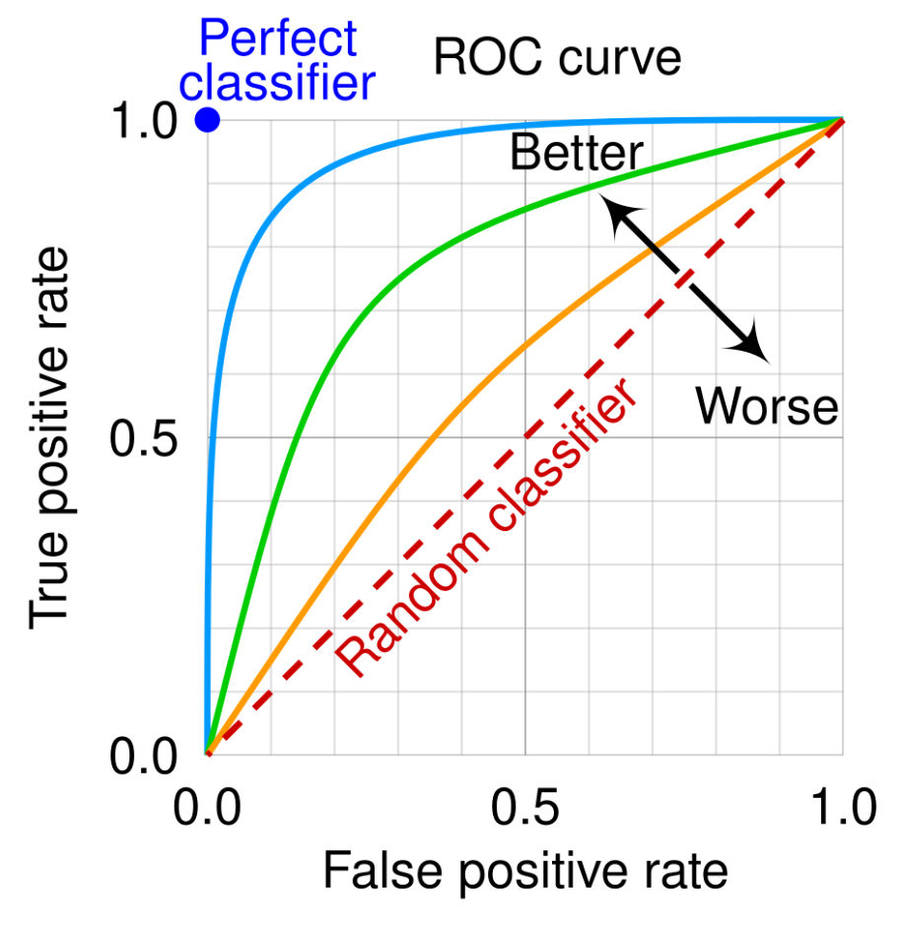
Classification Metrics: higher level
Precision=TP​/(TP+FP)
Recall = TP/(TP+FN)
F1 = 2P*R/(P+R​)
Receiver operating characteristic curve (ROC):
True Positive Rate to False Positive Rate

Slide 58
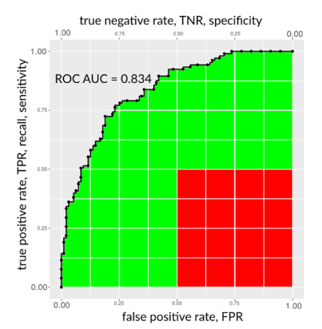
Classification Metrics: higher level
Precision=TP​/(TP+FP)
Recall = TP/(TP+FN)
F1 = 2P*R/(P+R​)
Receiver operating characteristic curve (ROC):
True Positives to False Positives
Area Under the Curve: rough metric to compare
model performances

Slide 59
Classification Metrics: higher level
from sklearn.metrics import classification_report
print(classification_report(y_test, pred))
precision recall f1-score support
0 0.98 0.97 0.98 357
1 0.58 0.63 0.60 30
2 0.88 0.96 0.92 158
3 0.75 0.82 0.78 33
4 0.29 0.13 0.18 31
accuracy 0.90 609
macro avg 0.69 0.70 0.69 609
weighted avg 0.89 0.90 0.89 609

Slide 60
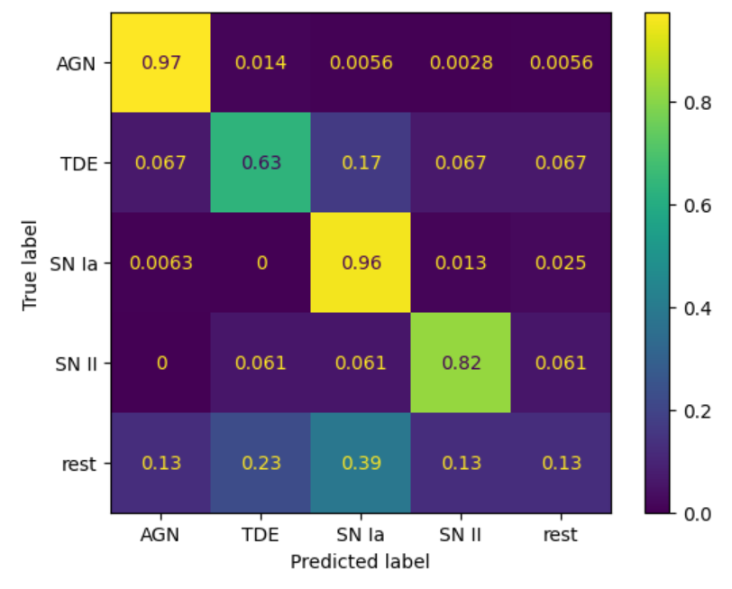
Classification Metrics: higher level
from sklearn.metrics import ConfusionMatrixDisplay
ConfusionMatrixDisplay.from_predictions(y_test, pred,
display_labels=['AGN','TDE','SN Ia','SN II',
'rest'],normalize='true')

Slide 61
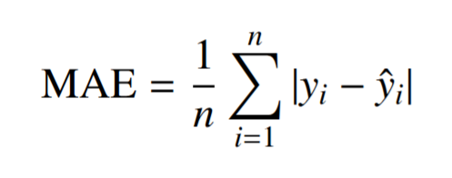
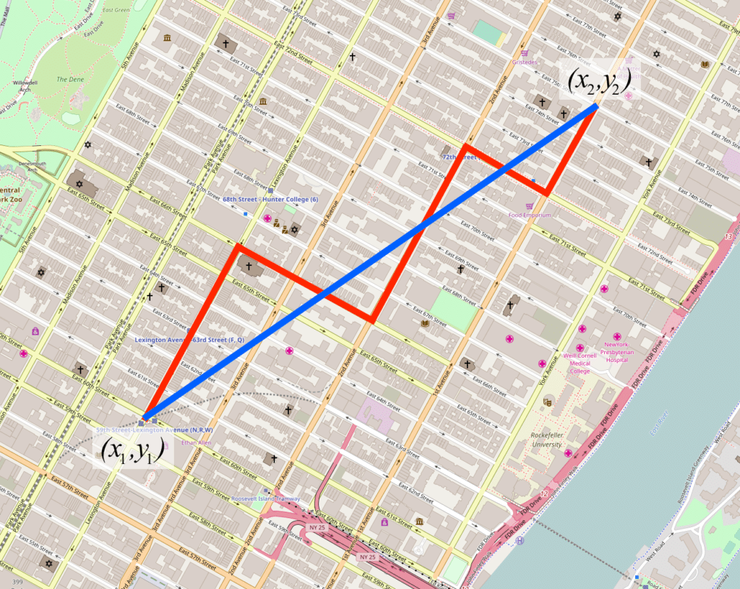
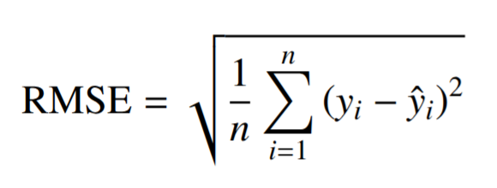
Regression metrics: MAE and RMSE
Difference between loss function and metric:
Loss is for the algorithm (has to be differentiable and computationally cheep), metric is for humans (easy to understand, relevant to the problem).
You can (and sometimes should!) write your own loss and metric functions!
Mean absolute error (MAE):
Root mean square error (RMSE):

Slide 62
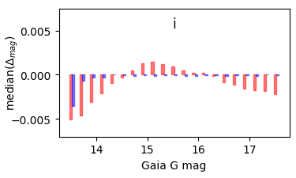
Regression metrics: MAE and RMSE
Remember: statistics knows how to lie. Single number is not informative.
Use residual plots and binned statistics (in 1D, 2D, nD…)
Mean absolute error (MAE):
Root mean square error (RMSE):

Slide 63

Final notes: Reproducibility
Fix random seeds
Save train/test splits
Log preprocessing steps
Version datasets (not just in file names :))
Separate config from code
Use git (no, seriously, use git, please)

Slide 64
Final notes: Workflow
Data
EDA -> Cleaning -> Feature engineering -> Split -> Train -> Evaluate (-> Rinse -> Repeat)

Slide 65
Final notes: Workflow
Data
EDA -> Cleaning -> Feature engineering -> Split -> Train -> Evaluate (-> Rinse -> Repeat)
70% of the time
90% of success

