Slide 1
RANDOM

Slide 2


Pseudo Random Number Generator with Cellular Automation (Rule 30)

Slide 3
Background
Pseudo Random Number Generator (PRNG)
Generating a sequence of numbers whose properties approximate the properties of sequences of random numbers
Cellular Automation (CA)
A discrete model consist of a regular grid of cells, each of a finite number of states

Slide 4
Rule 30
One-dimensional binary rule
Every cell spontaneously changes state based on its current state and the state of its two neighbors
Display aperiodic, chaotic behavior
Fig 1. One example with seed = [1]
Table 1 The new state of the cell
Current pattern | 110 | 110 | 101 | 100 | 011 | 010 | 001 | 000
New state of center cell | 0 | 0 | 0 | 1 | 1 | 1 | 1 | 0

Slide 5

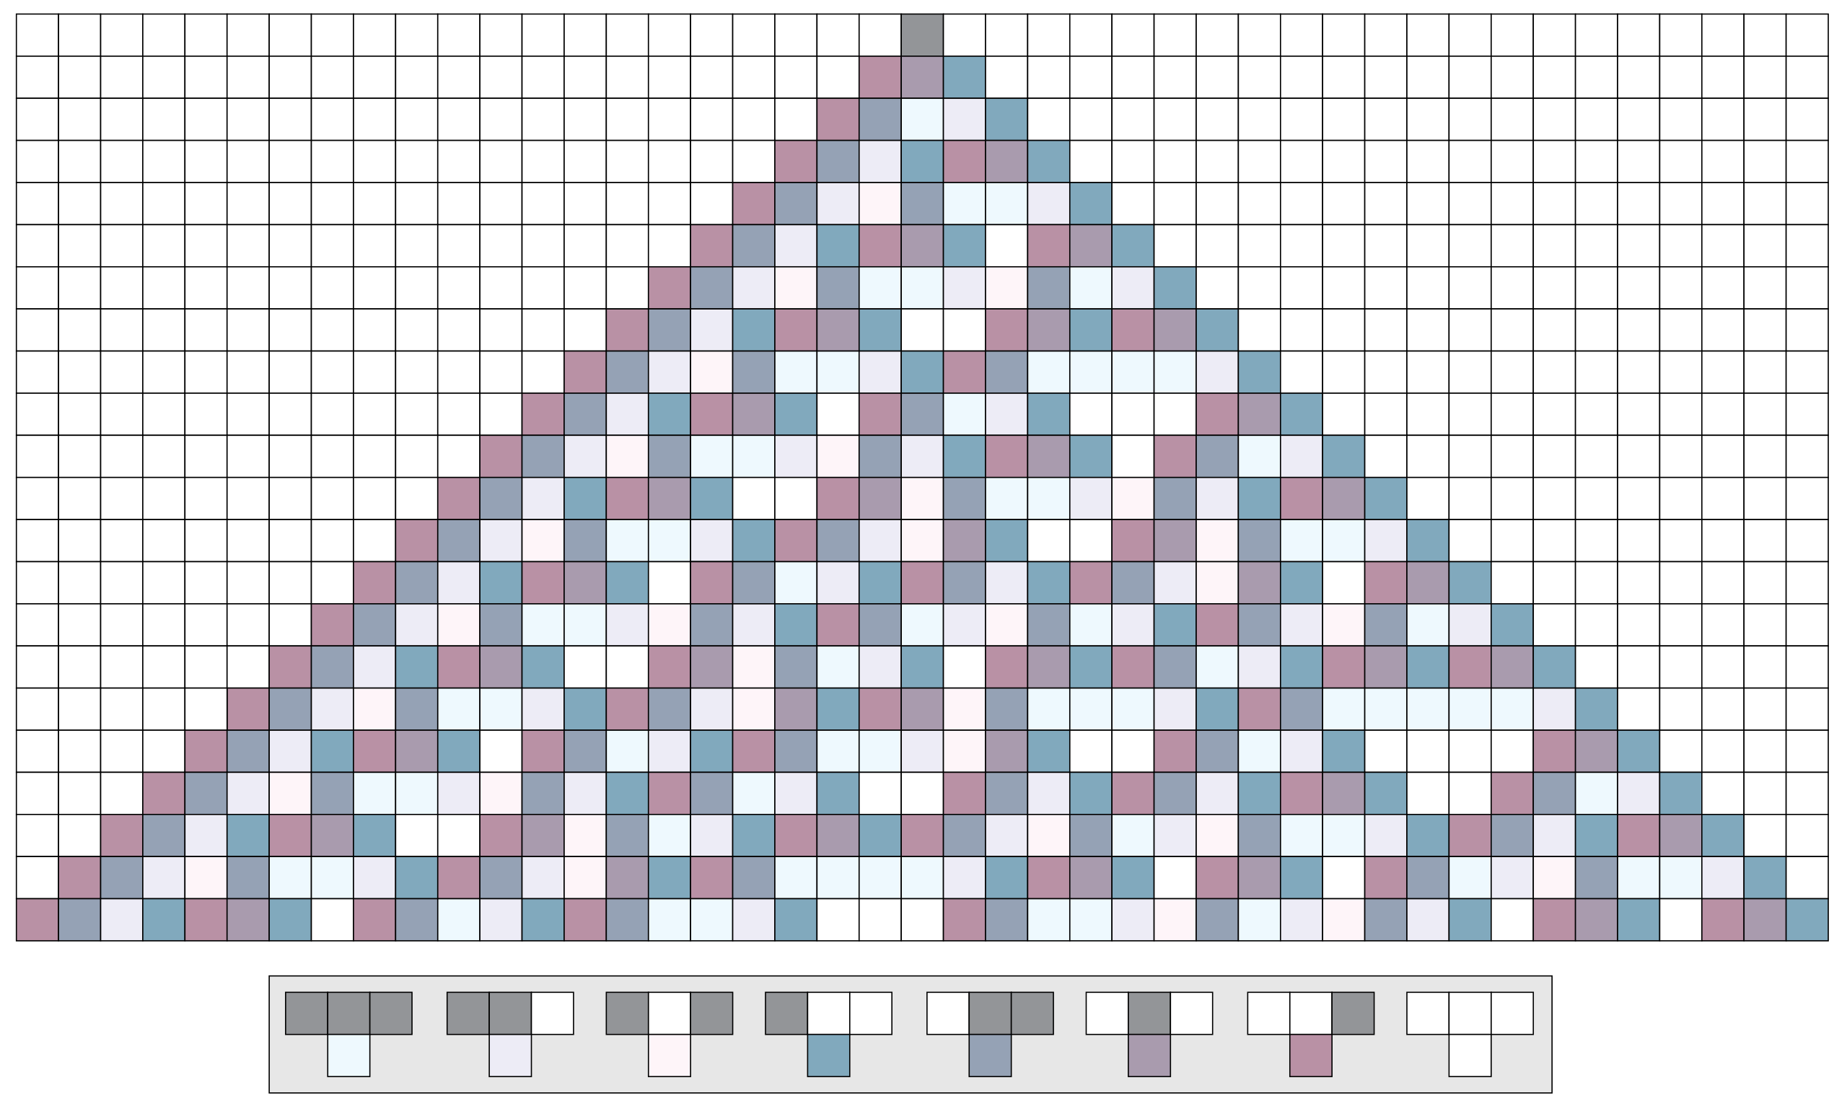
PRNG with Rule 30
Use the center column
Parameters
Window size : # of binary bits
Seed: Initial 01 string
n: iteration times
Fig 2. seed = [1], n = 21
Table 2 PRNG with different window size
Window size = 1 | [1, 1, 0, 1, 1, 1, 0, 0, 1, 1, 0, 0, 0, 1, 0, 1, 1, 0, 0, 1, 0]
Window size = 2 | [3, 2, 1, 3, 3, 2, 0, 1, 3, 2, 0, 0, 1, 2, 1, 3, 2, 0, 1, 2]

Slide 6
NIST Randomness Test
Ws = 1, n=100, seed = [1] | p-value (Result) | Memo | Recommendation
Frequency Test | 0.6892 (Pass) |  | n >= 100
Frequency Test within a Block | 0.8013 (Pass) | M = 11 | n >= 100
Runs Test | 0.4138 (Pass) |  | n >= 100
Longest Run Of Ones |  |  | n > 128
Binary Matrix Rank Test | 0.4171 (Pass) | M=Q=3 | M = Q = 32
Discrete Fourier Transform (Spectral) Test | 0.7456 (Pass) |  | n>=1000
Non-overlapping Template Matching Test | 0.3841 (Pass) | M=10, B=001 | m=9/10
Overlapping Template Matching Test | 0.7362 (Pass) | M=10, K=5, B=[1,1] | n>=10^6
Maurer's“Universal Statistical”Test | 0.9291 (Pass) | M=2, Q=4 | n>=387,840
Linear Complexity Test | 0.8088 (Pass) | M=13, K=6 | n>=10^6
Serial Test | 2/2 p-value>0.01(Pass) |  | m < log₂ n -2
Approximate Entropy Test | 0.8843 (Pass) | m=2 | m < log₂ n -2
Cumulative Sums (Cusum) Test | 0.6292 (Pass) | Forward | n >= 100
Random Excursions Test | 4/8 p-value <0.01 | Further test needed | n>=10^6
Random Excursions Variant Test | 2/18 p-value <0.01 | Further test needed | n>=10^6

Slide 7
Resources
My codes:
Github: https://github.com/wjr0102/PRNG_with_rule30.git
Code of rule 30, some other PRNGs and NIST randomness test (python 2.7)
NIST randomness test official website
Document and download: https://csrc.nist.gov/projects/random-bit-generation/documentation-and-software
The software using rule 30 to generate random number
Wolfram Mathematica: http://www.wolfram.com/mathematica/

Slide 8
References
Wolfram, S. . (1986). Random sequence generation by cellular automata. Advances in Applied Mathematics, 7(2), 123-169.
Spencer, J. . (2013). Cellular automata in cryptographic random generators. Computer Science.
Gage, D.., Laub, E.., Mcgarry, G.. Cellular Automate: Is Rule 30 Random? (https://www.cs.indiana.edu/~dgerman/2005midwestNKSconference/dgelbm.pdf)
NIST SP 800-22 Guidance (https://csrc.nist.gov/Projects/Random-Bit-Generation/Documentation-and-Software/Guide-to-the-Statistical-Tests)

Slide 9
Thanks

Slide 10
Pseudo Random Number Generator
Generating a sequence of numbers whose properties approximate the properties of sequences of random numbers
Mostly, Xn = f(Xn-1)
It is not truly random but completely determined by the initial value (seed)
Advantages:
High efficiency

Slide 11
Pseudo Random Number Generator History
Middle-square method
1946

Slide 12
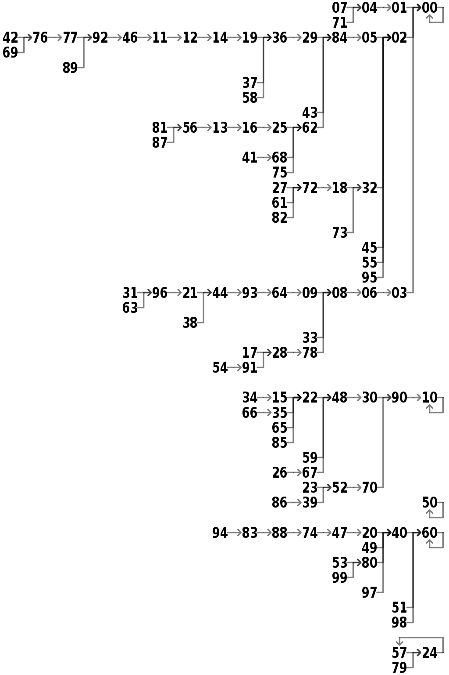
Middle-Square Method
seed: initial number
n: n-digit number
Input: seed, n
(1,2)
Seen = {}
Seen={}
Num = 1
1*1 = 1
Fill to 2-digit: 0001
Choose Middle: 00
0*0 = 0
Fill to 2-digit: 0000
Choose Middle: 00
Num seen?
Yes
No
Seen.add(Num)
Num = Num².middle
Seen={1}
Seen={1,0}
Terminal
Num=0

Slide 13
Middle-Square Method
Easy to implement
Poor quality
Unstable periods dependent on seed
Only

Slide 14
Pseudo Random Number Generator History
Lehmer
Middle-square method
1946
1951
middle(Xn)
g*Xn mod n

