Slide 1
Programming Style

Slide 2
Programming Style
Ensuring program correctness is important, but that is not the only thing you should pay attention to when writing programs
As a programmer, you should also learn how to write “good” programs
Part of your assignments are graded for style

Slide 3
Documentation
Every program should be well-documented with proper comments to:
Describe what the program is expected to do
Explain complicated code or purpose of some statements
Comments help readers (not only tutors, but also you) to understand your program
For the assignments, you should at least describe briefly about the program and explain the complicated code

Slide 4
Documentation
As a good practice, write comments:
At the beginning of every program
e.g. assignment / question number, your name, brief description of the program
// Author: Chan Tai Man
// U. No.: 3035288188
// Filename: hello.cpp
// Assignment Number: 1
// Description: Program to print hello world message
// Last Changed: September 23, 2016
#include <iostream>
…
Reminder: You should write your name and U. No. at the beginning of your program

Slide 5
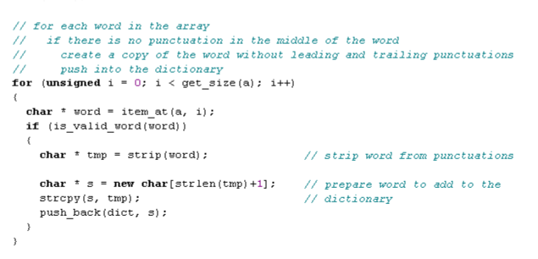
Documentation
As a good practice, write comments:
Within the program, where necessary, for better understanding
e.g. before a block of code to explain the logic of the code
for specific statements

Slide 6
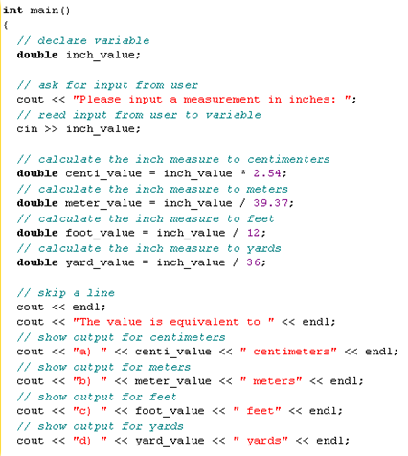
Documentation
Although comments help readability, watch out for excessive comments!
Comments should be appropriate
A line of comment for a line of code is too much

Slide 7
Format
Due to the free-formatting nature of C++, whitespace characters can be inserted freely between “tokens”
A token is any one of the terms in the program, such as the operators, keywords, a word in the string, etc
Indentation is used to format program source code to improve its readability
Notes:
Tokens : identifiers, keywords, constants, string literals, operators and other separators

Slide 8
Format: Indentation
Guidelines for indentation:
Statements within a “block” should be indented by the same amount.
Using a spacing of 2 to 4 whitespaces
e.g. using 2 whitespaces
int main()
{
int x; // within main(): indent 2 spaces
cin >> x; // within main(): indent 2 spaces
// the if statement is a "block", so the statements inside is further indented
if ( x < 0 ) // within main(): indent 2 spaces
cout << "Number less than 0" << endl; // within "if/else":
// indent 2 spaces from "if"
else
cout << "The square of " << x << " is " << x * x << endl;
}

Slide 9
Format: Spacing
Guidelines for use of whitespaces:
Leave a space between operands, operators, or symbols for clarity.
e.g. i) a: a = (b + c) / 2;
r: a=(b+c)/2;
ii) a: cout << "Total: " << total << endl;
r: cout<<"Total: "<<total<<endl;
iii) a: if (a == b && a < c)
r: if(a==b&&a<c)

Slide 10
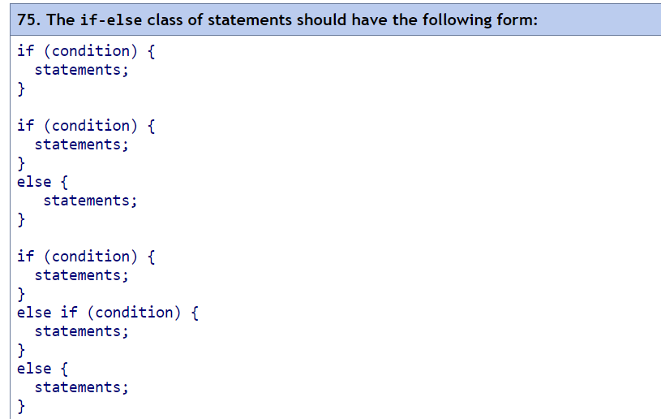
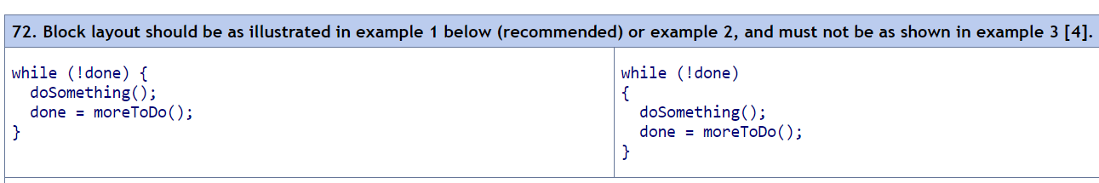
If-Else statements & While loops
http://geosoft.no/development/cppstyle.html#Layout%20and%20Comments

Slide 11
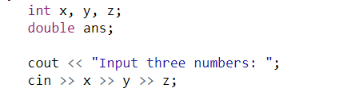
Format: Spacing
Leave an empty line between each logical block of statements
between functions
between the variable declarations and the input/output statements, e.g.

Slide 12
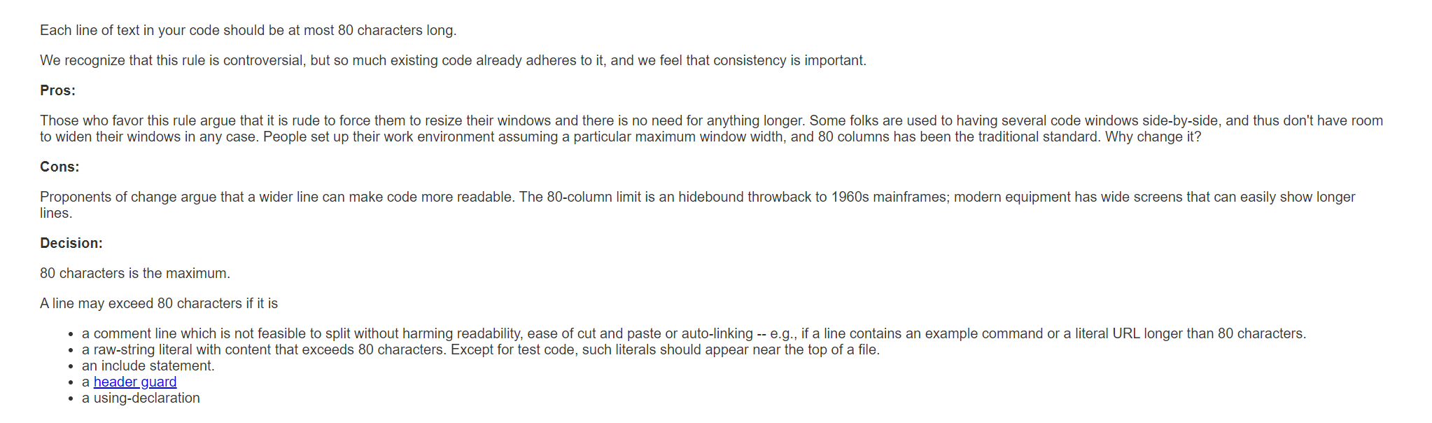
Line of code
Avoid too many characters per line!
https://google.github.io/styleguide/cppguide.html#Line_Length

Slide 13
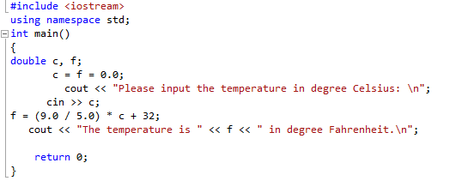
Poor Indentation Example

Slide 14
Reference
C++ Programming Style Guidelines
http://geosoft.no/development/cppstyle.html

