Slide 1
20DEC
Removing Group of Skills (updated)

Slide 2
Source: Skills extracted from 2016 Jobs Bank job postings
Data: Skills level (weight) of association to its assigned Group of Skills
Data components: Skills, Group of Skills, NMF weights
Stats:
No. of Skill Groups (SG): 65
No. of Skills: 11908
Approach: TOP K (20/50/100)
NMF weight TH = (0.01)

Slide 3
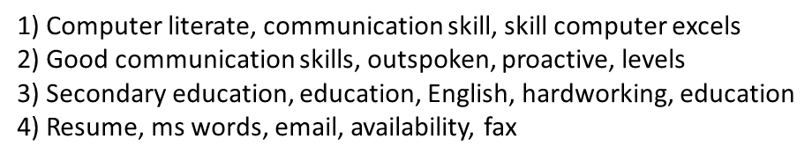
The following Skill Groups (SG) removed
Id=36,40,47,52
Method to remove:
Heatmap level of association (Job category- SG)
Observe association level of each SG(id) to all Job Categories.
Observe highest associated Job Category for current SG.
Compare highest association level of current SG to global maximum association level (0.234 (Law)).
Highest association level for SG(id)= 36,40,47,54, not significant compared to global maximum of association level.
SG(id)= 36,40,47,54, does not have a significant association to any of the Job Categories.
Link to API: http://research.larc.smu.edu.sg/skillsense/heatmap/ (Click on any Job Category)

Slide 4
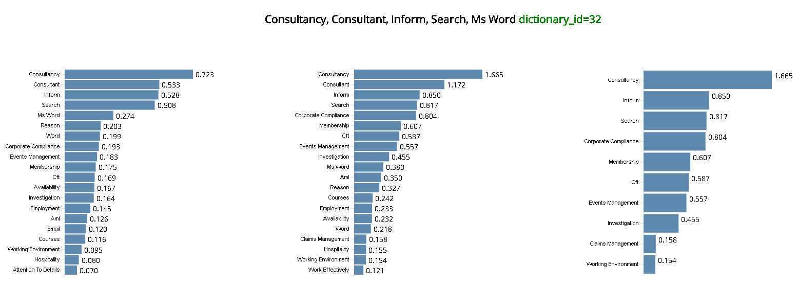
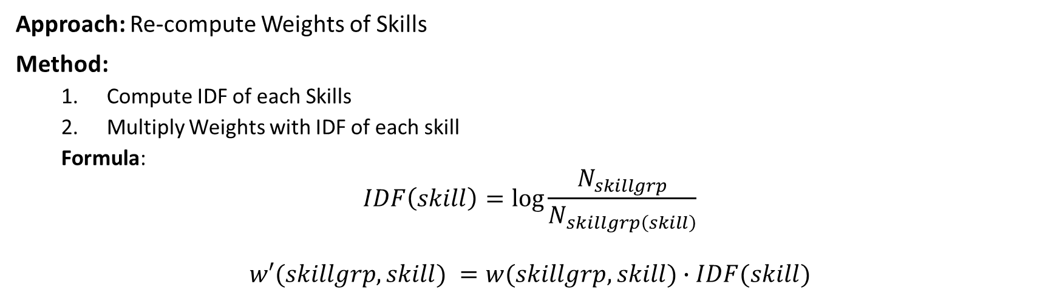
Motivation: -Association level (weights) of Skills in each SG is too dense.
-Top K Skills in each SG have similar Weights (SG below)
-Ensure distinction of Weights of representative Skills.
Approach: Re-compute Weights of Skills
Method:
Compute IDF of each Skills
Multiply Weights with IDF of each skill
Formula:
$$IDF\left(skill\right)=\log{\frac{N_{skillgrp}}{N_{skillgrp\left(skill\right)}}}$$
$$w′(skillgrp, skill) =w(skillgrp, skill)∙IDF(skill)$$
Assign each Skill to only 1 Group of Skill
-Ensure no overlapping of Skills across all Groups of Skills.

Slide 5
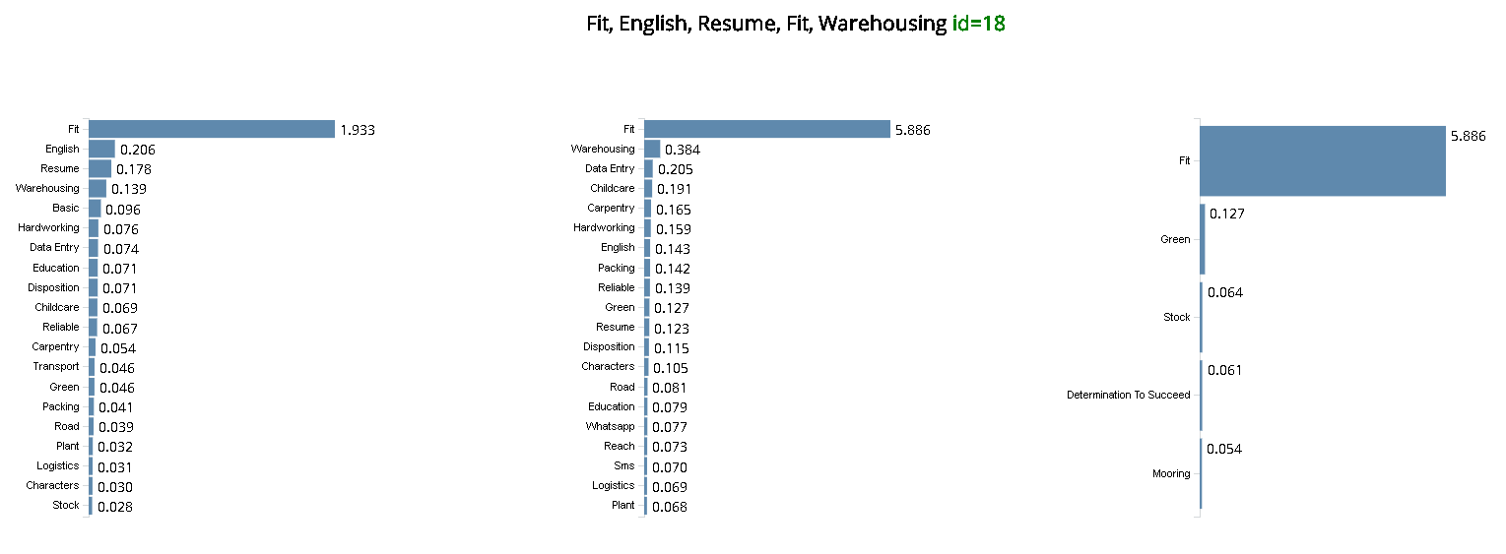
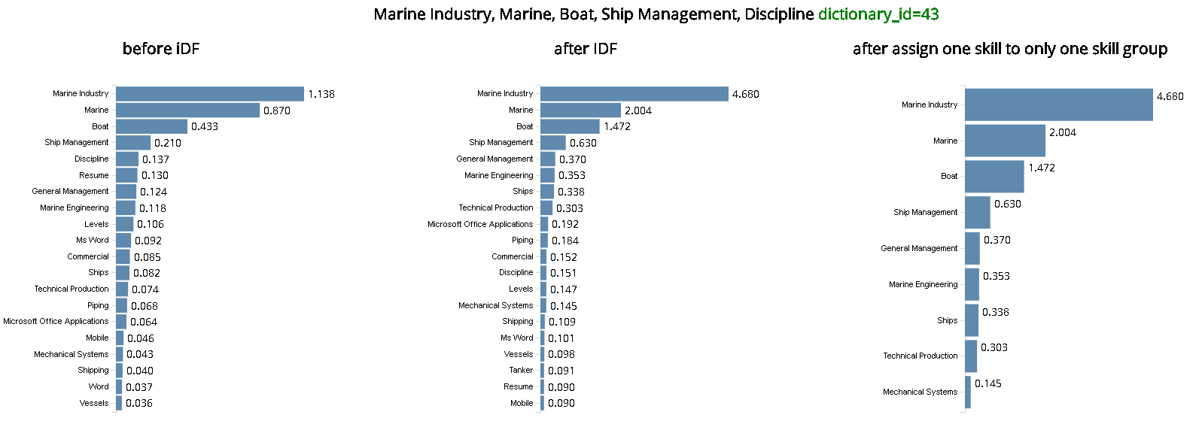
Observing Groups that has less than 15 Skills associated

Slide 6
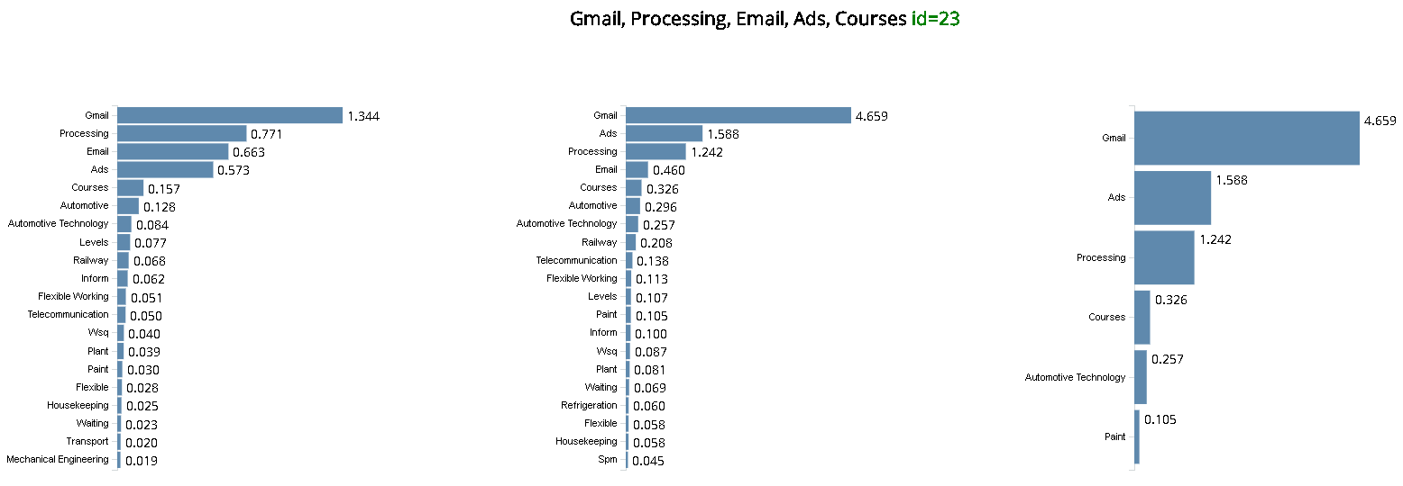
Observing Groups that has less than 15 Skills associated

Slide 7
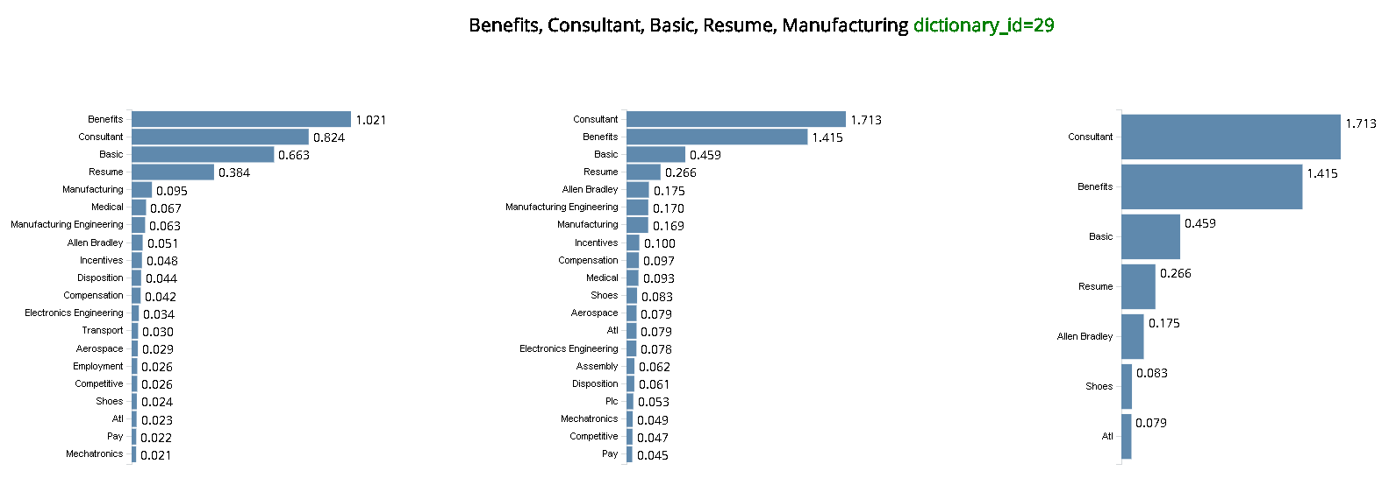
Observing Groups that has less than 15 Skills associated

Slide 8
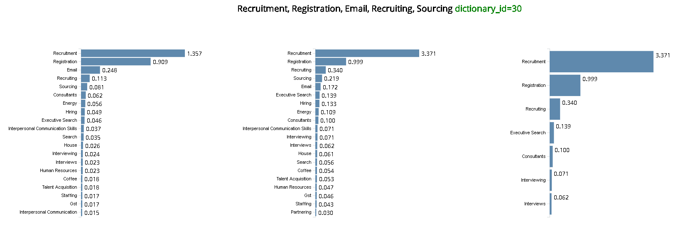
Observing Groups that has less than 15 Skills associated

Slide 9
Observing Groups that has less than 15 Skills associated

Slide 10
Observing Groups that has less than 15 Skills associated

Slide 11
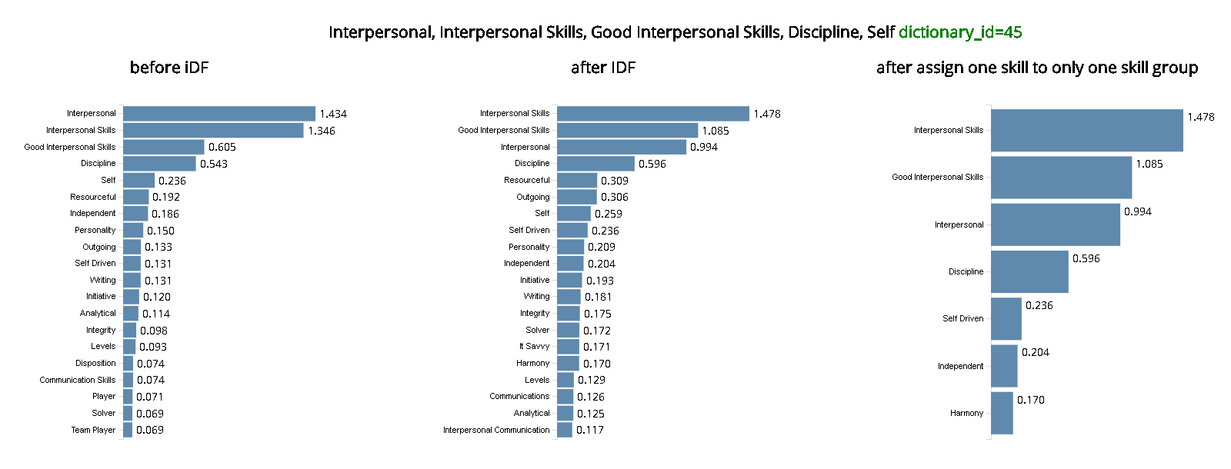
Observing Groups that has less than 15 Skills associated

Slide 12
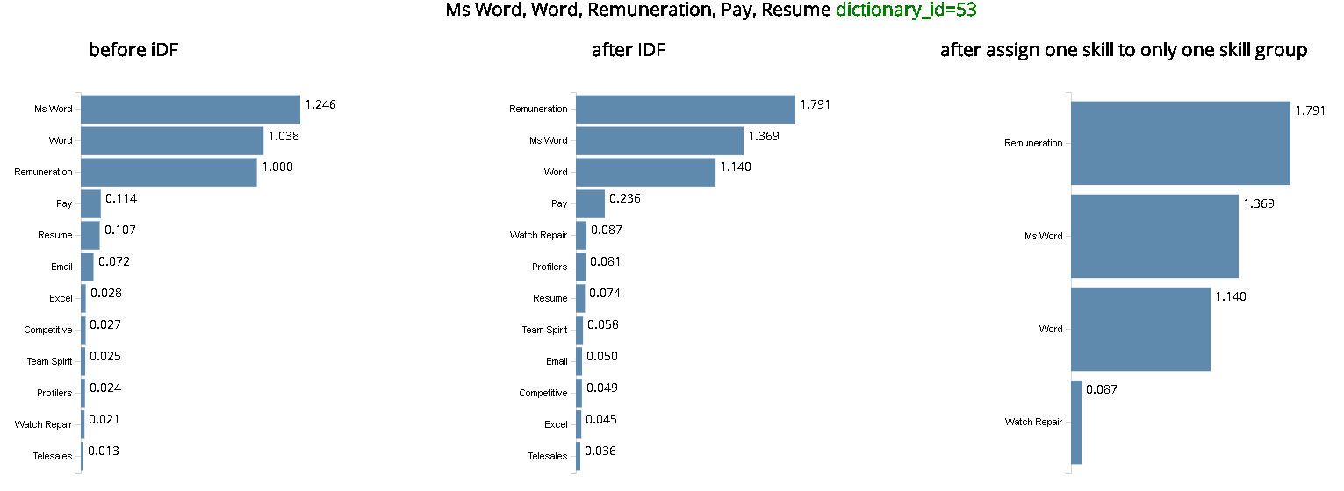
Observing Groups that has less than 15 Skills associated

Slide 13
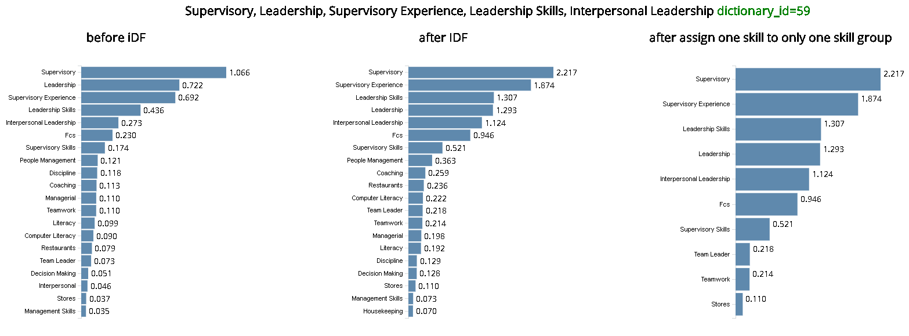
Observing Groups that has less than 15 Skills associated

Slide 14
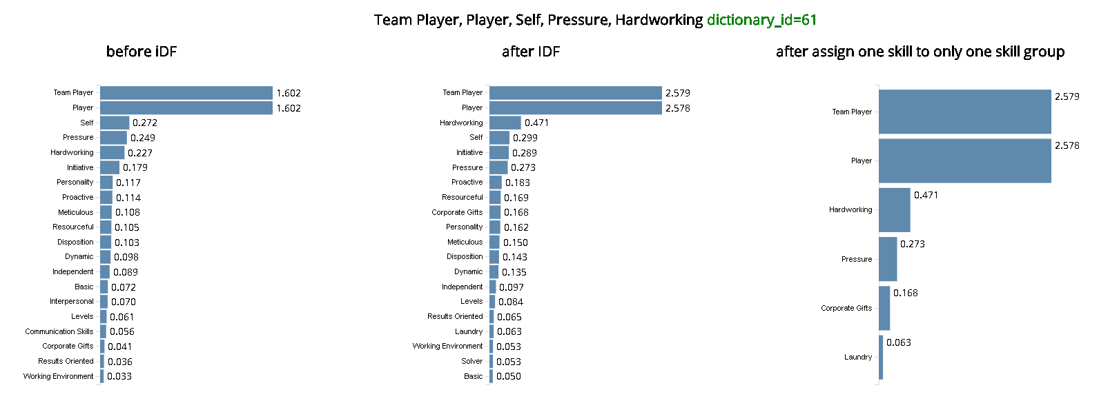
Observing Groups that has less than 15 Skills associated

Slide 15
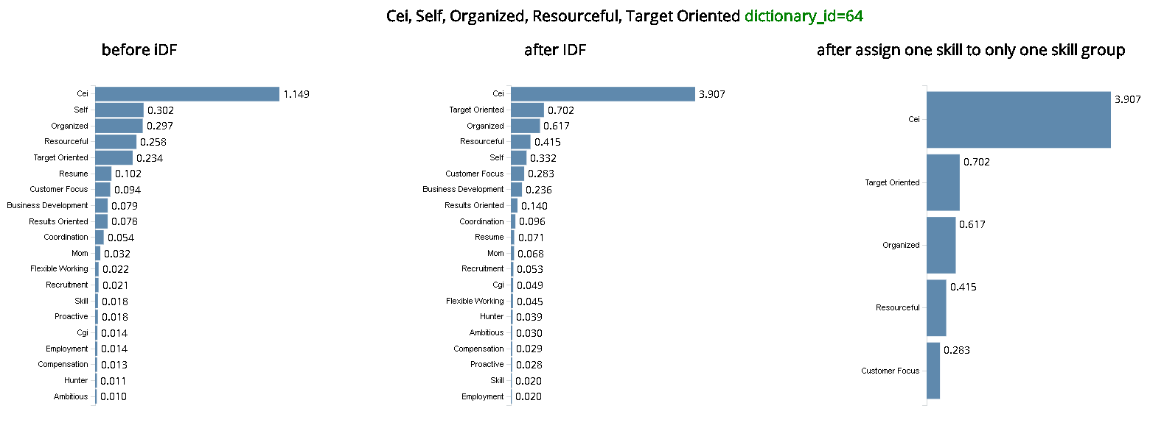
Observing Groups that has less than 15 Skills associated

Slide 16
The following Skill Groups further removed (continued)
ID | Skill Groups
53 | Ms Word, Word, Remuneration, Pay, Resume
64 | Cei, Self, Organized, Resourceful, Target Oriented
18 | Fit, English, Resume, Fit, Warehousing
23 | Gmail, Processing, Email, Ads, Courses
61 | Team Player, Player, Self, Pressure, Hardworking
45 | Interpersonal, Interpersonal Skills, Good Interpersonal Skills, Discipline, Self
30 | Recruitment, Registration, Email, Recruiting, Sourcing
29 | Benefits, Consultant, Basic, Resume, Manufacturing
43 | Marine Industry, Marine, Boat, Ship Management, Discipline
59 | Supervisory, Leadership, Supervisory Experience, Leadership Skills, Interpersonal Leadership
32 | Consultancy, Consultant, Inform, Search, Ms Word
Method to remove:
Assign each Skill to only 1 Skill Group.
Observe Group of Skills with relatively few amount of Skills(15) compared to overall number of Skills contained in each Skill Group.
Groups containing general Skills (e.g. hardworking, discipline) may be removed.

Slide 17
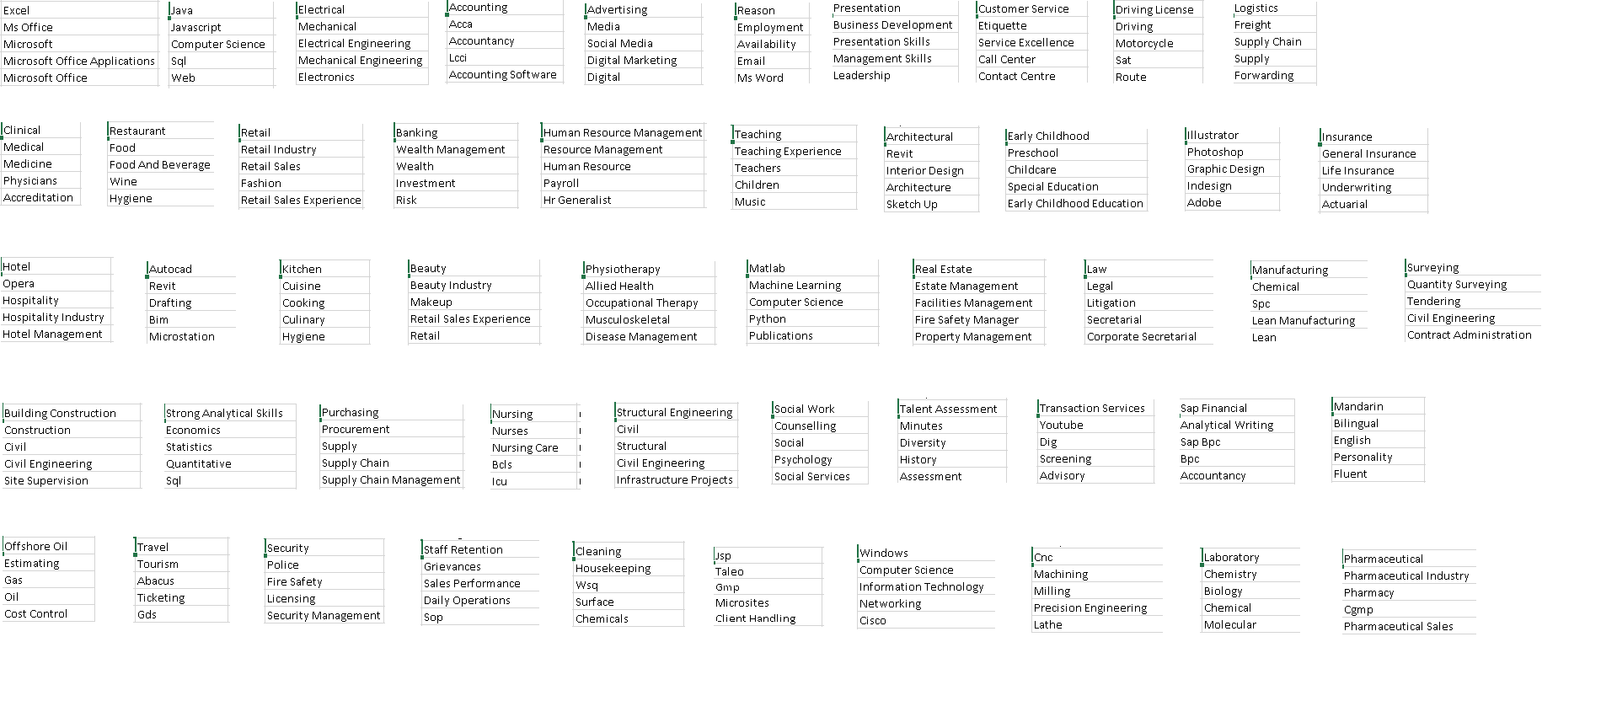
Our first look at 50 Groups of Skills:
SG_id 0
SG_id 5
SG_id 31
SG_id 37
SG_id 44
SG_id 46
SG_id 55
SG_id 56
SG_id 57
= removed
= verified
= cert abbrv

Slide 18
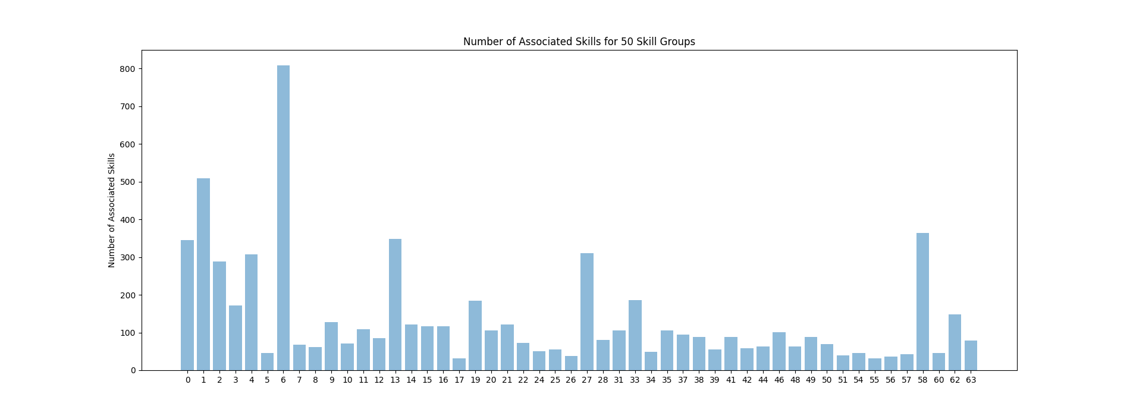
For record: SG with Min & Max number of associated Skills
Min(Nskills) = 31 (SG 17, 55)
Max(Nskills) = 808 (SG 6)
SG = Skills Group ID / ID of Group of skills

Slide 19
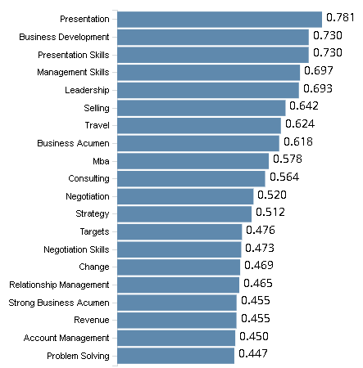
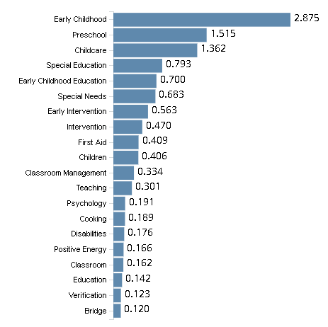
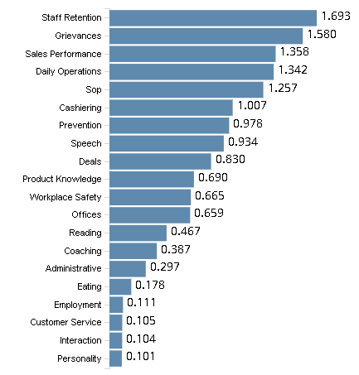
For record: SG with Min & Max number of associated Skills
(SG 6)
(SG 17)
(SG 55)
Min(Nskills) = 31 (SG 17, 55)
Max(Nskills) = 808 (SG 6)
SG = Skills Group ID / ID of Group of skills

Slide 20
The following Skill Groups further removed (continued)
ID | Skill Groups
0 | Excel, Ms Office, Microsoft, Microsoft Office Applications, Microsoft Office
5 | Reason, Employment, Availability, Email, Ms Word
12 DEC
44 | Talent Assessment, Minutes, Diversity, History, Assessment
46 | Transaction Services, Youtube, Dig, Screening, Advisory
15 DEC
Method to remove:
Plot Skills popularity distribution across all Job Posting. (Box Plot > Slide 21, 22)
Observe Skills population diversity characteristic of each Skill Group.
Groups with uneven Skill population size could be containing a set skills describing different specializations.

Slide 21
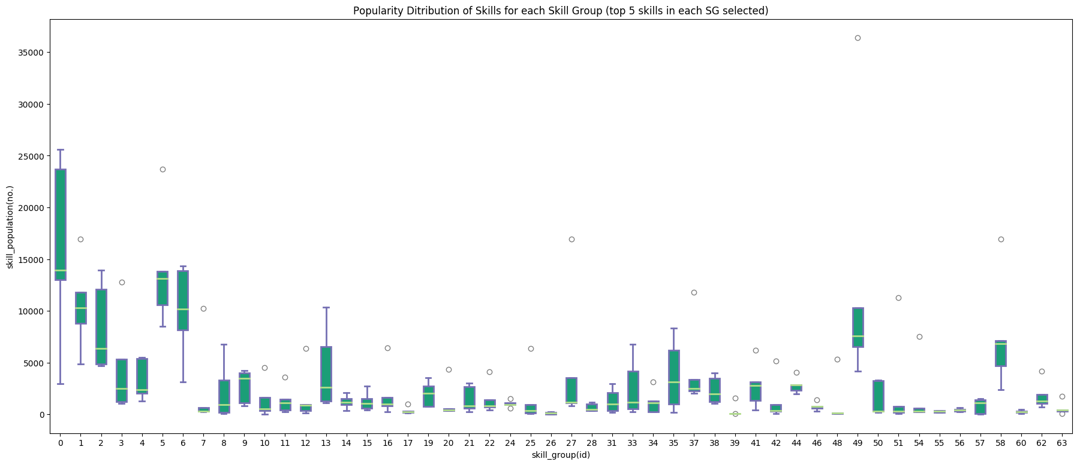
English(36395)

Slide 22
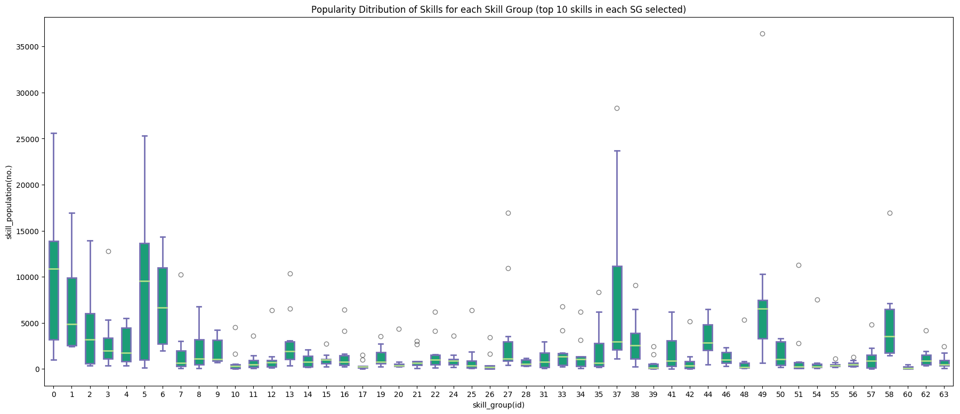
English(36395)

Slide 23














48 Groups of Skills: (1 skill to only represent max 1 skill group)(SG 0,5 removed)
before
after
1 | Java
1 | Javascript
1 | Sql
1 | Web
1 | J2Ee
25 | Beauty
25 | Beauty Industry
25 | Makeup
25 | Retail Sales Experience
25 | Treatment
37 | Strong Analytical Skills
37 | Economics
37 | Statistics
37 | Quantitative
37 | Analytical
56 | Cleaning
56 | Housekeeping
56 | Surface
56 | Chemicals
56 | Pay
11 | Restaurant
11 | Food
11 | Food And Beverage
11 | Wine
11 | Restaurants
27 | Matlab
27 | Machine Learning
27 | Python
27 | Publications
27 | Programming
38 | Purchasing
38 | Procurement
38 | Negotiation
38 | Sourcing
38 | Negotiation Skills
62 | Laboratory
62 | Chemistry
62 | Biology
62 | Molecular
62 | Biotechnology
12 | Retail
12 | Retail Industry
12 | Retail Sales
12 | Fashion
12 | Merchandising
34 | Surveying
34 | Quantity Surveying
34 | Tendering
34 | Contract Administration
34 | Survey
48 | Sap Financial
48 | Analytical Writing
48 | Sap Bpc
48 | Bpc
48 | Ecc
16 | Architectural
16 | Interior Design
16 | Architecture
16 | Sketch Up
16 | Sketch
35 | Building Construction
35 | Construction
35 | Site Supervision
35 | Bcss
35 | Construction Safety
54 | Security
54 | Police
54 | Licensing
54 | Security Management
54 | Enforcement
= removed
= verified
= cert abbrv

Slide 24
46 Groups of Skills: (1 skill to only represent max 1 skill group)(SG 44,46 removed)
before
after
3 | Accounting
3 | Acca
3 | Accountancy
3 | Lcci
3 | Accounting Software
3 | Cpa
3 | Myob
3 | Audit
3 | Accounting System
3 | Accounts Payable
3 | Accounting
3 | Acca
3 | Accountancy
3 | Lcci
3 | Accounting Software
3 | Cpa
3 | Myob
3 | Audit
3 | Tax
3 | Accounting System
= removed
= verified
= cert abbrv

Slide 25
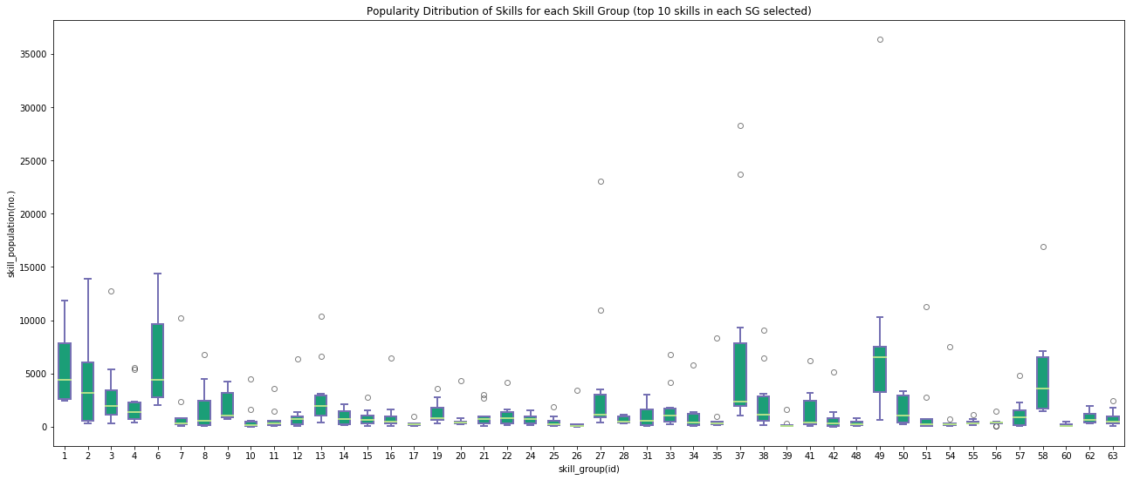
English(36395)

Slide 26
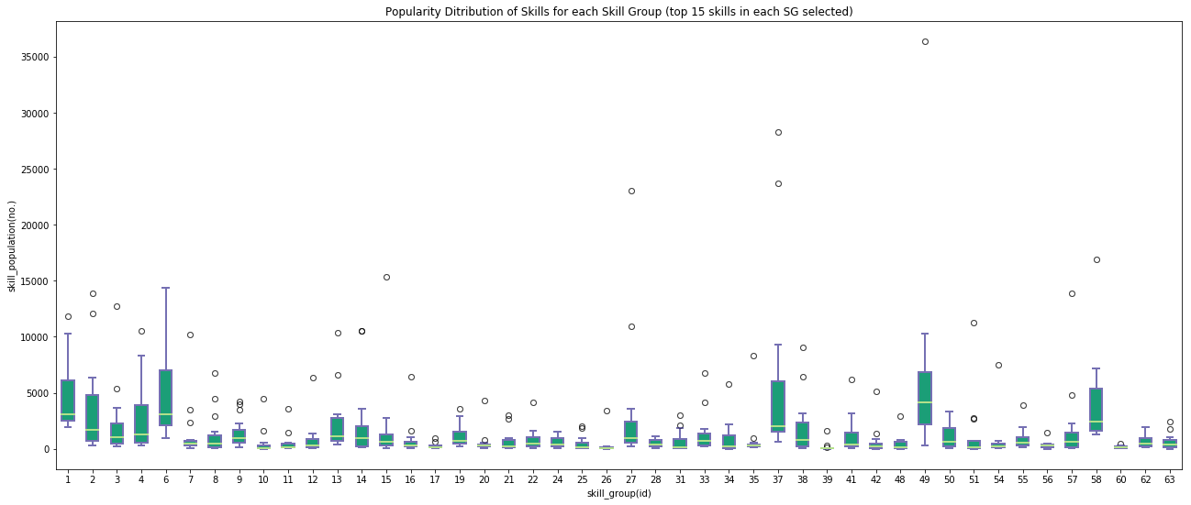
English(36395)

Slide 27
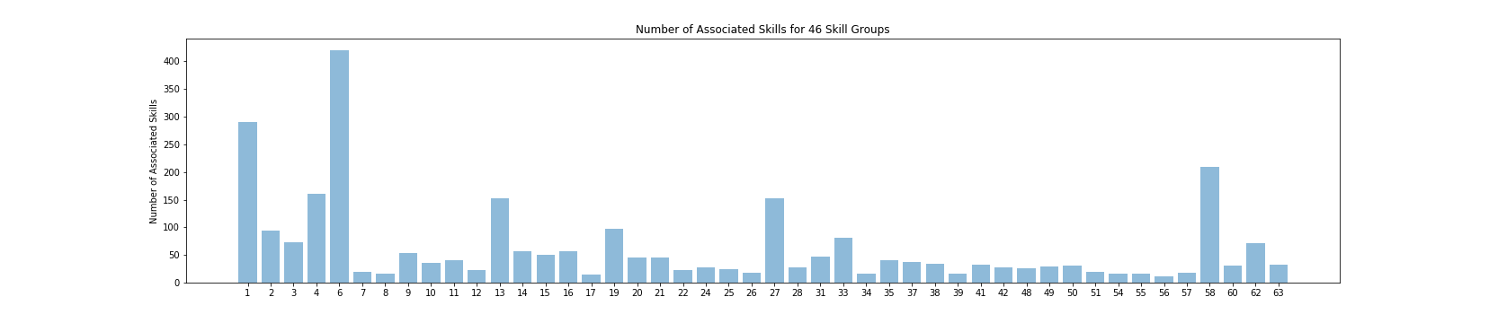
46 SGs: SG with Min & Max number of associated Skills
SG 56 = 12 skills
SG 6 = 420 skills
SG = Skills Group ID / ID of Group of skills

Slide 28
20DEC
Validating top skills from each group of Skills (identify stopskills)

Slide 29
Validating top skills from each group of Skills (identify stopskills)
Steps taken:
1. for each skill in a group, search for job post (JobsBank) containing the skill.
2. identify semantics of the particular skill in the corresponding job description context. It may appear as a skill or not.
3. iterate through all of job post containing the skill. If number of job post containing the skill too large (>100), sample any 20 random of job posts for skill validation.
After iterate through all job posts:
IF searched skill is found being indeed a skill in the context of the its job description for any of its job post,
skill CAN NOT be removed from dictionary
ELSE IF searched skill is found being not a skill in the corresponding job description,
look out for similar skills (e.g. eating < healthy eating) (to check if overlapping)
search skill through LinkedIn skill search webpage: linkedin.com/topic/<input:skill>
look through users possessing the skill
Table of potential stopskills (could be removed):
ID | Skill | Skills Group(id) | remark
3204 | eating (top 16) | 55
747 | availability (top 12) | 57
8789 | ris (top 16) | 8
10101 | surface (top 3) | 56
7453 | pay (top 5) | 56
5111 | injury (top 17) | 8
filename: dict_stopskills.csv

Slide 30
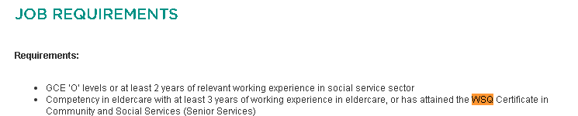
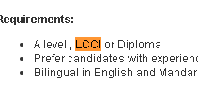


Stopskill (cases)
(certificate/qualification level) from top 5 skills of each group
ID | Skill | Skills Group(id)
11443 | wsq (top 2) | 56
5749 | lcci (top 4) | 3
115 | acca (top 2) | 3
2400 | cpa (top 6) | 3
877 | bcls (top 4) | 39
880 | bcss (top4) | 35
539 x
“wsq”
1168 x
“lcci”
1929 x
“cpa” (Certified Public Accountant)
2505 x
“acca” (the Association of Chartered Certified Accountants)
69 x
“bcls” (Basic Cardiac Life Support)

Slide 31
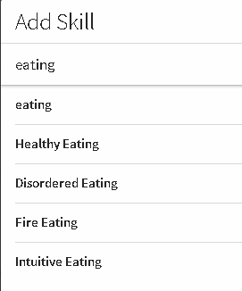
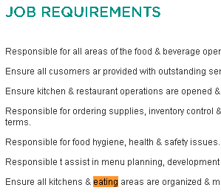

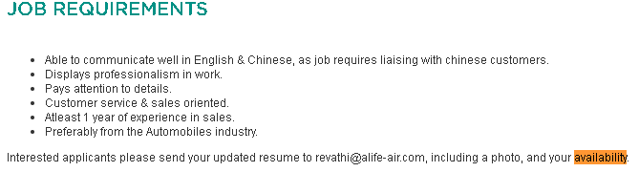

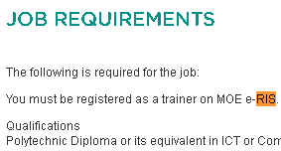

Stopskill (cases)
invalid
LinkedIn Search results for “eating”
to simulate,
click on “add skill” in profile page,
start typing skill and observe search results
Similar skill:
=“healthy eating”
=not in any SG
140 x
(F&B)
____________________“eating”
Similar skill:
=“high availability”
=top 151(SG 58)
=“Availability Management”
=not in any SG
5349 x
“availability”
“ris”
abbv for “registration”

Slide 32



Stopskill (cases)
247 x
“surface”
Similar skill:
=“surface treatment”, “surface analysis”
=not in any SG
“surface finishing” not in dictionary

Slide 33
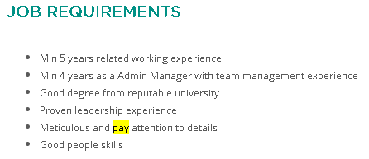
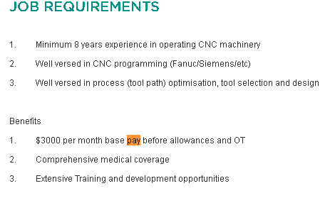
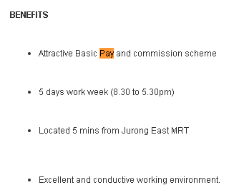
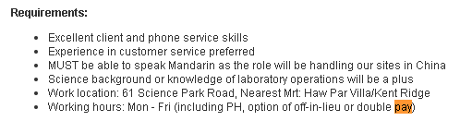
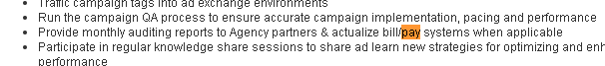
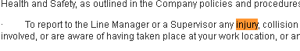
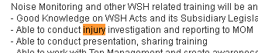
Stopskill (cases)
1279 x
Similar skill:
=“pay tv”
=not in any SG
=“payroll”
=(top 4) SG14
____________________“pay”
“pay systems” not in dictionary
Similar skill:
=“personal injury”
=top 46 (SG 31)
“injury”
82 x
“injury investigation” not in dictionary

Slide 34


Stopskill (cases)
24x
“shoulder”
(top18) SG 8
3309x
“driving license”
(top1) SG 8
no longer in LinkedIn skills

Slide 35


Stopskill (cases)
Similar skill:
=“visual basic”
=(top 230) SG1
15315x
“basic”
(top11) SG 10
Num of job_post | Skill | Ranking (Top in group) | SkillGroup ID
3957x | certified | 108 | 10

Slide 36
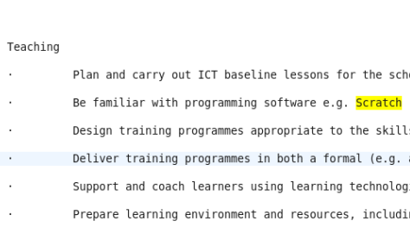
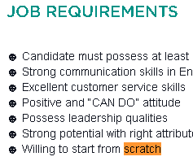
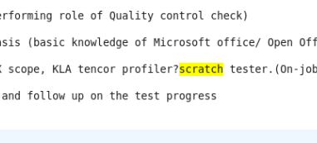
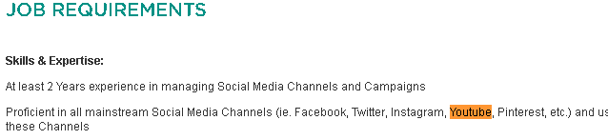
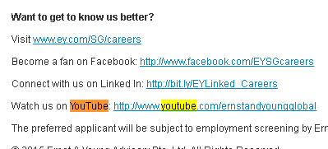


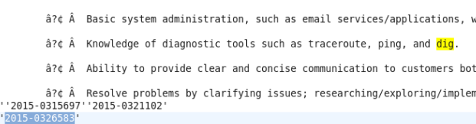

Stopskill (cases)
valid?
invalid
“scratch”
“scratch”
“youtube”
755 x
“youtube”
“sat”
“sat”
FAT (Factory Acceptance Test)
SAT (Site Acceptance Test)
“dig”
“dig”

Slide 37
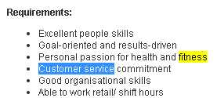

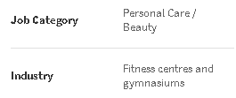
Stopskill (cases)
Irrelevant skill respect to its group (top10)
valid?
7 | Customer Service | 2.903219 | 10215
7 | Etiquette | 0.860923 | 670
7 | Service Excellence | 0.40824 | 295
7 | Call Center | 0.382689 | 316
7 | Contact Centre | 0.336759 | 234
7 | Enquiries | 0.300102 | 814
7 | Cash Handling | 0.298274 | 58
7 | Customer Oriented | 0.256954 | 2351
7 | Customer Care | 0.144553 | 159
7 | Fitness | 0.125497 | 324
SG 7 “fitness” & customer service” – 52 job posts
Check job posts which contains both “fitness” and each other skills within SG
removed skill from group

Slide 38

Stopskill (cases)
Irrelevant skill respect to its group(top10)
valid?
25 | Beauty | 3.582138 | 944
25 | Beauty Industry | 3.431943 | 342
25 | Makeup | 0.647125 | 62
25 | Retail Sales Experience | 0.61726 | 150
25 | Treatment | 0.424439 | 678
25 | Mom | 0.412307 | 1857
25 | Skin | 0.354995 | 104
25 | Hair | 0.347264 | 166
25 | Committment | 0.338225 | 23
25 | Spa | 0.333549 | 251
SG 25 “mom” & “beauty” – 102 job posts
Check job posts which contains both “mom” and each other skills within SG
Observe skills population distribution
SG 25 “mom” & “treatment” – 1 4 job posts

Slide 39

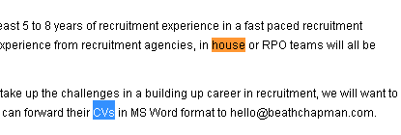

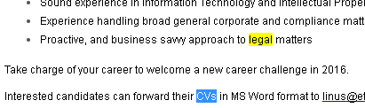
Stopskill (cases)
Irrelevant skill respect to its group(top10)
valid?
31 | Law | 2.003834 | 2982
31 | Legal | 1.866588 | 2117
31 | Litigation | 1.376336 | 168
31 | Secretarial | 0.854391 | 998
31 | Corporate Secretarial | 0.71289 | 345
31 | Common Law | 0.606027 | 82
31 | House | 0.504448 | 1827
31 | Intellectual Property | 0.495794 | 165
31 | Cvs | 0.348368 | 743
31 | Business Law | 0.329632 | 63
-30 job posts
Check job posts which contains both “cvs”, “house” and each other skills within SG
-77 job posts

Slide 40
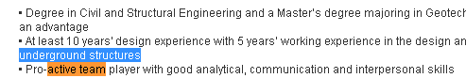

Stopskill (cases)
Irrelevant skill respect to its group(top10)
valid?
41 | Structural Engineering | 3.406992 | 1367
41 | Civil | 2.577318 | 6192
41 | Structural | 2.310508 | 2804
41 | Civil Engineering | 1.243383 | 3140
41 | Infrastructure Projects | 0.664732 | 400
41 | Railway | 0.57142 | 388
41 | Structural Design | 0.473874 | 164
41 | Active Team Player | 0.378101 | 256
41 | Underground Structures | 0.356903 | 23
41 | Construction Supervision | 0.350935 | 97
Check job posts which contains both “Active Team Player” and each other skills within SG
SG 41 “Active Team Player” only appear together with
“structural”,
“civil”,
“underground structures” – total 20 job posts
Similar skill:
=“energetic team player”
=not in any SG
=“team player”
= SG6 (top56) =>
Presentation,
Business Development,
Presentation Skills,
Management Skills,
Leadership

Slide 41
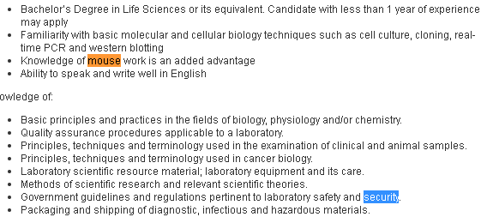
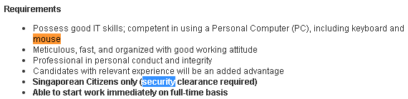
Stopskill (cases)
Irrelevant skill respect to its group(top10)
valid?
54 | Security | 2.468507 | 7496
54 | Police | 1.662678 | 239
54 | Licensing | 0.646606 | 325
54 | Security Management | 0.520172 | 244
54 | Enforcement | 0.386349 | 188
54 | Law Enforcement | 0.37882 | 79
54 | Security Operations | 0.350512 | 206
54 | Military | 0.267051 | 164
54 | Cisa | 0.208174 | 689
54 | Mouse | 0.183852 | 134
Check job posts which contains both “mouse” and each other skills within SG
SG 54 “mouse” only appear together with “security” – 7 job posts

Slide 42
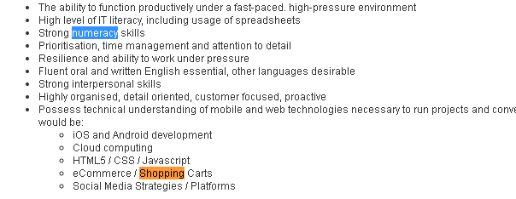
Stopskill (cases)
Irrelevant skill respect to its group(top10)
valid?
56 | Cleaning | 4.909555 | 476
56 | Housekeeping | 0.69615 | 422
56 | Chemicals | 0.318101 | 278
56 | Shopping | 0.222575 | 291
56 | Numeracy | 0.154085 | 374
56 | Organization Skills | 0.139883 | 1441
56 | Heavy Equipment | 0.121797 | 70
56 | Equipments | 0.116256 | 412
56 | Fluids | 0.111942 | 28
56 | Health And Safety | 0.092805 | 380
SG 56 “numeracy” only appear together with shopping” – 1 job post
Check job posts which contains both “numeracy” and each other skills within SG
removed skill from group

Slide 43
Stopskill (cases)
Irrelevant skill respect to its group(scope: top15)
SkillGp_id | Irrelevant Skill
12 | Windows Operating System
24 | hiring
25 | ms words
26 | knowledge base
38 | ms office tools
48 | ms office applications
56 | executive administrative

Slide 44
Stopskill (cases)
Irrelevant skill respect to its group(scope: top15)
SkillGp_id | Irrelevant Skill
7 | fitness
24 | hiring
56 | numeracy
removed from its group

Slide 45






Skills description (checked & valid)(for top 10 skill from each SG)
“crystal report”
“hris”
“freight”
“luxury”
LinkedIn source
“prophet”

Slide 46
Analyzing skills occurrences
“youtube” && “transaction services” = 512 job posts

Slide 47
Skills population distribution across job posts
Approach:
Top K skills to represent a group: 5/10/20/50/100
Box plot:
To see popularity distribution of specific group of skills
Stats:
Job Posts : 232021
Skills : 11908
NMF weight TH = (0.01)
Groups that has most number of skills, Max (next)
Groups that has least number of skills, Min (next)

Slide 48
20DEC
Extra skills popularity distribution plots

Slide 49


Slide 50


Slide 51


Slide 52

Population Distribution of Skills across Job Posts (for each skill_group)
Interpersonal(47326)

Slide 53
Our first look at 48 Groups of Skills: (1 skill to only represent max 1 skill group)(SG 0,5 removed)
SG_id 31
SG_id 37
SG_id 44
SG_id 46
SG_id 55
SG_id 56
SG_id 57
= removed
= verified
= cert abbrv

