Slide 1

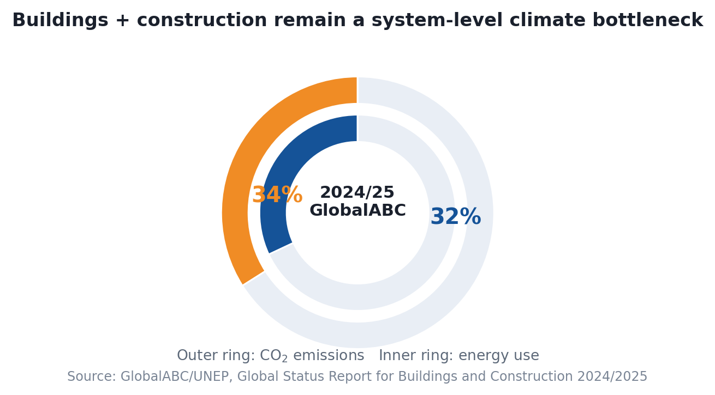
Project
Overview
Integrated Solution
& Project
Composition
Feasibility, Risk &
Budget Planning
Expected
Outcome
Updated Context: Buildings remain a major decarbonisation bottleneck
Reframing slide 4 with 2024-2025 sector evidence rather than a generic background statement.
What changed in the evidence base?
GlobalABC/UNEP now frames the sector as consuming 32% of global energy and contributing 34% of global CO2 emissions.
The same 2024/2025 report flags cement and steel alone as responsible for 18% of global emissions.
This makes operational coordination in buildings a climate issue, not only an efficiency issue.
Implication for our project
The real challenge is no longer only installing PV, batteries or smart meters.
The harder step is turning those assets into verifiable, auditable net-zero operation at building-cluster level.
That is why HKUST(GZ) as a living lab is a strong testbed for cluster-scale dispatching.
Source: GlobalABC / UNEP (2025)
32% global energy use
34% global CO2 emissions
18% materials
4

Slide 2
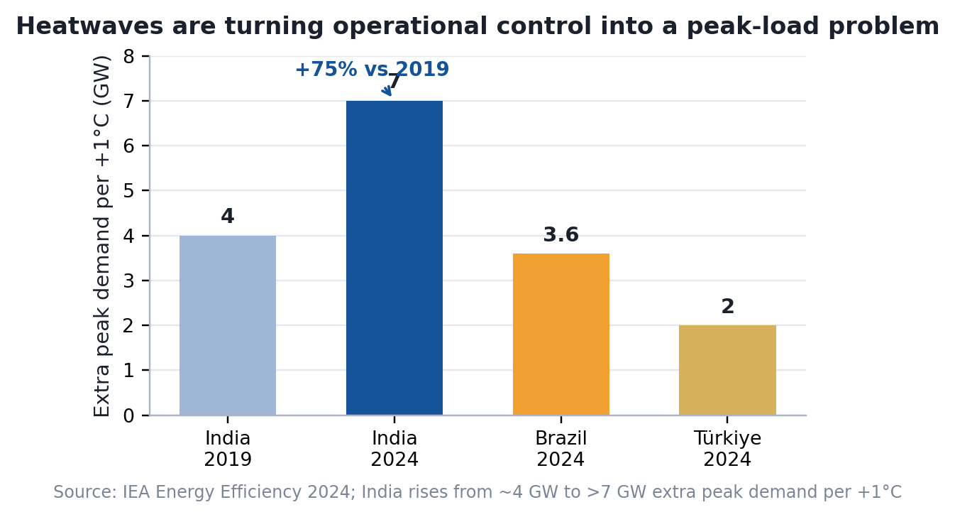
Project
Overview
Integrated Solution
& Project
Composition
Feasibility, Risk &
Budget Planning
Expected
Outcome
Updated Problem Framing: The implementation gap is now a peak-demand problem
Rewriting slide 5 so the gap is evidenced by 2024 heatwave and dispatch data, not only by abstract barriers.
1. Forecasting uncertainty
High-frequency cooling loads and weather extremes make static PV-load assumptions unreliable in real operation.
2. Control coordination
Dispatch has to react across HVAC, storage, PV and user loads fast enough to avoid curtailment, peaks and comfort penalties.
3. Carbon-cost trade-off
Without predictive scheduling, operators often trade carbon targets for peak-charge avoidance or vice versa, slowing ROI.
2024: >40 countries
Nearly 70% demand
Takeaway: operational net-zero requires predictive, weather-aware cluster dispatch rather than hardware-first deployment.
Sources: IEA Energy Efficiency 2024; IEA analysis based on Real-Time Electricity Tracker and Weather, Climate and Energy Tracker.
5

Slide 3
Project
Overview
Integrated Solution
& Project
Composition
Feasibility, Risk &
Budget Planning
Expected
Outcome
Updated Campus Case: Why cluster control is harder on a public campus
Replacing the old metaphor graphic with a more research-grounded campus challenge map.
A
A. Microclimate variability
B
B. Load heterogeneity
C
C. Control integration gap
Annex 82 identifies weather as a dominant factor for energy flexibility at cluster level.
Campus-scale operation is sensitive to local solar exposure, cooling demand and short-term weather swings.
Recent campus energy reviews describe university buildings as dynamic, irregular and not well captured by simple seasonal patterns.
Class timetables, exam periods, offices and shared facilities make load shapes inherently mixed.
A 2024 occupant-centric control review finds significant challenges remain in integrating real occupant behaviour into practical controls.
Annex 82 also notes scarcity of field studies at building-cluster level, so implementation evidence is still limited.
Design implication: the solution must couple local forecasting, occupant-aware control and cluster-level coordination in one dispatch loop.
Sources: IEA EBC Annex 82 Summary Report (2024); Methodologies and evaluations of energy flexibility for clusters of buildings (2025); Toward Sustainable Campus Energy Management (2025); Building Simulation occupant-centric control review (2024).
6

