Slide 1
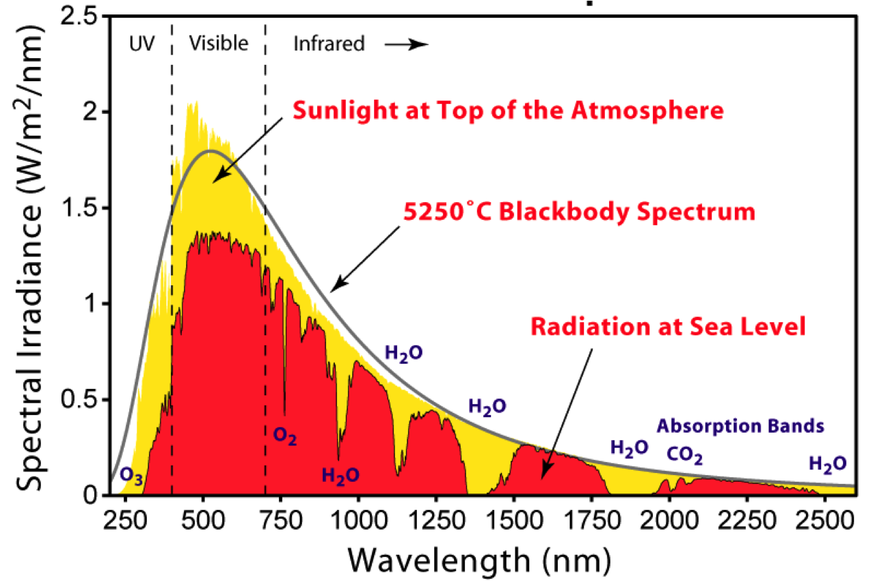
Example of a good slide: A descriptive title
yellow: …
red: …
Black: …
caption, explaining exactly what’s shown in the figure including both axes and all lines, etc
A brief take home message. Everything on slide in 24 points or larger
Notes:
ELIZABETH
Most of the radiation reaches the earth

