Slide 1

Cloud-Based Modeling and Data Sharing for MJOs, States, and EPA
US Environmental Protection Agency
December 14, 2020

Slide 2

Discussion Topics
Overview of cloud computing and benefits
Potential challenges with current state/MJO compute environments
Goals of engaging with states/MJOs on cloud computing and data sharing
Potential benefits
Cloud capabilities: file storage and sharing and computing
Status of EPA’s work
Proposed phased effort
Potential opportunities to collaborate

Slide 3
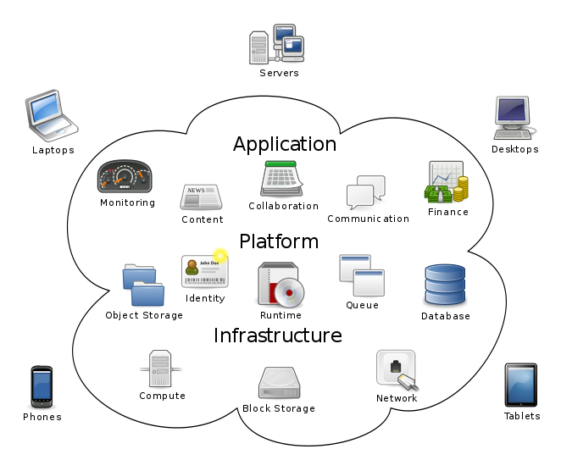
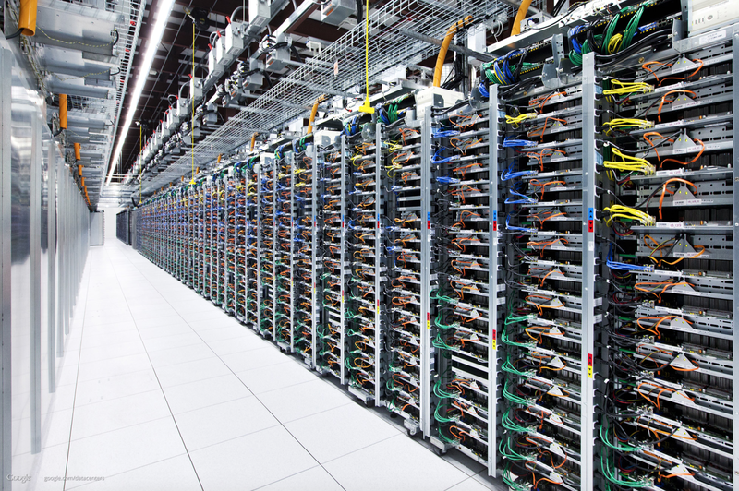


What Is Cloud Computing?
Google Data Center
Sam Johnston via Wikipedia
Resources/services fluidly assigned/provided!

Slide 4
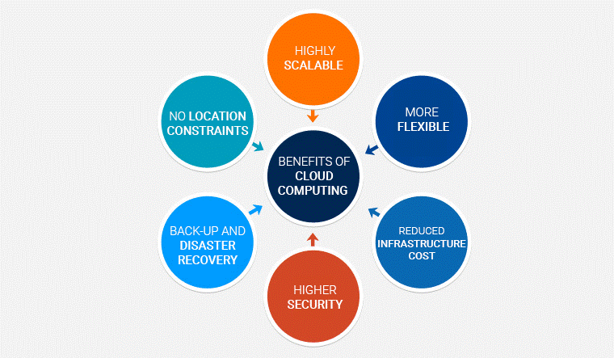
Cloud Benefits and Examples
Examples of Cloud Users
EPA
Microsoft Office 365
OLEM’s e-Manifest
EPA emergency response
Salesforce/Business Automation Platform
Other Agencies
DOJ, DOD, CIA, SBA
Commercial
Netflix
Gmail
GE Gas & Oil
Pacific Gas & Electric
Maersk Line
BMW
Shell
Knowarth Technologies
via Medium

Slide 5

Overall Goal
Enable states/MJOs to more easily receive/send large data sets and to conduct modeling and analysis in the cloud (e.g., using a cloud service provider such as Amazon Web Services or Microsoft Azure)
Components of this Effort
EPA provide data sets, models, and other tools in cloud along with supporting materials. Would bear cost of storing base data sets.
States/MJOs directly access commercial cloud services and make use of the data sets and tools EPA provides. Would have their own cloud account and bear cost of compute servers and their own storage.
Would be an option for states/MJOs, not required.
Note that significant expertise will still be required by the states/MJOs to properly configure and run SMOKE and CMAQ

Slide 6
Potential Benefits
Improved ability of states/MJOs to conduct simulations to meet their needs
May eliminate need to procure and maintain special hardware
Help overcome the learning curve of setting up the modeling environment (e.g., installing software libraries, finding and compiling code)
Ability to obtain surge computing capacity as needed
Improve sharing of information between states/MJOs and EPA (e.g., base data sets, outputs from attainment demonstrations)
Improve efficiency of OAQPS sharing data sets and assisting states/MJOs in configuring simulations
Support other groups, e.g., universities that want to run SMOKE and CMAQ

Slide 7
Why Now?
Cloud technologies offer mature capabilities and are widely used
Multiple modeling groups are using the cloud (e.g., CMAS* and AER with CMAQ, CMAS* with SMOKE, LADCO and NCAR with WRF, ERG with MOVES, LADCO with CAMx, Harvard with GEOS-Chem)
EPA moving towards greater adoption of cloud platforms
EPA’s Office of Mission Support now provides multiple enterprise cloud environments that enable streamlined access (e.g., reduced security and contracting burdens)
Applications such as Envirofacts, e-Manifest, CDX, and AirNow are in the cloud
EPA’s Office of Research and Development is sharing large data sets with the public via the cloud
Widespread and growing utilization of cloud in government, industry, and academia makes it easier for all parties to find or develop the expertise required to utilize cloud capabilities
* CMAS is running small domains for training purposes.

Slide 8
Key Capability: File Storage and Sharing
Can easily store many terabytes of information
Cost for storage is modest, e.g., $23/TB/month for Amazon Web Services (AWS) Simple Storage Service (S3)
Cost can be even lower if access to data will be infrequent
E.g., S3 storage where can wait 1 minute to 12 hours to retrieve data costs $4/TB/month
E.g., a modeling platform with 20TB of data would cost $5,520/year to store with default S3 or $960/year with slower retrievals
No cost to share data within a cloud service provider.
But, cost to download data is significant, e.g., $90/TB.
E.g., 100 people downloading a 20TB modeling platform would cost $180K
Download cost can be borne by downloader or data owner, at the discretion of data owner.

Slide 9
Key Capability: Computing
Many options for computing instances available, e.g., types of processors, cores, amount of RAM, networking speed
Can request multiple flavors of Linux (as well as Windows)
Pay per minute of usage with more capable processors typically costing more, e.g., on AWS high performance CPU with 8 cores would be $0.68/hour, 48 cores $4.61/hour
“Spot” instances. Pay less if use processors that are idle, with the caveat that the providers will stop work and give the processor to someone else if they will pay full price.
Typically discounted 50% or more

Slide 10
Brief Demo of Computing on Amazon Web Services (AWS) with Elastic Compute Cloud (EC2)

Slide 11
Status of EPA’s Work
Storage
One month of 2016 Modeling Platform uploaded to S3 (4TB) as a pilot
Modeling
One-week simulation of continental US at 12km resolution on one EC2 instance (48 cores)
Required ~9 hours to perform simulation, 246x396x35
Completed 2016 Southeast benchmark case on multiple EC2 instances
Initial test of hibernating simulation on one instance
Part of testing whether spot instances could be used

Slide 12
Example Costs
Storage
S3: $23/TB/month or less
No cost to access data from within AWS.
However, ~$90/TB to download the data. An entire modeling platform in compressed format is 16-20 TB (up to $1800 for complete download).
Computations
Pay only when instances are running
Cost depends on what type of EC2 instance. Dozens of options
For initial runs of CONUS 12km domain (c5d.metal instance)
~$41 to simulate a week
Potential opportunities to reduce costs
Find instances with better performance per $ for CMAQ
Use fewer cores which may improve efficiency but increase length of simulation
Use spot instances

Slide 13
Proposed Phased Effort
Perform “requirements analysis” to identify specific state/MJO needs
What data sets, models, tools, usage patterns, etc.?
Share data sets (e.g., 2016 platform inputs and outputs)
Make SMOKE and CMAQ and limited analysis tools available in cloud-ready form
Provide documentation and other support
Potential extensions
Additional analysis tools
MOVES
WRF

Slide 14
Potential Opportunities to Collaborate
All interested groups
Discuss requirements
Groups able to try cloud-based approaches established by others
Evaluate approaches
Develop and provide feedback on documentation
Groups with more time and technical capacity
Develop and share best practices
There are often multiple options, and we are still learning the best way to accomplish goals and to understand performance vs. cost trade-offs.
Try/migrate additional tools/models (e.g., analysis tools)
Try different ways of sharing (e.g., containers)
Optimize approaches (e.g., find optimal processors, use cluster manager)
Pursue additional cloud platforms (e.g., Microsoft Azure)
Others?

