Slide 1
Azure Symbols

Slide 2
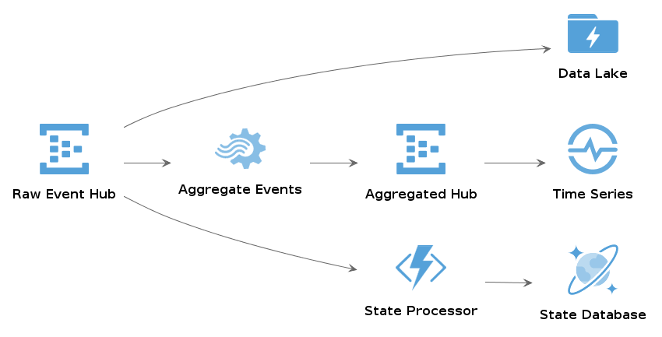
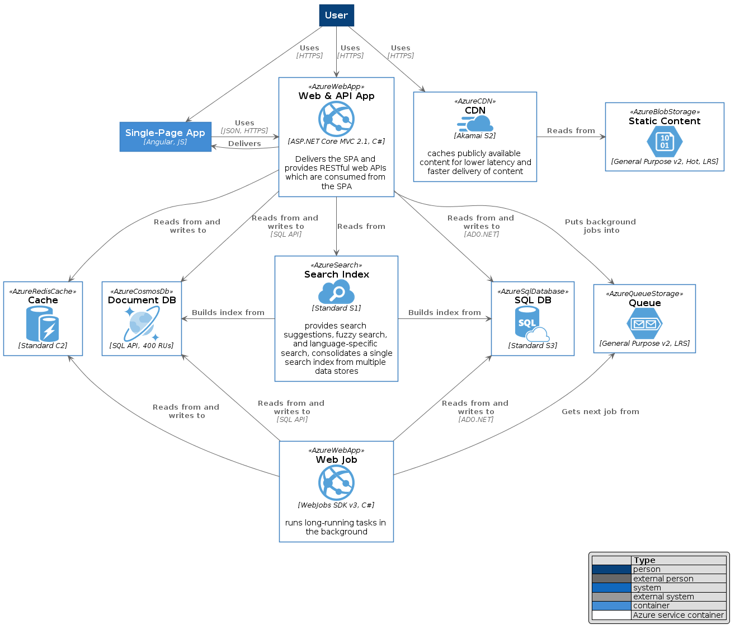
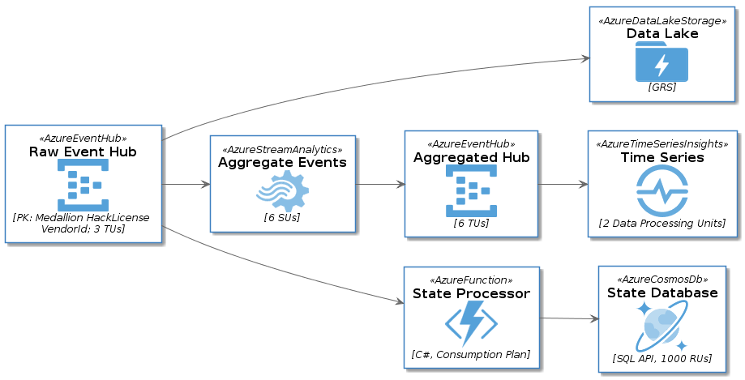
Azure-PlantUML
This export of Azure Symbols is part of Azure-PlantUML.
With Azure-PlantUML you can create high-level and technical diagrams:
And you can combine this with C4-PlantUML for using the C4 model for software architecture:

Slide 3
But sometimes you just want to use PowerPoint – that’s the reason the following slides exist. Please ensure to create always meaningful diagrams – I really recommend the software architecture diagram review checklist. All symbols are available as colorized and monochrome versions. My recommendation: use the monochrome symbols to avoid distracting your stakeholders.

Slide 4

General
Azure

Slide 5
General
Azure

Slide 6






AIMachineLearning
Azure BatchAI
Azure Bot Service
Azure Cognitive Services
Azure Machine Learning Service
Azure Machine Learning Studio
Microsoft Genomics

Slide 7






AIMachineLearning
Azure BatchAI
Azure Bot Service
Azure Cognitive Services
Azure Machine Learning Service
Azure Machine Learning Studio
Microsoft Genomics

Slide 8








Analytics
Azure Stream Analytics
Azure Databricks
Azure HDInsight
Azure Data Lake Analytics
Azure Analysis Services
Azure Event Hub
Azure Data Catalog
Azure Data Explorer

Slide 9







Analytics
Azure Stream Analytics
Azure Databricks
Azure HDInsight
Azure Data Lake Analytics
Azure Analysis Services
Azure Event Hub
Azure Data Catalog
Azure Data Explorer

Slide 10






Compute
Azure Virtual Machine
Azure App Service
Azure Function
Azure Batch
Azure Service Fabric
Azure Virtual Machine Scale Set

Slide 11






Compute
Azure Virtual Machine
Azure App Service
Azure Function
Azure Batch
Azure Service Fabric
Azure Virtual Machine Scale Set

Slide 12





Containers
Azure Container Registry
Azure Container Instance
Azure Service Fabric Mesh
Azure Kubernetes Service
Azure Web App For Containers

Slide 13





Containers
Azure Container Registry
Azure Container Instance
Azure Service Fabric Mesh
Azure Kubernetes Service
Azure Web App For Containers

Slide 14









Databases
Azure Sql Database
Azure Cosmos Db
Azure Sql Data Warehouse
Azure Data Factory
Azure Redis Cache
Azure Sql Stretch Database
Azure Database For Postgre SQL
Azure Database For My SQL
Azure Database For MariaDB

Slide 15









Databases
Azure Sql Database
Azure Cosmos Db
Azure Sql Data Warehouse
Azure Data Factory
Azure Redis Cache
Azure Sql Stretch Database
Azure Database For Postgre SQL
Azure Database For My SQL
Azure Database For MariaDB

Slide 16









DevOps
Azure Dev Ops
Azure Boards
Azure Pipelines
Azure Repos
Azure Test Plans
Azure Artifacts
Azure Application Insights
Azure Dev Test Labs
Azure Lab Services

Slide 17









DevOps
Azure Dev Ops
Azure Boards
Azure Pipelines
Azure Repos
Azure Test Plans
Azure Artifacts
Azure Application Insights
Azure Dev Test Labs
Azure Lab Services

Slide 18



Identity
Azure Active Directory
Azure Active Directory Domain Services
Azure Active Directory B2C

Slide 19



Identity
Azure Active Directory
Azure Active Directory Domain Services
Azure Active Directory B2C

Slide 20



Integration
Azure Event Grid
Azure Logic Apps
Azure Service Bus

Slide 21



Integration
Azure Event Grid
Azure Logic Apps
Azure Service Bus

Slide 22






InternetOfThings
Azure IoT Hub
Azure IoT Edge
Azure IoT Central
Azure Time Series Insights
Azure Maps
Azure Digital Twins

Slide 23





InternetOfThings
Azure IoT Hub
Azure IoT Edge
Azure IoT Central
Azure Time Series Insights
Azure Maps
Azure Digital Twins

Slide 24












Management
Azure Backup
Azure Site Recovery
Azure Scheduler
Azure Automation
Azure Log Analytics
Azure Monitor
Azure Resource Groups
Azure Policy
Azure Blueprints
Azure Subscription
Azure Management Groups
Azure Managed Applications

Slide 25












Management
Azure Backup
Azure Site Recovery
Azure Scheduler
Azure Automation
Azure Log Analytics
Azure Monitor
Azure Resource Groups
Azure Policy
Azure Blueprints
Azure Subscription
Azure Management Groups
Azure Managed Applications

Slide 26

Media
Azure Media Services

Slide 27

Media
Azure Media Services

Slide 28


Mobile
Azure Notification Hubs
Azure Mobile App

Slide 29


Mobile
Azure Notification Hubs
Azure Mobile App

Slide 30










Networking
Azure Express Route
Azure DNS
Azure Virtual Network
Azure Traffic Manager
Azure Load Balancer
Azure VPN Gateway
Azure Application Gateway
Azure Azure DDoS Protection
Azure Virtual WAN
Azure Front Door Service

Slide 31










Networking
Azure Express Route
Azure DNS
Azure Virtual Network
Azure Traffic Manager
Azure Load Balancer
Azure VPN Gateway
Azure Application Gateway
Azure Azure DDoS Protection
Azure Virtual WAN
Azure Front Door Service

Slide 32


Security
Azure Key Vault
Azure Sentinel

Slide 33


Security
Azure Key Vault
Azure Sentinel

Slide 34










Storage
Azure Storage
Azure Stor Simple
Azure Data Lake Storage
Azure Blob Storage
Azure Disk Storage
Azure Managed Disks
Azure Queue Storage
Azure File Storage
Azure Data Box
Azure Net App Files

Slide 35






Storage
Azure Storage
Azure Stor Simple
Azure Data Lake Storage
Azure Blob Storage
Azure Disk Storage
Azure Managed Disks
Azure Queue Storage
Azure File Storage
Azure Data Box
Azure Net App Files

Slide 36





Web
Azure CDN
Azure API Management
Azure Search
Azure Web App
Azure SignalR Service

Slide 37





Web
Azure CDN
Azure API Management
Azure Search
Azure Web App
Azure SignalR Service

