Slide 1
Assignment 1,2
Reference code will be released at 17th April.

Slide 2
Assignment 3
Word2Vec Implementation
Hierarchical Softmax
Assign binary code(Huffman coding)
Train with only weights connected to the activated nodes
Return : cost value and gradient of two word vectors
Negative Sampling
Frequency table
Random sampling during training
Return : cost value and gradient of two word vectors
Subsampling
Read(preprocess) corpus and make dictionary
Subsample corpus in every epoch

Slide 3
Assignment 3
Strongly recommend reading the following paper
T. Mikolov, I. Sutskever, K. Chen, G. Corrado, J. Dean, “Distributed Representations of Words and Phrases and their Compositionality”, NIPS 2013
https://papers.nips.cc/paper/5021-distributed-representations-of-words-and-phrases-and-their-compositionality.pdf

Slide 4
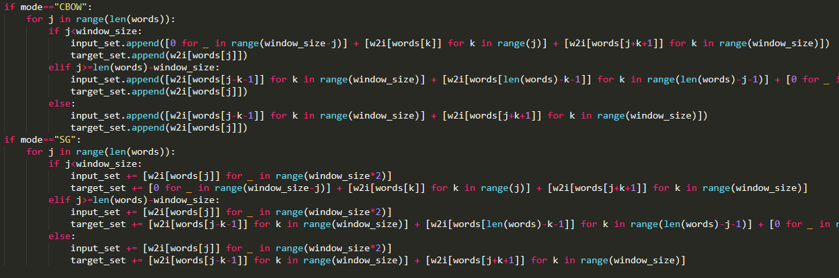
Assignment 3
Changes on Skeleton Code
Now, train_set is divided into input_set and target_set

Slide 5
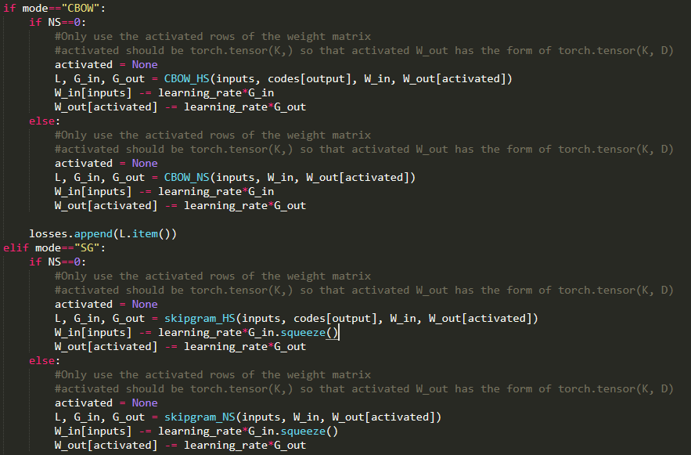
Assignment 3
Activated Weight Matrix
We use an activated W_out for the computational efficiency.
You should implemented activation code for
W_out.

Slide 6
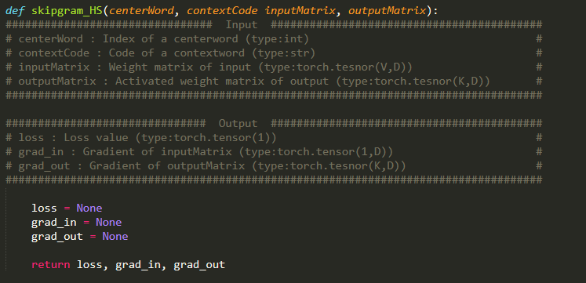
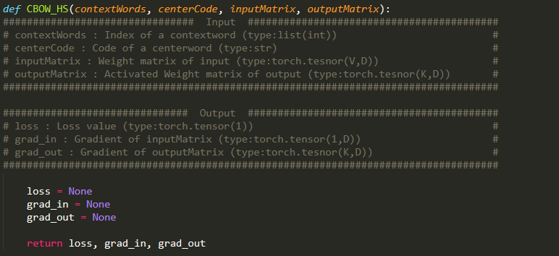
Assignment 3
Hierarchical Softmax

Slide 7
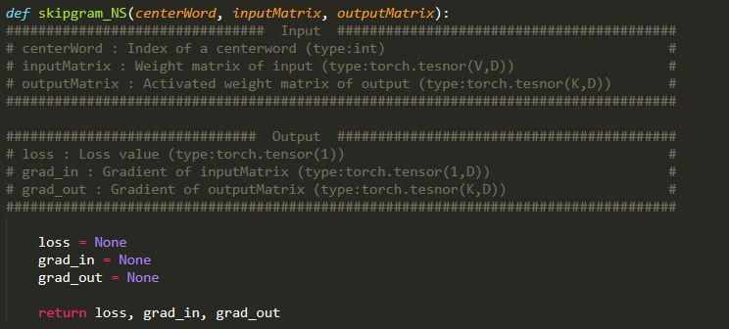
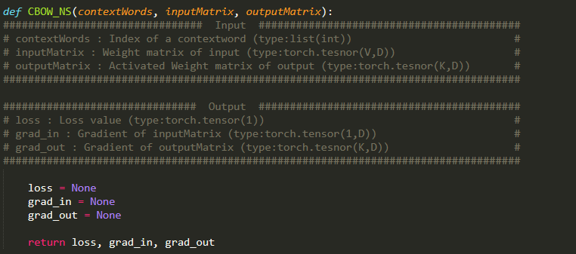
Assignment 3
Negative Sampling

Slide 8
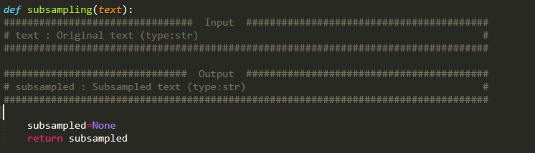
Assignment 3
Subsampling

Slide 9
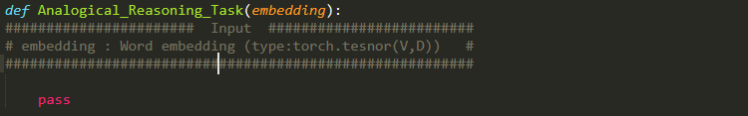
Assignment 3
Word2Vec Experiment
Analogical reasoning task[1][2]
“Germany” : “Berlin” :: “France” : ?
vec(x) =vec(“Berlin”) - vec(“Germany”) + vec(“France”)
Find the word x using cosine similarity
(Question words are zeroed)
[1] http://code.google.com/p/word2vec/source/browse/trunk/questions-words.txt
[2] Tomas Mikolov et al. Distributed Representations of Words and Phrases and their Compositionality, 2013

Slide 10
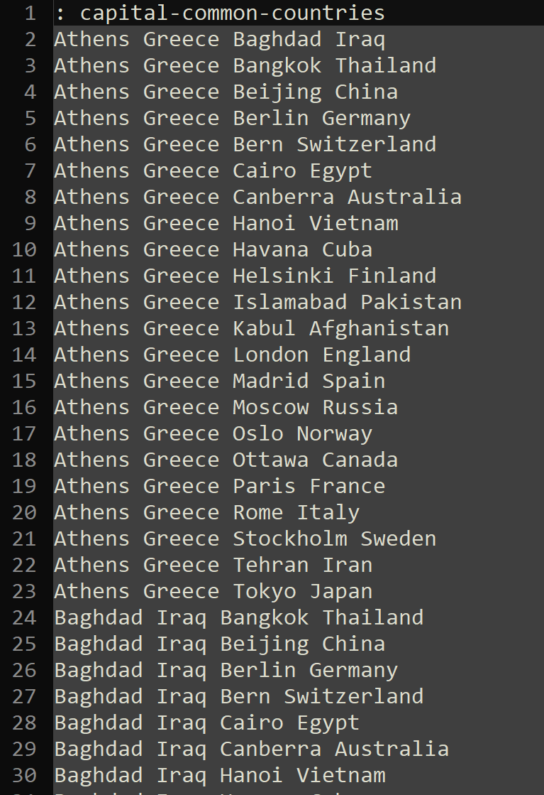
Assignment 3
Word2Vec Experiment
Analogical reasoning task[1]
“Germany” : “Berlin” :: “France” : ?
vec(x) =vec(“Berlin”) - vec(“Germany”) + vec(“France”)
Find the word x using cosine similarity
(Question words are zeroed)
[1] http://code.google.com/p/word2vec/source/browse/trunk/questions-words.txt
[2] Tomas Mikolov et al. Distributed Representations of Words and Phrases and their Compositionality, 2013

Slide 11
Assignment 3
Word2Vec Experiment
Analogical reasoning task[1][2]
CBOW or Skip-gram
Hierarchical Softmax or Negative Sampling
Subsampling or not
Corpus : text8, 1B tokens corpus
[1] http://code.google.com/p/word2vec/source/browse/trunk/questions-words.txt
[2] Tomas Mikolov et al. Distributed Representations of Words and Phrases and their Compositionality, 2013

Slide 12
Submission 3
Due Date : ~4/28(일) 23:59
Submission : Submission : Online submission on blackboard
word2vec.py + Report with analysis of word analogy task(.docx / .hwp)
You must implement the components yourself!
File name : StudentID_Name.zip

Slide 13
Q&A
조교 박준형 : irish07@korea.ac.kr

