Slide 1
unpv13e

Slide 2
There are two reasons for the TIME_WAIT state
To implement TCP's full-duplex connection termination reliably
The first reason can be explained by looking at Figure 2.5 and assuming that the final ACK is lost. The server will resend its final FIN, so the client must maintain state information, allowing it to resend the final ACK. If it did not maintain this information, it would respond with an RST (a different type of TCP segment), which would be interpreted by the server as an error. If TCP is performing all the work necessary to terminate both directions of data flow cleanly for a connection (its full-duplex close), then it must correctly handle the loss of any of these four segments. This example also shows why the end that performs the active close is the end that remains in the TIME_WAIT state: because that end is t
To allow old duplicate segments to expire in the network
To understand the second reason for the TIME_WAIT state, assume we have a TCP connection between 12.106.32.254 port 1500 and 206.168.112.219 port 21. This connection is closed and then sometime later, we establish another connection between the same IP addresses and ports: 12.106.32.254 port 1500 and 206.168.112.219 port 21. This latter connection is called an incarnation of the previous connection since the IP addresses and ports are the same. TCP must prevent old duplicates from a connection from reappearing at some later time and being misinterpreted as belonging to a new incarnation of the same connection. To do this, TCP will not initiate a new incarnation of a connection that is currently in the TIME_WAIT state. Since the duration of the TIME_WAIT state is twice the MSL, this allows MSL seconds for a packet in one direction to be lost, and another MSL seconds for the reply to be lost. By enforcing this rule, we are guaranteed that when we successfully establish a TCP connection, all old duplicates from previous incarnations of the connection have expired in the network.

Slide 3
"little-endian" and "big-endian"
The terms "little-endian" and "big-endian" indicate which end of the multibyte value, the little end or the big end, is stored at the starting address of the value.
network byte order is Big-endian

Slide 4
distinguish between the interface on which a packet arrives versus the destination IP address of that packet
We must be careful to distinguish between the interface on which a packet arrives versus the destination IP address of that packet. In Section 8.8, we will talk about the weak end system model and the strong end system model. Most implementations employ the former, meaning it is okay for a packet to arrive with a destination IP address that identifies an interface other than the interface on which the packet arrives. (This assumes a multihomed host.) Binding a non-wildcard IP address restricts the datagrams that will be delivered to the socket based only on the destination IP address. It says nothing about the arriving interface, unless the host employs the strong end system model.

Slide 5
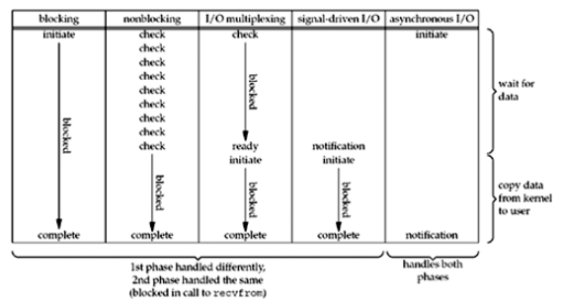
Comparison of the I/O Models

Slide 6
Synchronous I/O versus Asynchronous I/O
A synchronous I/O operation causes the requesting process to be blocked until that I/O operation completes.
An asynchronous I/O operation does not cause the requesting process to be blocked.
Using these definitions, the first four I/O models—blocking, nonblocking, I/O multiplexing, and signal-driven I/O—are all synchronous because the actual I/O operation (recvfrom) blocks the process. Only the asynchronous I/O model matches the asynchronous I/O definition.

Slide 7
select / poll / epoll: practical difference for system architects
http://www.ulduzsoft.com/2014/01/select-poll-epoll-practical-difference-for-system-architects/
http://blog.csdn.net/hustsselbj/article/details/47616229

