Slide 2
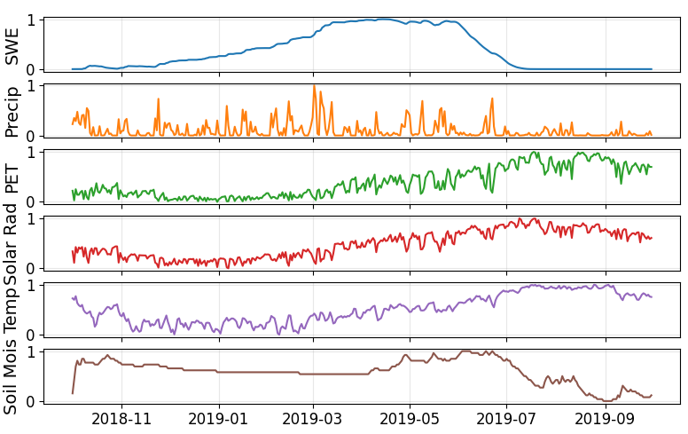
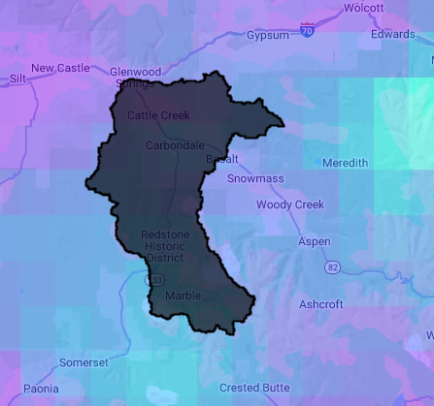
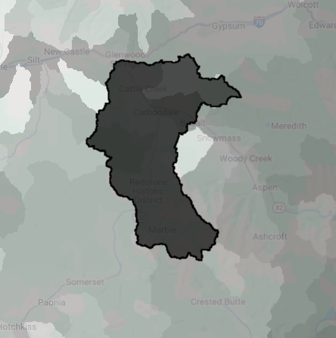
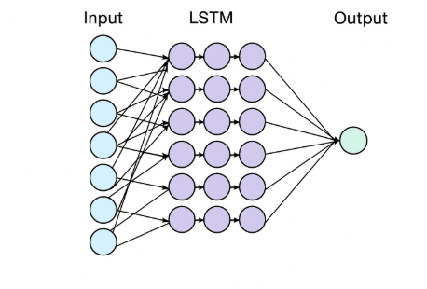
Estimating Streamflow for 10-01-2019 for One Catchment
Zonal Statistics over NLDAS5 daily meteorological time series
10-01-2019 Mean Streamflow
1.1 mm/d
Catchment characteristics from HydroAtlas, MODIS, DEM, etc.
Variable | Value
Percent Clay | 14
Percent Silt | 37
Percent Sand | 49
Elevation | 1800
Mean Aridity Index | 2.5
Percent Lake Area | 3
Slope | 21

