Slide 1
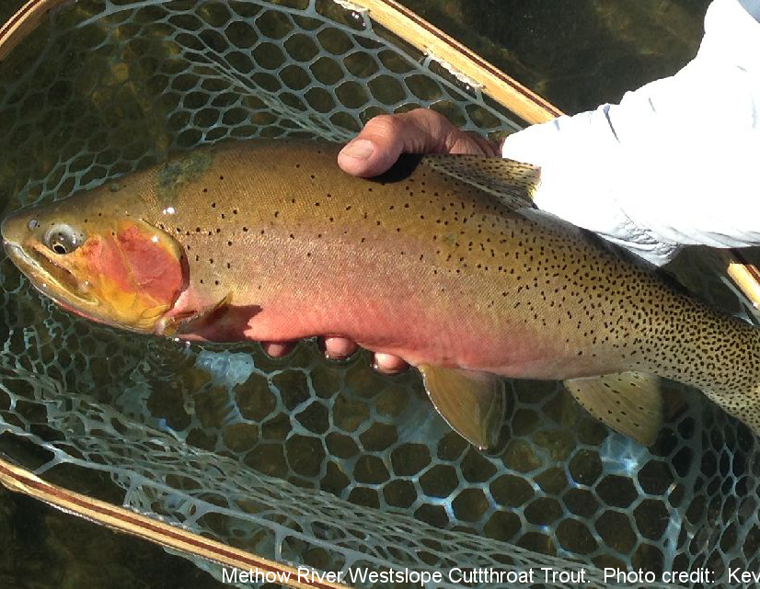
Using Elevation and Weight data to Ease Hybrid Fish Identification
William Keenan
Can elevation and weight data be used to aide in the identification of hybrid Rainbow Trout and Westslope Cutthroat Trout?

Slide 2
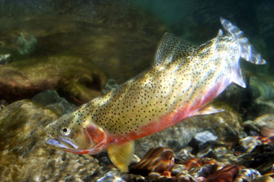
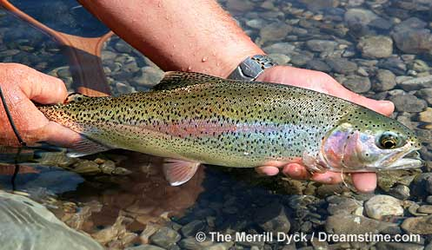
Which one is which?

Slide 3

Motivation and Background
This summer I will be working as a Native Trout Conservation Intern in Yellowstone National Park
Yellowstone has the same hybridization problem in its streams and rivers
A large part of my job will involve catching and identifying native, invasive, and hybrid trout.
Could weight and elevation data be handy when trying to accurately identify these fish?

Slide 4
Approach
I will answer this question by using data from a study done in Alberta Canada on hybridization between Rainbow Trait and native Westslope Cutthroat Trout.
As mentioned in this study, correctly identifying RT, WCT, and their hybrid offspring is extremely difficult in the field.
I will use statistical analysis and linear regression to find how viable identification using weight and elevation may be.

Slide 5
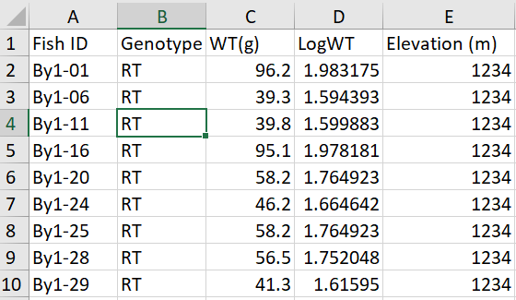
About the Data
The data contains 356 lines representing 356 fish. There are weight and elevation data for each one, as well as other metabolic statistics such as oxygen consumption and enzyme levels.
In the fish ID column, By1 represents the site these fish were collected.
There are 23 sites.

Slide 6
Anticipated Results
I anticipate that I will find significant differences between weight, elevation, and genotype
These may not be significant enough on their own, but combined with a trained eye they may allow a quicker identification process
Although my results will be relevant to the watershed studied in Alberta, they will not be relevant to all populations of rainbow and westslope cutthroat trout.

