Slide 1
Easy FBI data Analysis
William Keilsohn
VU Biology
2018

Slide 2


So what do you study, again?
Notes:
Turkey – http://wikiclipart.com/cooked-turkey-clipart_27825/
Man w/ question mark – https://www.clipartmax.com/max/m2i8K9K9d3m2N4H7/

Slide 3

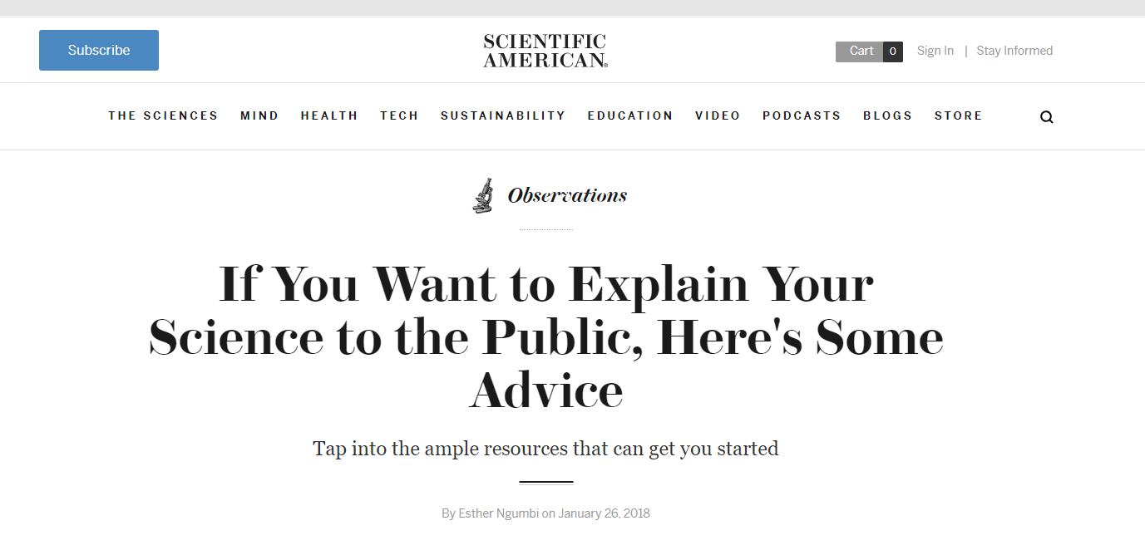
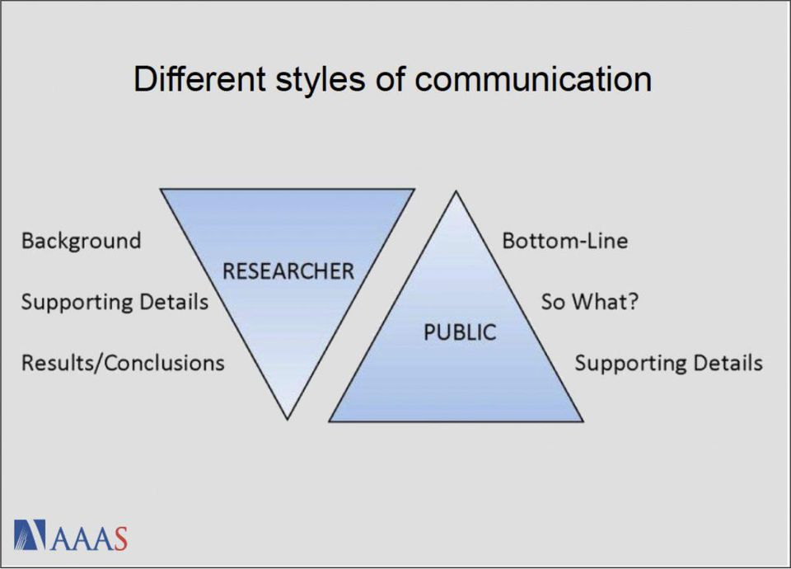
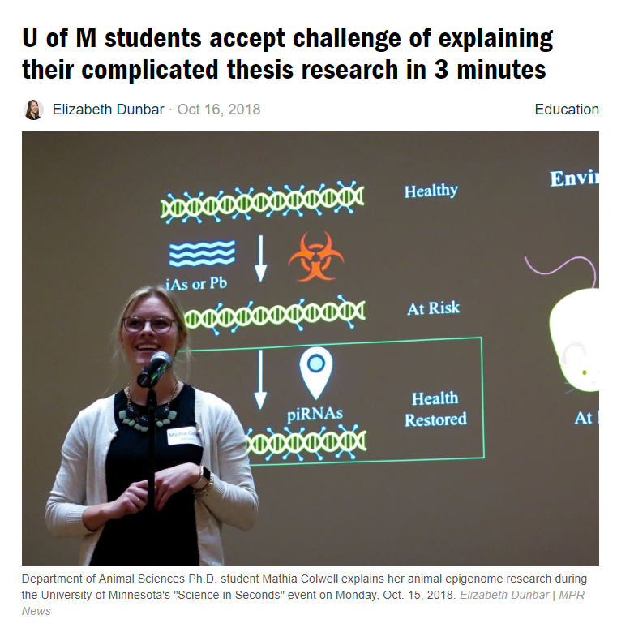
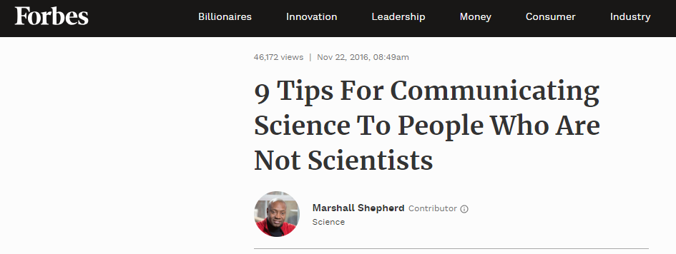
Notes:
News Northeastern – https://news.northeastern.edu/2018/05/25/how-to-explain-to-scientists-how-to-explain-science/
Scientific America – https://blogs.scientificamerican.com/observations/if-you-want-to-explain-your-science-to-the-public-heres-some-advice/
U of M – https://www.mprnews.org/story/2018/10/17/three-minute-science-challenges-university-of-minnesota-students-to-reach-public
Forbs and Figure – https://www.forbes.com/sites/marshallshepherd/2016/11/22/9-tips-for-communicating-science-to-people-who-are-not-scientists/#289814bc66ae

Slide 4
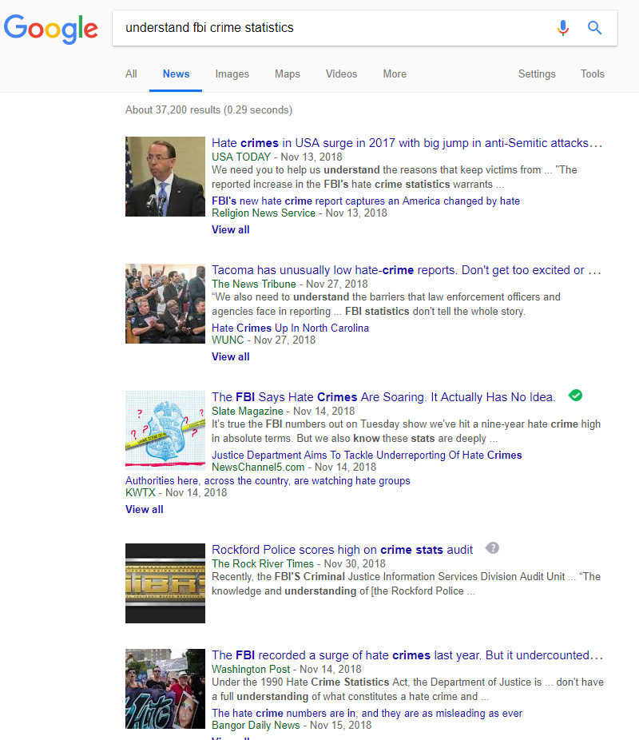
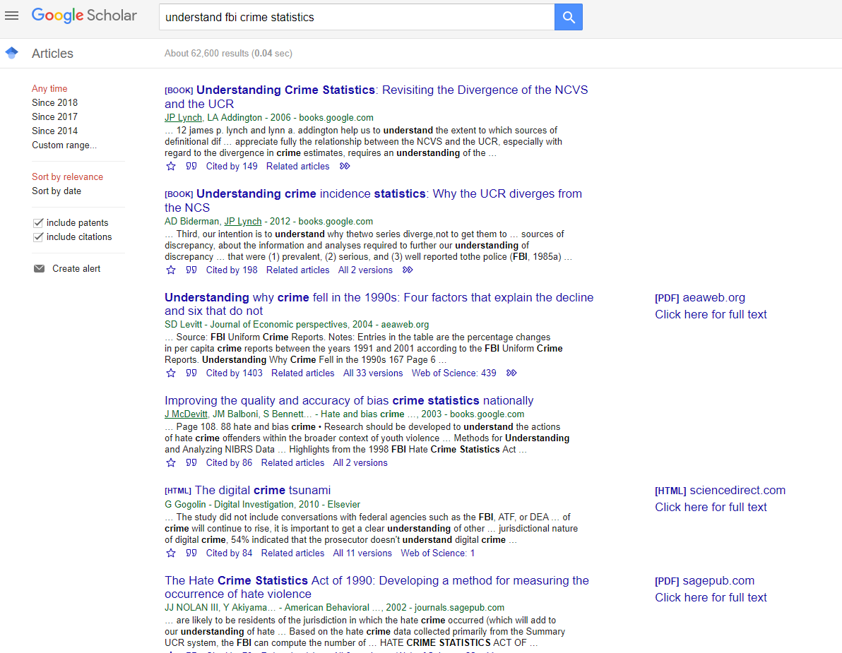
The public has an exceptionally hard time understanding crime statistics.
Notes:
Just google searches so:
Left: https://www.google.com/search?q=understand+fbi+crime+statistics&tbm=nws&ei=6D4FXM_rA4jc5gL7uavoDA&start=0&sa=N&ved=0ahUKEwjP_4HZ8IPfAhUIrlkKHfvcCs04FBDy0wMISQ&biw=1920&bih=938&dpr=1
Right: https://scholar.google.com/scholar?start=0&q=understand+fbi+crime+statistics&hl=en&as_sdt=0,39&lookup=0

Slide 5
Make Crime Data More Accessible to the Public
Emphasize long term trends
Allow users to ask questions
Provide graphs and easy to read figures
Simplify the data interpretation experience for the user

Slide 6
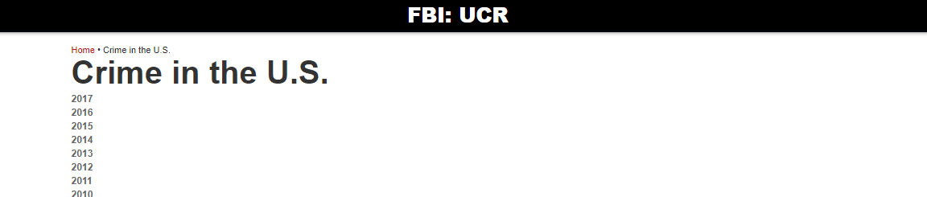
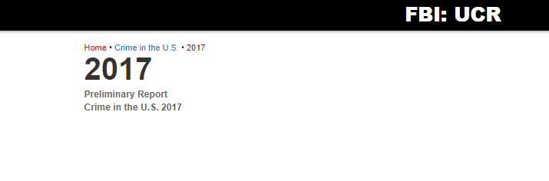
First step: obtaining the data
5 years
Full crime reports for each year
Notes:
Top: https://ucr.fbi.gov/crime-in-the-u.s
Bottom: https://ucr.fbi.gov/crime-in-the-u.s/2017

Slide 7
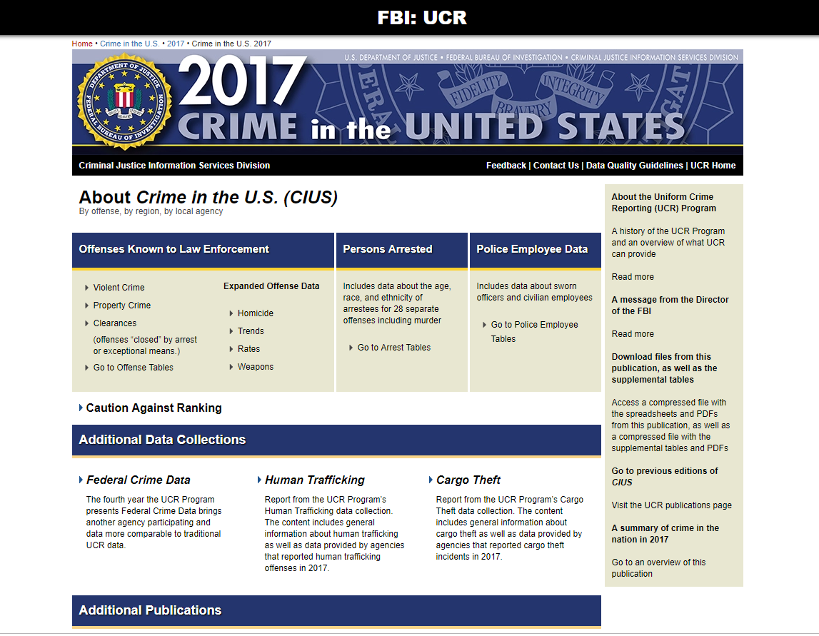
Notes:
https://ucr.fbi.gov/crime-in-the-u.s/2017/crime-in-the-u.s.-2017

Slide 8
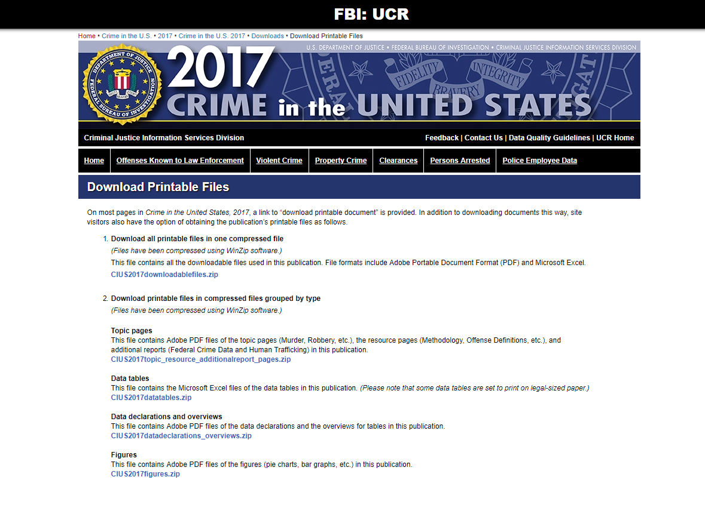
Notes:
https://ucr.fbi.gov/crime-in-the-u.s/2017/crime-in-the-u.s.-2017/downloads/download-printable-files

Slide 9
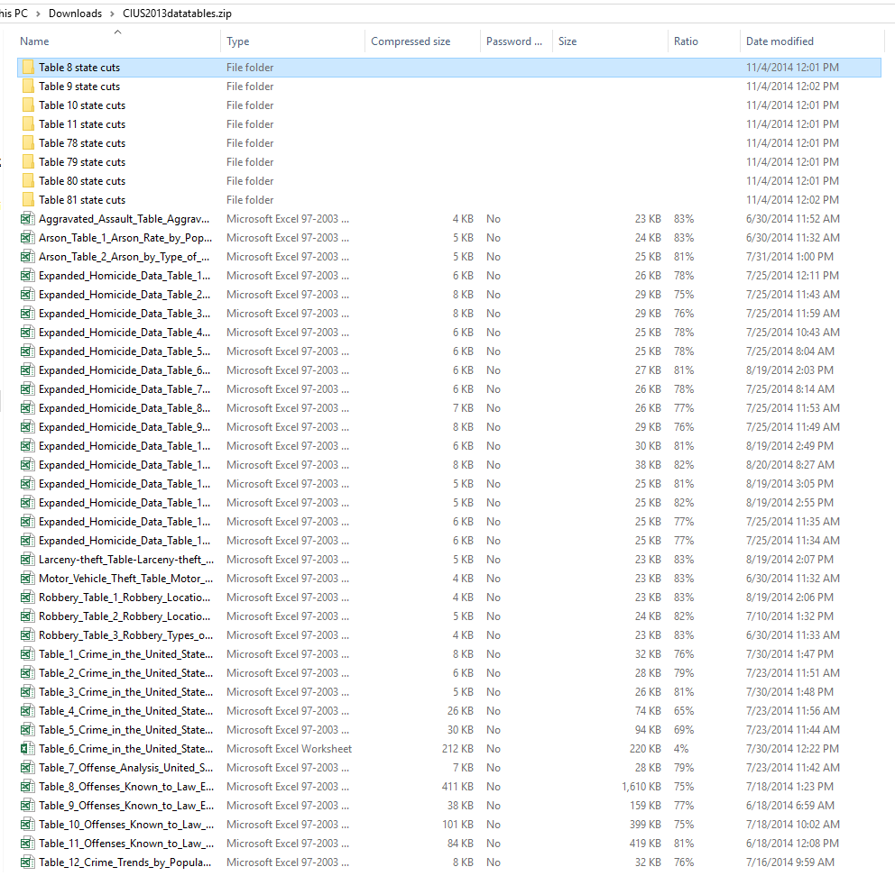
Just the crime data
250 files
51 states
47,193 points of data

Slide 10



Packages
Numpy
Pandas
Os
Matplotlib
Random
Scipy
PIL

Slide 11
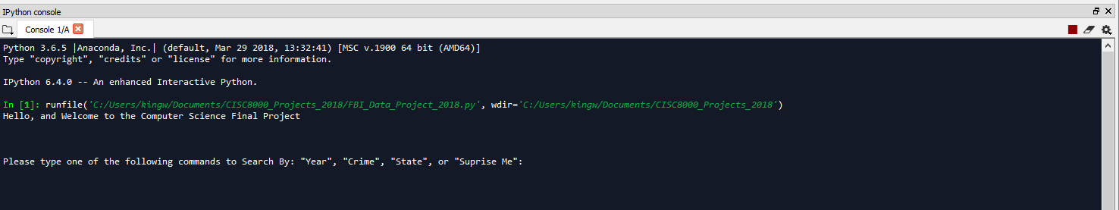
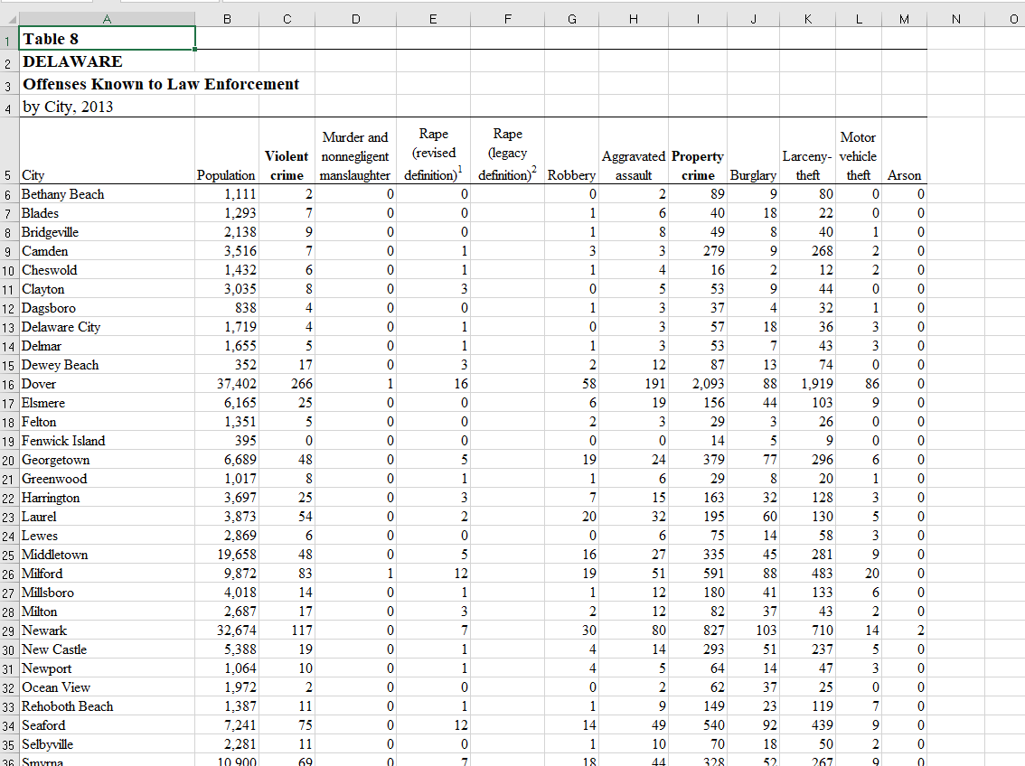
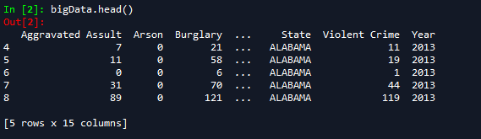
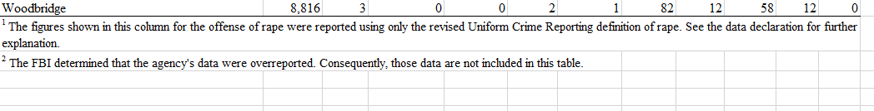
Notes:
Load

Slide 12
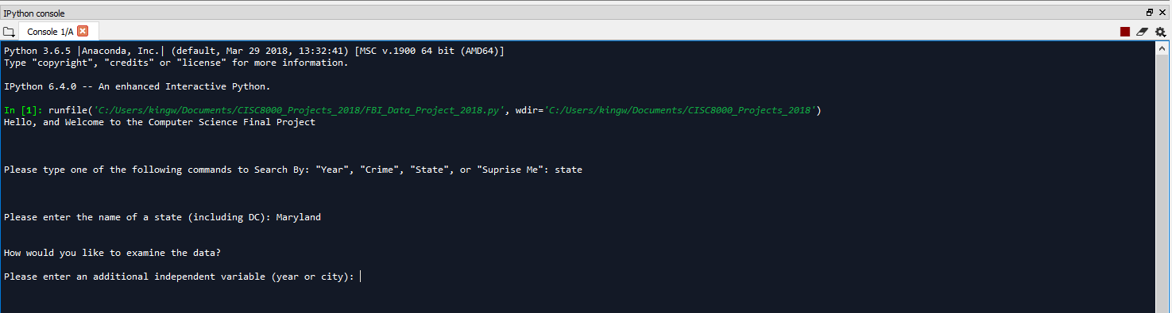
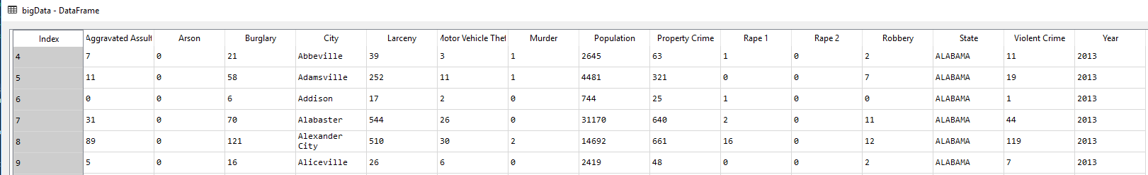
Notes:
Select State
Maryland

Slide 13
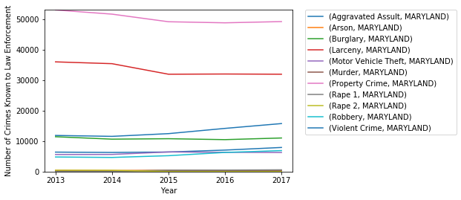
Program Returns Results
Notes:
Year

Slide 14
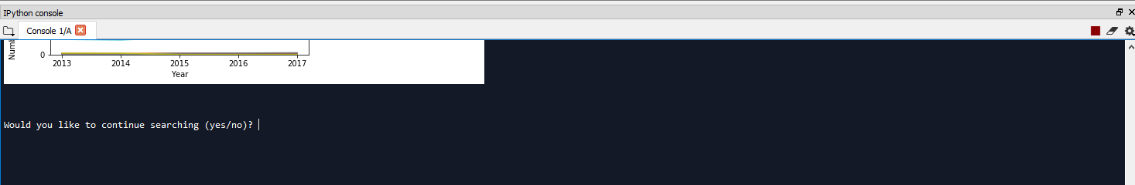
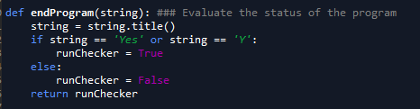

YES | NO
Notes:
Additional Options

Slide 15
No Pain == No Gain
Challenges
Lessons
Differing numbers of columns between years of data
Building graphs that were both readable and ‘intelligent’
Working with images and figures
Parsing and cleaning large data sets
It’s difficult to make good quality tools for data interpretation.
Maryland has had a relatively steady crime rate
Notes:
Conclusions

Slide 16
Future goals would focus on looks and versatility
Additions
Removals
Nicer (i.e. easier to read) graphs
A larger data set
10 years
More options
Hard to interpret graphs
Repetitive comparisons
Notes:
Improvements
-Nicer graphs
-More options
-Larger data set

Slide 17
Questions?

Slide 18
References:
http://wikiclipart.com/cooked-turkey-clipart_27825/
https://www.clipartmax.com/max/m2i8K9K9d3m2N4H7/
https://news.northeastern.edu/2018/05/25/how-to-explain-to-scientists-how-to-explain-science/
https://blogs.scientificamerican.com/observations/if-you-want-to-explain-your-science-to-the-public-heres-some-advice/
https://www.mprnews.org/story/2018/10/17/three-minute-science-challenges-university-of-minnesota-students-to-reach-public
https://www.forbes.com/sites/marshallshepherd/2016/11/22/9-tips-for-communicating-science-to-people-who-are-not-scientists/#289814bc66ae
https://ucr.fbi.gov/crime-in-the-u.s
https://www.clipartmax.com/download/m2H7K9K9Z5b1H7Z5_anaconda-anaconda-python-logo/
https://www.clipartmax.com/download/m2i8H7K9i8G6H7m2_big-image-python-gif-file-logo/
https://en.wikipedia.org/wiki/Spyder_(software)#/media/File:Spyder_logo.svg
Notes:
References in order of appearance

