Slide 1
Report 2016-06-01 Adaptive and Reactive Planning
Kentaro Wada
www.kentaro.wada@gmail.com

Slide 2
Todo
Reactive and Adaptive Path Planning Using Sensor Feedback and Operator Input
Sensor / operator input in real/simulated world
[x] Force sensor in real robot (Fanuc LR Mate 200iD)
[x] Installation & setup simulation.
[ ] Implement force sensor plugin.
[ ] Software for operator input.
Convert these input to be usable by planner
[ ] Survey about existing planners and their acceptable inputs.
[ ] Software for converting input for planner.
Re-planning while the execution of joint trajectory
[ ] Survey about existing planners and ROS interface.
[ ] Software for re-planning.
Demonstration
[ ] Demo with simulation + force sensor
[ ] Demo with real robot + force sensor
[ ] Demo with simulation/real + visual sensor

Slide 3
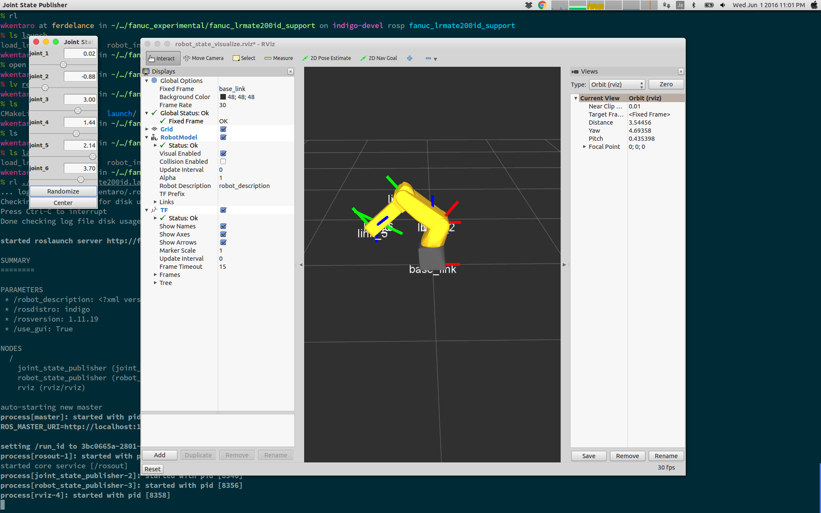
Installation & Getting Started
Watch GitHub Repos
https://github.com/ros-industrial/fanuc
https://github.com/ros-industrial/fanuc_experimental
Tutorials
http://wiki.ros.org/Industrial
http://wiki.ros.org/fanuc/Tutorials
Tried sample roslaunch for Fanuc LRMate200id

Slide 4
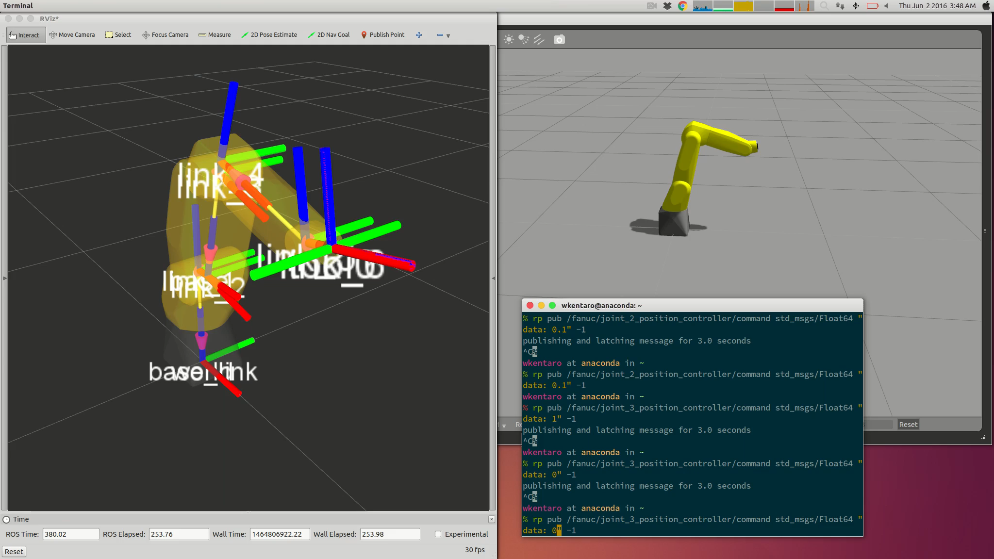
Setup Simulation on Gazebo
Done
Spawn Fanuc LRMate200id model on Gazebo
Setup joint position controller
Not Yet
Send robot joint trajectories
Force sensor plugin

