Slide 1
Best practices for scientific computing
Write programs for people, not computers
Let the computer do the work
Make incremental changes
Don’t repeat yourself (or others)
Plan for mistakes
Optimize software only after it works correctly
Document design and purpose, not mechanics
Collaborate
Greg Wilson, D. A. Aruliah, C. Titus Brown, Neil P. Chue Hong, Matt Davis, Richard T. Guy, Steven H. D. Haddock, Katy Huff, Ian M. Mitchell, Mark Plumbley, Ben Waugh, Ethan P. White, Paul Wilson, Best Practices for Scientific Computing, 26/09/13, http://arxiv.org/abs/1210.0530

Slide 2
Overheard at a conference
“Sometimes efficiency is more important than correctness”

Slide 3
Have your say…
Iterative development does not just apply to software!
What were the good and bad points about this boot camp?

Slide 4
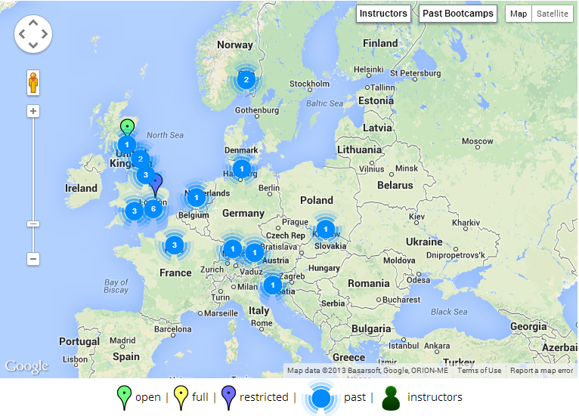



Want to get involved?
Grab us during a break!
admin-uk@software-carpentry.org
http://software-carpentry.org/bootcamps

