Slide 1
Data Warehouse Querying using Natural Language
Abhinav Jindal (Jin)
Notes:
I’m Jin- Abhinav Jindal
Budding data scientist, full-time data & analytics specialist.
I looked at a problem of finding words - data through a database - came across sentence transformers as a viable solution. Today I’m going to take you through that journey, some solutions I explored, and share some results. There will be an opportunity to ask questions at the end.

Slide 2
Structure
Intro
Problem Statement
Possible solutions and methodologies
Methodology used
Results - examples
Future scope
QnA

Slide 3
The problem
The current process for reporting on the health information linked to NIHR RDN portfolio is very time-consuming, labour-intensive, and prone to human error. We run queries in SQL Server to retrieve information. This presents a word-for-word return based on exact string matches, and loses records with similar meaning i.e. semantic context is lost.
Notes:
There is a problem as well as an opportunity to improve ways of working. Through adoption of simplistic data science methods using Natural Language Processing.
Meta data For ‘SEMANTIC’
Google Hackathon - a large language model called Vertex-
Tell ppl what you’re going to tell them - TEll them - And finally tell them what you’ve told them (summarise)
Story - 3 ACTS - Start - middle - end – Focus on Coherence

Slide 4
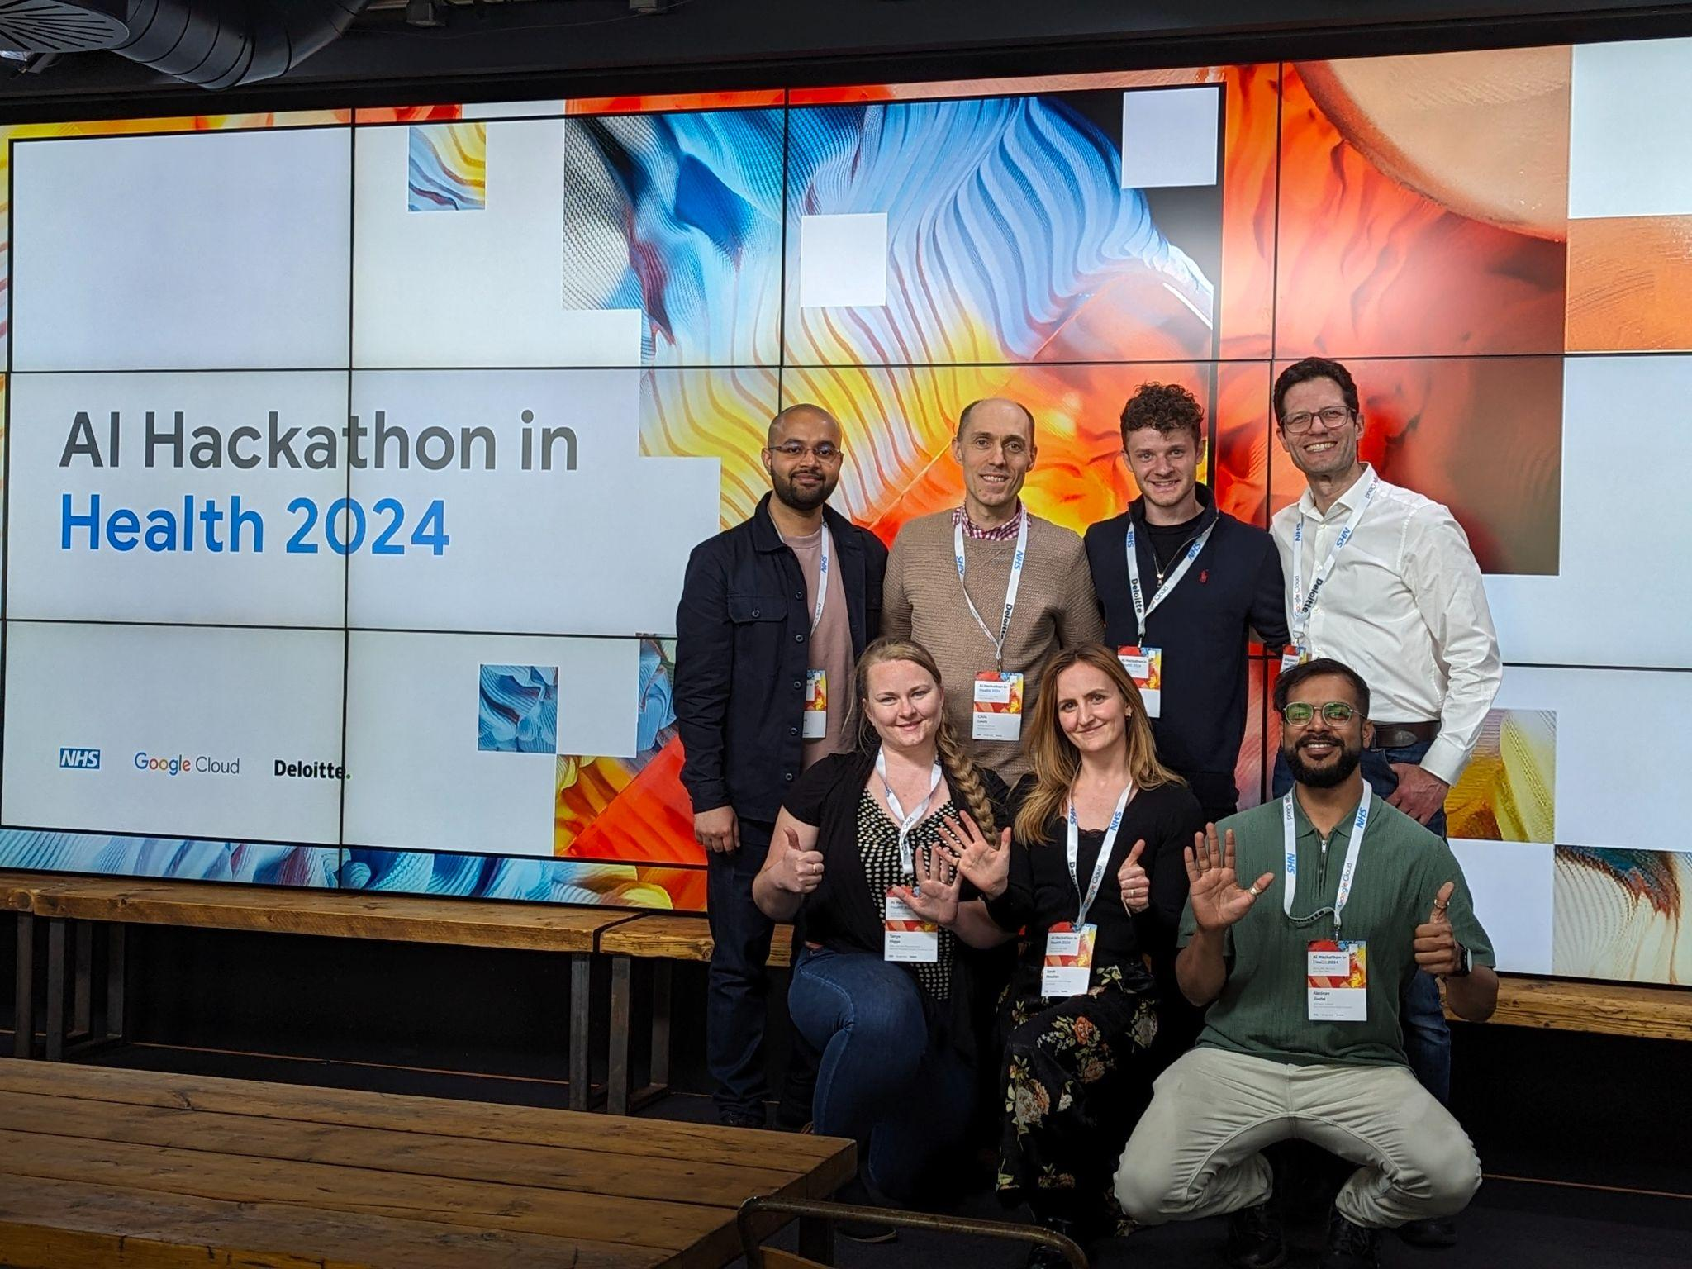
Inception
‘Exploratory analysis’
Notes:
> Outgoing fellow on HSMA-6, delivered by Dan Chalk & Sammy Rosser from NIHR Applied Research Collaboration with University of Exeter - learnt about DS, Streamlit and others.
> Participated in NHS AI Hackathon ‘2024, organised by Google, where I learnt about RAG.
> Created LLM app with streamlit
Learnt about two ideas - what is a RAG & a simple enough user interface without a lot of code - streamlit
> Experimented with RAG

Slide 5
Why did I look elsewhere?
Complexity
not FOSS
Resource hungry models
Simple problems require simple solutions
Notes:
Talk about shortcomings

Slide 6
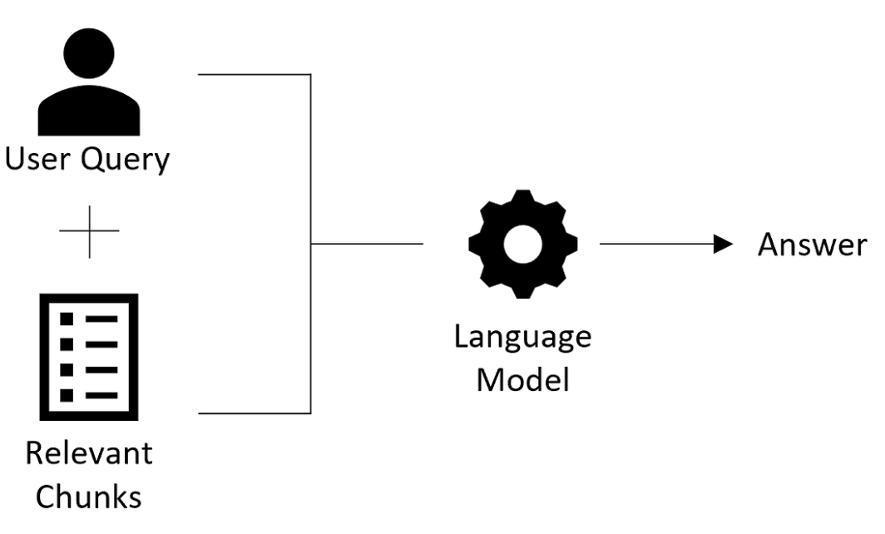
Retrieval Augmented Generation
(RAG)
Fig. 1: Original RAG model
Notes:
Analogy from Nvidia: Imagine a courtroom; where specialized cases will require specialized knowledge. so judges send court clerks to a law library, looking for precedents and specific cases they can cite.
Like a good judge, large language models (LLMs) can respond to a wide variety of human queries. But to deliver reliable judgementds grounded in specific court proceedings — the model needs to be provided that information.
The court clerk of AI is a process called retrieval-augmented generation, or RAG for short.

Slide 7
The solution:
User inputs query
System outputs relevant healthcare research programmes data
Automated approach with - human in loop
Less time, effort, manual verification
A ‘Google’ search for databases
Notes:
I’ve devised a system that enables the use of semantic capabilities. It allows users to input query related to healthcare research and get relevant information linked to the studies(part of NIHR RDN portfolio). This automated approach aims to significantly reduce the time and effort required for manual verification, ensuring more efficient and reliable outcomes.

Slide 8
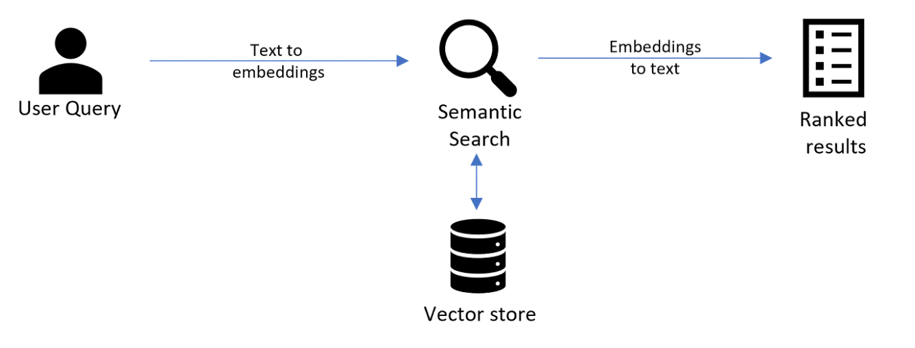
Process flow:

Slide 9
Methodology
Notes:
Sentence embedding model - convert into vectors

Slide 10
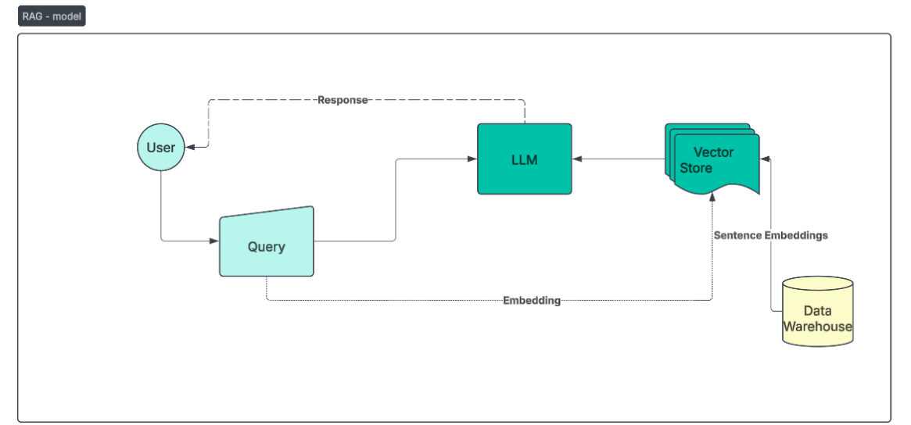
Methodology Used
Fig. 2: Finalized RAG - Semantic Search model

Slide 11
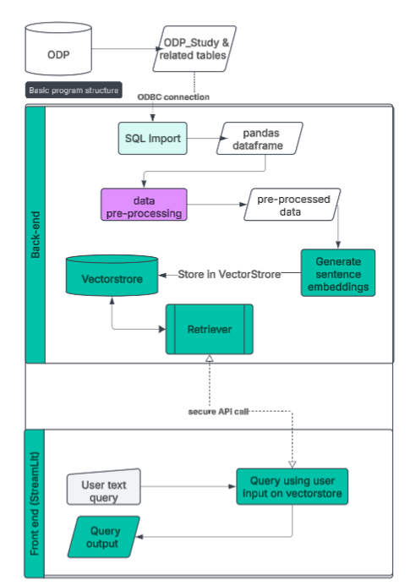
Data flow
Notes:
As the following data model and process flow diagrams will explain, this program makes a call to NIHR RDN data warehouse through a secure connection. After some necessary pre-processing of data using pandas and numpy, it then converts the text fields into sentence embeddings vectors using sentence-transformer. The converted vectors are then stored in the FAISS vector store for seamless querying.
Afterwards, a user or an analyst uses the front-end streamlit web-app to input a readable query (e.g. ‘Show me research around mental health’) AND the number of records to be fetched. The model then compares the user input against the vector store using k-nearest neighbours approach to produce a list of research studies, along with a rank(lower is better) and a similarity score(lower is better). The RAG also summarises the output. An API endpoint is used to separate the back-end indexing, data querying and transformations and the front-end web-interface.

Slide 12
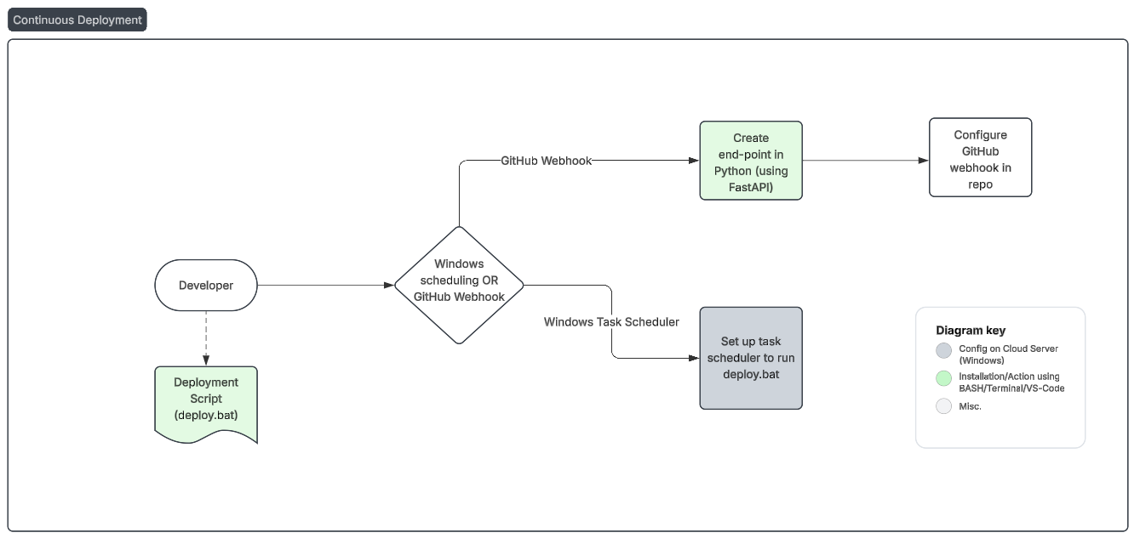
CI/CD Pipeline

Slide 13

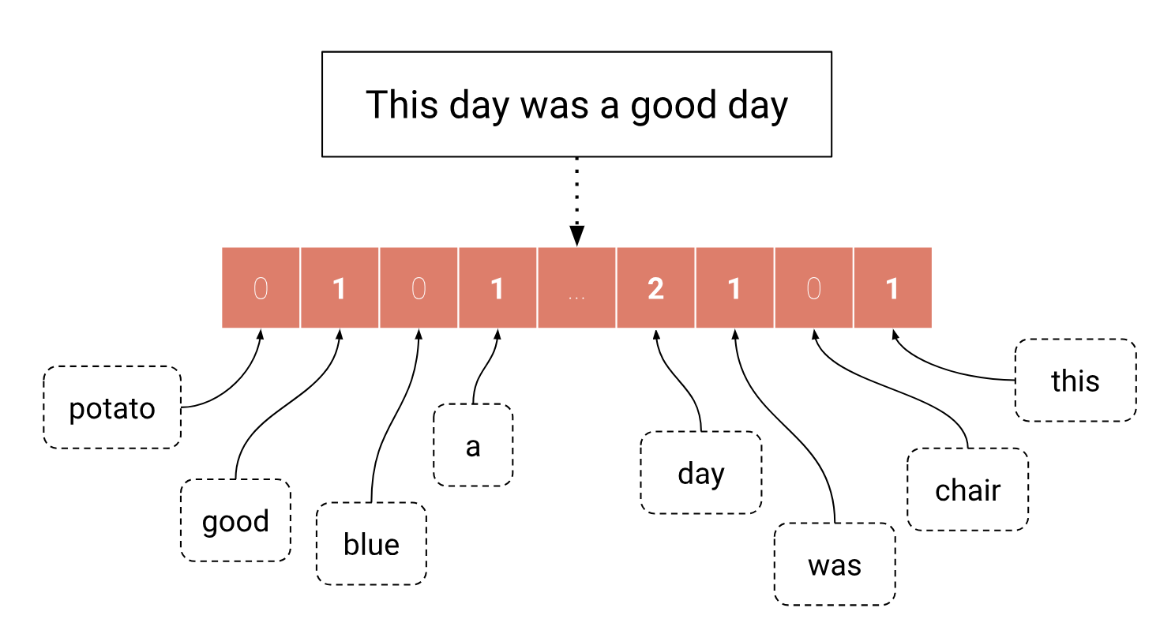
Sentence Transformers (SBERT)
go-to Python module for text and image embedding models
It can compute embeddings (quickstart)
calculate similarity scores using Cross-Encoder models (quickstart)
applications, including semantic search, semantic textual similarity, and paraphrase mining.
Source
Notes:
Add an example – vector
To the uninitiated, This is what I mean by vectorization -
Vector store - FAISS why is it used
Similarity methods - K-means, cosine, KNN,

Slide 14

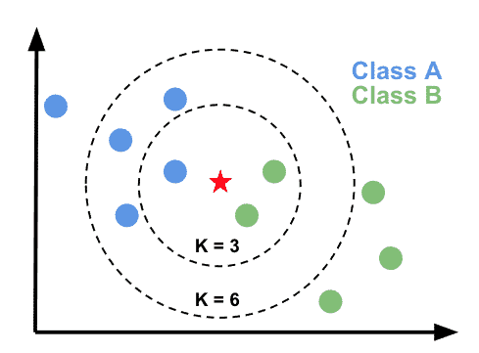
Facebook AI Similarity Search (FAISS)
library for efficient similarity search and clustering of vectors
search multimedia documents impossible with standard database engines (SQL)
includes nearest-neighbor search optimizing memory-speed-accuracy tradeoff.
KNN model - source
Notes:
Alternatives include ChromadB - which is more suited for small to medium datasets and AI applications. Based on my research, it is not as mature as FAISS.
Faiss is built on a few basic algorithms with very efficient implementations: k-means clustering, PCA, PQ encoding/decoding.
https://github.com/facebookresearch/faiss/wiki/Faiss-building-blocks:-clustering,-PCA,-quantization
Given a set of vectors {x1,...,xn} in dimension d, Faiss builds a data structure in RAM. After the structure is constructed, when given a new vector x in dimension d it performs efficiently the operation:
i=argmini‖x−xi‖
where ‖.‖ is the Euclidean distance.
trade precision for speed, ie. give an incorrect result 10% of the time with a method that's 10x faster or uses 10x less memory

Slide 15
Sample Outputs

Slide 16
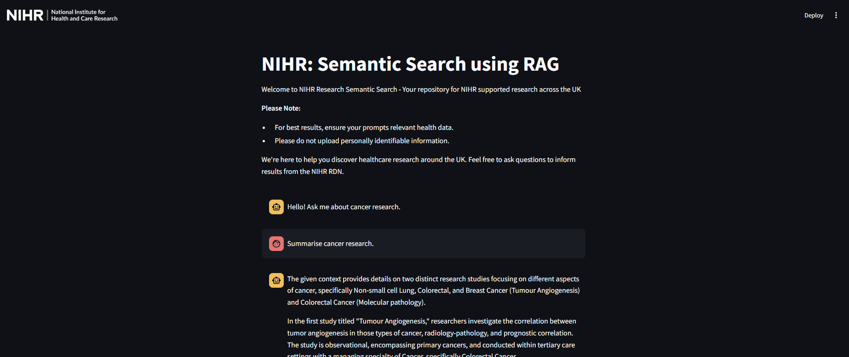
Based on a K value of 10.

Slide 17
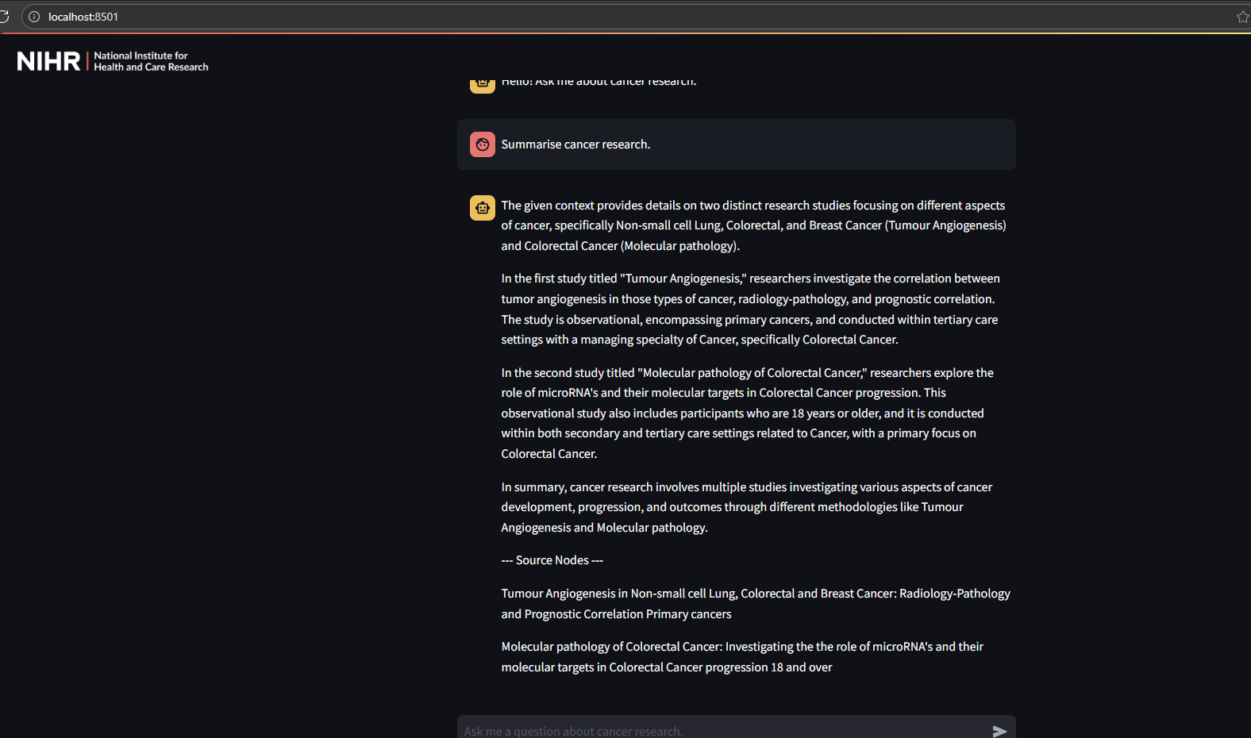
Sample output with k limited to top 10. Summarisation by RAG

Slide 18

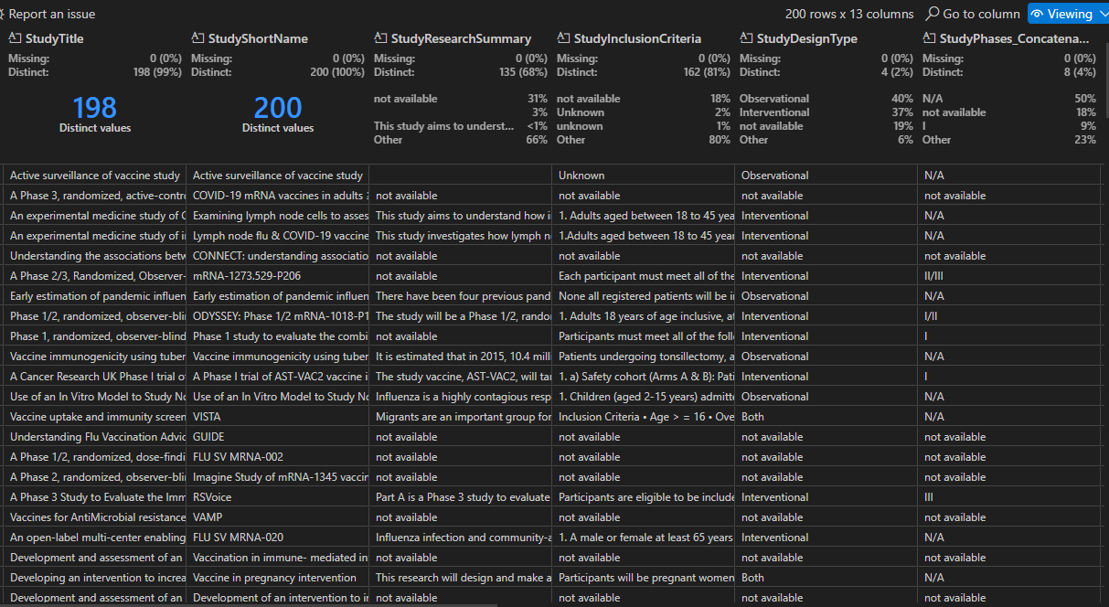
User input
Based on previous iteration of semantic search without RAG
Search results
Notes:
With K = 200

Slide 19

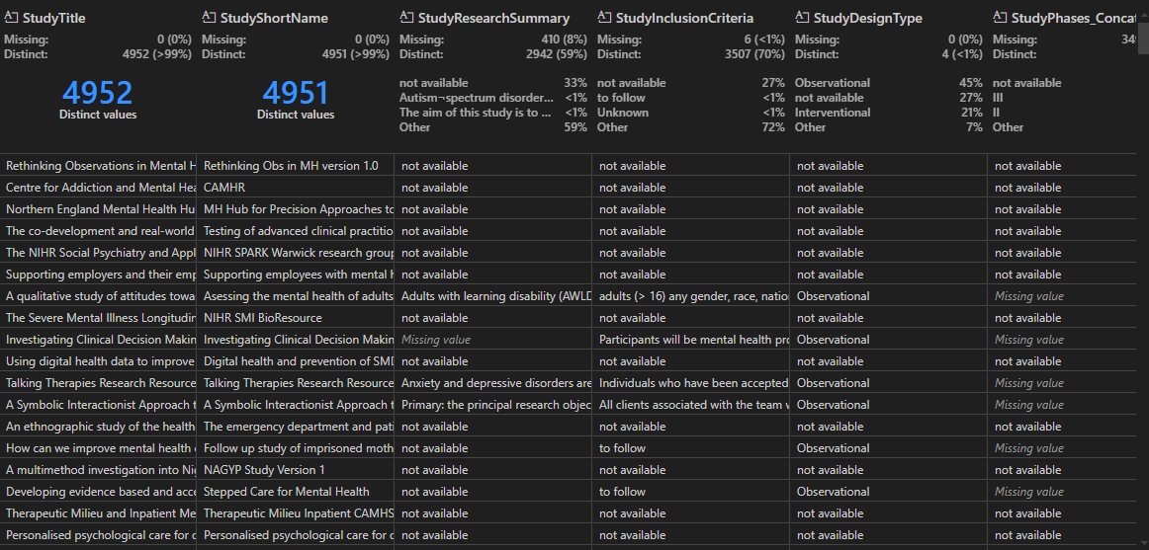
User input
Based on previous iteration of semantic search without RAG
Search results
Notes:
With K = 5000

Slide 20

Outcomes - What was achieved?
Democratization of data analysis
More exhaustive results
Results summarisation
Data Exploratory Analysis
Operational and performance efficiencies
Curated Portfolios
Notes:
Why should they be interested (audience)
The app is currently in testing, and following CI/CD approach. I’m excited about its potential to streamline our operations and provide more accurate and timely data to the public and the Department of Health and Social Care. By automating specific tasks or processes, the aim is to significantly reduce manual workload and improve the reliability of our reporting. Our goal is to continue refining and expanding the app's capabilities to deliver even greater value in the future.
Anybody should be able to run a query, in theory; and not solely analysts with SQL know-how
Women’s health curated portfolio
Cancer Curated Portfolio
Vaccines curated portfolio

Slide 21
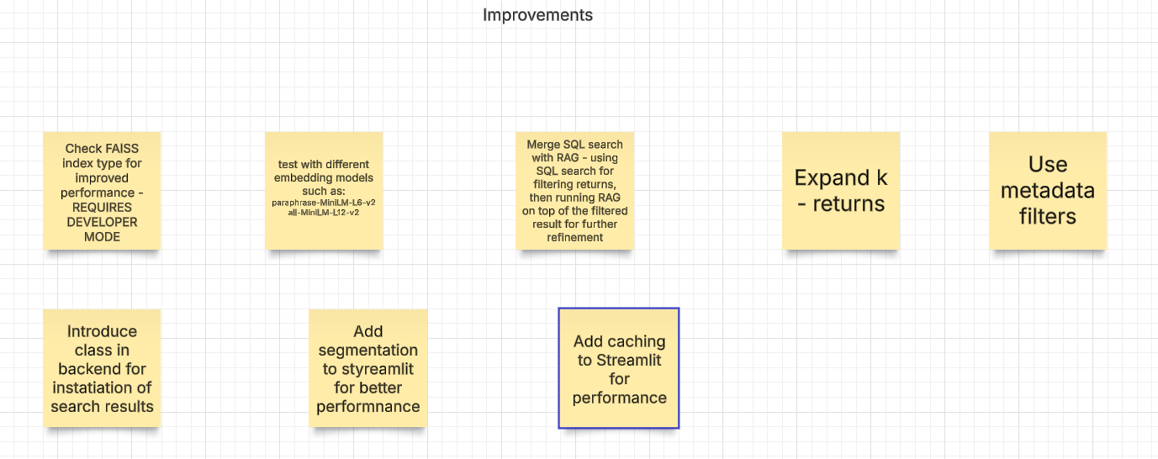
Proposed Improvements
Notes:
To improve performance of streamlit app : run background processes/functions as st.fragments -
Some additional considerations:
API end-point using FastAPI already enabled
Security via
SSO or API key for securely giving user access or making secure API calls from front-end to back-end - TBD
Possible solution: https://developers.google.com/identity/sign-in/web/sign-in
AI-specific RACM
Front-end:
Ports to be opened for StreamLit
Reverse Proxy using Nginx (Also securing front-end server via HTTPS protocol)
Uvicorn server developed - as per recommendation by Sr. Data Scientist at NIHR CCF
Use IIS server to expose the application to users
Containerization using Docker - for modular deployment, more security, avoiding single point of failure, and future-proofing

Slide 22
Terms of Use
Github Repo
Streamlit
Hugging Face
FAISS
Sentence-transformers

Slide 23
QnA?

