Slide 1

Introduction to Causal Inference for R and Python users
Nathan Thomas
NHS Black Country ICB

Slide 2
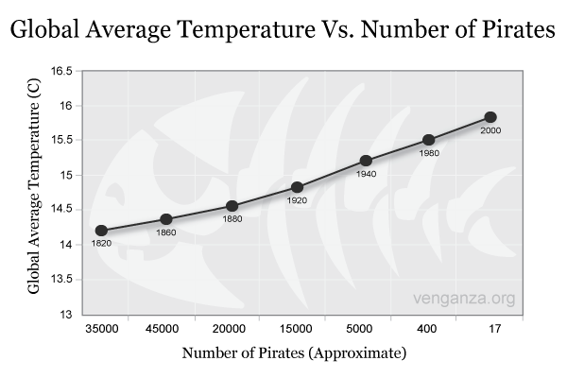


Introduction
There is a statistically significant negative relationship between the global average temperature and the number of pirates
Therefore, to combat climate change, as many people as possible should become pirates
ARRR
Pirates

Slide 3

Why?
Pirate’s to-do list:
Find treasure ship
Relocate booty to your ship
Sink treasure ship
Repeat

Slide 4
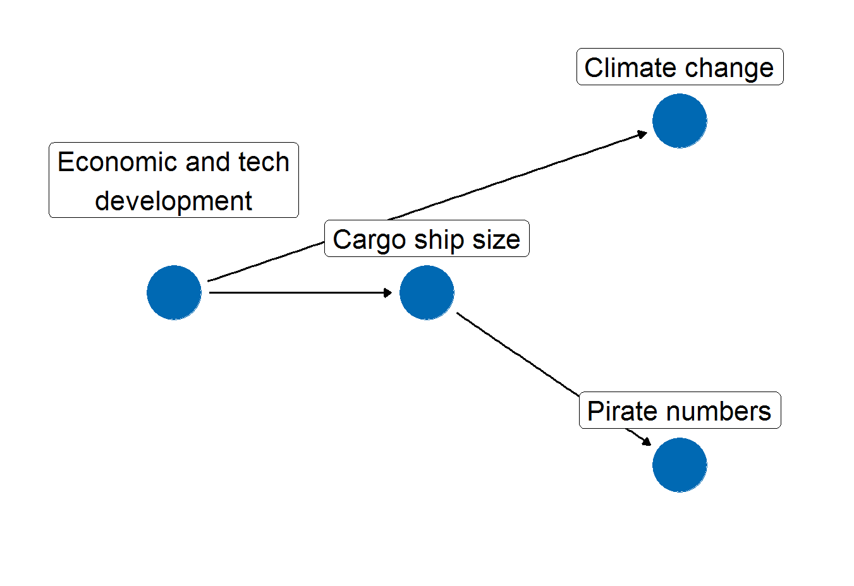
What’s the cause?
Pirate numbers and climate change aren’t correlated because one causes the other
They are correlated because they share the same cause
Directed Acyclic Graph (DAG) expressing the joint cause of climate change and pirate numbers (oversimplified)

Slide 5
Estimating causal effects
What would the survival rate have been if we hadn’t given people the drug?
We’re often interested in the difference between the outcome we observe under some treatment and what would have been observed if the treatment hadn’t been applied
What would costs have been if we hadn’t implemented the efficiency drive?
‘What would have been’ = counterfactual
Observed – counterfactual = causal effect

Slide 6


Estimating the counterfactual
We don’t have a time machine – so how can we estimate the
counterfactual?
‘Before’ vs. ‘after’ – only works if there are no confounding variables
Randomised controlled trials – control group acts as proxy for the counterfactual
Causal inference – using a causal model to estimate the counterfactual from observed data

Slide 7
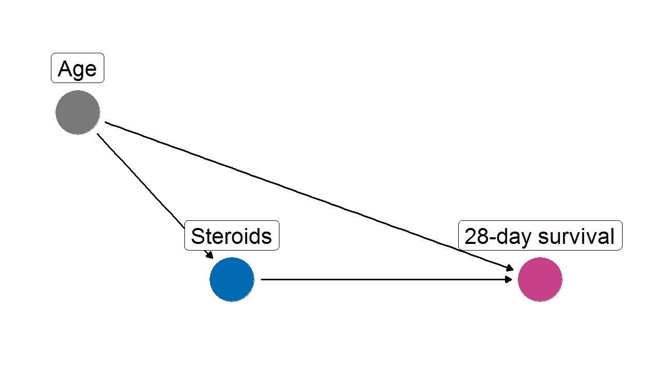
Defining a causal model
Treatment = Steroids
Outcome = 28-day survival
Age affects both treatment assignment and outcome, so confounds the relationship between steroids and 28-day survival
Did the treatment group have higher survival because they received steroids, or because they were younger?

Slide 8
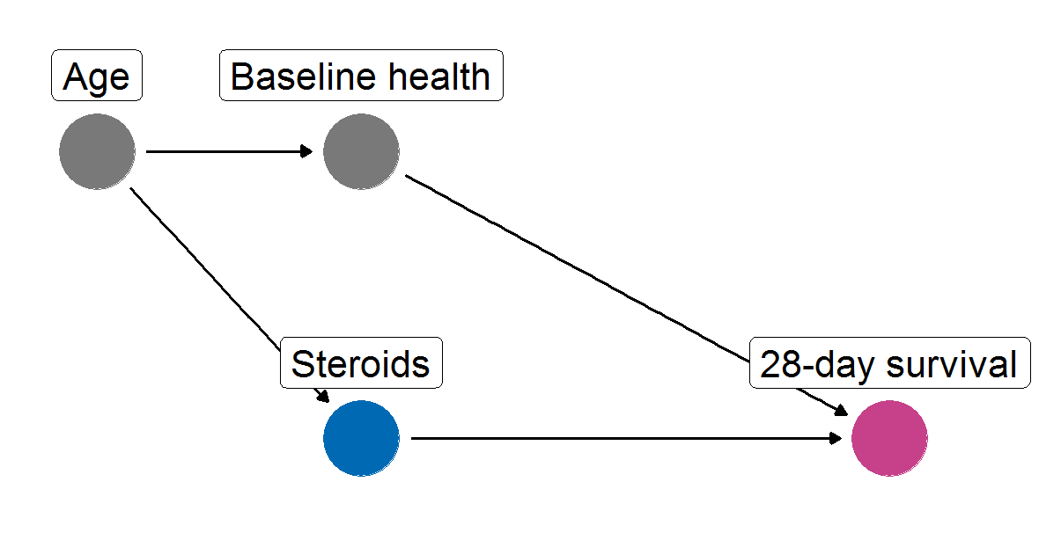
A (slightly) more complicated example
Age affects Baseline health, which affects 28-day survival
There is a back-door path between Steroids and 28-day survival that runs through Baseline health and Age

Slide 9
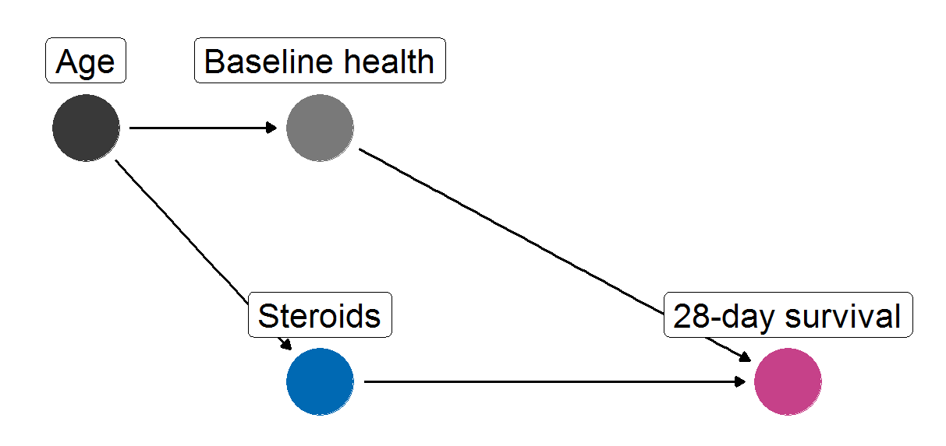
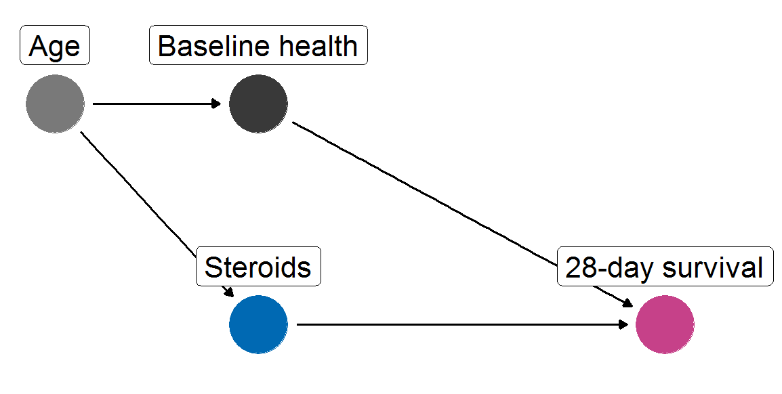
Closing the back-door path
To close a back-door path, it is only necessary to control for one confounding variable on the path
A set of variables that together close all back-door paths in the model is called an adjustment set
A model can have multiple adjustment sets

Slide 10
Causal inference methods
Matching / Stratification
Finding observations in the data set that are identical/similar on all variables in the adjustment set except the treatment
Weighting
Determining the propensities for treatment of each level of each variable and weighting the outcome accordingly
Regression
In regression models that include all variables in the adjustment set, the coefficient for the treatment variable is proportional to the treatment effect
Machine learning
Integrating causal models into machine learning algorithms

Slide 11

Reducing bias
Confounding introduces bias (causes us to underestimate or overestimate causal effects)
Adjusting for confounding aims to reduce the amount of bias in our estimates
Success depends on:
Accuracy of causal model
Appropriate use of techniques to ensure balance between treatment and control groups
Sample size

Slide 12
Example causal inference workflow
Step 1: Design causal model with input from domain experts and target population
Step 2: Use the model to produce a measurement framework for all the variables in the adjustment set
Step 3: Collect data
Step 4: Estimate causal effect from the collected data, using causal inference methods to adjust for differences between groups

Slide 13
Resources for R and Python
 | R | Python
Book | Causal Inference in R by Barrett, D’Agostino McGowan, and Gerke (still a work-in-progress) | Causal Inference and Discovery in Python by Aleksander Molak
Packages | `ggdag` for drawing DAGs `MatchIt` and `WeightIt` for matching and weighting `pcalg` | `pmgpy` `pywhy`

Slide 14
General Resources
Pearl and Mackenzie, The Book of Why
  Nice introduction to causal thinking written for a general audience
Morgan and Winship, Counterfactuals and causal inference
  More academic textbook covering key principles and approaches such as potential outcomes framework and structural causal models
McElreath, Statistical Rethinking
  A complete course of YouTube lectures covering a variety of topics relevant to causal inference
The 100% CI blog
cStructure – causal reasoning platform

Slide 15

Summary
Causal inference can get us a less biased estimate of causal effects using observational data, when RCTs are infeasible or impossible
The degree of bias depends on the accuracy of the causal model used, steps taken to ensure balance, and sample size
A range of resources exists for implementing causal inference in R and Python, with supportive online communities

Slide 16
Thank you
Nathan Thomas | nathan.thomas6@nhs.net

