Slide 1
Advanced Access Control in GraphQL APIs
Group 4: Wilke Klausing, Huy Viet Nguyen

Slide 2
Structure
Recap
Plugin Logic
Purpose Tree
Rule Creation
Showcase
Benchmarks
Conclusion

Slide 3
1. Recap: Task
Create a re-usable component for at least one widely used framework/stack for developing GraphQL Web APIs allowing developers to easily add access control to their APIs

Slide 4
1. Recap: Planning
Access Control Plugin for Apollo Server with following characteristics:
Configuration:
No database, only two configuration files:
Purpose tree as configuration file
Rules as configuration file

Slide 5
1. Recap: Planning
Access Control Models:
Purpose-based Access Control
Attribute-based Access Control
Goal:
Flexible
Reuseable
Developer Friendly

Slide 6
2. Plugin Logic
serverWillStart
Initialize Plugin
purpose.yml
requestDidStart
Request Verification
responseWillSend
Response Verification
rules.json
Apollo Server Request Lifecycle Events
Apollo Server Plugin

Slide 7

2.1. Purpose Tree
purpose.yml

Slide 8
2.2. Rule Creation (Header Rule)
Header Rule Example
{
"field": "First_Name",
"category": "header",
"compare": "user-agent",
"operation": "contains",
"value": "Chrome",
"policy": "deny",
"error": "emptystring"
}
rules.json

Slide 9
2.2. Rule Creation (Purpose Rule)
Purpose Rule Example
{
"field": "TotalSteps",
"category": "purpose",
"purpose": "health",
"exception": "sleep analytics",
"policy": "allow",
"error": "delete"
}
rules.json

Slide 10
Showcase

Slide 11
Benchmark
Two GCloud VMs used:
Location: Germany, US
Type: e2-medium (2 vCPUs, 4 GB memory)
Benchmark test:
1000 Requests to the Apollo Server
Response with and without AC Plugin are identical

Slide 12

Benchmark
Test 1: BURJ (101943 key/values)
Test 2: GRANDE (833 key/values)
Test 3: TALL (473 key/values)

Slide 13
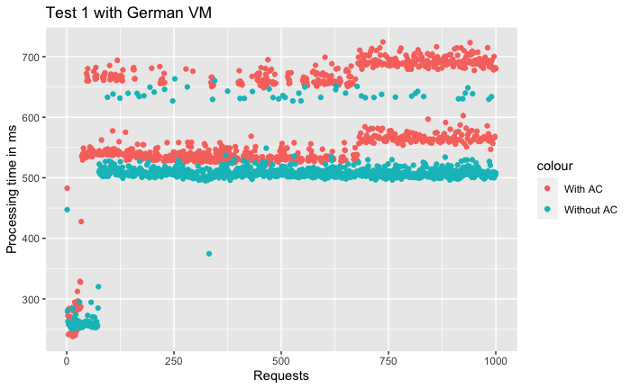
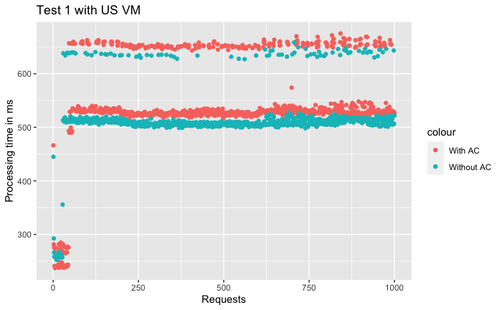
Benchmark

Slide 14
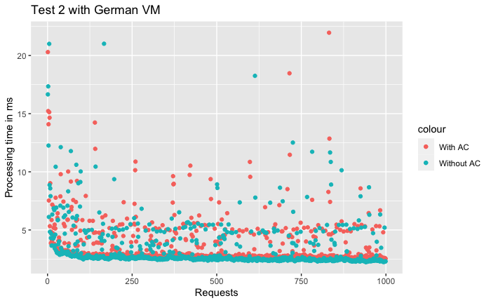
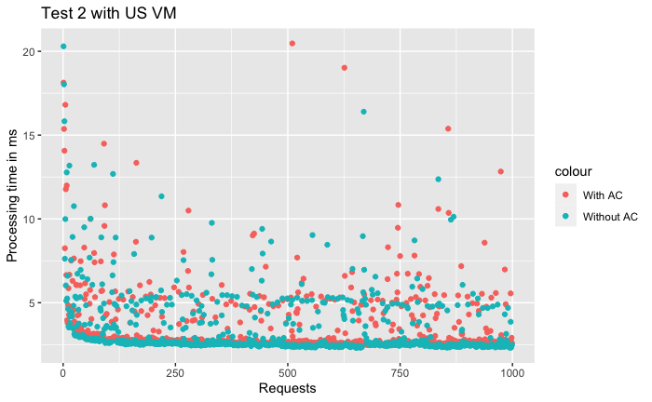
Benchmark

Slide 15
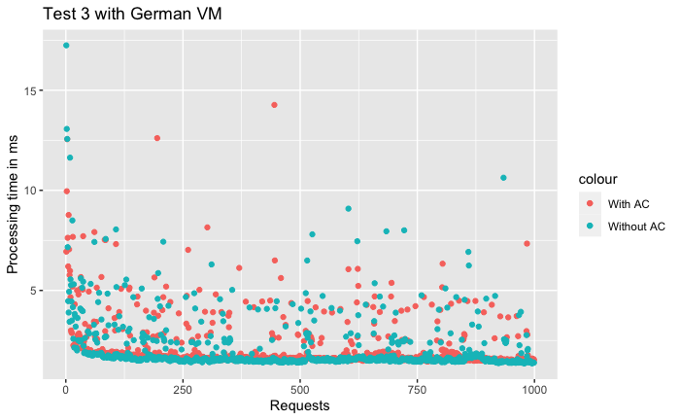
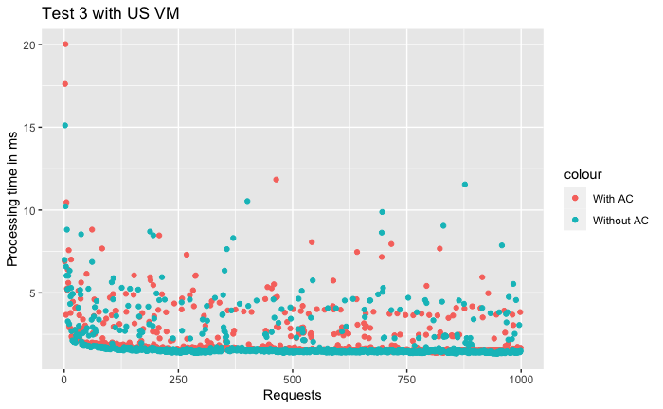
Benchmark

Slide 16
Conclusion
Results of Germany VMs are more unstable:
Test1: 16,78% (86,67ms)
Test2: 8,87% (0,2876ms)
Test3: 4,74% (0,0973ms)
Results of US VMs show following overhead:
Test1: 6,18% (31,64ms)
Test2: 6,34% (14,02ms)
Test3: 5,20% (0,1046ms)

Slide 17
Conclusion
Overhead of 5-10% seems plausible, needs further testing
Goals accomplished:
Flexible: Configuration files
Reuseable: Plugin can be added to any Apollo Server
Developer Friendly: Configuration written in standard formats

Slide 18
Thank you for your attention.

