Slide 1
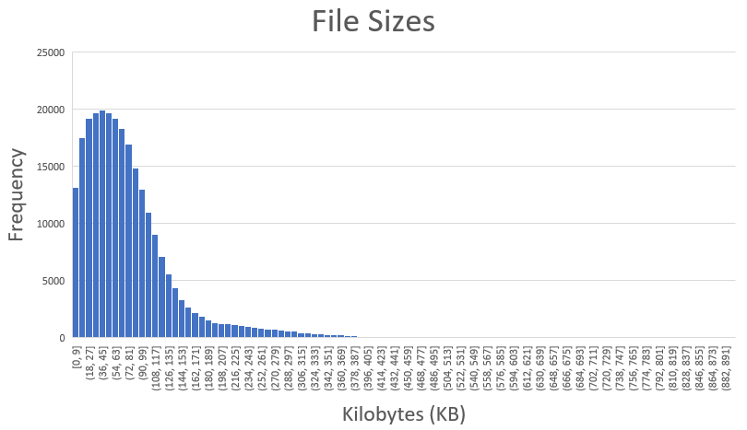
GNN Input Data Statistics
Maximum File Size | Minimum File Size | Standard Deviation | Number of Files
5041.12 KB | 5.62 KB | 368.33 KB | 256361
Figure 1. Histogram Chart

