Slide 1
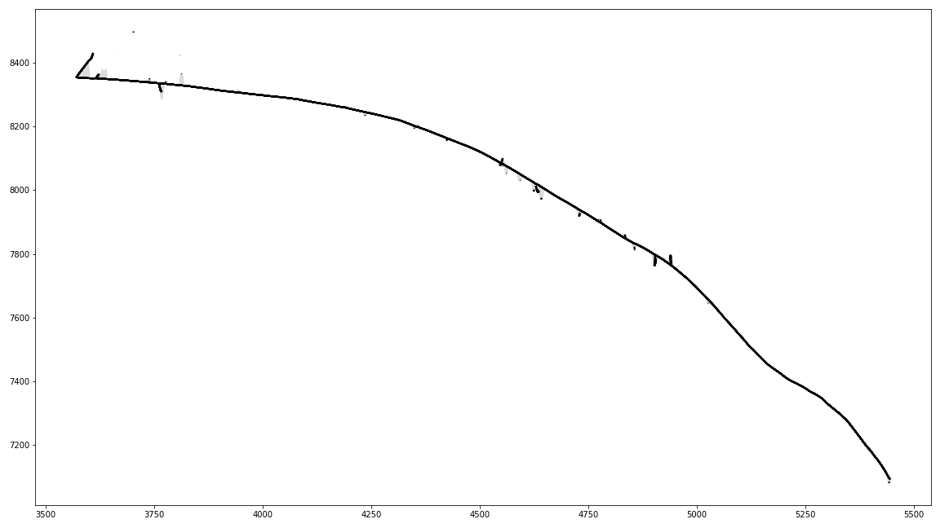
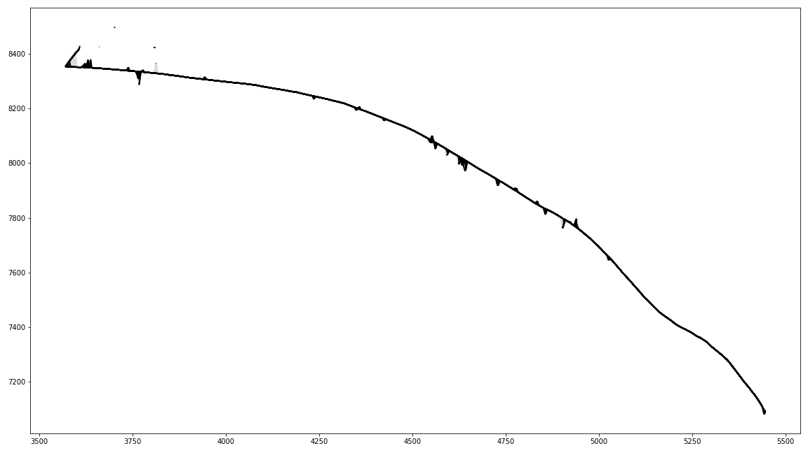
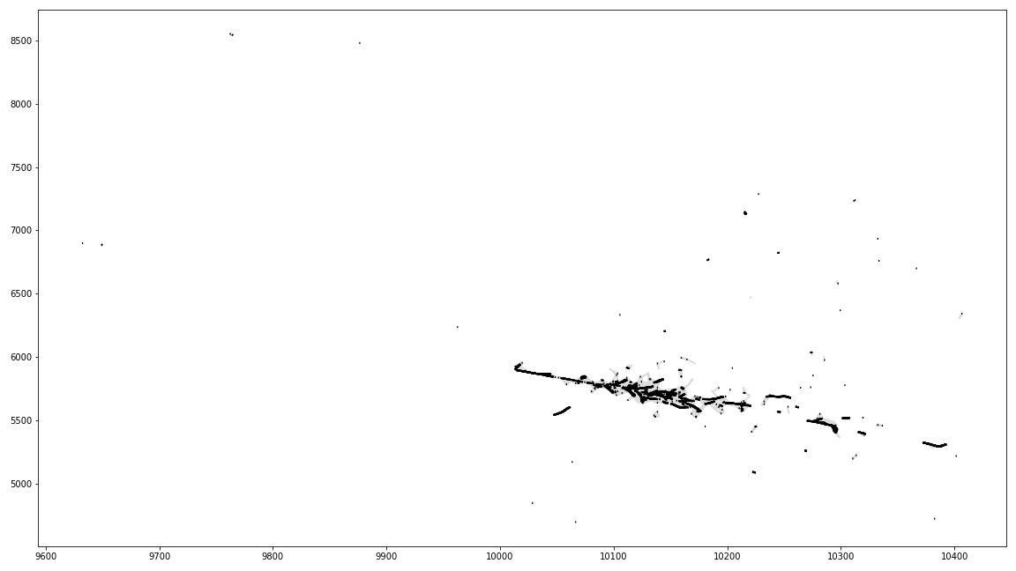
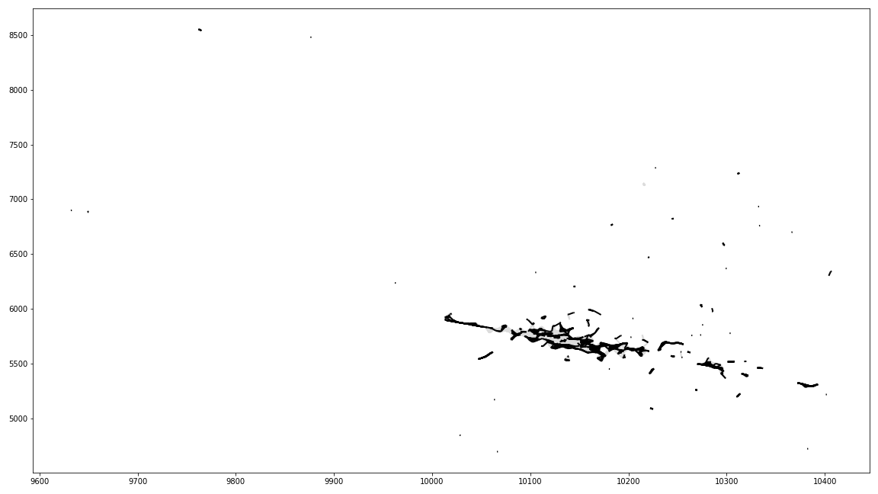
ExaTrkX GNN study
Evt025 edges true
Evt025 edges score
Preprocessing
Build graphs each of which contains all the hits of one particle
Input: raw data of coordinates and feature columns
Output: feature matrix and adjacency matrix (edge_index)
Training
Edge scores and node features are trained interchangeably
Input: feature matrix and adjacency matrix
Output: scores on the edges (true/false)
Results
~84% validation accuracy
571.8 sec for an epoch
Considering the number of training samples, the batch size is small (40)
The batch size affects the scalability as well as the model accuracy
We can consider scaling GNN training with large batch size
Next steps
Analyze the effectiveness of the current design and think about room for improvement
Analyze the scaling performance
Evt101 edges true
Evt101 edges score

Slide 2
Questions
One sample is a graph generated from all the hits of a single particle, is it correct? (# of files should be the same as # of events) →True
One event corresponds to several hits for a particle, is it correct? →True
Could you briefly explain how you calculated the accuracy? → ratio of the correctly predicted true edges.
The output from test.ipynb contains 101 events only. Could you briefly explain what that number is? → It’s an arbitrary number
Can we confirm the GNN model is MPNN based on Interaction Netwokrs? → True

