Slide 1

Exa.TrkX GNN Meeting
September 16, 2020

Slide 2
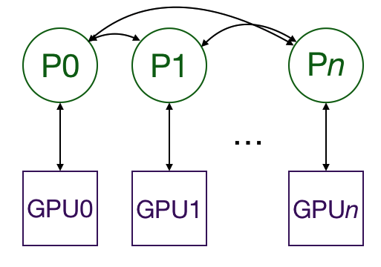
Average Gradients
Multi-GPU Implementation
Only gradients are passed between the processes and GPUs
Implemented using Pytorch and mpi4py

Slide 3
Experiment Results
Processes | Epoch Time (seconds)
1 | 7843
2 | 4459
4 | 2062
8 | 1091
I trained the message-passing network on the preprocessed fluxswap and nonswap datasets for dataset_size / batch_size = 7833 iterations to generate the above data

Slide 4
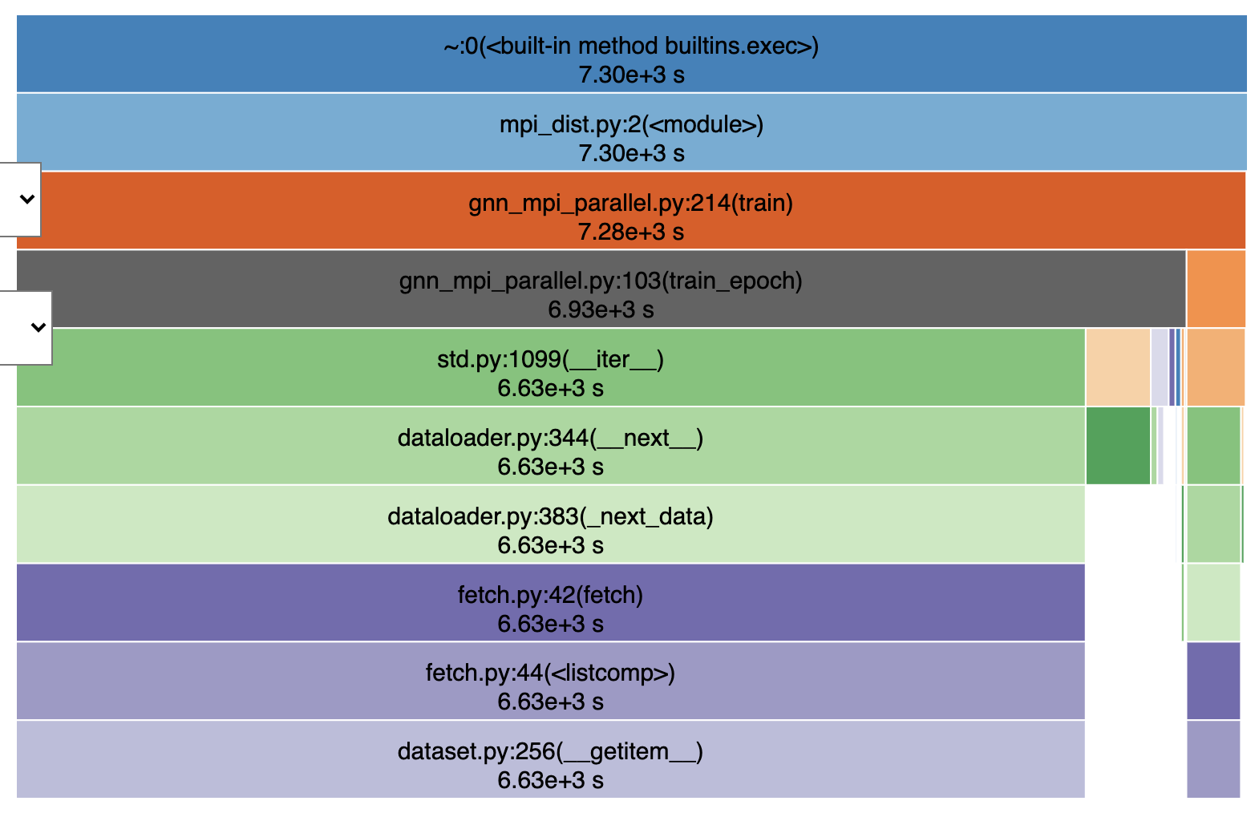
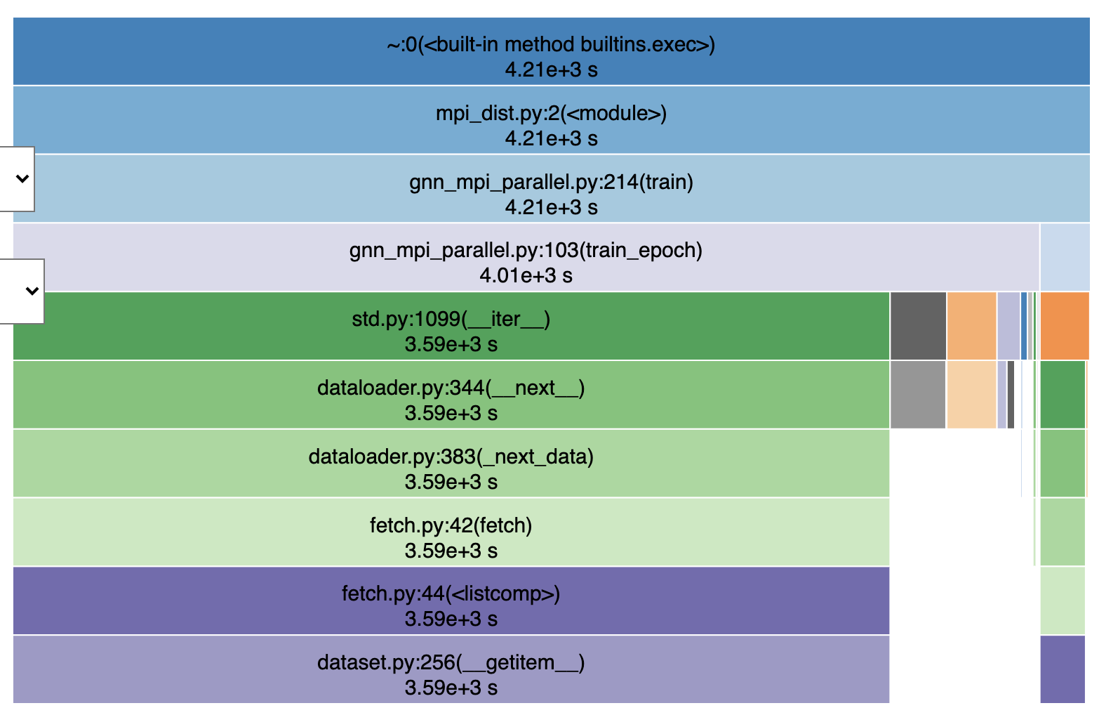
Profiling Epoch Time
Figure 1. Profile output for 1 process
Figure 2. Profile output for 2 processes

Slide 5
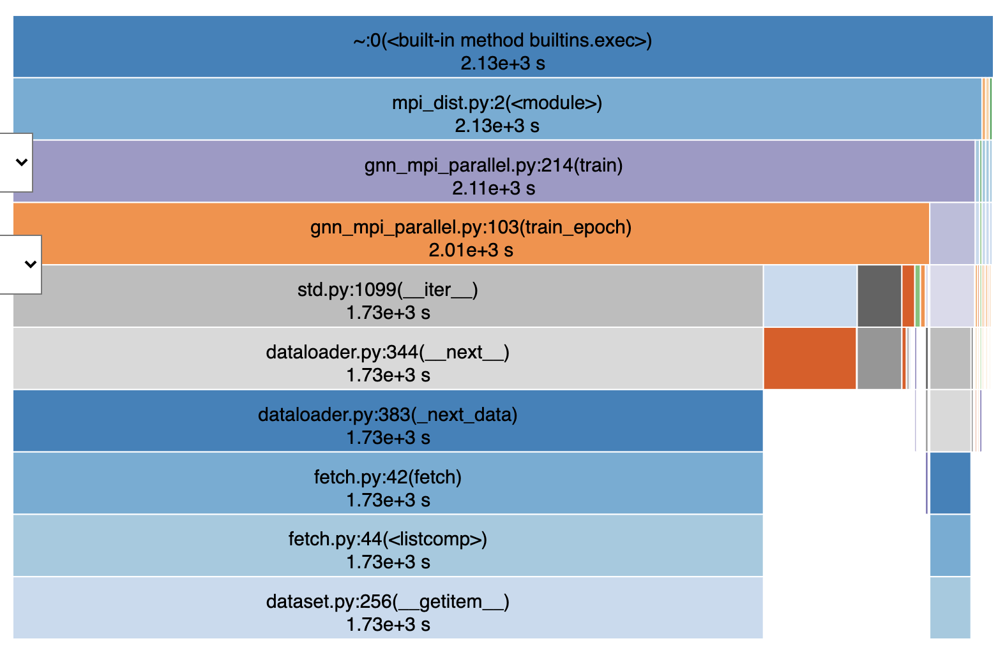
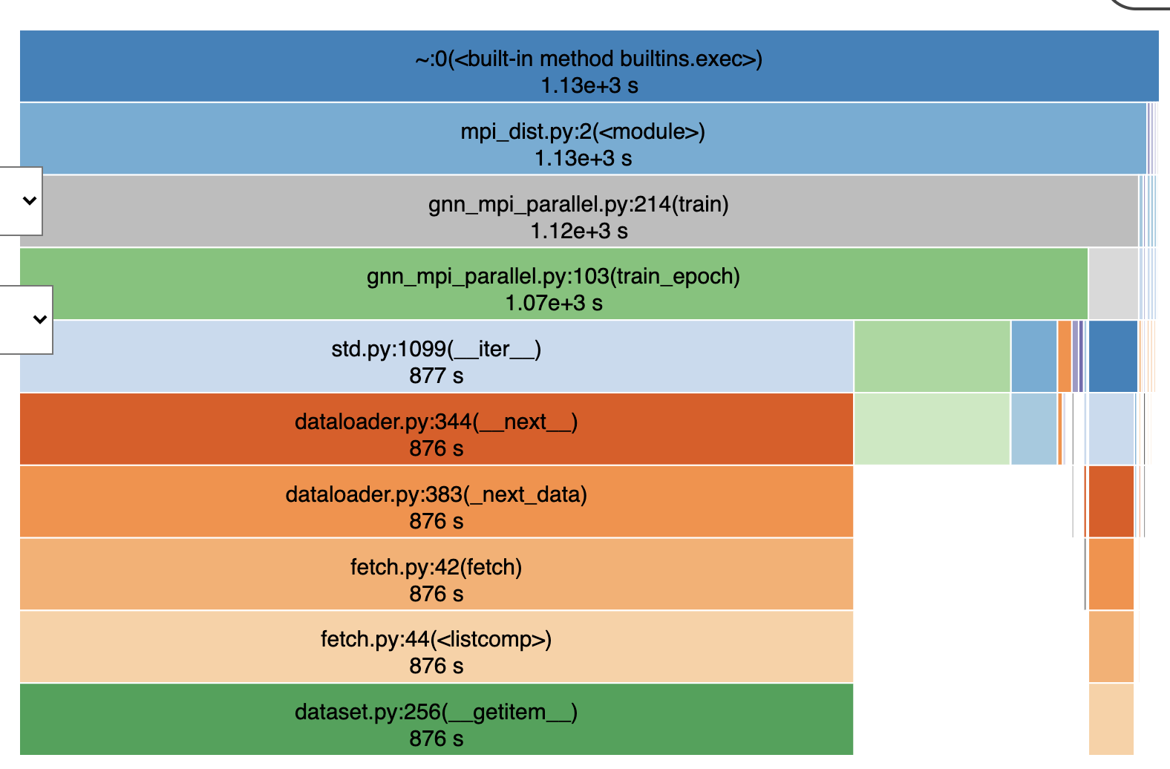
Profiling Epoch Time
Figure 3. Profile output for 4 processes
Figure 4. Profile output for 8 processes

Slide 6
I/O & Computation Time Analysis
Total size | Number of files | Average size of files
89 GB | 263818 | 359.37 KB
Processes | I/O Time | Total Time | Percentage | Read Bandwidth*
1 | 6630 | 7843 | 84.53% | 13.42 MB
2 | 3590 | 4459 | 80.51% | 12.40 MB
4 | 1730 | 2062 | 83.90% | 12.86 MB
8 | 876 | 1091 | 80.29% | 12.70 MB
*Read bandwidth was calculated using total size / processes / I/O time

Slide 7
Next Steps
Collect more timing breakdowns for various number of processes
Investigate low read bandwidth on Cori Lustre file system
Study more on I/O behavior and focus on reducing its cost

