Slide 1
GNN Meeting
September 2, 2020

Slide 2
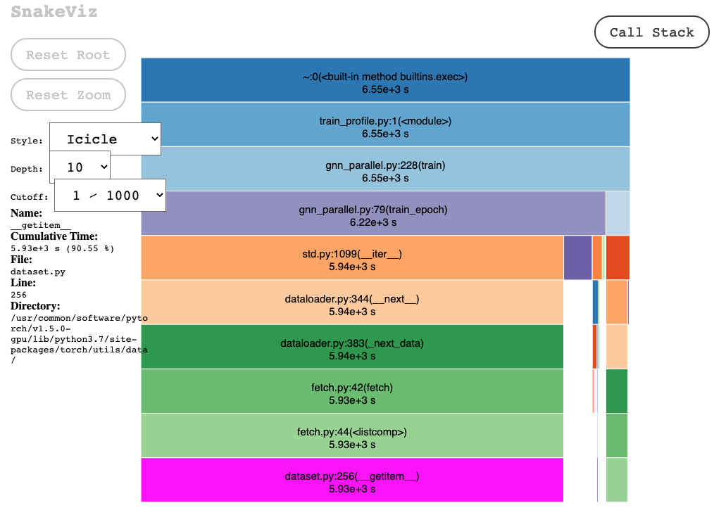
Profiling with cProfile and Snakeviz
Profiled GNN code (1 epoch shown)
90.55% is spent for I/O time
5930 seconds of 6659 second epoch
81.89% of time for read I/O function call alone
Read I/O function is most frequently called function

Slide 3
Preliminary Results
Processes | Iterations (Batch size 32) | Epoch Time (seconds)
1 | 7833 | 6659
2 | 3917 | 3534
4 | 1958 | 1822
8 | 979 | 894

Slide 4
Action Items
Study the profiler more in-depth to breakdown all of the timings in the codebase
Include average gradients function across all GPU machines
Optimize function with ring all-reduce
Overlap communication with computation
Training code clean-up
Reprofile final experimental results

