Slide 1
Study of File Read Performance in GNNs
GNN Training using dune ccqe dataset
Total of 256,361 files and 89 GB
Our experiment used a subset of 6,400 files and 190848 MB (200 batches of size 32)
Experiments run on Cori used 1 KNL compute node
The data array elements read from each file were ‘x’, ‘y’, ‘edge_index’
Lustre stripe counts of 1, 2, 4, 8 and MPI processes of 1, 2, 4, 8, 16 used as experimental parameters

Slide 2
File Read Times (s)
Run with 1 KNL node on Cori
Lustre Stripe Count | Stripe Count = 1 |  | Stripe Count = 2 |  | Stripe Count = 4 |  | Stripe Count = 8
MPI Processes | Pytorch | C-HDF5, driver=mpio | Pytorch | C-HDF5, driver=mpio | Pytorch | C-HDF5, driver=mpio | Pytorch | C-HDF5, driver=mpio
1 process | 2,179.32 | 744.92 | 1,921.65 | 718.42 | 2,065.76 | 690.63 | 2,003.57 | 698.13
2 processes | 1,094.75 | 387.07 | 932.41 | 360.09 | 1,005.84 | 338.15 | 1,075.40 | 353.18
4 processes | 543.22 | 191.88 | 419.72 | 181.37 | 487.95 | 168.36 | 487.56 | 180.08
8 processes | 279.01 | 94.84 | 312.83 | 102.39 | 110.60 | 83.97 | 118.60 | 89.31
16 processes | 144.43 | 48.78 | 116.92 | 51.98 | 119.80 | 46.54 | 122.49 | 53.14
Notes:
Maximum file read

Slide 3
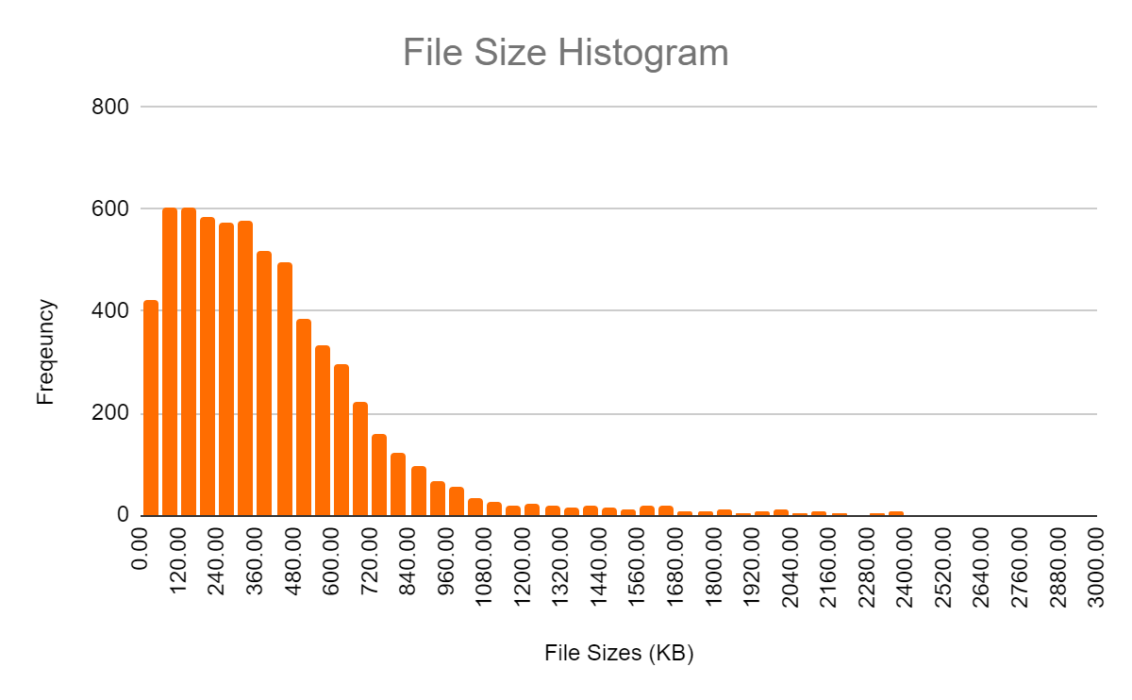
Input Graph Data Statistics
Maximum File Size | Minimum File Size
2964.74 KB | 6.49 KB
Notes:
6400 file histogram
Describe the assignment of MPI process to files

Slide 4
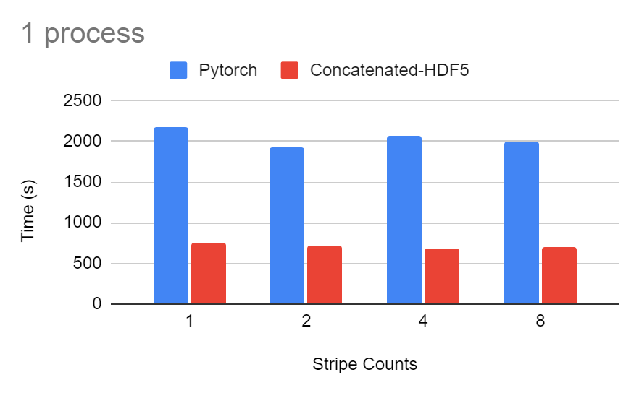

Slide 5
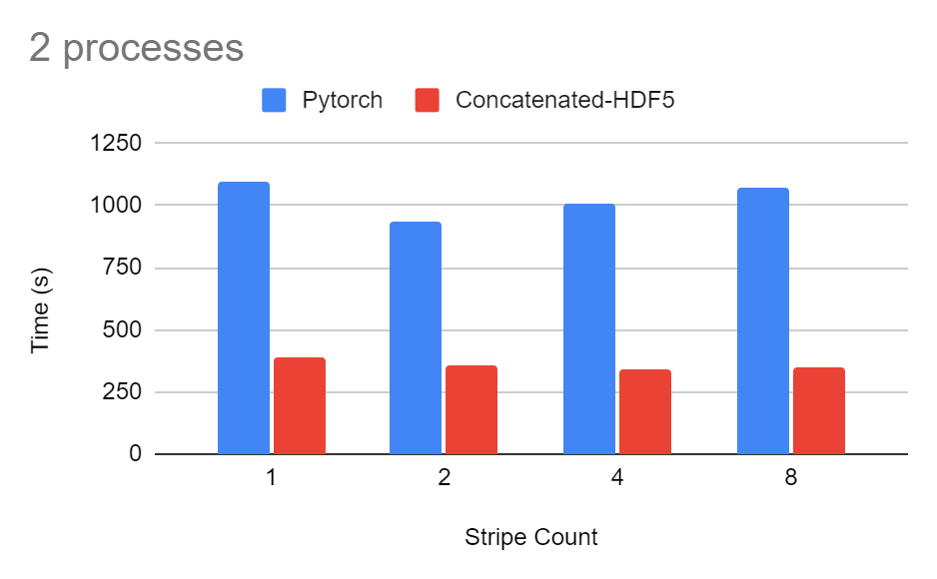

Slide 6
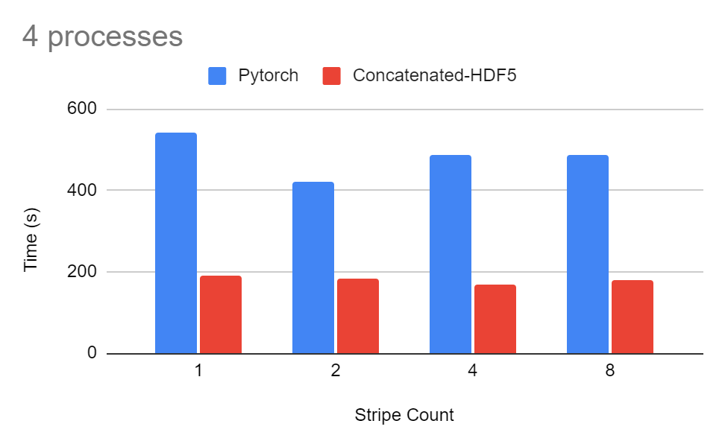

Slide 7
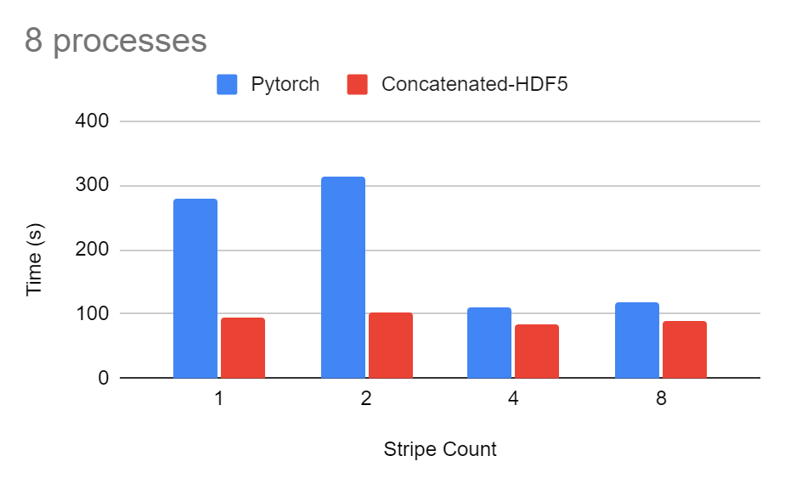

Slide 8
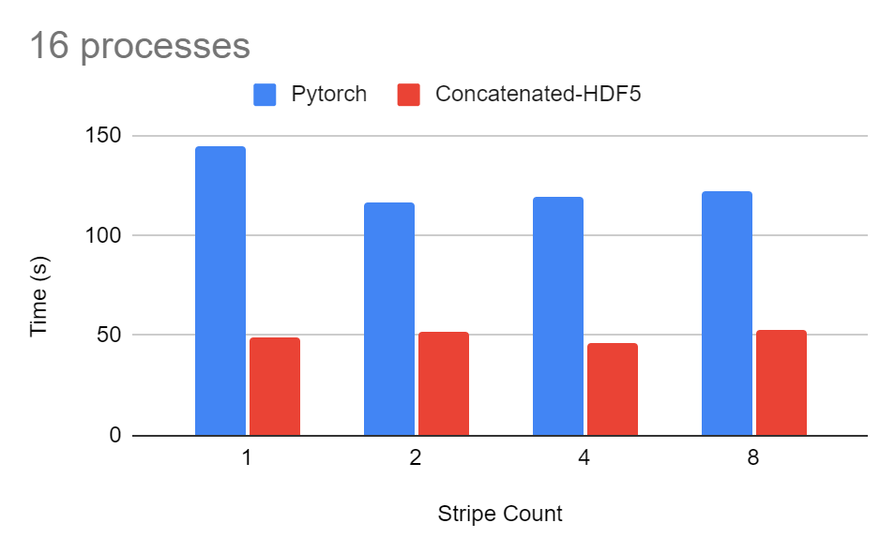

Slide 9
Experiment Discussion
Experiment Analysis
1. There is an uneven I/O workload between MPI processes due to varying graph file sizes
2. Increasing the stripe count does not proportionally increase I/O performance because of small graph size (KB) and relatively larger stripe chunk size (MB)
Next Steps
1. Assign the graph files to MPI processes differently than by file index
2. Aggregate the read requests to eliminate the overhead of reading 1 graph at a time
Notes:
File reads read 1 graph at a time and there is a large overhead (i.e. data preparation vs. delivery)

