Slide 1
Real-Time Sentiment Analysis of Twitch Chats
An Exploration
William Klock Spring 2016

Slide 2
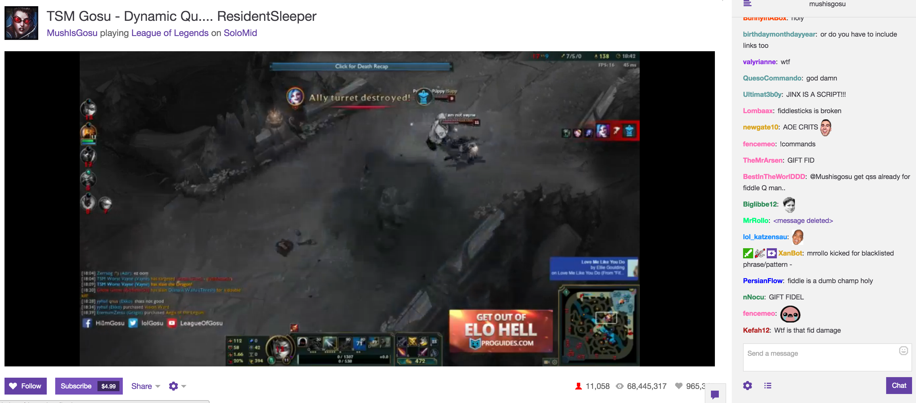
Defining The Problem

Slide 3
Defining The Problem
Can we derive information from the chat?
Can we gather the information fast enough?

Slide 4
Motivation
Why you should care:
Live-streams are on the rise
Financial incentive to be able to predict outcome of event
Difficulties:
Nobody has done this before
Very, very informal text
Very short text

Slide 5
Data
Movie reviews
Sentiment Polarity Dataset Version 2.0 (nltk)
Twitter messages
Sentiment140 Lexicon

Slide 6
Model
Web-based Chat
Scraper/Parser
Classifier
Classifier
Classifier
Naïve Bayes Classifier
Simple, probabilistic, bag-of-words

Slide 7
Results
Disagreement between two classifiers
Movie reviews seemed to give more informative answers
Need more data

Slide 8
Moving Forward
Create manually labeled set of training data based on an entire chat log
Explore different kinds of classifiers (Decision tree, Maximum Entropy)
Optimize learners
Expand to other niches

