Slide 1
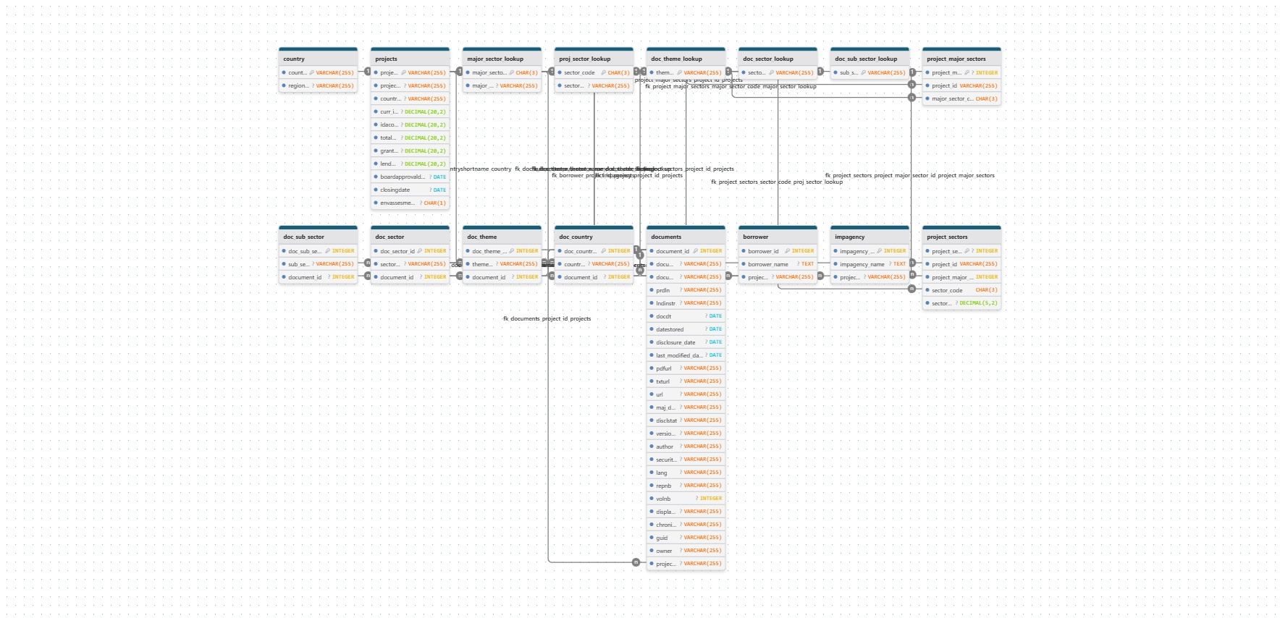

Slide 2
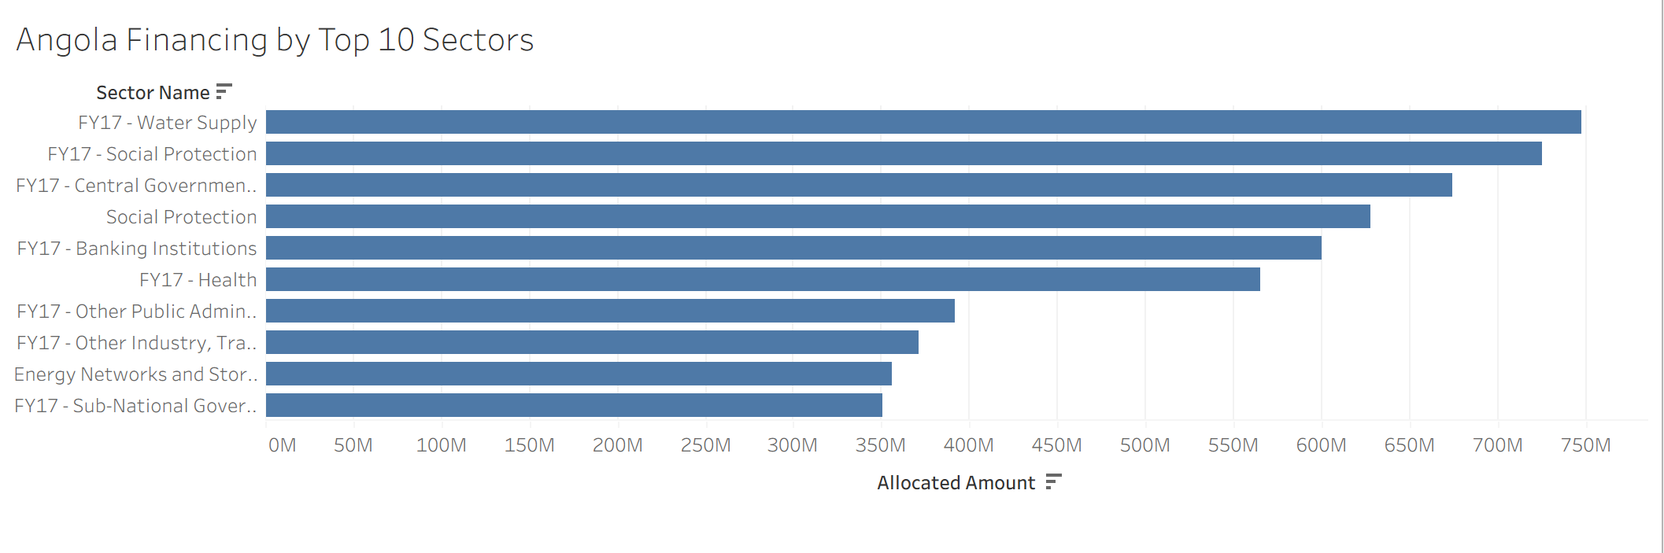
Sector Aggregation

Slide 3
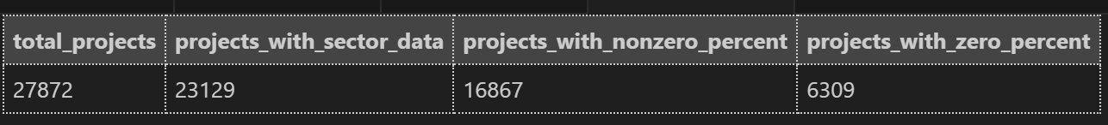
Sector Data

Slide 4
Still need
Documents
Properly insert into database
Failed Batches

