Slide 1
Chinese Power Plants: Predicting Emissions
A Cursory Glance at the Internal and an Example with Tajikistan

Slide 2


“China is the biggest environmental polluter in the World [sic], by far. They do nothing to clean up their factories and laugh at our stupidity (Trump, 2013)!”

Slide 3
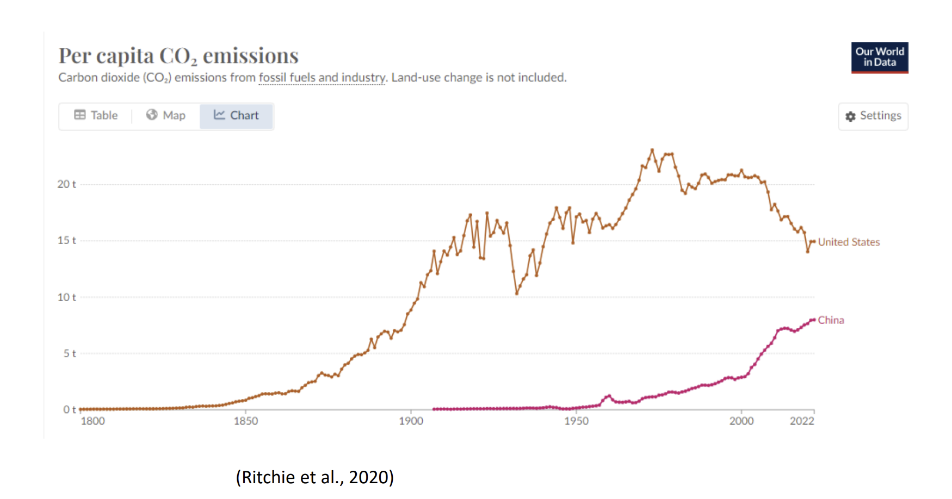

Slide 4

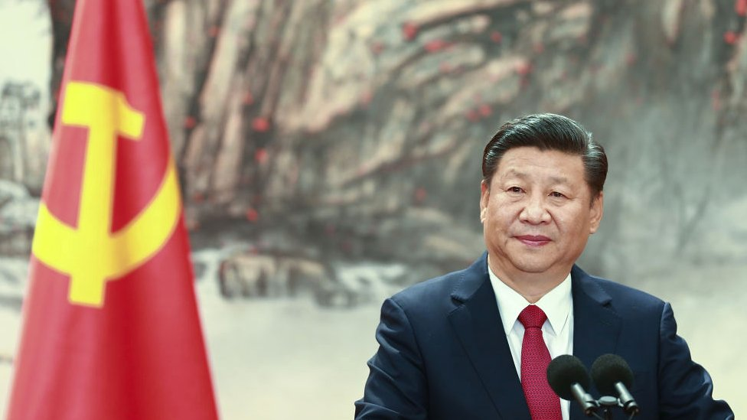
China pledges to stop building new coal energy plants abroad
22 September 2021

Slide 5
Using the Internal
Public GCDF
Filtered (not cancelled, not a debt rescheduling, recommended for agg.)
Energy sector (1145 records)
Known completion year (631 records)
Somewhere in the description has “MW”
370 Records

Slide 6
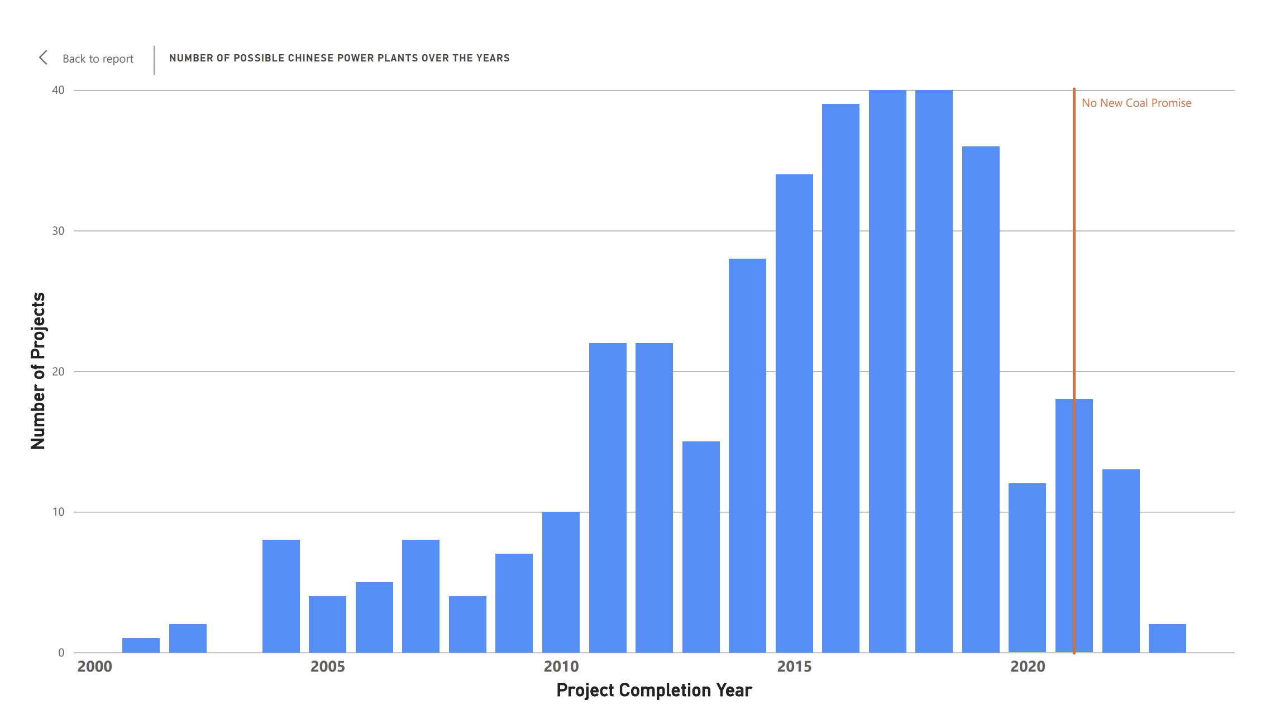

Slide 7
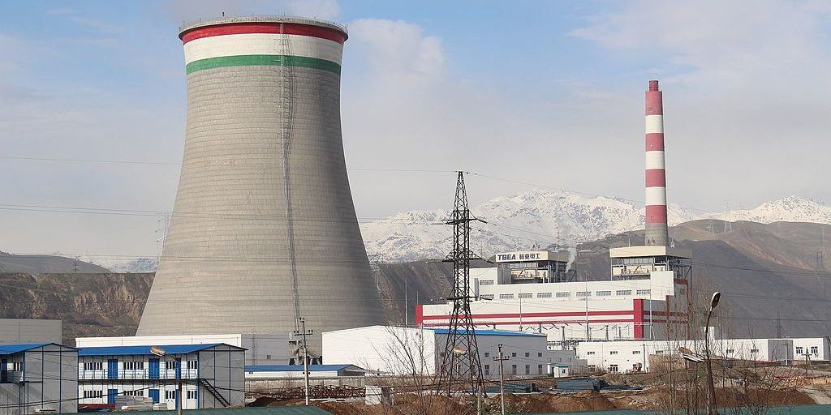
Closer Look: Tajikistan’s Coal Fired Dushanbe -2
(Natalia 2018)

Slide 8

Closer Look: Tajikistan’s Coal Fired Dushanbe -2
Hydropower
Uzbekistan natural gas imports
AidData Record IDs
Phase 1 – 100 MW (2014)
54106
91801
Phase 2 – 300 MW (2016)
46211
71137
(Norov 2025)
⮽
(Natalia 2018)

Slide 9
Methodology
American Power Plants 2013-2023
Coal
Oil
Natural Gas
Megawatt per hour
Year
Linear Regression ⮽
Random Forest
Predict Chinese Emissions
Carbon, Sulfur, Nitrogen
Compare Country Emissions vs Plant Emissions
Our World in Data
Tech Stack:
Python
Spark (big data)
(U.S. Energy Information Administration 2024)

Slide 10
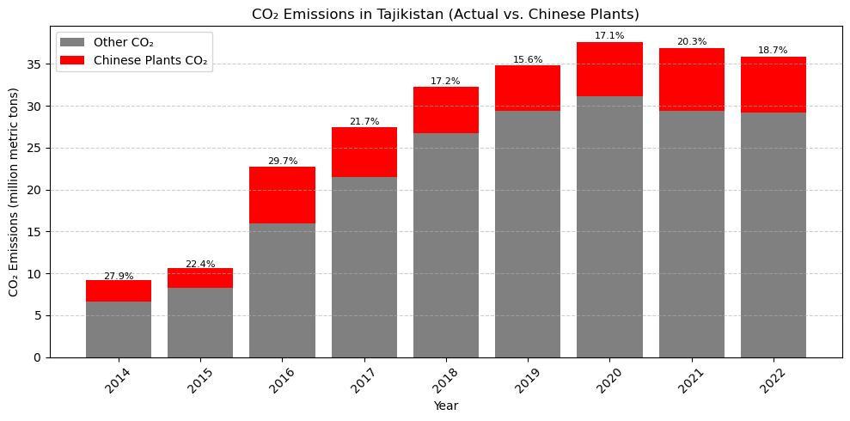
“…less than 50 meters from residential homes…” (Natalia 2018)

Slide 11
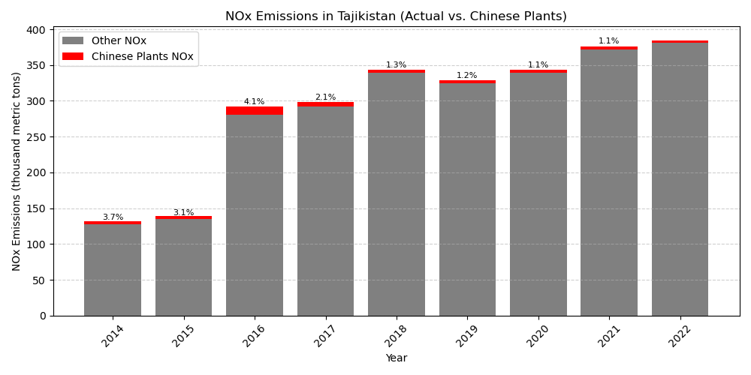
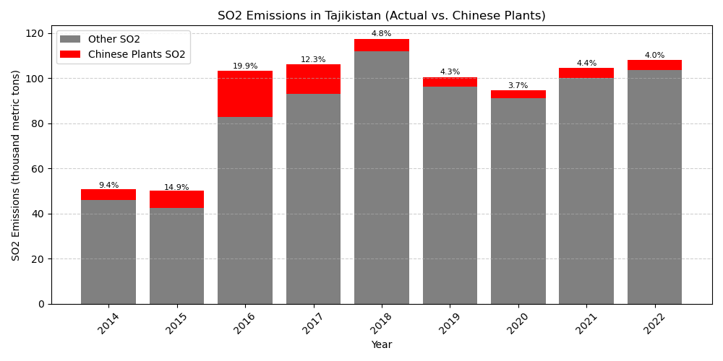

Slide 12
“That accountability now seems a bit less attainable with the suspension of the U.S. air quality monitoring program in Tajikistan and worldwide.”
(Norov 2025)

Slide 13
Next Steps
Stats
Model derived from research, not convenience
More predictors needed?
How many hours do these plants run?
Research
Perspectives on Chinese energy
So what?
Health statistics?
Goal
Publish

Slide 14
Notes
Natalia, Idrisova. 2018. “A Second Coal Fired Power Plant for the Tajik Capital.” BankWatch Network, January 17.
Norov, Kulobiddin. 2025. After US Cuts, Accountability on Air Quality to Take a Hit in Tajikistan. March 13. https://thediplomat.com/2025/03/after-us-cuts-accountability-on-air-quality-to-take-a-hit-in-tajikistan.
Our World in Data. n.d. “CO₂ Emissions Per Capita.” https://ourworldindata.org/grapher/co-emissions-per-capita.
U.S. Energy Information Administration. 2024. “Emissions by Plant and by Region.” November 5. https://www.eia.gov/electricity/data/emissions/.

