Slide 1
FreeBSD support for Stanford NetFPGA
  Wojciech A. Koszek
  wkoszek@FreeBSD.org
  2009.09.17

Slide 2
Work was done as a part of the internship at:
Helsinki Institute of Information Technology
<http://www.HIIT.fi>
Ericsson Nomadic Lab
<http://www.ericsson.com>
Helsinki, Finland

Slide 3
Code I'm going to discuss: http://people.freebsd.org/~wkoszek/netfpga netfpga-devel@ mailing list has this code as well

Slide 4
Very short introduction to FPGAs

Slide 5
Physically, FPGA processor is just a chip
PHYSICAL PINS
FPGA
PROCESSOR
PHYSICAL PINS
PHYSICAL PINS
PHYSICAL PINS

Slide 6
FPGA processor is just a bunch of digital logic blocks
I/O
buffer
MUL
LOGIC

Slide 7
Each digital logic block can be programmed to perform specific action on its inputs
LOGIC EXPRESSION

Slide 8
  Block functionality and block connections can be changed at will with Hardware Description Language like Verilog

Slide 9
Physical connections between HDL's names and physical PINs are specified in separate User Constraints File (UCF) file

Slide 10
HDL
(Verilog/VHDL)
USER
CONSTRAINT FILE
Verification and synthesis
Bit Stream File

Slide 11
Examples of cool stuff people do in FPGAs right now
Accelerated computations
  Cryptography
  Compression
Complete Systems-on-Chip
  CPU with MMU
Accelerated Networking

Slide 12
FPGA chip can perform specific task much, much faster than conventional CPUs

Slide 13
FPGA work in FreeBSD

Slide 14
Xilinx ISE WebPack
(IDE for Verilog) used to work for me year ago on FreeBSD
(Linux emulation layer)

Slide 15
FPGA processor programming used to work for me as well
With xc3sprog project tools, I was able to program Xilinx Spartan 3 Starter Kit

Slide 16
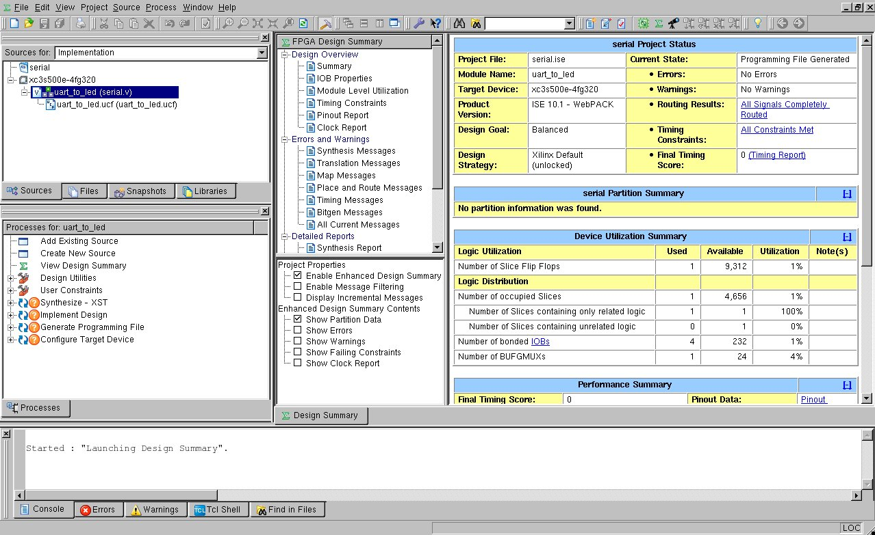
WebPACK 10.1 with recent FreeBSD-CURRENT

Slide 17
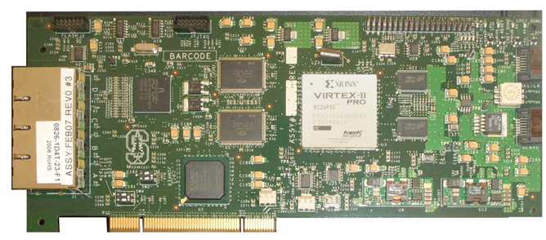
NetFPGA card

Slide 18
Yet another network adapter?!

Slide 19
..well, sort of:
4 ports of Gigabit Ethernet handled by Broadcom 5464SX
2 high speed, serial I/O connectors
64MB of DDR2 DRAM, 4.5MB of SRAM
PCI interface

Slide 20
...but FPGA processors are present as well

Slide 21
Other NetFPGA Work
www.netfpga.org
OpenFlow Reference implementation
Reference Ipv4 Router
Reference Ethernet Switch
Reference 4-port NIC
VPN appliances
various buffer-queue stuff
Past projects have all been developed on LINUX :-(

Slide 22
How does it look like in practice?

Slide 23
NetFPGA: 3 puzzles
  ``Firmware'': functionality provider
  (bitstream)
  Userspace tools: for firmware (bitstream) upload
  Kernel driver: low-level glue

Slide 24
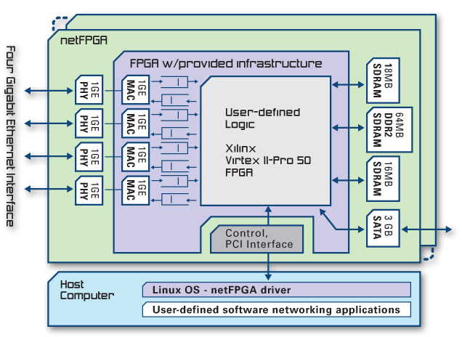
Broadcom PHY deals with physical aspects of the Ethernet
This chip doesn't have documentation available publicly :-(

Slide 25
Broadcom chip is tied to Xilinx Virtex II FPGA processor
  Processor implements Ethernet MAC functionality (MAC this is provided by Xilinx)

Slide 26
The rest of the functionality comes from the designer
  My work was based on ready-to-use reference design called ``4 port 1Gbit Ethernet NIC''

Slide 27
PCI communication is handled by separate, smaller FPGA chip

Slide 28
NetFPGA naming
  CPCI: small FPGA (Spartan2)
  responsible for PCI
  interface
  CNET: BIG FPGA for Ethernet
  control

Slide 29
Packet transmission in the NetFPGA world

Slide 30
Idle state
NetFPGA
OS
Network

Slide 31
Data is being sent to the card
NetFPGA
OS
Network

Slide 32
Interrupt is delivered
NetFPGA
OS
Network
„DATA AVAILABLE”

Slide 33
In order to „see”, which port has a data available, you read a register
NetFPGA
OS
Network
You get the transfer length this way too

Slide 34
DMA transfer is started
NetFPGA
OS
Network

Slide 35
Data is copied into the single linear buffer prepared by the host
Please note we don't have a direct access to hardware rings and descriptors

Slide 36
NetFPGA programming

Slide 37
NetFPGA programming (Linux)
USER SPACE
SAVE PCI REGISTERS
Upload REPROGRAMMER bitstream
Upload CPCI image
Upload CNET image
Restore PCI registers
GO!

Slide 38
Current utilities in Linux
Read card's memory chunk
Write to the card
Program the card
Reprogram CPCI

Slide 39
..utilities:
readreg
writereg
nf2_download
cpci_reprogram.pl

Slide 40
NetFPGA Linux driver

Slide 41
  In Linux driver:
  PCI registers saved from userspace :-(
  Additional dependency on user-space tools

Slide 42
Linux NetFPGA driver is 'monolithic'

Slide 43
CPCI/CNET programming is tied to Ethernet port structures
Use of ifnet-specific ioctl()s

Slide 44
Other problems
See netfpga-devel@ mailing list

Slide 45

FreeBSD driver design

Slide 46
Driver is BSD-licensed

Slide 47
Driver has two parts
Programming (/dev/...) interface
Ethernet (``ifconfig'') layer

Slide 48
Card itself appears to NEWBUS as
``NetFPGA controller''
Later called (NFC)

Slide 49
It's up to the controller to export CPCI/CNET interface

Slide 50
Each NFC has 4 Ethernet ports, later called ``NetFPGA ports'' (NFP)

Slide 51
NFC
NFP0
NFP1
NFP2
NFP3
PHY0
PHY1
PHY2
PHY3

Slide 52
Appearance of NetFPGA in the FreeBSD (devinfo -rv)
PCI
NFC
NFP [0-3]

Slide 53
  NFC

Slide 54
Programming interface appears as separate device
/dev/netfpga[0-9]+
You just send ioctl() commands there

Slide 55
  ioctl() handler detects the fact of ``Programming”
  It saves registers and restores them once device is being closed

Slide 56
In FreeBSD, NFC also exports string with register offsets via sysctl() interface

Slide 57
The plan is to fight with quite dynamic nature of HDL specifications and stay away from ABI breakages

Slide 58
nf_read_reg(”REGISTER”) instead of nf_read_reg(REGISTER)

Slide 59
It would be nice to be able to enable Ethernet interface layer only when there's Ethernet support in a bitstream

Slide 60
Any ideas for „Ethernet” detection?

Slide 61
  NFPs

Slide 62
NFPs are handled by separate module (driver)

Slide 63
NFPs are started from NFC attach routine with: bus_generic_attach()

Slide 64
Every NFP is visible to the system as Ethernet interface
.
nf2c0: flags=8843<UP,BROADCAST,RUNNING,
SIMPLEX,MULTICAST> metric 0 mtu 1500
options=28<VLAN_MTU,JUMBO_MTU> ether 00:6e:66:32:63:30
inet 10.0.0.1 netmask 0xff000000 broadcast 10.255.255.255 media: Ethernet autoselect (none)

Slide 65
NetFPGA programming in FreeBSD

Slide 66
One program – nfutil(8) deals with CPCI reprogramming, CNET programming and register access

Slide 67
nfutil(8) is built on top of the libnetfpga, library for NetFPGA operations

Slide 68
nfutil(8) will probably have to provide some argv[0] tricks in order to mimic Linux utilities

Slide 69
Right now nfutil(8) has hierarchical commands: nfutil image write <file> nfutil cpci write <file> nfutil reg read <register>

Slide 70
There's is libcla, library for hierarchical command handling

Slide 71
<file> arguments point to bitstream files
(there's a libxbf for bitstream handling as well)

Slide 72
Some numbers

Slide 73
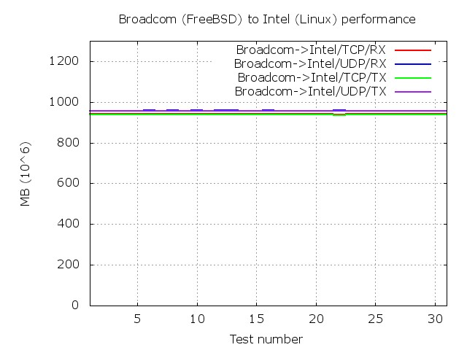
Non-NetFPGA performance

Slide 74
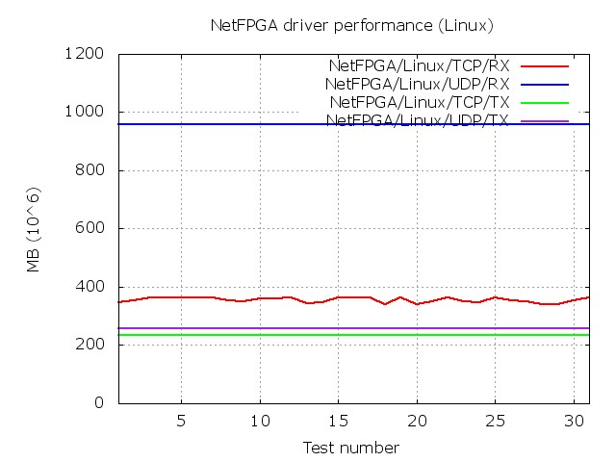
NetFPGA performance (Linux)

Slide 75
NetFPGA performance (FreeBSD)
  ENOTYET :-(

Slide 76
Problems

Slide 77
  Minimum DMA transfer is 60 bytes
  I could get handling of this limitation wrong

Slide 78
  I could get software mitigation of typical ring/descriptors primitives wrong
  (There's no access to hardware-assisted RX/TX of packets)

Slide 79
Linux driver has more than one buffer for transmission but only one for receiving...

Slide 80
  Reset of the PHY chip seems to take some ``nondeterministic amount of time”
  No Broadcom chip specs :-(

Slide 81
I now got some support about
MAC/PHY/CNET reset order
No hardware to test :-(

Slide 82
  Problems with new register system made it impossible to work with latest NetFPGA release
  I used 1.2.5 release

Slide 83
RFC

Slide 84
NetFPGA comes with broken firmware
New firmware has to be uploaded just after computer boot

Slide 85
NetFPGA firmware
Licensing
  NetFPGA code and Verilog files: BSD license
  MAC IP Core from Xilinx:
    Should be OK to redistribute
CPCI reprogramming could happen as a part of driver attach routine:
  CPCI image is relatively small

Slide 86
Summary

Slide 87
FreeBSD (very) experimental support is here...
Card is detected and can be programmed
Programming utilities are here
Basic network functionality works
  Ping program is able to transmit/receive packets
  Basic benchmarking works

Slide 88
Future

Slide 89
Plans
Bring NetFPGA support to the FreeBSD source code base
  Work on stability
  Work on PERFORMANCE
    Being better than Linux would be nice!

Slide 90
FreeBSD/NetFPGA out-of-box?
  Card driver (netfpga.ko)
  Port driver (if_nf.ko)

Slide 91
How do we handle unregistered PCI Vendor and PCI Device numbers?

Slide 92
Other plans?
Getting an access to the FPGA hardware at home?

Slide 93
2 x Future

Slide 94
Support for NetFPGA-ng
(planned release: somewhere in 2010)

Slide 95
NetFPGA-NG:
4x10Gbit SFP+
Biggest Virtex 5 FPGA processor
Maybe improved interrupt policy?

Slide 96
Other FPGA-based cards
CESNET/INVEA-TECH cards
  Virtex 5
  2 x 10GBit (4 x 10GBit in preparation)
  Industry standard
  not sure about PCI-e interface

Slide 97
Getting support for more FPGA-based accelerators

Slide 98
Special THANKS...
Pekka Nikander (Ericsson)
Jussi Kangasharju (HIIT)

Slide 99
Code I talked about: http://people.freebsd.org/~wkoszek/netfpga netfpga-devel@ mailing list has this code as well

Slide 100
This presentation will be available on:
http://FreeBSD.czest.pl/~wkoszek/netfpga/
and
http://people.FreeBSD.org/~wkoszek/netfpga/

Slide 101
Q/A

Slide 102
The End
  Wojciech A. Koszek
  wkoszek@FreeBSD.org
  2009.09.17

