Slide 1
FreeBSD support for Stanford NetFPGA
  Wojciech A. Koszek
  wkoszek@FreeBSD.org
  2009.08.25

Slide 2
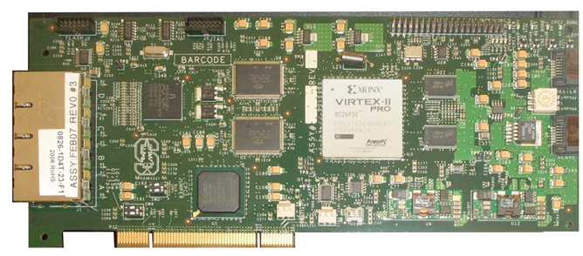
NetFPGA card

Slide 3
NetFPGA card
4 ports of Gigabit Ethernet
2 high speed, serial I/O connectors
64MB of DDR2 DRAM, 4.5MB of SRAM
Fully reprogrammable without additional hardware
PCI interface

Slide 4
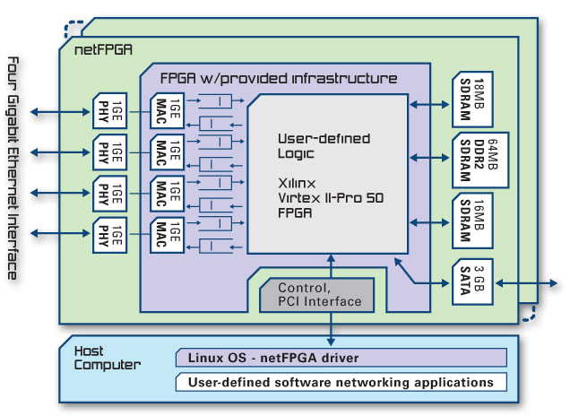

Slide 5
NetFPGA: 3 puzzles
  Bitstream: functionality provider
  Userspace tools: for bitstream upload
  Kernel driver: low-level glue

Slide 6
NetFPGA naming
  CPCI: small FPGA (Spartan2)
  responsible for PCI
  interface
  CNET: BIG FPGA for Ethernet
  control

Slide 7
Packet transmission in the NetFPGA world
NetFPGA
OS
Network

Slide 8
Data is being sent to the card
NetFPGA
OS
Network

Slide 9
Interrupt is delivered
NetFPGA
OS
Network

Slide 10
In order to „see”, which port has a data available, you read a register
NetFPGA
OS
Network

Slide 11
DMA transfer is started
NetFPGA
OS
Network

Slide 12
NetFPGA programming

Slide 13
NetFPGA programming (Linux)
USER SPACE
SAVE PCI REGISTERS
Upload REPROGRAMMER bitstream
Upload CPCI image
Upload CNET image
Restore PCI registers
GO!

Slide 14
  PCI registers saved from userspace :-(
  Additional dependency on user-space tools

Slide 15
NetFPGA driver in the (Linux) kernel is monolithic..

Slide 16
CPCI/CNET programming is tied to Ethernet port structures

Slide 17

FreeBSD driver design

Slide 18
Driver has 2 parts:
Programming interface
Ethernet interface

Slide 19
Card itself appears as
``NetFPGA controller''
Later called (NFC)

Slide 20
It's up to the controller to export CPCI/CNET interface

Slide 21
Each NFC has 4 Ethernet gates named:
``NetFPGA ports''
Later called: (NFP)

Slide 22
NFC
NFP0
NFP1
NFP2
NFP3
PHY0
PHY1
PHY2
PHY3

Slide 23
Interface appears as separate device
/dev/netfpga
Userspace application works by opening /dev/netfpga and sending commands to it

Slide 24
Two level driver architecture?
It would be nice to be able to enable Ethernet interface layer only when there's Ethernet support in a bitstream

Slide 25
Every NFP is visible to the system as Ethernet interface
.
nf2c0: flags=8843<UP,BROADCAST,RUNNING,
SIMPLEX,MULTICAST> metric 0 mtu 1500
options=28<VLAN_MTU,JUMBO_MTU> ether 00:6e:66:32:63:30
inet 10.0.0.1 netmask 0xff000000 broadcast 10.255.255.255 media: Ethernet autoselect (none)

Slide 26
  ...but after driver is loaded, Ethernet interfaces always appear automatically
  even if there's no bitstream

Slide 27
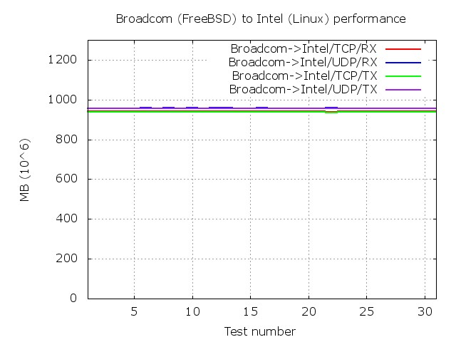
Non-NetFPGA performance

Slide 28
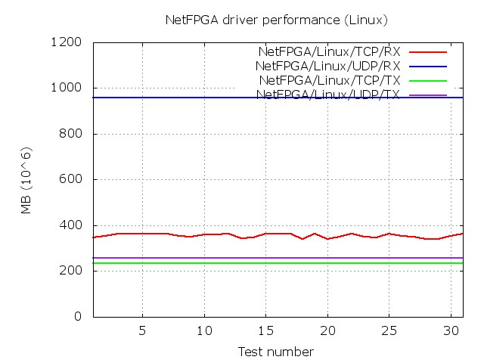
NetFPGA performance (Linux)

Slide 29
NetFPGA performance (FreeBSD)
NOT YET :-(
Sorry!

Slide 30
Performance problems..
Minimum DMA transfer is 60 bytes
I could get handling of this limitation wrong

Slide 31
Performance problems..
There's no access to hardware-assisted RX/TX of packets
I could get software mitigation of typical primitives wrong.

Slide 32
Problems (1)
  When to start Ethernet ``ifnet'' layer in the kernel?
  Right now you don't know if the „4 Gigabit Ethernet reference design” has been loaded or not

Slide 33
Problems (2)
  Problems with new register system made it impossible to work with new NetFPGA release
  We used 1.2.5 release

Slide 34
Problems (3)
  Reset of the PHY chip seems to take some „undeterministic amount of time”.
  Correct reset should be done each time Ethernet interface is brought up.

Slide 35
Plans
Bring NetFPGA support to the FreeBSD source code base
  Work on stability
  Work on PERFORMANCE
    Being better than Linux would be nice!

Slide 36
Project's repository
svn co
https://vcs.hiit.fi/svn/psirp/src/netfpga/projects/freebsd_netfpga
This is still Work-In-Progress!

Slide 37
Special THANKS...
Pekka Nikander
Jussi Kangasharju
Bengt Sahlin

Slide 38
This presentation will be available on:
http://FreeBSD.czest.pl/~wkoszek/netfpga/

Slide 39
The End
Wojciech A. Koszek
wkoszek@FreeBSD.org
2009.08.25

