Slide 1
FreeBSD support for Stanford NetFPGA
  Wojciech A. Koszek
  wkoszek@FreeBSD.org
  2009.08.25

Slide 2
This summer was quite cool...

Slide 3
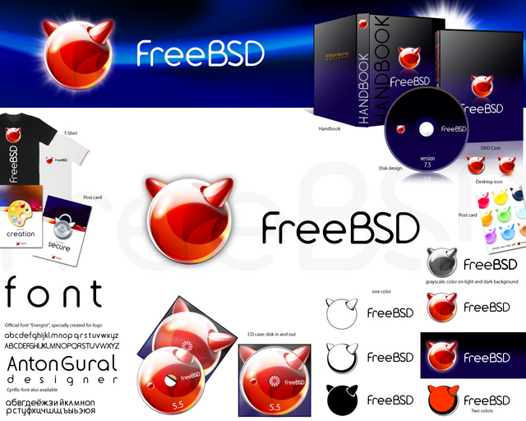
FreeBSD system..

Slide 4
+

Slide 5
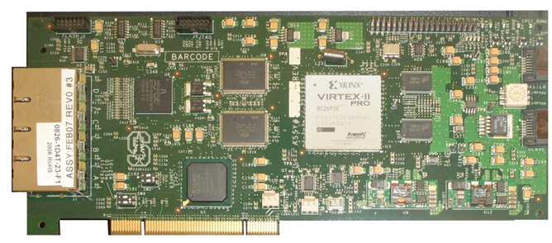
NetFPGA card

Slide 6
Why is NetFPGA cool?
One of the first network adapters that let you to control everything by yourself!

Slide 8
I want to have an algorithm for network traffic processing

Slide 9
I want my algorithm to be *FAST*
!!!

Slide 10
I can implement it directly in the hardware

Slide 12
NetFPGA

Slide 13
You want your algorithm to run on a stable base...

Slide 14
You consider your work important and you'd like to deliver it with the best possible quality...

Slide 15
You want to use academic/research/industry standards

Slide 16
But you also plan to use your work so that it can be incorporated in *your* product
...which you can sell

Slide 17
That's why you choose FreeBSD

Slide 18
Why do we like FreeBSD?
Free
Stable
Secure
Fast
Liberal license (good for *your* business)

Slide 19
NetFPGA
Hardware/software interface
FreeBSD

Slide 20
Details

Slide 21
NetFPGA card: details
4 ports of Gigabit Ethernet
2 high speed, serial I/O connectors
64MB of DDR2 DRAM, 4.5MB of SRAM
Fully reprogrammable without additional hardware
PCI interface

Slide 22
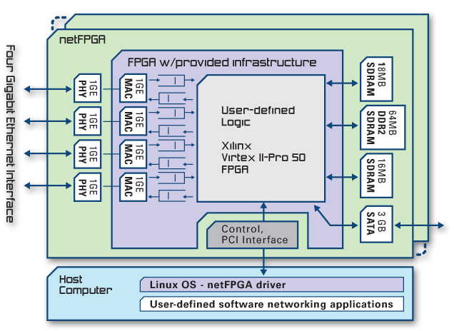

Slide 23
NetFPGA: 3 puzzles
  Firmware: functionality provider
  User utilities: for bitstream upload
  Kernel driver: low-level glue

Slide 24
What level we're working on?
Example..

Slide 25
Packet transmission in the NetFPGA world
NetFPGA
OS
Network

Slide 26
Data is being sent to the card
NetFPGA
OS
Network

Slide 27
Interrupt is delivered
NetFPGA
OS
Network

Slide 28
In order to „see”, which port has a data available, you read a register
NetFPGA
OS
Network

Slide 29
DMA transfer is started
NetFPGA
OS
Network

Slide 30
NetFPGA programming

Slide 31
Verilog Source Code
FIRMWARE
[Bitstream]
(sort of a program)

Slide 32
„Bitstream” file has a specific format...

Slide 33
Library for Xilinx Bitstream Files has been implemented

Slide 34
Bitstream
(sort of a program)
NetFPGA
Card

Slide 35
Current utilities in Linux
Read card's memory chunk
Write to the card
Program the card
Obtain statistics

Slide 36
New utilities had to be implemented
Programming the card from the FreeBSD system is possible now
There is only one tool that lets you to do all the work

Slide 37

FreeBSD driver design

Slide 38
Driver has 2 parts:
Programming interface
Ethernet interface

Slide 39
NetFPGA Controller and NetFPGA ports handling
has been implemented

Slide 40
NFC
NFP0
NFP1
NFP2
NFP3
PHY0
PHY1
PHY2
PHY3

Slide 41
Interface appears automatically in the filesystem, once the device is present in the PC:
/dev/netfpga

Slide 42
  Problem..: when driver is loaded, Ethernet interfaces always appear automatically
  ..even if there's no bitstream

Slide 43
Results

Slide 44
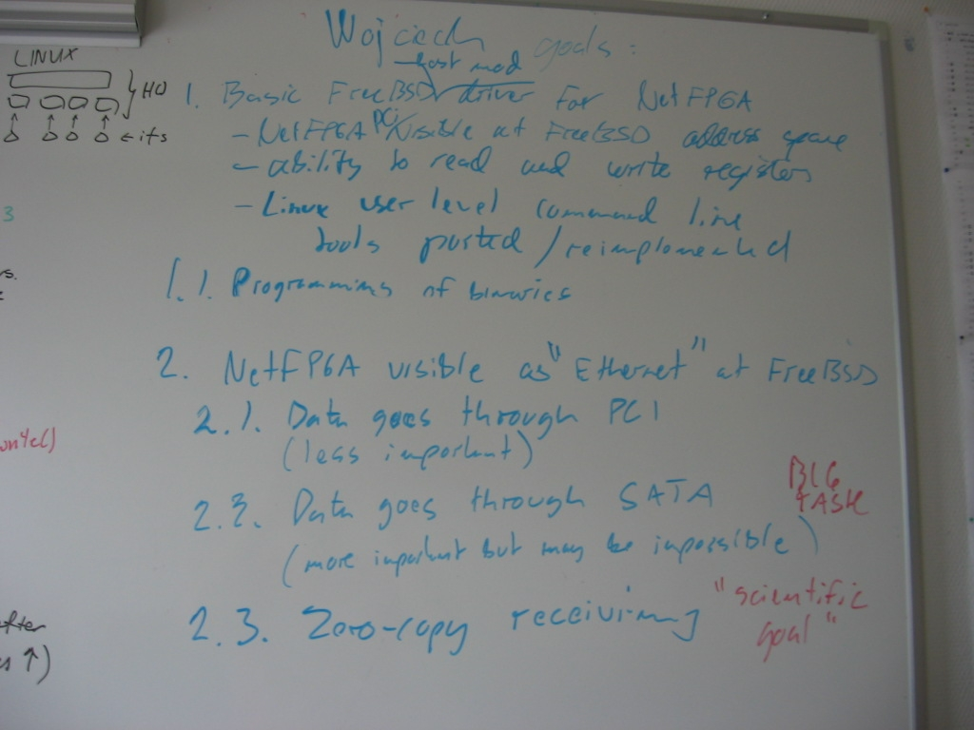

Slide 45
FreeBSD experimental support is here...
Card is detected and can be programmed
Programming utilities are here
Basic network functionality works
  Ping program is able to transmit/receive packets
  Basic benchmarking works

Slide 46
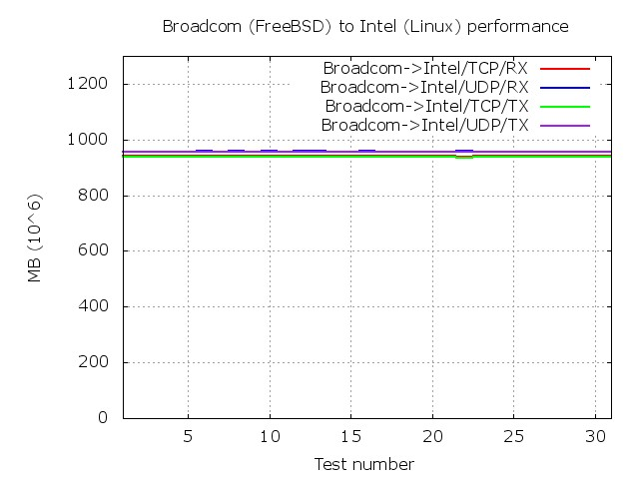
Non-NetFPGA performance

Slide 47
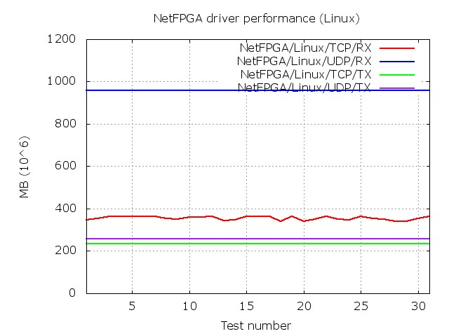
NetFPGA performance (Linux)

Slide 48
NetFPGA performance (FreeBSD)
NOT YET :-(
Sorry!

Slide 49
  We used 1.2.5
  (not so up-to-date)
  release of NetFPGA reference designs

Slide 50
Plans
Bring NetFPGA support to the FreeBSD source code base
  Work on stability
  Work on PERFORMANCE
    Being better than Linux would be nice!

Slide 51
Project's repository
svn co
https://vcs.hiit.fi/svn/psirp/src/netfpga/projects/freebsd_netfpga
This is still Work-In-Progress!

Slide 52
Special THANKS...
Pekka Nikander
Jussi Kangasharju
Bengt Sahlin
Ericsson and HIIT teams

Slide 53
This presentation will be available on:
http://FreeBSD.czest.pl/~wkoszek/netfpga/

Slide 54
The End
Wojciech A. Koszek
wkoszek@FreeBSD.org
2009.08.27

