Slide 1
Advanced Jmol Workshop
Bob Hanson
St. Olaf College, Northfield, MN
http://www.stolaf.edu/people/hansonr
21th Biennial Conference on Chemical Education
University of North Texas
Aug 2, 2010

Slide 2
Workshop Goals
Check out some cool working pages
Time to ASK QUESTIONS
Behind-the-scenes look into Jmol Applet
Time to ASK QUESTIONS
Make connections
Time ot ASK QUESTIONS
Signed vs. Unsigned Applet
Time to ASK QUESTIONS
Brainstorm
Time to ASK QUESTIONS

Slide 3
Working Pages
Most pages that I have written are at
http://chemapps.stolaf.edu/jmol
new.htm
cool.htm

Slide 4
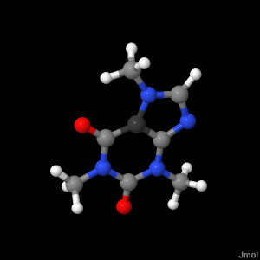
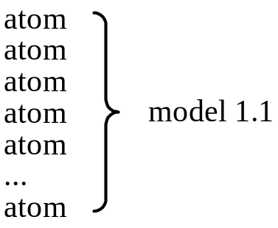
The Jmol Data Model - load
load “caffeine.xyz”
Jmol produces ONE list of atoms; models point to atoms.
Very efficient for selecting atoms.

Slide 5
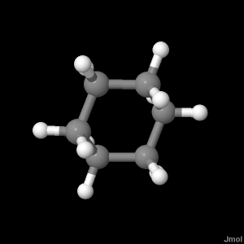
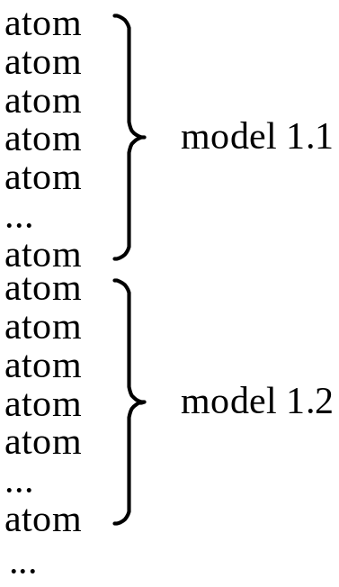
The Jmol Data Model - load
load “cyclohexane_movie.xyz”
Still just one list of atoms; models point to different atoms.

Slide 6
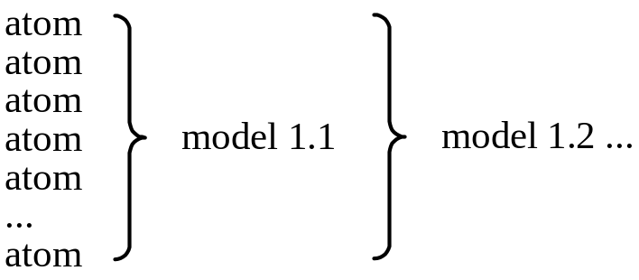
The Jmol Data Model - trajectory
load trajectory “cyclohexane_movie.xyz”
frame *
Trajectories are different: Models point to SAME set of atoms.
Changing frames just sets new atom positions.
Very efficient for huge model sets such as from MD calculations.

Slide 7
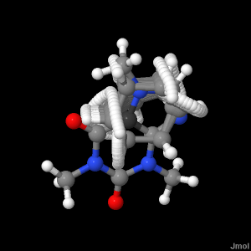
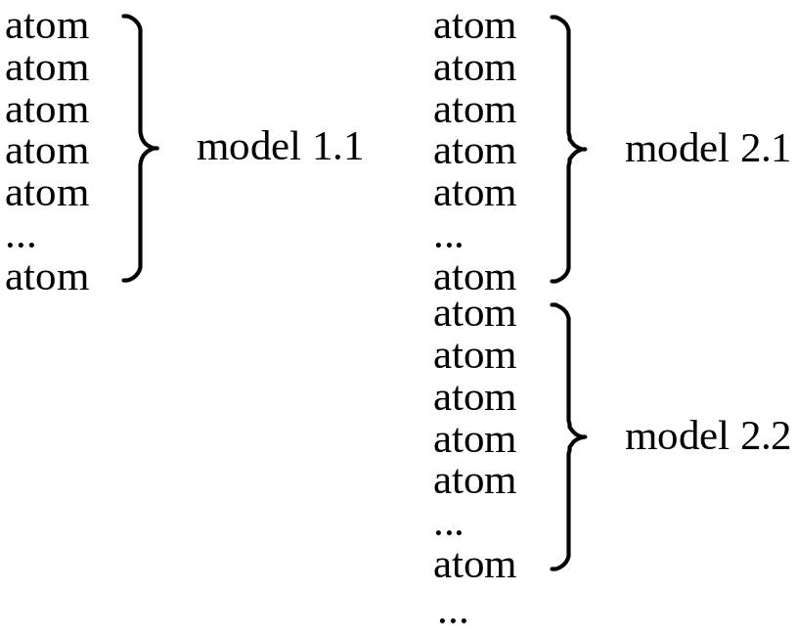
The Jmol Data Model - files
load files “caffeine.xyz” “cyclohexane_movie.xyz”
frame *
Multiple files – same as before; file number just increments

Slide 8
The Jmol Data Model - append
load “caffeine.xyz”
load append “cyclohexane_movie.xyz”
frame *
Same thing

Slide 9
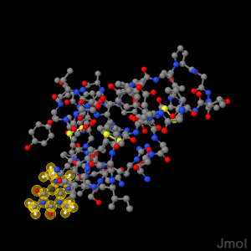
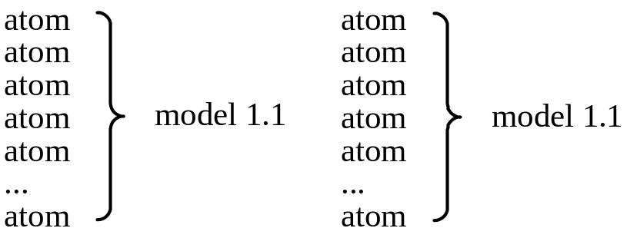
The Jmol Data Model - appendNew
load “1crn.pdb”
set appendNew FALSE
load append “caffeine.xyz”
selectionHalos on; select not protein
Set appendNew FALSE adds atoms to last model in set.

Slide 10
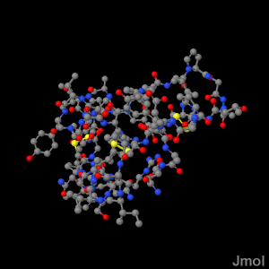
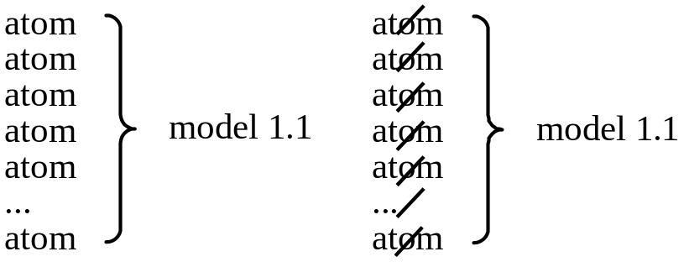
Delete {atoms}
load “1crn.pdb”
set appendNew FALSE
load append “caffeine.xyz”
delete not protein
Delete does not REMOVE any atoms, just marks them “deleted”.
Does NOT save any memory and is NOT REVERSIBLE

Slide 11
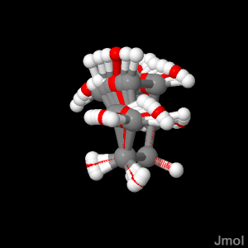
Zap {atoms}
load “cyclohexane_movie.xyz”
zap model < 5 or model > 10
select 1.7; color red
Zap with atoms REMOVES atoms for all models containing the selected atoms.
Frees memory.
Model numbers are NOT CHANGED.
CAVEAT: STATE IS NOT PRESERVED!

Slide 12
Drag-and-drop loading
Application and signed applet
PDB files get “cartoons only” look
Includes Jmol-generated PNG/JPG/ZIP files

Slide 13
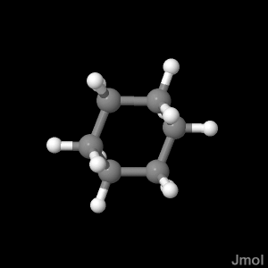
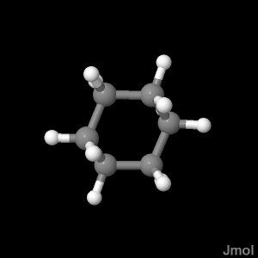
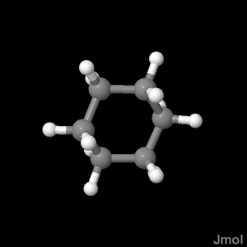
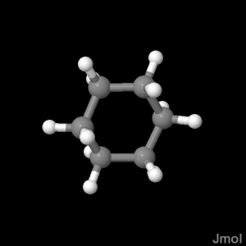
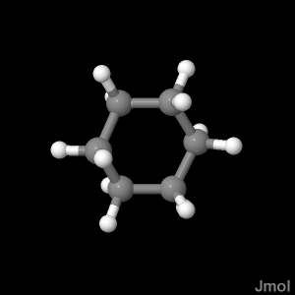
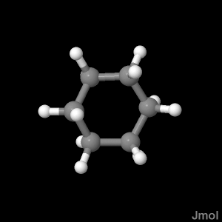
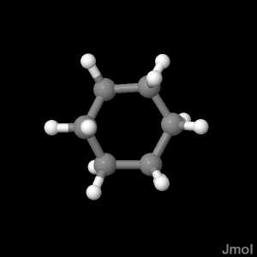
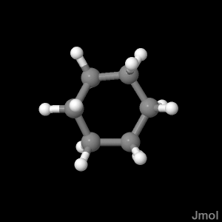
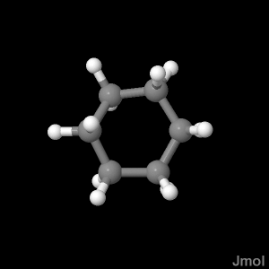
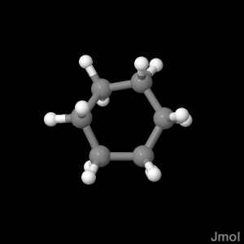
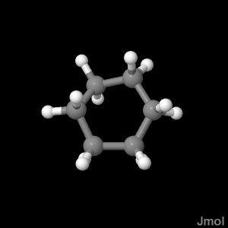
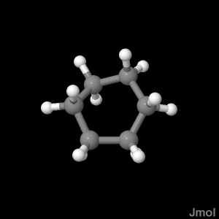
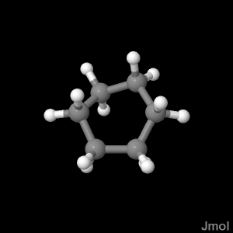
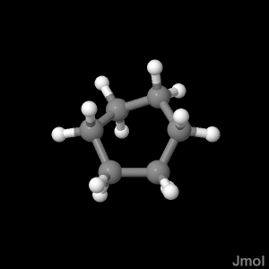
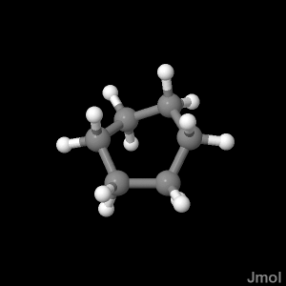
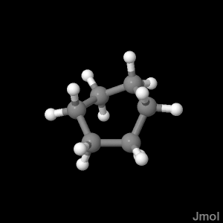
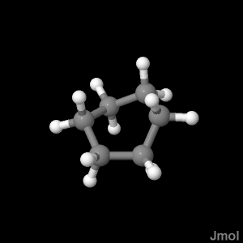
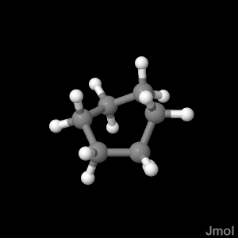
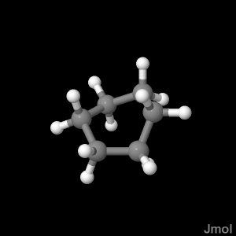
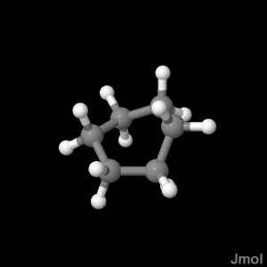

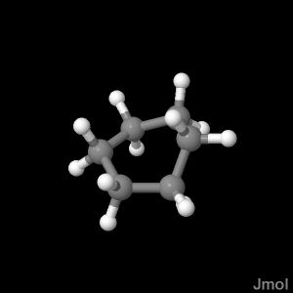
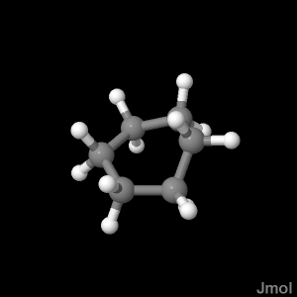
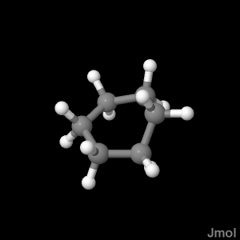
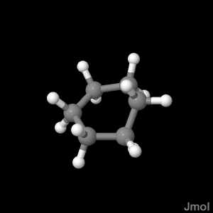

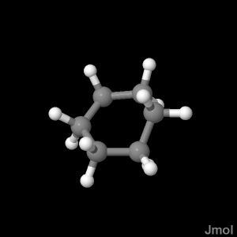
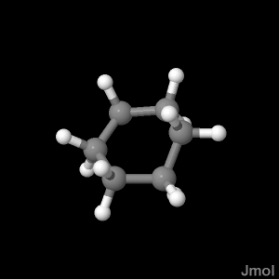
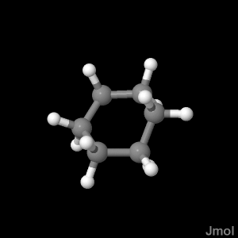
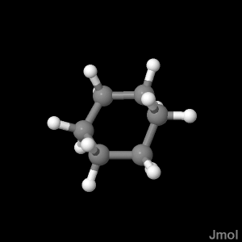
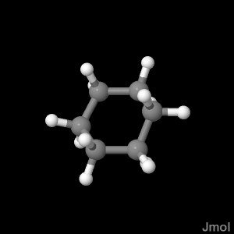

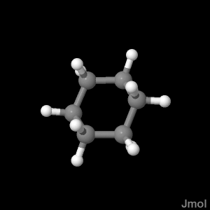
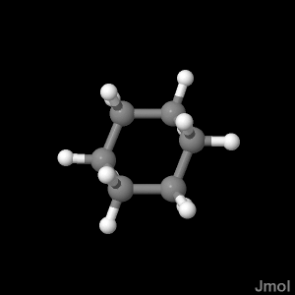

Animation Tricks
load “cyclohexane_movie.xyz”
animation on
Plays all “frames” (models) in all files.
No skipping.

Slide 14
Animation Tricks
load “cyclohexane_movie.xyz”
frame range 1.5 1.10
animation play
Frame range lets you select a contiguous subset of the frames to animate.
Be sure to use animation PLAY, not ON.

Slide 15
Animation Tricks
load “cyclohexane_movie.xyz” [1,6,11,16,22]
animation on
just loads the specified models
new feature (added yesterday ☺)

Slide 16
More Tricks
You choose…

