Slide 1
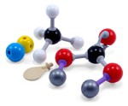
Jmol in the Classroom:
Molecule of the Moment
Bob Hanson
South University School of Pharmacy
Savannah, Georgia
May 26, 2011

Slide 2
The Jmol Project
Jmol molecular visualization project
Open-source
Jmol.sourceforge.net
Active user/developer community
  about 400 “users”
  about 150 “developers”
  collectively 23,000 list messages

Slide 3
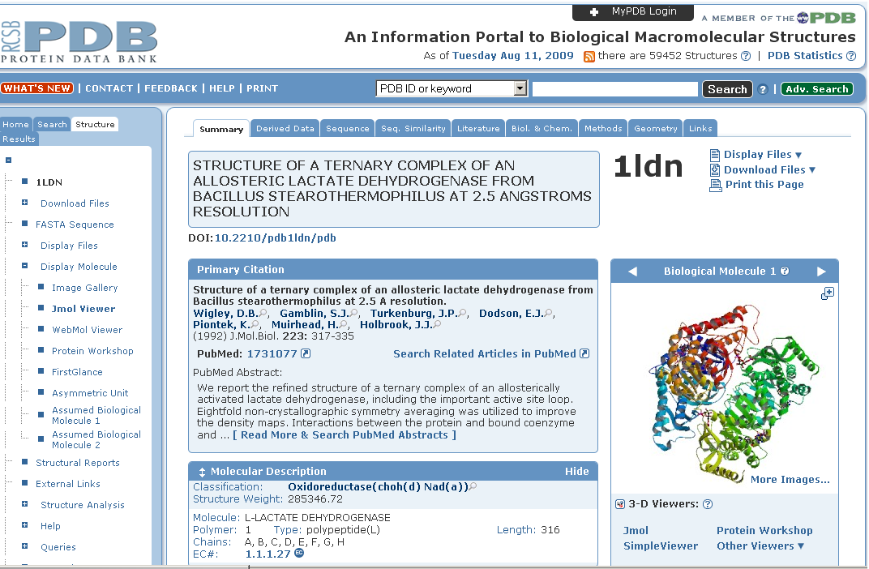
The Jmol Applet
Peter Rose, RCSB http://www.rcsb.org/pdb/explore/jmol.do?structureId=1LDN

Slide 4
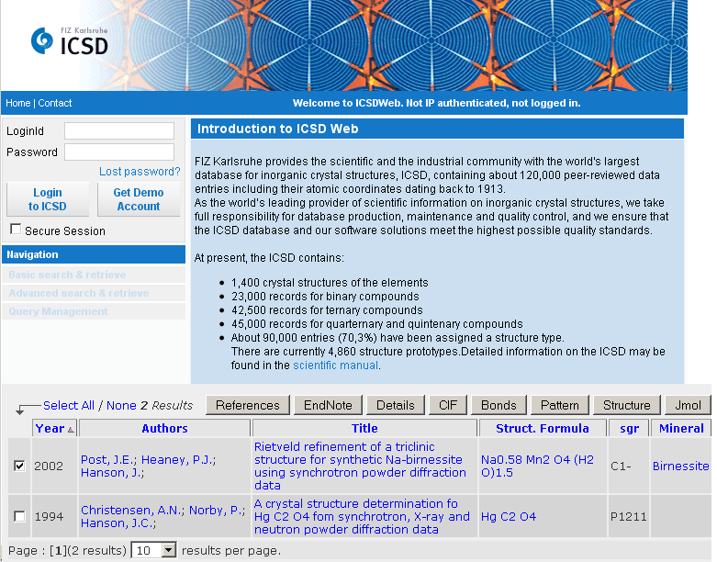
Alan Hewat, http://icsd.fiz-karlsruhe.de/icsd/

Slide 5
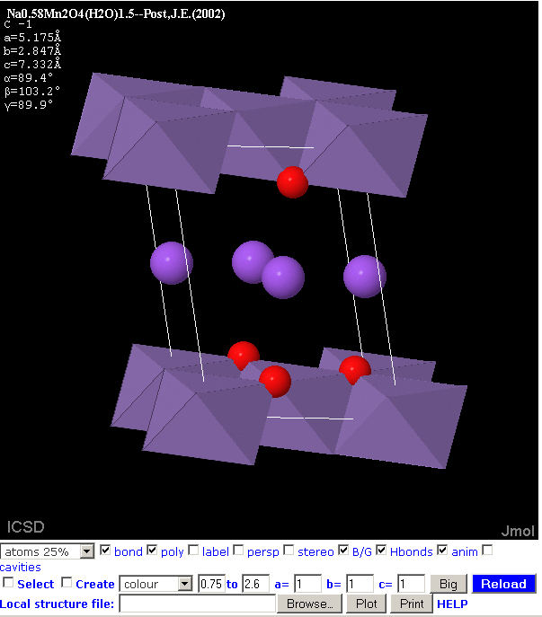
Alan Hewat, http://icsd.fiz-karlsruhe.de/icsd/

Slide 6
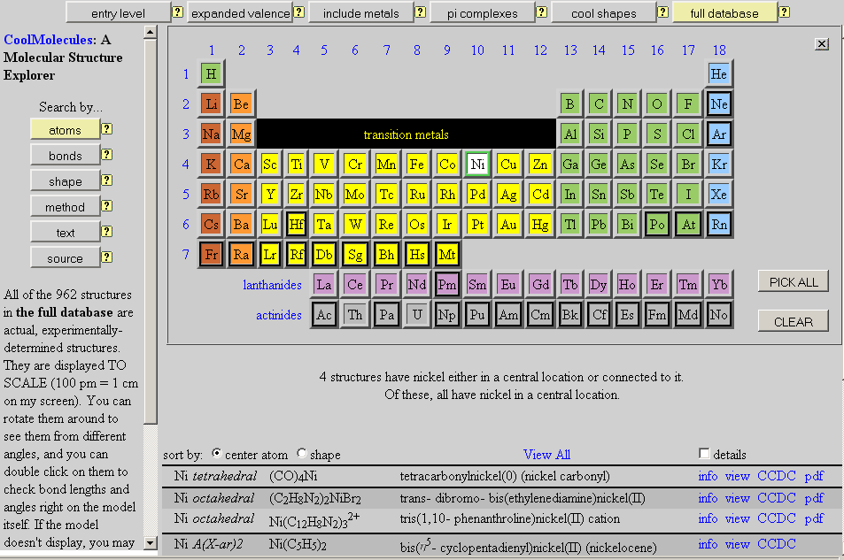
Bob Hanson, http://www.stolaf.edu/depts/chemistry/mo/struc/explore.htm

Slide 7
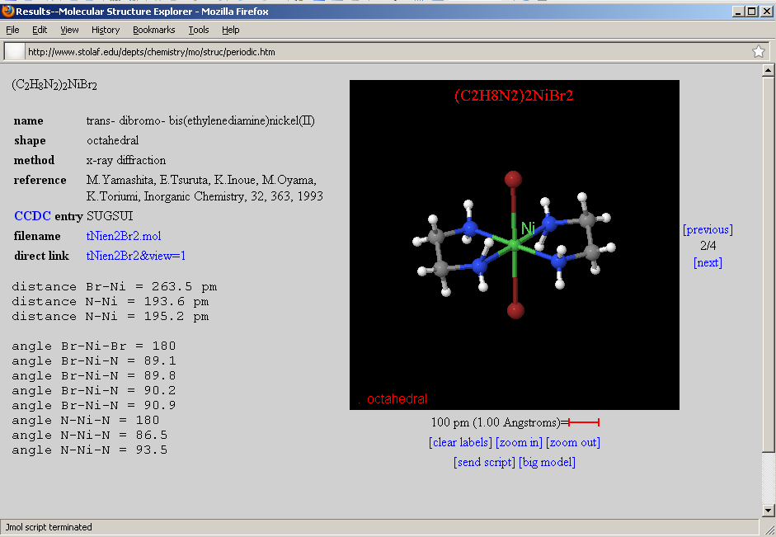
Bob Hanson, http://www.stolaf.edu/depts/chemistry/mo/struc/explore.htm

Slide 8
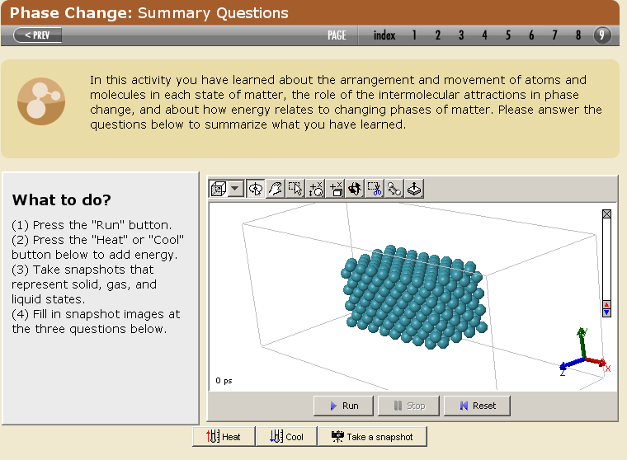
The Molecular Workbench
Charles Xie, Concord Consortium http://mw.concord.org/modeler/

Slide 9
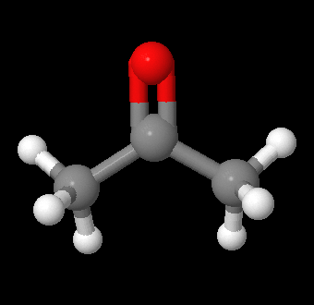
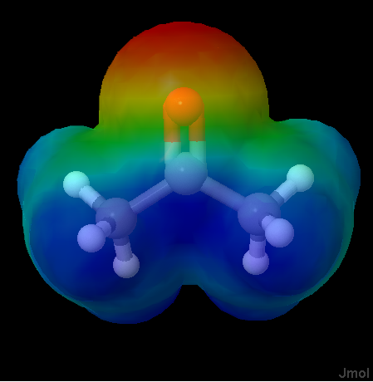
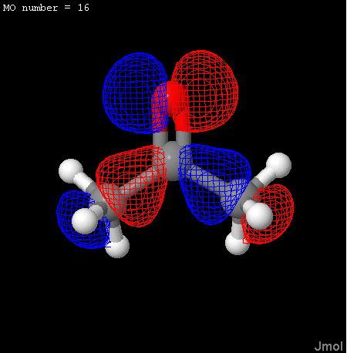
Standard Jmol Input and Display Capability
3D
Coordinate
File
Jmol
Example Coordinate/Data Formats
MDL Molfile
mol
Protein Data Bank
pdb
SPARTAN
spartan
JME Editor
jme
Structure Data Format
sdf
MEP Calculated from sdf Data
HOMO Calculated from spartan Data

Slide 10
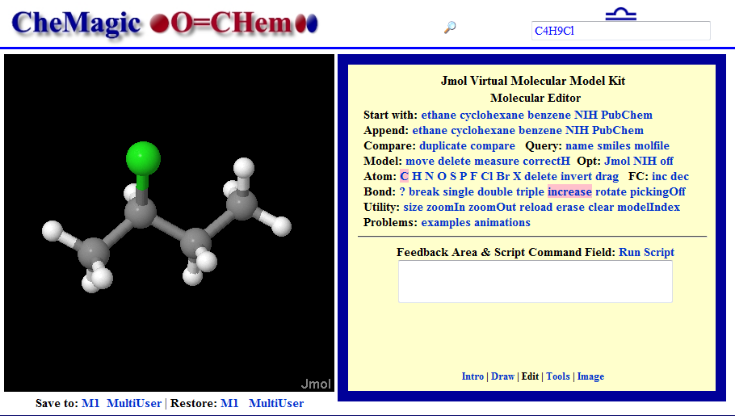
CheMagic O=Chem VMK
Molecular Editor
http://chemagic.com/web_molecules

Slide 11
Chemical Identifier Resolver
NIH: NCI/CADD Group Web Resource
“representation”
“identifier”
/SMILES
/names, /iupac_name
/cas
/inchi, /stdinchi
/inchikey, /stdinchikey
/ficts, /ficus, /uuuuu
/image
/file, /sdf
/mw, /monoisotopic_mass
/formula
/twirl, /3d (Just for Fun)
/urls (Possibilities)
chemical names
CAS numbers
*SMILES strings
IUPAC InChI/InChIKeys
NCI/CADD Identifiers
CACTVS HASHISY
NSC number
*molfile
NIH Resolver
* Spoken by Jmol
Markus Sitzmann
http://cactus.nci.nih.gov/chemical/structure

Slide 12
Jmol/NIH Information Flow
Student
types
“tylenol”
This model kit is special!
Jmol (3D)

Slide 13
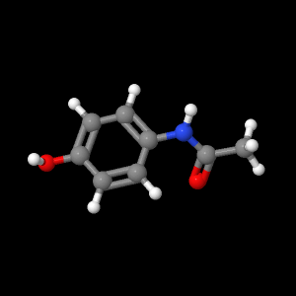
Jmol/NIH Information Flow
Student
types
“tylenol”
This model kit is special!
Jmol (3D)

Slide 14
Jmol/NIH Information Flow
Student
types
“tylenol”
This model kit is special!
Jmol (3D)
SDF file
“tylenol”
NIH Resolver

Slide 15
Jmol/NIH Information Flow
This model kit is special!
load “$tylenol”
Jmol (3D)
SDF file
“tylenol”
NIH Resolver
http://cactus.nci.nih.gov/chemical/structure/tylenol/file?format=sdf&get3d=True

Slide 16
Jmol/NIH Information Flow
Identifier can be a chemical name, a SMILES string, a CAS registry number, an “IUPAC-like” name, an INCHI key, or any one of many other formats
This model kit is special!
load “$tylenol”
Jmol (3D)
SDF file
“tylenol”
NIH Resolver
http://cactus.nci.nih.gov/chemical/structure/tylenol/file?format=sdf&get3d=True

Slide 17
Jmol/NIH Information Flow
Talking about a drug in class? Need a structure? Chances are the NIH has it, and it is just a click away.
This model kit is special!
load “$tylenol”
Jmol (3D)
SDF file
“tylenol”
NIH Resolver
http://cactus.nci.nih.gov/chemical/structure/tylenol/file?format=sdf&get3d=True

Slide 18
Jmol and Drug-Receptor/Enzyme Binding
Project with Art Cox combines my knowledge of Jmol and visualization with Art’s knowledge of medicinal chemistry to:
A) Develop a set of on-line tutorials for med chem.
B) Develop a GENERAL way to quickly depict and analyze
drug-receptor binding.

Slide 19
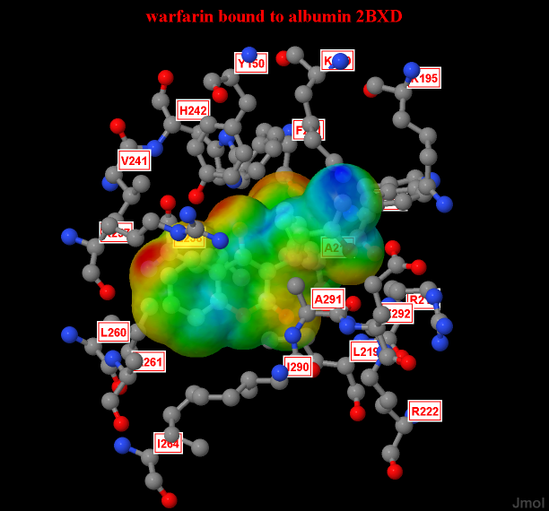
Jmol and Drug-Receptor/Enzyme Binding
Project with Art Cox combines my knowledge of Jmol and visualization with Art’s knowledge of medicinal chemistry to:
A) Develop a set of on-line tutorials for med chem:
    Warfarin binding to serum albumin

Slide 20
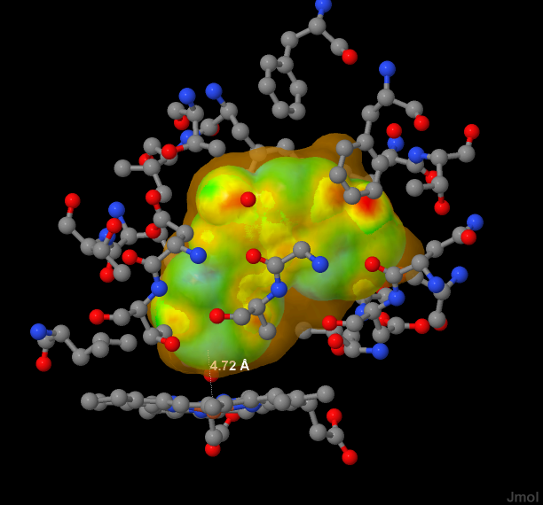
Jmol and Drug-Receptor/Enzyme Binding
Project with Art Cox combines my knowledge of Jmol and visualization with Art’s knowledge of medicinal chemistry to:
A) Develop a set of on-line tutorials for med chem:
    Cyp450 substrate selectivity

Slide 21
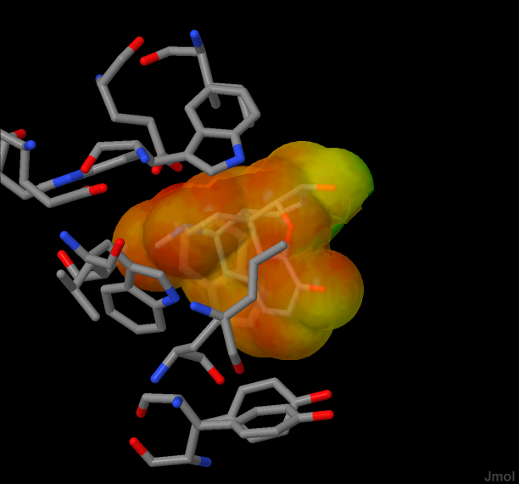
Jmol and Drug-Receptor/Enzyme Binding
Project with Art Cox combines my knowledge of Jmol and visualization with Art’s knowledge of medicinal chemistry to:
A) Develop a set of on-line tutorials for med chem.
B) Develop a GENERAL way to quickly depict and analyze
drug-receptor binding.

