Slide 1
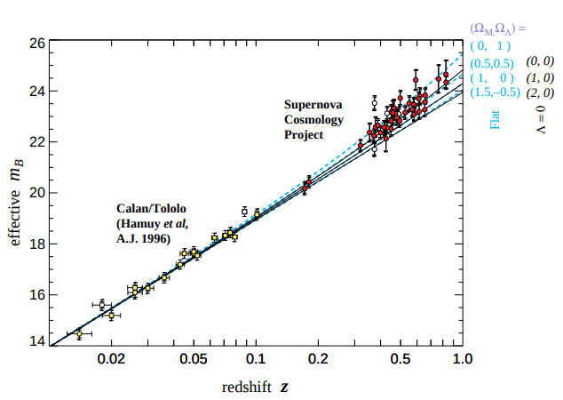
Measurements of Omega and Lambda from 42 High-Redshift Supernovae
(Perlmutter 1999)
Recreating this classic cosmology paper in a Jupyter Notebook
- Used high-z supernovae as standard candles to probe cosmological constants
- Constrained mass density ΩM and cosmological-constant energy density ΩΛ
- Results are consistent with a positive, non-zero cosmological constant
This classic paper establishes that the expansion of the universe is accelerating, and puts constraints on the value of the mass density and cosmological constant energy density.
Key results to be replicated are shown at right.

Slide 2
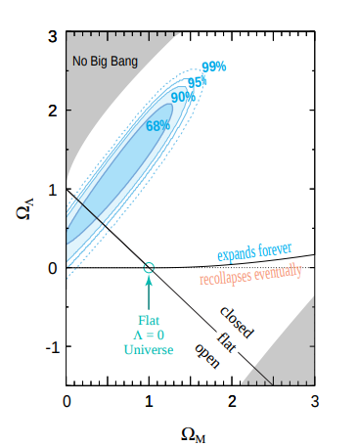
Proposed Solution
Query for Type 1a SN with high redshift
Make module to standardize SN peak magnitudes with width-luminosity relation
Plot M_{B} vs Z
Make module to calculate
    ΩM and ΩΛ
Make interactive widget for best fit confidence regions in ΩM - ΩΛ plane for variant analyses (Fig 5 in paper)

